Slide 1

Introduction to Project Management

Slide 2
What is Project Management?
The art of organising, leading, reporting and completing a project through people

Slide 3
What is Project Management?
A project is a planned undertaking
A project manager is a person who causes things to happen
Therefore, project management is causing a planned undertaking to happen.

Slide 4
Project Manager Role
A Good Project Manager
  Takes ownership of the whole project
  Is proactive not reactive
  Adequately plans the project
  Is Authoritative (NOT Authoritarian)
  Is Decisive
  Is a Good Communicator
  Manages by data and facts not un-informed optimism
  Leads by example
  Has sound Judgement
  Is a Motivator
  Is Diplomatic
  Can Delegate

Slide 5
Stakeholder
“A person or group of people who have a vested interest in the success of an organization and the environment in which the organization operates”

Slide 6
Typical Stakeholders
Sponsor
Funding Body
Customer
Suppliers
End User
Environmental Agency
Maintenance Team
Neighbours/Community/Shareholders
Fusion Community
Interfaces

Slide 7
Stakeholder Engagement process
Identify Stakeholders
Assess needs
Define actions
Establish communication channels
Gather feedback
Monitor and review

Slide 8
The Project Process
Gate 0
Strategic and Budgetary Approval
Gate 1
Project Justification - Approve Project Definition
Undertake Design
Gate 2
Design Approval - Approval of Final Documents
Gate 3
Readiness for Manufacture - Approval to place Contract
Initiate Project
Prepare Technical Design Ensure Machine Compatibility Prepare Safety Case Modification
Project set-up
Undertake Tender
Major Project Proposals
Project Definition
Conceptual Design
Scheme Design
Detailed Design
Tender Invitation & Assessment
Appoint Project Sponsor Assess Project Priority Assess Budget Implications Est. Proj. Deliverables and Objectives Appoint Project Leader Approve Project Set-up
Raise/Extend/Update initial TCD-R/PERF Prepare Outline Conceptual Design Define Design Constraints Prepare Interface Requirements Spec. (IRP) Finalise Conceptual Design Hold Conceptual Design Review (CDR) Clear CDR Issues Initiate Modification Safety Case Update PMP Approve Proceed to Detailed Design
Extend TCD-Rs/PERFs Prepare Sub-system Detailed Design Hold Detailed Design Review (DDR) Clear Sub-system DDR Issues Use TCD-I/MMAC for Sub-system DD Approval Prepare Final Documents including: - Design Documents., Machine Compatibility Documents., Safety Case Modification
EFDA/CSU/JOC Management
*** These will comprise:
- Technical Specification - Drawings - Contractual Requirements
Project Team/IRP/EFDA/CSU/JDC
Project Team/Interfaces/EFDA/CSU/JDC
* This will include:
- Initial WBS, OBS and CBS - Project Plan - Risk and Procurement Strategies
Draft Statement of Requirements (SoR) Review & Approve SoR Identify Resources Appoint Project Team Produce & Maintain Procurement Plans Undertake Project Risk Assessment Prepare Project Boundary Document Develop Project Management Plan (PMP)* Raise initial TCD-R/PERF** Prepare Preliminary Conceptual Design**
Raise/Extend Sub-system TCD-Rs/PERFs Agree Classifications & Interfaces Prepare Sub-system Scheme Design Hold Sub-system Scheme Design Review (SDR) Clear Sub-system SDR Issues Update PMP Use TCD-I/MMAC for Sub-system SD Approval
Compile Tender Docs.*** Send out Invitations (ITTS) Hold Clarification Meetings Receive Tenders Evaluate Tenders Arrange site visits Approve changes to Specs. Choose preferred Company
** These will only take place here for large projects demanding DO effort for preliminary Conceptual work
Project Team/Contracts/EFDA
Project Leader/Project Team/EFDA/CSU
Project Team/Interfaces
Implement Project
Gate 4
Readiness for Operation - Acceptance of System
Complete Project
Note: Overall Project Management and Reporting will be as defined in the Project Management Plan (PMP)
Manufacture Equipment
Install Equipment
Test & Commission
Confirm Completion
Project Review
Gates (Formal Decision Points) See accompanying notes
Raise Contract Documentation Place Contract Hold Kick off Meeting (KOM) Clarify Issues (Quality Plan) Monitor Progress Witness key Procedures Complete Release Note Approve Complete Package**** Approve Release Note Pack & Dispatch Equipment
Test Equipment against Test Schedule Commission Complete System
Project Team/ICM/EFDA/CSU
Undertake Post Project Review
Confirm Technical Completion Review Project Records Complete Handover Documents Resolve Reservations Obtain Acceptance of Completed Project
Project Team/CSU
Project Team/Contractor/ICM
Receive Equipment Pre-test Equipment Install equipment
**** This includes supporting documentation
Project Team/ICM
Project Team/EFDA/CSU

Slide 9
Key Points in Project Set-up and Definition
Create Project Management Plan (PMP)
Be clear of scope and objectives
Establish clear statement of what is to be done (WBS)
Establish Risks to be Managed
Establish Costs and Durations
Establish Resources Required

Slide 10
Project management Plan - PMP
Master Document for Project
Defines the following:-
  Project Objectives, Scope, Deliverables
  Stakeholders (Internal & External)
  Work to be done (WBS)
  Project Organisation and Resources (OBS)
  Project Costings (CBS)
  Project Schedule
  Procurement/Contract Strategy
  Risk Management
  Quality management
  Change Management

Slide 11
Project Planning

Slide 12
Planning
Adequate planning leads to the correct completion of work
Inadequate planning leads to frustration towards the end of the project & poor project performance

Slide 13
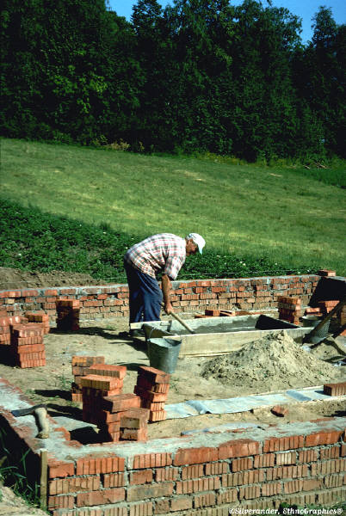
Work Breakdown Structure (WBS)
The Work Breakdown Structure is the foundation for effective project planning, costing and management.
It is the most important aspect in setting-up a Project
It is the foundation on which everything else builds

Slide 14
Work Breakdown Structure - Definition
“A Work Breakdown Structure (WBS) is a hierarchical (from general to specific) tree structure of deliverables and tasks that need to be performed to complete a project.”

Slide 15
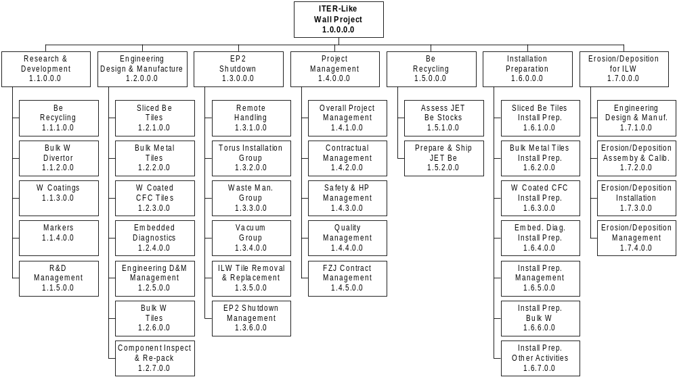
Example WBS - Top Level ILW Project

Slide 16
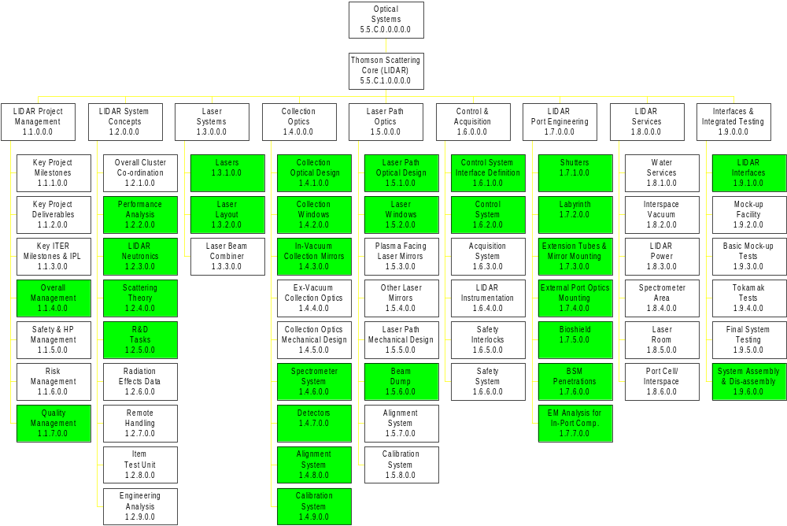
Example WBS - Top Level TSCL Project

Slide 17
Project Planning – WBS (1)
Lowest Level of WBS is the Work Package (WP)
WP can be clearly defined allowing package to be costed, scheduled and resourced
WP contains a list of Tasks to be Performed that form the basis for the Schedule
WP allows assignment of responsibilities (Work Package Manger, WPM)

Slide 18
Project Planning – WBS (2)
WBS allows hierarchical build-up of costs and schedule
Cost and Schedule can be reported at any level of the WBS
WBS facilitates strong management during project execution (Cost and Schedule control)
WBS can be used for many other things - Document Management, Risk Management etc.

Slide 19
Project Planning
A word about Scheduling
  Schedules (task durations) can have a wide variation
  There is no unique answer. Rather, there is a statistical variation depending on assumptions
  Need to understand the basis of scheduling (Most challenging; Most likely; Absolute certainty - bet your life on it!)
  Most people are very optimistic/naive

Slide 20
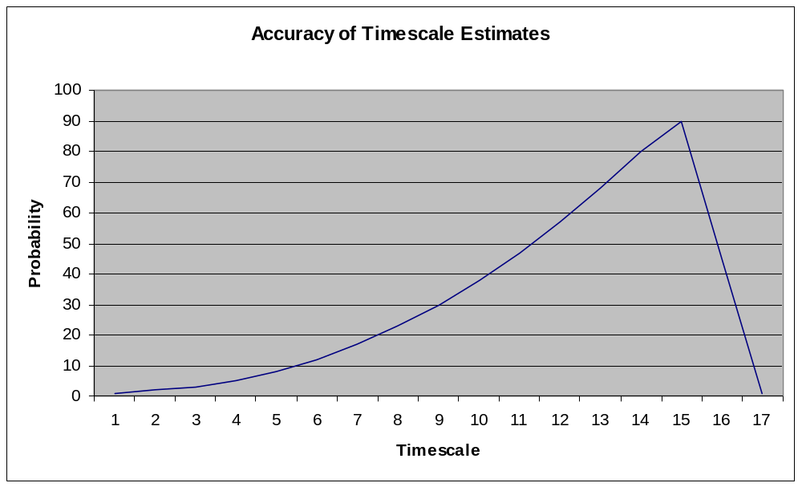
Common schedule development
Subsequent Estimates
First Estimate

Slide 21
Project Planning – Key Points
Recognise that adequate project planning is essential
Produce a sound WBS
Use the framework provided by the Project Management Plan (PMP) template
Involve the right people
Allow enough time
Be systematic

Slide 22
Project Risk Management

Slide 23
Project Risk – Definition (1)
“Project risk is an uncertain event or condition that, if it occurs, has a positive or negative effect on a project objective”

Slide 24
Project Risk – Definition (2)
“A combination of the probability of a defined threat or opportunity (Likelihood) and the magnitude of the consequences of the occurrence (Impact) defines a Risk Index”

Slide 25
Risk Impact
Threat → Scope → Poor Quality Product
Threat → Schedule → Late Delivery
Threat → Cost → Overspend
In addition there are health, safety and environmental threats that must be managed

Slide 26
Risk Management Process
Identify Risks
Assess likelihood and impact
Rank risks and prioritize
Define risk management approach & actions
Implement actions
Monitor & review

Slide 27
Risk Management – Key Points
Make the management of risk integral to the way the project is managed
Ensure that cost and time contingencies are consistent with identified risks
Focus on the “significant few” – don’t try to manage too many risks
Be vigilant (be ready for possible problems and diffuculties)and proactive

Slide 28
Project Monitoring and Control

Slide 29
Project Monitoring
Typical Monitoring Activities
  regular reviews of progress against schedule using WBS as basis (Plan against Baseline)
  regular review of actual costs (O/P from SAP) against budgeted costs and Earned Value at WBS level
  regular review of resource loading
  regular progress meetings with project team
  regular meetings with contractors
  production of periodic progress reports
  risk reviews
  inspections/ audits

Slide 30
Project Control
Typical Control Activities
  assign responsibilities at Work Package level
  staged authorisation of work to be done
  staged release of budgets (staged release of WBS(e) numbers)
  ensure PM has a ‘Management Reserve’ under his control
  seek corrective action reports when WPs go ‘off track’ (overrunning or overspending)
  release Management Reserve carefully

Slide 31
Project Monitoring and Control Summary
Monitor against the plan – status regularly
Take a factual approach to decisions
Identify management action early
Check that defined controls are being applied – correct if necessary
Apply change control

Slide 32
Confirm Completion
Ensure design records are complete and accurate
Ensure any outstanding actions or issues are addressed
Ensure Maintenance Records are produced
Ensure User Manuals are produced
Hold a formal Post Project review

