Slide 1
Step Wise: An
approach to planning software projects

Slide 2
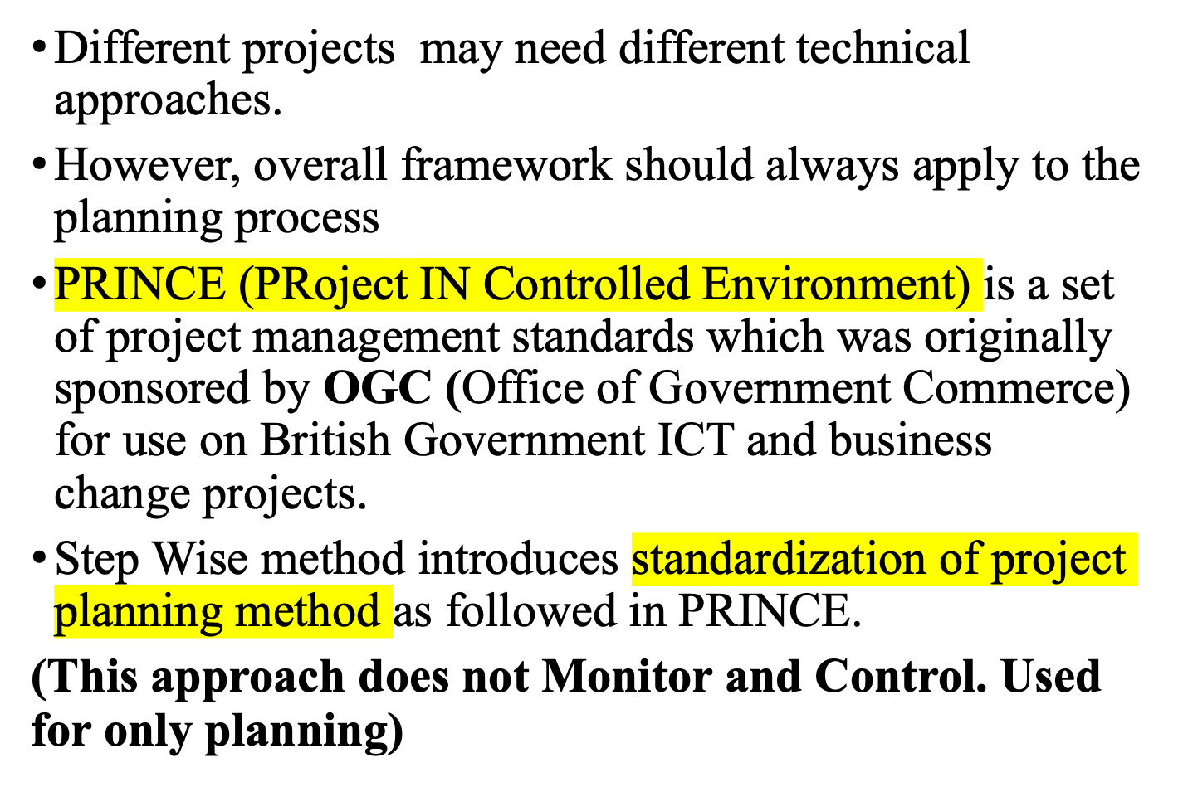
Introduction

Slide 3
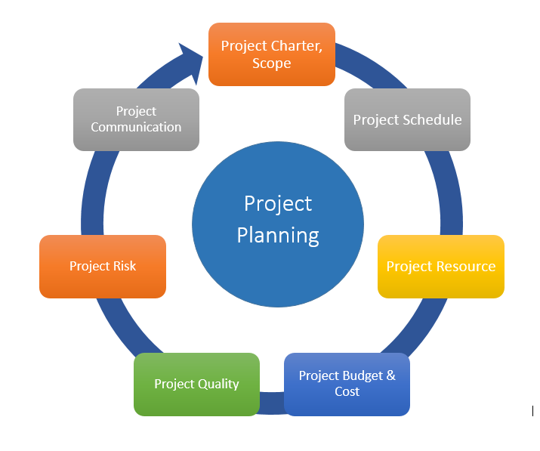

Slide 4
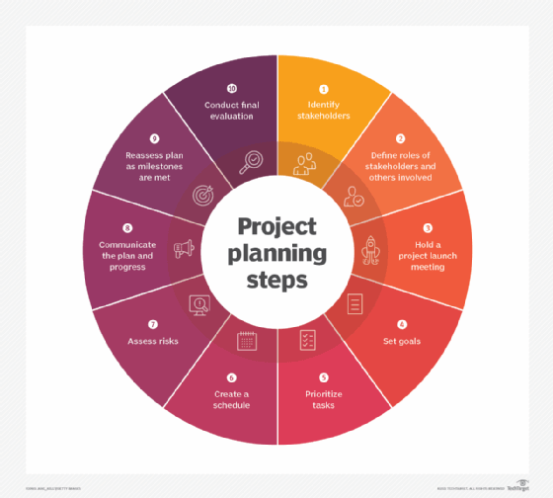

Slide 5
‘Step Wise’ - aspirations
Practicality
  tries to answer the question ‘what do I do now?’
Scalability
  useful for small project as well as large
Supports various range of applications
Accepted techniques
  e.g. borrowed from PRINCE etc
Notes:
The motivation for identifying an overall framework was that students, and others, were often at a loss as to where to start when new to project planning. A structured approach was seen as catering for the needs of such people.
Students are perhaps most likely to come into contact with some kind of project planning (i) when they are involved in student projects, especially those carried in groups and (ii) if they are members of a project team when they are undertaking a placement year in industry. The first situation is probably quite small-scale compared to the second. The same general principles of planning however relate to both.
The approach described here is designed to be applicable to a range of different types of project. For example, multimedia projects are not explicitly discussed, but one of the authors teaches a course project management for multimedia and the general approach described here seems to work satisfactorily when applied to these type of projects.
It might be asked why a standard approach such as PRINCE2 has not been adopted. In fact there is an outline of the PRINCE2 framework in an Appendix to the textbook. There has been caution about using PRINCE2 more centrally because:
PRINCE2 tend to be used mainly in the UK and many users of the Software Project Management textbook are from elsewhere
The content of this course would be vulnerable to changes to the method imposed by its design authority
PRINCE2 tends to focus more on procedural and bureaucratic matters at the expense of techniques – the few planning techniques that are associated with PRINCE, for example, the development of product flow diagrams, are used in the Step Wise approach as well.

Slide 6
Examples
Stock maintenance system of a warehouse
Develop a Payroll processing system
Design an Invoice system that automates order processing
Design a Tax estimation system for an employee in an organization
A Game or cartoon developed for children
A mobile app to support visually impaired / elderly citizens

Slide 7
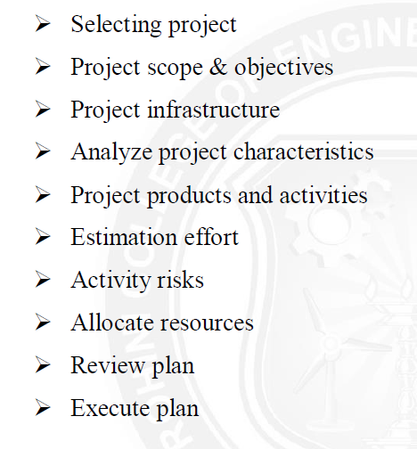
Outline of Step Wise planning (10 steps)

Slide 8
‘Step Wise’ - an overview
0.Select
project
1. Identify
project objectives
2. Identify project
infrastructure
3. Analyse
project
characteristics
Review
4. Identify products
and activities
5. Estimate effort
for activity
Lower
level
detail
For each
activity
6. Identify activity
risks
10. Lower level
planning
7. Allocate
resources
9. Execute plan
8. Review/ publicize
plan
Notes:
This is an overview of the main steps, details of which will be discussed in the following overheads:
0. Select project There must be some process by which the project to be executed was selected. Chapter 3 on project evaluation looks at this in more detail.
1. Identify project objectives It is important that at the outset the main stakeholders are all aware of the precise objectives of the project. This has already been discussed in Chapter 1.
2. Identify project infrastructure This may not be a significant step where you are working on an in-house project in a very familiar environment. However, where the project is being carried out for external clients then you may need to investigate the characteristics of the environment in which the project is to be carried out.
3. Analyse project characteristics Different types of project will need different technical and management approaches. For example, a project to implement control software embedded in industrial equipment will need a different set of methods than a project to implement a business information system. A multimedia application would again need a different set of activities. (This is not to say that there could not be considerable overlaps in the approaches).
4. Identify products and activities With software projects, it is best to start by listing the products, both deliverable and intermediate, to be created. The activities needed to create the products can then be identified
5. Estimate effort for activity.
6. Identify activity risks Having assessed the amount of effort and the elapsed time for a project, the reasons why these might be vary during the actual execution of the project need to be considered. Where there is a very high risk of additional effort/time being needed then actions to reduce this risk may be formulated.
7. Allocate resources With software projects, these resources will mainly be staff, but could be equipment etc.
8. Review/publicize It is no good having a plan if no one knows about it
9. Execute Plan
10. Lower level planning Not all of a project, especially when it is large, can be planned in detail at the outset. Not all the information needed to plan the later stages will be available at the beginning: for example software development cannot be broken down into precise sub-tasks with realistic target times until more is known about what the overall design of the system is known.

Slide 9
Step 0: Select Project
Falls Outside main project planning process
Feasibility study suggests that there is a business case for the project
Has priority over other projects – Note the merits in project portfolio management

Slide 10
A project scenario
Hardware/software Development Team – for an organization
teams are selected for individual projects
Team experiences rift in between
HR manager suggests psychometric testing to select team
Similar minded members are grouped to develop the Software package
usability is important - decision to carry out usability tests
Notes:
In this lecture the example is neither the Amanda nor Brigette project, as one that is smaller is needed in order to convey the main ideas in the lecture.
In this scenario, a hardware/software engineering company has been experiencing problems with friction and bad feeling among team members working on software development projects. The human resources manager has looked into these problems and has suggested that software development staff be given psychometric tests so that people can allocated to projects with co-workers who are likely to be temperamentally compatible – see, for example, the Belbin approach discussed in chapter 11.
It has been decided that this might be best implemented by incorporating the testing into a software application, and Visual Basic has been suggested as the programming language. A local university is to be approached to see if there is a student who might be able to implement this application as a final year project.
It is important that staff be willing to use the tool so usability considerations are seen as important.

Slide 11
Step 1 Establish project scope and objectives
1.1 Identify objectives and measures of effectiveness
  Expected timescales and resources required
  ‘how do we know if we have succeeded?’
1.2 Establish a project authority
  ‘who is the boss?’- overall project authority
  Project authority should be a project manager rather than HR manager
1.3 Identify all stakeholders in the project and their interests
  ‘who will be affected/involved in the project?’
  All the parties interested in the project (users of the final application/one involved in the development or implementation of the project).
  project team members to complete on-line questionnaires: concern about results?
Notes:
1.1. Identifying objectives and measures of effectiveness. This was discussed in chapter/lecture 1. To revise this students could be asked to try to produce a succinct statement of the objectives for the student described previously. Key points are that the student project objectives must be such that a student can realistically be responsible for their achievement. For instance, an objective to reduce conflict between project team members would be at too high a level for a software developer: he or she is there to produce software and evaluation of the particular pyschometric test would be outside their capabilities. If the student was a psychology student and the project was regarded as a psychological one, then things might be different.
1.2.Establishment of a project authority In the case of students on placement or carrying final year projects for outside organizations, the problem of identifying who has the final say on the project can occur surprisingly often, particular when different user groups have conflicting requirements. In larger, more formal projects, the project authority might reside in a Project Board or steering committee.
1.3 Identify all stakeholders in the project and their interests. Stakeholders can be anyone who has an interest in the project. They may be users of the final application or might be involved in the development or implementation of the project.

Slide 12
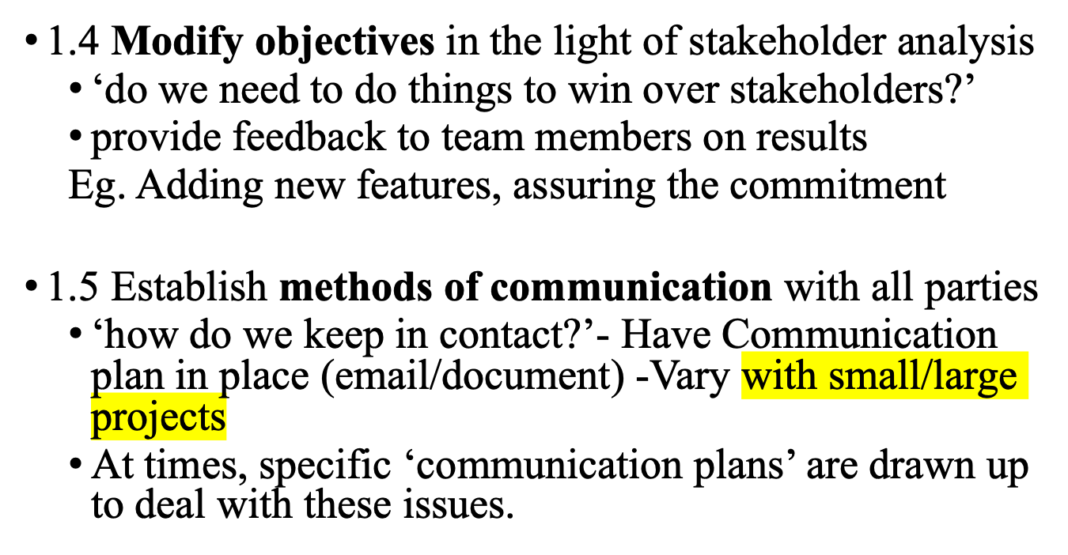
Step 1 continued
Notes:
1.4 Modify objectives in the light of stakeholder analysis. The key point here is the need to ensure commitment to the project from the important stakeholders. This might need to be done by ensuring that there is some benefit from the project for them. Note this is a similar idea to Barry Boehm’s ‘Theory W’ (‘W’ stands for ‘everyone a winner’)
1.5 Establish methods of communication with all parties In the case of a small student project, it might be mainly swapping email addresses and mobile phone numbers. With larger projects, it could involve setting up groups who meet regularly to co-ordinate action. Sometimes specific ‘communication plans’ are drawn up to deal with these issues.

Slide 13
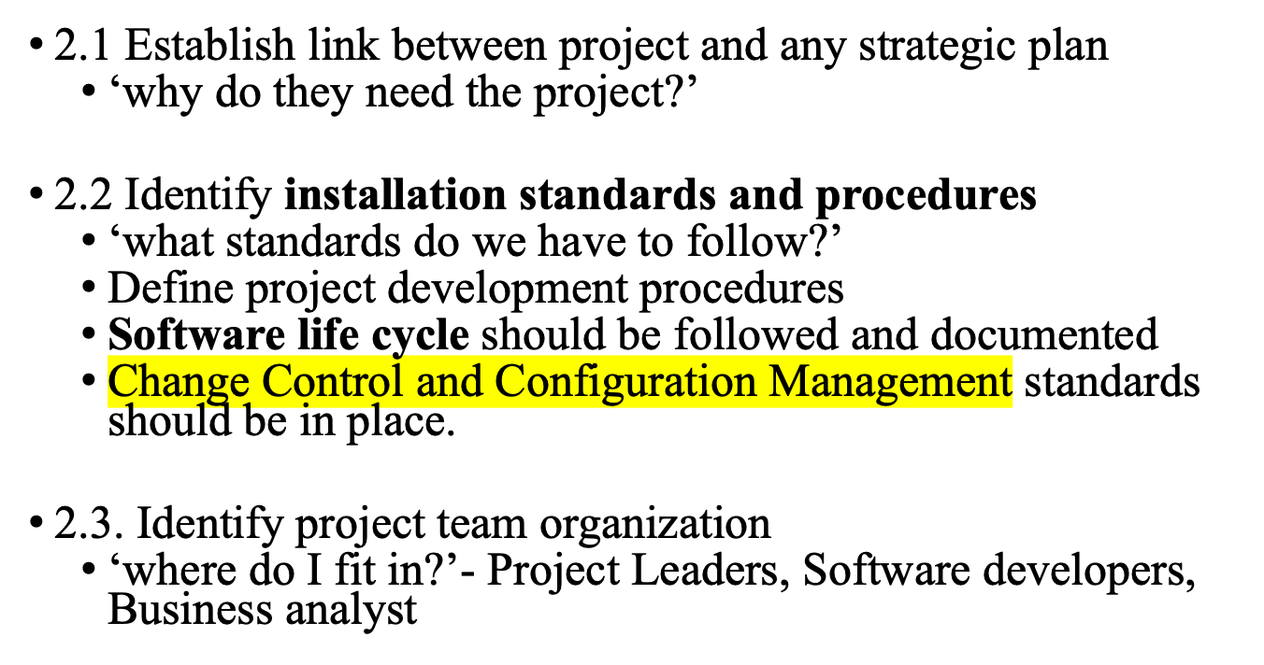
Step 2 Establish project infrastructure
Notes:
At the same time as establishing exactly what the project objectives are, the person responsible may know little about the organizational environment in which the application is to be developed and implemented. The actions in Step 2 address this problem.

Slide 14
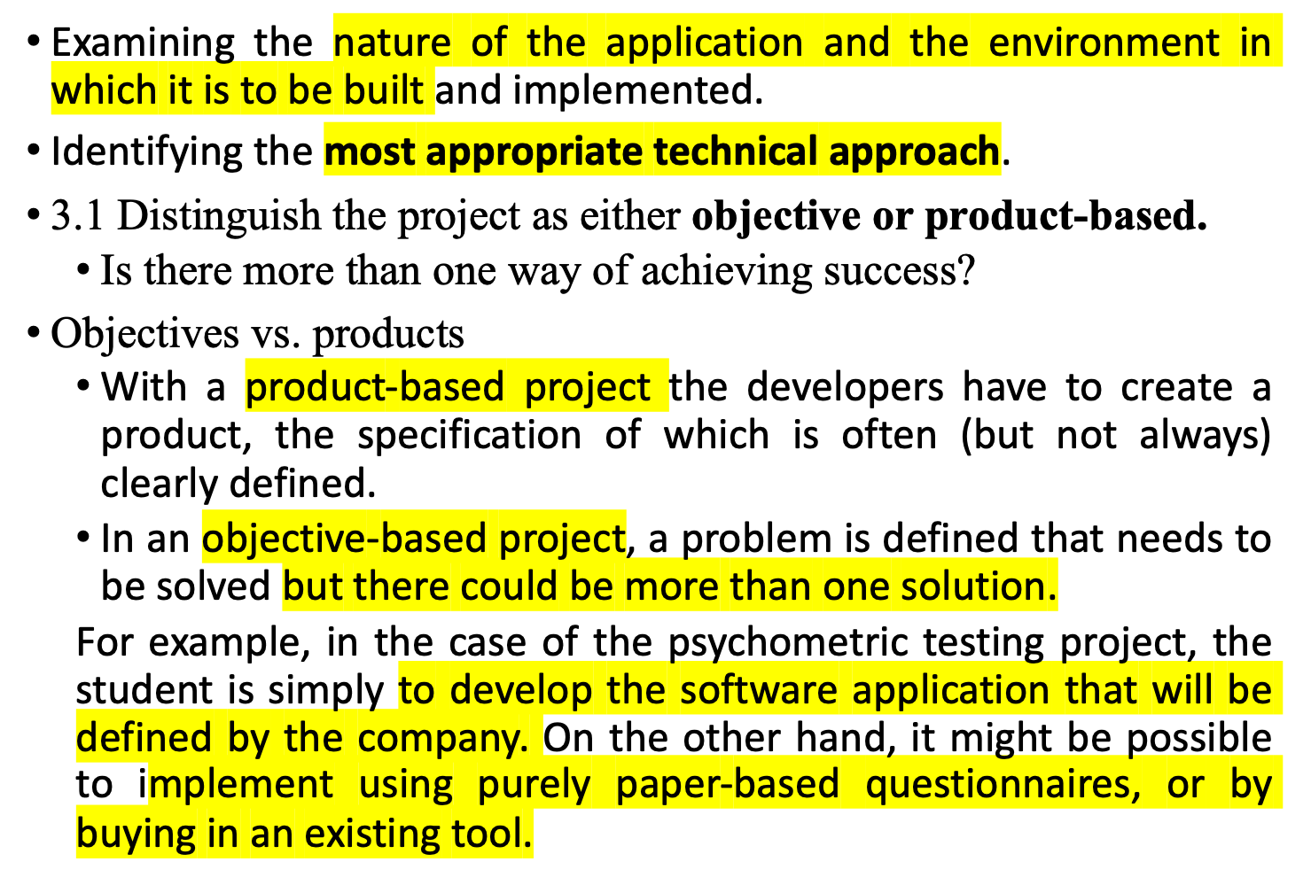
Step 3 Analysis of project characteristics
Notes:
Step 3 is about examining the nature of the application to be built and the environment in which it is to be built and implemented and identifying the most appropriate technical approach.
3.1 Objective-based versus product-based projects. With a product-based project the developers have to create a product, the specification of which is often (but not always) clearly defined. In an objective-based project, a problem is defined that needs to be solved but there could be more than one solution. For example, in the case of the psychometric testing project, it could be assumed that the student is simply to develop the software application that will be defined by the company. On the other hand, it might be possible to implement pyschometric testing using purely paper-based questionnaires, or by buying in an existing tool if a broader, objective-based, approach was adopted.
3.2 Analyse other project characteristics – such as is it an information system or an embedded real time or a multimedia application? Is it safety-critical? Etc etc

Slide 15
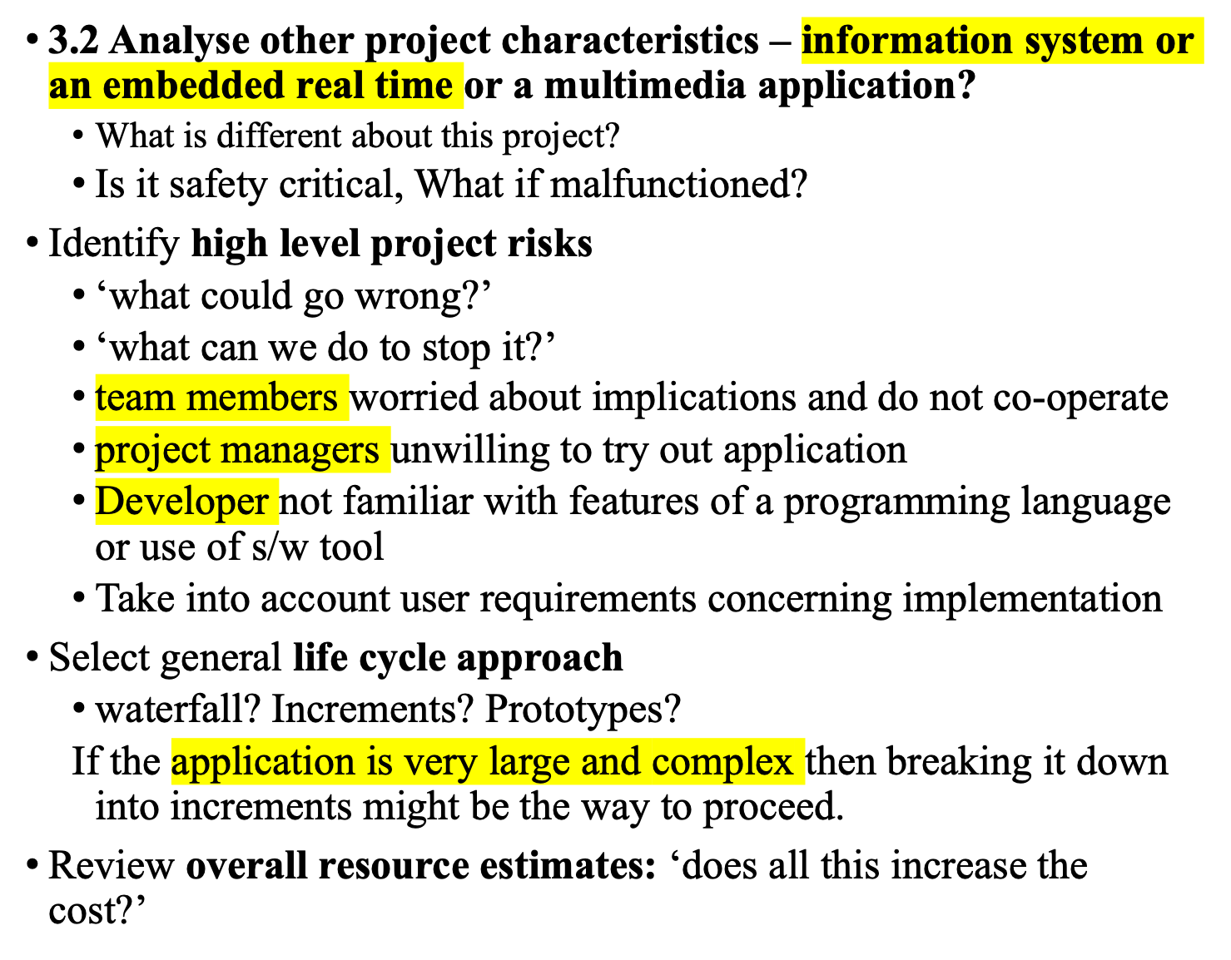
Notes:
Identifying high level risks could influence the general approach to the project. For example, if the users appeared to be uncertain about the precise nature of the requirement then a more iterative approach, including the use of prototypes to refine user needs, might be selected.
If the application is very large and complex then breaking it down into increments might be the way to proceed. Chapter/lecture 4 looks at this in more detail.

Slide 16
Back to the scenario
Objectives vs. products
  use paper questionnaire then input results of the analysis?
Some risks
  team members worried about implications and do not co-operate
  project managers unwilling to try out application
  Developer not familiar with features of VB
Answer? - evolutionary prototype?
Notes:
The development of an evolutionary prototypes which is tried out at various stages with the ultimate end-users might help to overcome possible anxieties with the system. If the developer is not familiar with VB then they may design an interface etc, which does not fully exploit the features of VB.

Slide 17
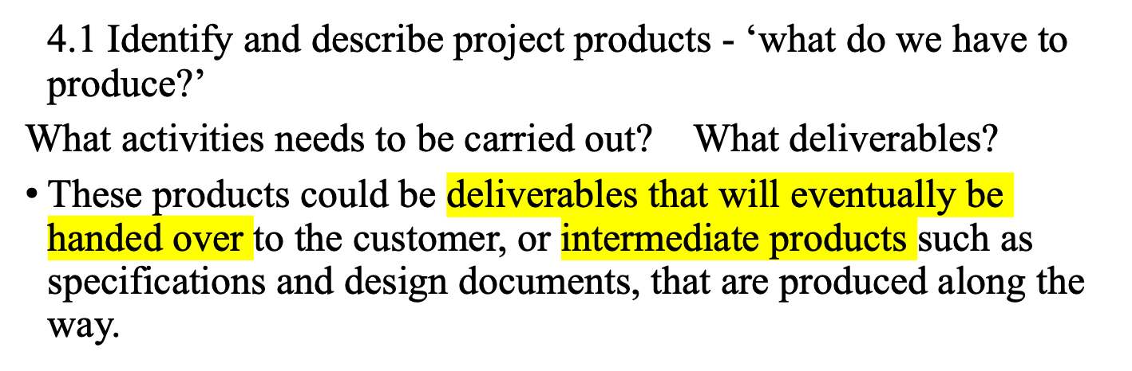
Step 4 Identify project products and activities
Usability
testing
A product breakdown structure
(PBS)
Selected
subjects
Testing
arrangements
Test results
Change
requests
Booked
PC
Questionnaire
design
Completed
questionnaire
Analysis
report
Product
Notes:
Here we follow the PRINCE approach of firstly identifying the products to be created. These products could be deliverables that will eventually be handed over to the customer, or intermediate products such as specifications and design documents, that are produced along the way.
The PBS is a way of listing these products.
In the scenario, the need for usability testing was identified, and the example of planning a usability test is used here. In order to do the testing, we need a set of selected subjects, a group of people who have similar characteristics to those who will finally use the system and who have agreed to try out the application. We need to have a booked PC that is available for testing when we need it. We are going to give each subject a questionnaire to complete when they have tried out the application (completed questionnaire), but we will need to have a questionnaire design first. We are also to observe the subjects using the application and collect details of things like the time taken to complete standard tasks and the errors they make (test results). These will then be analysed and the results put in an analysis report which will then be used to suggest changes to the application (change requests).
All the boxes in the diagram which are not sub-divided at a lower level represent products. Boxes that are sub-divided (i.e. usability testing and testing arrangements) are names given to the group of activities that are connected to them lower in the hierarchy.

Slide 18
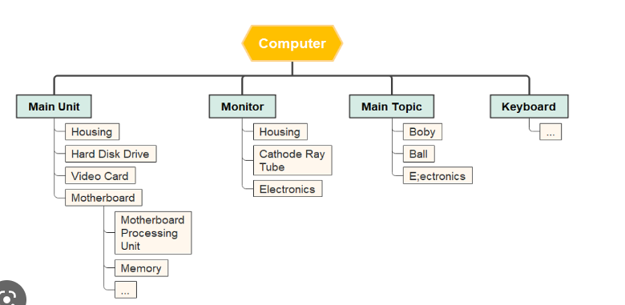

Slide 19
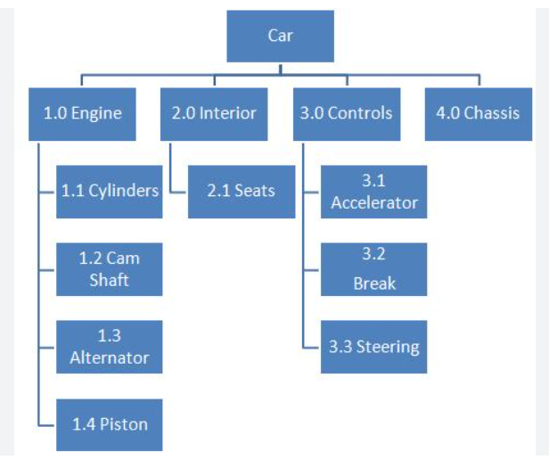

Slide 20
product breakdown structure
(PBS) Product Breakdown Structure (PBS)
product breakdown structure
(PBS)
Products will form a hierarchy.
The main products will have set of component products, which in turn might have sub-component products and so on.
These relationships can be documented in a Product Breakdown Structure (PBS).

Slide 21
Products
The result of an activity
Could be (among other things)
  physical thing (‘installed pc’),
  a document (‘logical data structure’)
  a person (‘trained user’)
  a new version of an old product (‘updated software’)

Slide 22
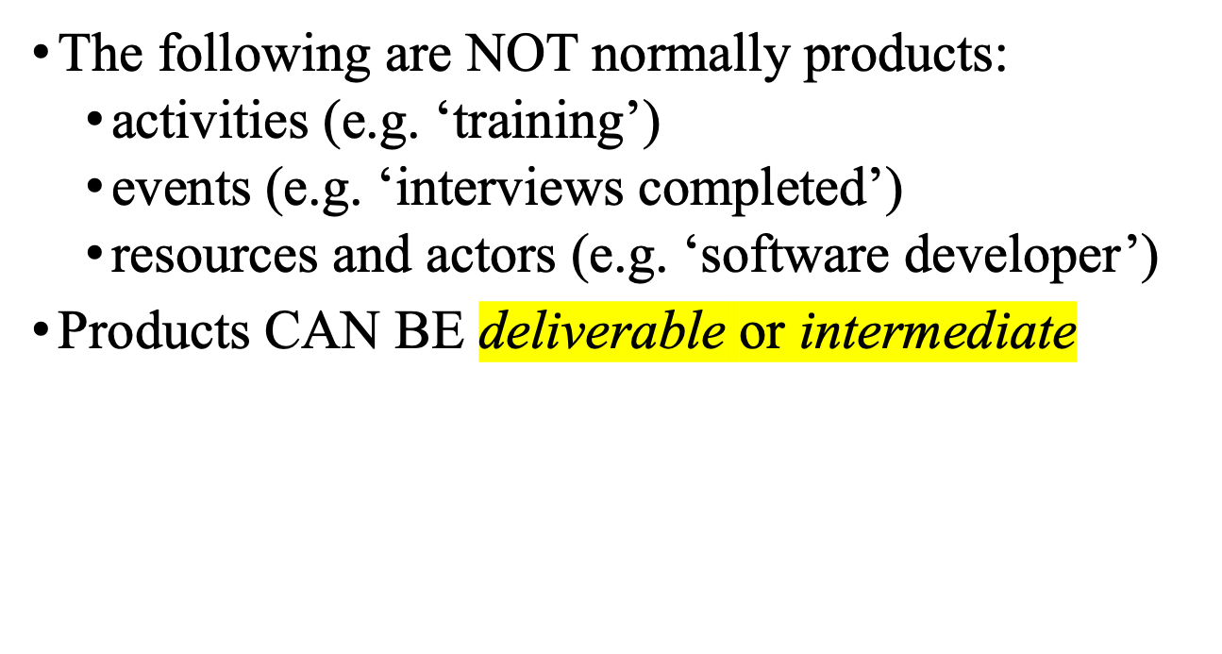
Products

Slide 23
Product description (PD)
Product Name/identity
Description - Details / Purpose
Derivation - what is it based on? Other products from which it is derived
Composition - what does it contain?
Format
Relevant standards
Quality criteria
Notes:
The names of products on the PBS can be rather vague. If you were to ask someone to produce, for example, the ‘analysis report’ in the usability testing scenario, then you would need to explain exactly what you mean by that. This is done via a Product Description. PDs can usually be re-used from one project to another.
Note that they are different from specifications – the explain in general terms what a product is and the description is relevant to all instances of that product. A specification describes a particular instance within the class of products.

Slide 24
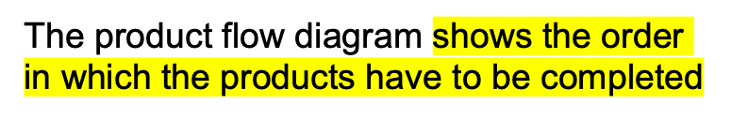
Step 4
4.2 document Generic product flows - product flow diagram -Effectively it defines a method of working. Shows the sequence in which products must be developed
Eg. an additional product called ‘testing plan’ is identified in usability testing
Testing plan
Selected
subjects
Questionnaire
design
Booked
machine
Completed
questionnaire
Test results
Analysis report
Change
requests
Notes:
The product flow diagram shows the order in which the products have to be completed.

Slide 25
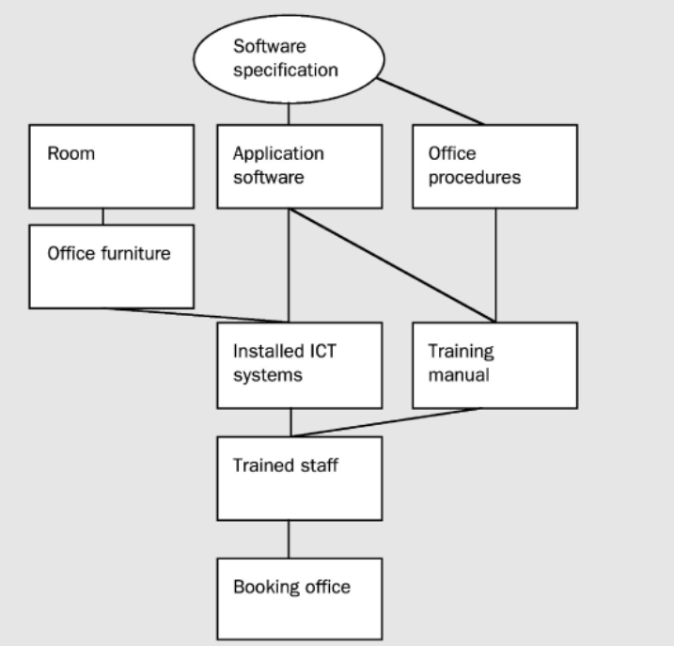
Software specification - product that already exists and that will be used to generate one or more of the products in the PFD.

Slide 26
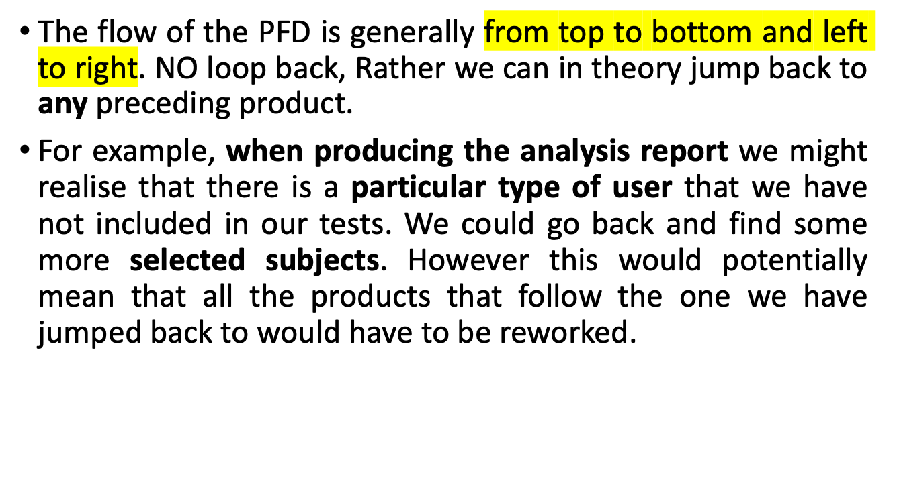

Slide 27
Step 4.3 Recognize product instances
The PBS and PFD will probably have identified generic products e.g. ‘software modules’
It might be possible to identify specific instances e.g. ‘module A’, ‘module B’ …
But in many cases this will have to be left to later, more detailed, planning

Slide 28
4.4. Produce ideal activity network
Identify the activities needed to create each product in the PFD
More than one activity might be needed to create a single product
Identify the activities and create/draw an activity network which shows the tasks that have to be carried out and the order in which it has to be executed.

Slide 29
An ‘ideal’ activity
The activity network is the basis of the data that is input to planning software tools (eg. MS Project)
Select
subjects
Plan
testing
Design
questionnaire
Conduct
tests
Analyse
results
Draft change
requests
Book
machine

Slide 30
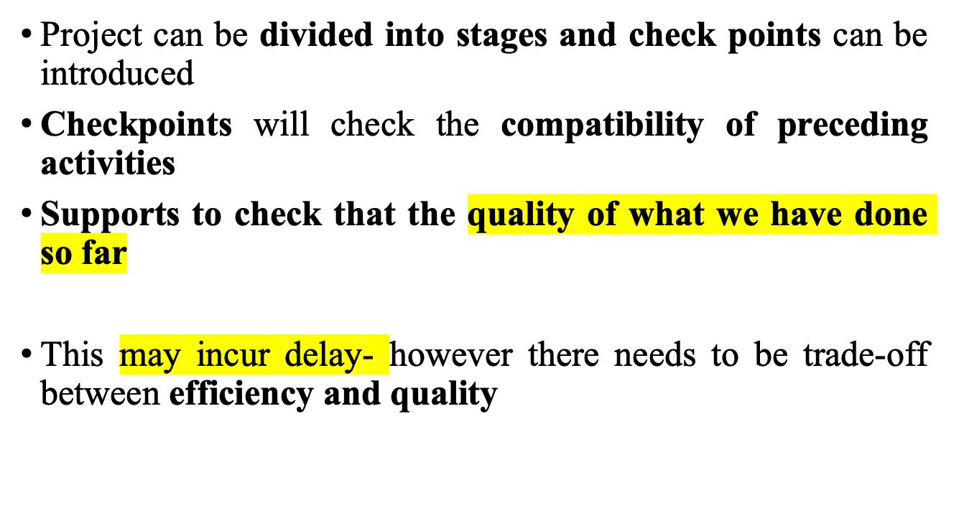
Step 4.5 Add check-points if needed

Slide 31
Step 4.5 Add check-points if needed
Design
module A
Code
module A
Design
system
Design
module B
Code
module B
Test
system
to check that all the module designs are compatible with one another before continuing
Design
module C
Code
module C
put in a
check point
Design
module A
Code
module A
Design
system
Design
module B
Check-point
Code
module B
Test
system
Design
module C
Code
module C
Notes:
There are some points in the project when we want to check that the quality of what we have done so far is a sound basis for further work. In the example we have decided to check that all the module designs are compatible with one another before continuing. Note that the benefit of reducing wasted work at a later stage when incompatibilities lead to products being reworked, has to be balanced against the delay caused by the check-point. The start of coding of modules A, B and C all have to wait for the completion of the design of all the modules A, B and C. With no check-point, module A could be coded as soon as the design of module A had been done without having to wait for B and C.

Slide 32
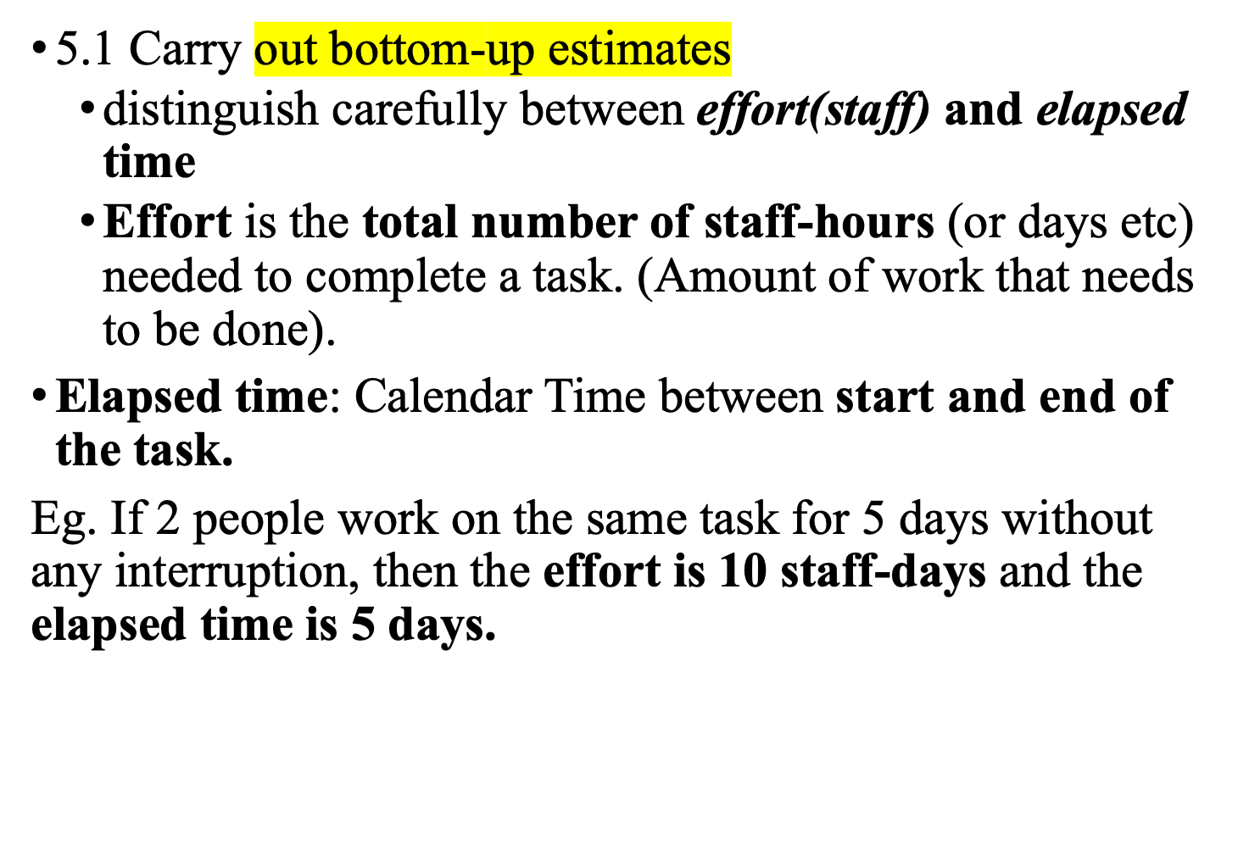
Step 5:Estimate effort for each activity
Notes:
Effort is the total number of staff-hours (or days etc) needed to complete a task. Elapsed time is the calendar time between the time task starts and when it ends. If 2 people work on the same task for 5 days without any interruption, then the effort is 10 staff-days and the elapsed time is 5 days.
Using the PBS/PFD to generate the activities often means that some activities are very small and others are huge. Often there is an activity called ‘write software’ which is 70% of a software development project. These large activities need to be broken down into more manageable small tasks. You should aim for the average length of your activities to be about the time between progress meetings e.g. if you have team progress meeting once a fortnight, try to make the tasks last about 2 weeks.
Lecture/chapter 5 explores estimating in some depth.

Slide 33
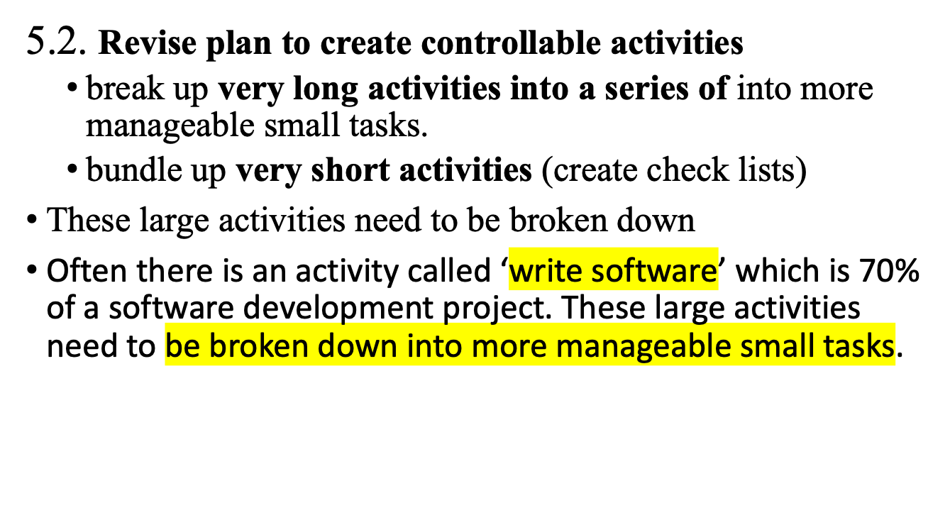

Slide 34
Using the PBS/PFD to generate the activities often means that some activities are very small and others are huge. Often there is an activity called ‘write software’ which is 70% of a software development project. These large activities need to be broken down into more manageable small tasks. You should aim for the average length of your activities to be about the time between progress meetings e.g. if you have team progress meeting once a fortnight, try to make the tasks last about 2 weeks.

Slide 35
Step 6: Identify activity risks
6.1.Identify and quantify risks for activities (assuming clients requirement is clear and unambiguous)
  damage if risk occurs (measure in time lost or money)
  likelihood of risk occurring
6.2. Plan risk reduction and contingency measures
  risk reduction: activity to stop risk occurring
  contingency: action if risk does occur
Notes:
Note that we have already considered some high level risks that could affect the project as a whole at Step 3. Estimates of the effort and duration of activities can be quite tricky. When you produce an estimate for an activity it is worth reflecting about the events which could cause the assumptions upon which you have based your estimate to be wrong. Where the risk seems very high, then you might try to introduce new activities specifically designed to reduce the risk, or to formulate a contingency action if the risk should materialize. For example, there is not much you can do to stop people getting the flu at a critical time in the project, but you might be able to have a plan to bring in temporary cover for sickness in the case of time-critical activities.
Lecture/chapter 7 focuses particularly on risk.

Slide 36
6.3 Adjust overall plans and estimates to take account of risks
  e.g. change or add new activities which reduce risks associated with other activities e.g. training, pilot trials, information gathering

Slide 37
Step 7: Allocate resources
7.1 Identify and allocate resources to activities
7.2 Revise plans and estimates to take into account resource constraints
  e.g. staff not being available until a later date
  Carrying out non-project activities
Notes:
You now need to allocate resources (in particular, staff) to the activities in the plan. Where there is a resource constraint, that is there are not enough staff (or other resource) of the right type to start all the activities that run in parallel at the planned time, then the start of some activities may need to be delayed until the appropriate resources are available.

Slide 38
Gantt charts (named afterHenry Gantt)
LT = lead tester
Week commencing
TA = testing assistant
MARCH
APRIL
5
12
19
26
2
9
16
Plan testing
LT
Select subjects
TA
Design questionnaire
LT
Book machine
TA
Conduct tests
TA
Analyse results
LT
Draft changes
LT
Notes:
We now have the basic information needed to produce a plan. One way of presenting the plan is by means of a Gantt chart (named after Henry Gantt).

Slide 39
Step 8: Review/publicize plan
8.1 Review quality aspects of project plan
Each task should have quality criteria which should be passed before the activity is signed off.
8.2 Document plan and obtain agreement (Plan needs to be documented carefully and all parties should agree)
Notes:
We have noted already that it is not feasible to produce a detailed plan for all stages of the project right at the beginning of the project planning process and not all the information needed for the detailed planning of the later stages is available at the outset. Initially an outline plan for the whole project would be produced, plus a detailed plan for the first stage.

Slide 40
Step 9 and 10: Execute plan and create lower level plans
Detailed planning should be delayed and lower level pan should be focused initially

