Slide 1
COCOMO Models

Slide 2
Project Management
Logic is a systematic method of coming to the wrong conclusion with confidence.
Technology is dominated by those who manage what they do not understand.
Nothing ever gets built on schedule or within budget.
If mathematically you end up with the incorrect answer, try multiplying by the page number.

Slide 3
Motivation
The software cost estimation provides:
The vital link between the general concepts and techniques of economic analysis and the particular world of software engineering.
Software cost estimation techniques also provides an essential part of the foundation for good software management.

Slide 4
Cost of a project
The cost in a project is due to:
  the requirements for software, hardware and human resources
  the cost of software development is due to the human resources needed
  most cost estimates are measured in person-months (PM)

Slide 5
Cost of a project (.)
the cost of the project depends on the nature and characteristics of the project,
at any point, the accuracy of the estimate will depend on the amount of reliable information we have about the final product.

Slide 6
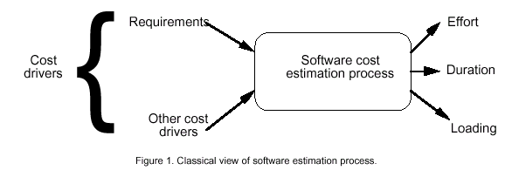
Software Cost Estimation

Slide 7
Effort
Effort Equation
  PM = C * (KDSI)^{n} (person-months)
    where PM = number of person-month (=152 working hours),
    C = a constant,
    KDSI = thousands of "delivered source instructions" (DSI) and
    n = a constant.

Slide 8
Productivity
Productivity equation
  (DSI) / (PM)
    where PM = number of person-month (=152 working hours),
    DSI = "delivered source instructions"

Slide 9
Schedule
Schedule equation
  TDEV = C * (PM)^{n} (months)
    where TDEV = number of months estimated for software development.

Slide 10
Average Staffing
Average Staffing Equation
  (PM) / (TDEV) (FSP)
    where FSP means Full-time-equivalent Software Personnel.

Slide 11
Cost Estimation Process
Cost=SizeOfTheProject x Productivity

Slide 12
Cost Estimation Process
Effort
Size Table
Lines of Code
Number of Use Case
Function Point
Development Time
Estimation Process
Number of Personnel
Errors

Slide 13
Project Size - Metrics
Number of functional requirements
Cumulative number of functional and non-functional requirements
Number of Customer Test Cases
Number of ‘typical sized’ use cases
Number of inquiries
Number of files accessed (external, internal, master)
Total number of components (subsystems, modules, procedures, routines, classes, methods)
Total number of interfaces
Number of System Integration Test Cases
Number of input and output parameters (summed over each interface)
Number of Designer Unit Test Cases
Number of decisions (if, case statements) summed over each routine or method
Lines of Code, summed over each routine or method

Slide 14
Project Size – Metrics(.)
Availability of Size Estimation Metrics:
Development Phase
Available
Metrics
a
Requirements Gathering
1, 2, 3
b
Requirements Analysis
4, 5
d
High Level Design
6, 7, 8, 9
e
Detailed Design
10, 11, 12
f
Implementation
12, 13

Slide 15
Function Points
STEP 1: measure size in terms of the amount of functionality in a system. Function points are computed by first calculating an unadjusted function point count (UFC). Counts are made for the following categories
External inputs – those items provided by the user that describe distinct application-oriented data (such as file names and menu selections)
External outputs – those items provided to the user that generate distinct application-oriented data (such as reports and messages, rather than the individual components of these)
External inquiries – interactive inputs requiring a response
External files – machine-readable interfaces to other systems
Internal files – logical master files in the system

Slide 16
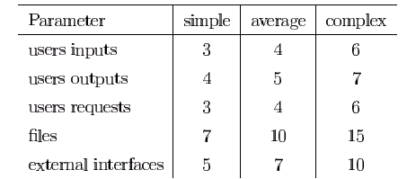
Function Points(..)
STEP 2: Multiply each number by a weight factor, according to complexity (simple, average or complex) of the parameter, associated with that number. The value is given by a table:

Slide 17
Function Points(...)
STEP 3: Calculate the total UFP (Unadjusted Function Points)
STEP 4: Calculate the total TCF (Technical Complexity Factor) by giving a value between 0 and 5 according to the importance of the following points (next slide):

Slide 18
Function Points(....)
    Technical Complexity Factors:
    Data Communication
    Distributed Data Processing
    Performance Criteria
    Heavily Utilized Hardware
    High Transaction Rates
    Online Data Entry
    Online Updating
    End-user Efficiency
    Complex Computations
    Reusability
    Ease of Installation
    Ease of Operation
    Portability
    Maintainability

Slide 19
Function Points(.....)
STEP 5: Sum the resulting numbers too obtain DI (degree of influence)
STEP 6: TCF (Technical Complexity Factor) by given by the formula
  TCF=0.65+0.01*DI
STEP 6: Function Points are by given by the formula
  FP=UFP*TCF

Slide 20
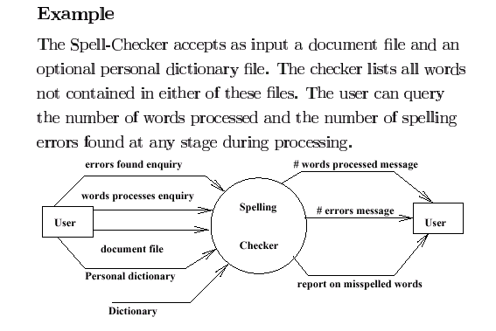
Example

Slide 21
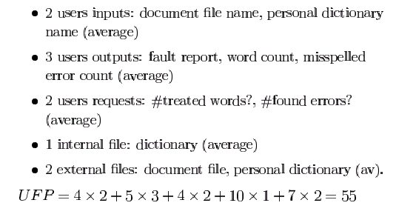
Example (.)

Slide 22
Example (..)
    Technical Complexity Factors:
      1. Data Communication 3
      2. Distributed Data Processing 0
      3. Performance Criteria 4
      4. Heavily Utilized Hardware 0
      5. High Transaction Rates 3
      6. Online Data Entry 3
      7. Online Updating 3
      8. End-user Efficiency 3
      9. Complex Computations 0
      10. Reusability 3
      11. Ease of Installation 3
      12. Ease of Operation 5
      13. Portability 3
      14. Maintainability 3
        DI =30 (Degree of Influence)

Slide 23
Example (…)
Function Points
  FP=UFP*(0.65+0.01*DI)= 55*(0.65+0.01*30)=52.25
  That means FP=52.25

Slide 24
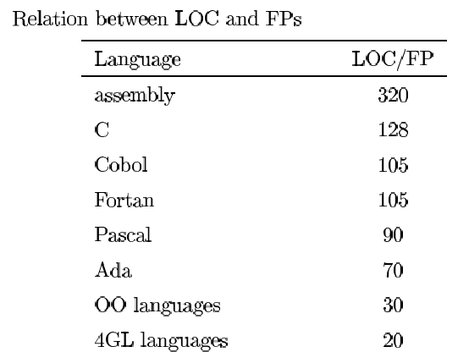
Relation between LOC and FP
Relationship:
  LOC = Language Factor * FP
  where
    LOC (Lines of Code)
    FP (Function Points)

Slide 25
Relation between LOC and FP(.)
Assuming LOC’s per FP for:
Java = 53,
C++ = 64
aKLOC = FP * LOC_per_FP / 1000
It means for the SpellChekcer Example: (Java)
LOC=52.25*53=2769.25 LOC or 2.76 KLOC

Slide 26
Introduction to COCOMO models
The COstructive COst Model (COCOMO) is the most widely used software estimation model.
The COCOMO model predicts the effort and duration of a project based on inputs relating to the size of the resulting systems and a number of "cost drives" that affect productivity.

Slide 27
COCOMO Models
COCOMO is defined in terms of three different models:
  the Basic model,
  the Intermediate model, and
  the Detailed model.
The more complex models account for more factors that influence software projects, and make more accurate estimates.

Slide 28
The Development mode
The most important factors contributing to a project's duration and cost is the Development Mode
    Organic Mode: The project is developed in a familiar, stable environment, and the product is similar to previously developed products. The product is relatively small, and requires little innovation.
    Semidetached Mode: The project's characteristics are intermediate between Organic and Embedded.
    Embedded Mode: The project is characterized by tight, inflexible constraints and interface requirements. An embedded mode project will require a great deal of innovation.

Slide 29
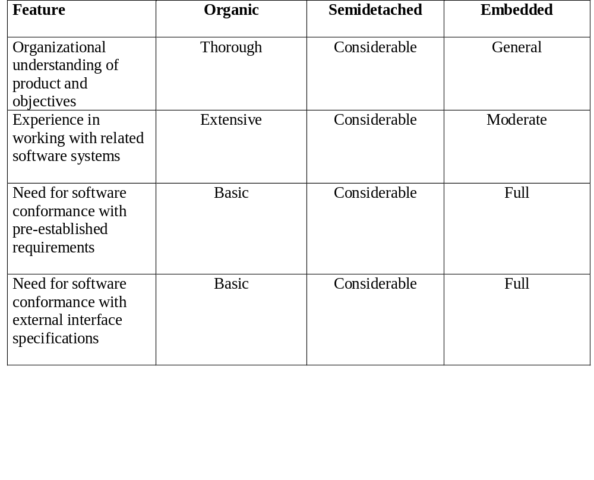
Modes

Slide 30
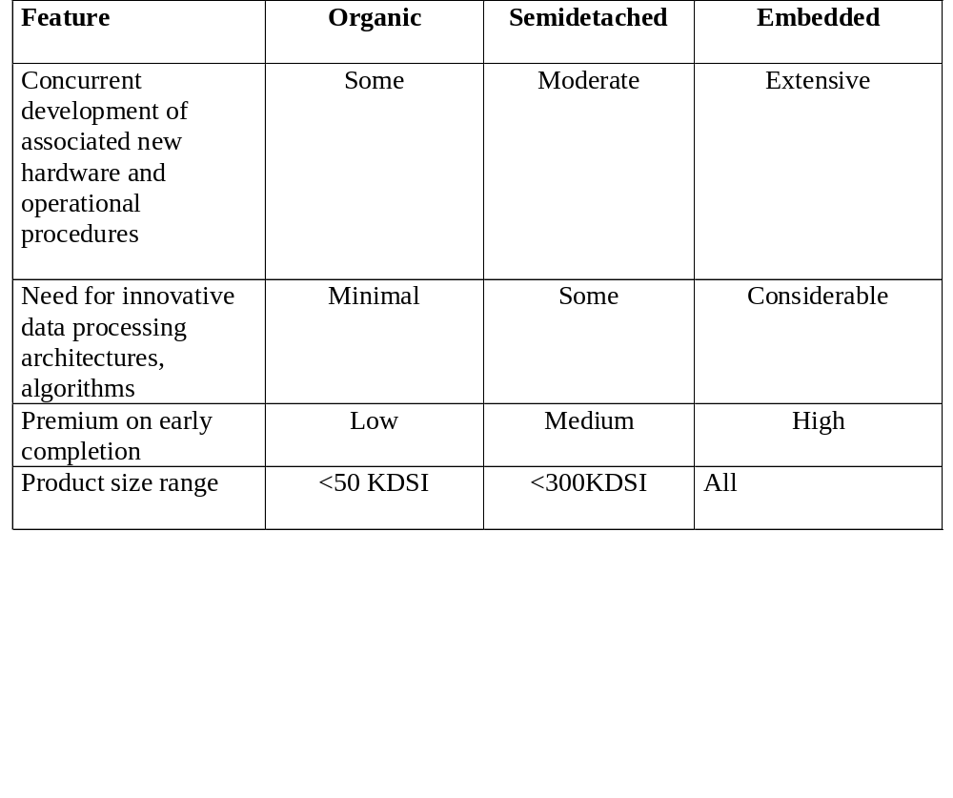
Modes (.)

Slide 31
Effort Computation
The Basic COCOMO model computes effort as a function of program size. The Basic COCOMO equation is:
  E = aKLOC^b
Effort for three modes of Basic COCOMO.
Mode | a | b
Organic | 2.4 | 1.05
Semi-detached | 3.0 | 1.12
Embedded | 3.6 | 1.20

Slide 32

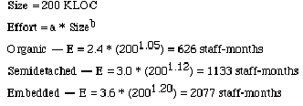
Example

Slide 33
Effort Computation
The intermediate COCOMO model computes effort as a function of program size and a set of cost drivers. The Intermediate COCOMO equation is:
  E = aKLOC^b*EAF
Effort for three modes of intermediate COCOMO.
Mode | a | b
Organic | 3.2 | 1.05
Semi-detached | 3.0 | 1.12
Embedded | 2.8 | 1.20

Slide 34
Effort computation(.)
Effort Adjustment Factor
Cost Driver
Very
Low
Low
Nominal
High
Very
High
Extra
High
Required Reliability
.75
.88
1.00
1.15
1.40
1.40
Database Size
.94
.94
1.00
1.08
1.16
1.16
Product Complexity
.70
.85
1.00
1.15
1.30
1.65
Execution Time Constraint
1.00
1.00
1.00
1.11
1.30
1.66
Main Storage Constraint
1.00
1.00
1.00
1.06
1.21
1.56
Virtual Machine Volatility
.87
.87
1.00
1.15
1.30
1.30
Comp Turn Around Time
.87
.87
1.00
1.07
1.15
1.15
Analyst Capability
1.46
1.19
1.00
.86
.71
.71
Application Experience
1.29
1.13
1.00
.91
.82
.82
Programmers Capability
1.42
1.17
1.00
.86
.70
.70
Virtual machine Experience
1.21
1.10
1.00
.90
.90
.90
Language Experience
1.14
1.07
1.00
.95
.95
.95
Modern Prog Practices
1.24
1.10
1.00
.91
.82
.82
SW Tools
1.24
1.10
1.00
.91
.83
.83
Required Dev Schedule
1.23
1.08
1.00
1.04
1.10
1,10

Slide 35
Effort Computation (..)
Total EAF = Product of the selected factors
Adjusted value of Effort: Adjusted Person Months:
APM = (Total EAF) * PM

Slide 36


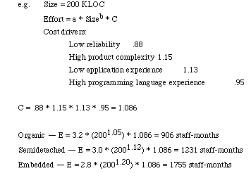
Example

Slide 37
Software Development Time
Development Time Equation Parameter Table:
Development Time, TDEV = C * (APM **D)
Number of Personnel, NP = APM / TDEV
Parameter | Organic | Semi-detached | Embedded
C | 2.5 | 2.5 | 2.5
D | 0.38 | 0.35 | 0.32

Slide 38
Distribution of Effort
A development process typically consists of the following stages:
  Requirements Analysis
  Design (High Level + Detailed)
  Implementation & Coding
  Testing (Unit + Integration)

Slide 39
Distribution of Effort (.)
The following table gives the recommended percentage distribution of Effort (APM) and TDEV for these stages:
Percentage Distribution of Effort and Time Table:
Req
Analysis
Design,
HLD + DD
Implementation
Testing
Effort
23%
29%
22%
21%
100%
TDEV
39%
25%
15%
21%
100%

Slide 40
Error Estimation
Calculate the estimated number of errors in your design, i.e.total errors found in requirements, specifications, code, user manuals, and bad fixes:
  Adjust the Function Point calculated in step1
AFP = FP ** 1.25
  Use the following table for calculating error estimates
Error Type | Error / AFP
Requirements | 1
Design | 1.25
Implementation | 1.75
Documentation | 0.6
Due to Bug Fixes | 0.4

Slide 41
All Together
Design
Classes*(2Function Points)
DI=∑ratings of selected factors
₁₄
TCF=0.65+0.01*∑(DI)_{j}
¹
Min[TCF]=0.65; Max[TCF]=1.35
Unadjusted Function Point (UFP table)
LOC=13.20*Num of Method
LOC=18.25*Num of Method
TCF
Modify
FP=UFP*TCF
bKLOC=∑ (LOCs for all Classes)/1000
AFP=FP*1.25
aKLOC=FP*LOC_per_FP/1000
Java=53; C++=64
Compute Errors = AFP*Y
KLOC=Max[aKLOC, bKLOC]
Compute Effort: Person Month, PM=A*(KLOC**B)
Result
EAF=Product of selected factor
Adjusted PM: APM=(total EAF)*PM
NP | Effort | time
Req | APM | TDEV
Factor:1-15
Development Time: TDEV=C*(APM**D)
Number of personnel: NP=APM/TDEV

