Slide 1
Project Estimation Technique

Slide 2
Project Estimation Technique
Empirical Estimation Technique
Heuristic Estimation Technique
Analytical

Slide 3
Empirical Estimation Technique
The Project estimation is done based on prior experience of similar products.
Basically, two approach is used :
  Expert Judgment
  Delphi Cost Estimation.

Slide 4
  Expert Judgment
Expert makes an educated guess.
But it is subject to human error and individual bias.
More refined educated guess can be made by the group of expert for all modules individually.

Slide 5
Delphi Cost Estimation
This techniques also works on expert judgment but follow the iterative method.
Delphi in software estimation takes into account the following key points :
  Expert's and Coordinator Selection
  Briefing about the project to the experts
  Gathering an idea/estimate from the experts
  Assimilate the ideas and finalize it and submit to co-ordinator.
  Gathering of idea and estimation will continue until reach the reasonable cost of the project.

Slide 6
Advantages
A useful technique in the absence of experts within the organization, as Delphi allows hiring experts from external sources with required domain knowledge for the project.
It is a quick technique to arrive at an estimate.
Delphi technique is popular for its simplicity
Disadvantages
Sometimes it becomes difficult to find and analyze the right expert.
Difficulty in deciding the number of experts required.
The estimates derived, are not auditable.
This technique can only estimate the size and effort of the project but not the time.

Slide 7
Heuristic Estimation Technique
Every Software project can be classified into three category:
  Organic
  Semidetached
  Embedded
According to Boehm, software cost estimation should be done through:
  Basic COCOMO (Constructive Cost Estimation Model)
  Intermediate COCOMO
  Detailed/Complete COCOMO
  COCOMO-II

Slide 8
Organic
A development project can be treated of the organic type, if the project is
A well-understood application program,
The size of the development team is reasonably small, and
The team members are experienced.
The size of the project in the range of 2-50 KLOC
Example:
Inventory Management systems,
Payroll System.

Slide 9
Semidetached
A development project can be treated with semidetached type if the development consists of a mixture of experienced and inexperienced staff.
Team members may have finite experience in related systems but may be unfamiliar with some aspects of the order being developed.
Example of Semidetached system includes developing a new operating system (OS), a Database Management System (DBMS), Linker, Loader, and complex inventory management system.
Size should be between 50-300 KLOC

Slide 10
Embedded
A development project is treated to be of an embedded type, if the software being developed is strongly coupled to complex hardware, or if the stringent regulations on the operational method exist.
Size must be greater than 300 KLOC.
For Example: ATM, Air Traffic control.

Slide 11
Basic COCOMO Model
The basic COCOMO model provide an accurate size of the project parameters. The following expressions give the basic COCOMO estimation model:
Effort=a₁*(KLOC)^{a2} PM
T_{dev}=b₁*(efforts)^{b2} Months
Where
KLOC is the estimated size of the software product indicate in Kilo Lines of Code,
a₁,a₂,b₁,b₂ are constants for each group of software products,
T_{dev} is the estimated time to develop the software, expressed in months,
Effort is the total effort required to develop the software product, expressed in person months (PMs).

Slide 12
The constant values of a and b for the Basic Model for the different categories of system:
Software Project | a₁ | a₂ | b₁ | b₂
Organic | 2.4 | 1.05 | 2.5 | 0.38
Semi-Detached | 3.0 | 1.12 | 2.5 | 0.35
Embedded | 3.6 | 1.20 | 2.5 | 0.32

Slide 13
Example1: Suppose a project was estimated to be 400 KLOC. Calculate the effort (E) and development time (D) for each of the three model i.e., organic, semi-detached & embedded.
(i)Organic Mode
E = 2.4 * (400)^{1.05} = 1295.31 PM
D = 2.5 * (1295.31)^{0.38}=38.07 PM
(ii)Semidetached Mode
E = 3.0 * (400)^{1.12}=2462.79 PM
D = 2.5 * (2462.79)^{0.35}=38.45 PM
(iii) Embedded Mode
E = 3.6 * (400)^{1.20} = 4772.81 PM
D = 2.5 * (4772.8)^{0.32} = 38 PM

Slide 14
Example2: A project size of 200 KLOC is to be developed. Software development team has average experience on similar type of projects. The project schedule is not very tight. Calculate the Effort, development time, average staff size, and productivity of the project.
Average Staff Size = E/D Person
Productivity = KLOC/E
Productivity is measured in KLOC/PM.

Slide 15
Intermediate COCOMO
The basic COCOMO model considers that the effort is only a function of the number of lines of code and some constants calculated according to the various software systems.
The intermediate COCOMO model recognizes these facts and refines the initial estimates obtained through the basic COCOMO model by using a set of 15 cost drivers based on various attributes of software engineering.

Slide 16
Classification of Cost Drivers and their attributes
Cost drivers are classified into four category :
  I. Product Attributes
  II. Computer Attributes
  III. Personnel Attributes
  IV. Project Attributes

Slide 17
I. Product Attributes
RELY Required Software Reliability
DATA Data Base Size
CPLX Product Complexity
II. Computer Attributes
TIME Execution Time Constraint
STOR Main Storage Constraint
VIRT Virtual Machine Volatility1
TURN Computer Turnaround Time

Slide 18
III. Personnel Attributes
ACAP Analyst Capability
AEXP Application Experience
PCAP Programming Capability
VEXP Virtual Machine Experience1
LEXP Programming Language Experience
IV. Project Attributes
MODP Modern Programming Practices
TOOL Use of Software Tools
SCED Required Development Schedule

Slide 19
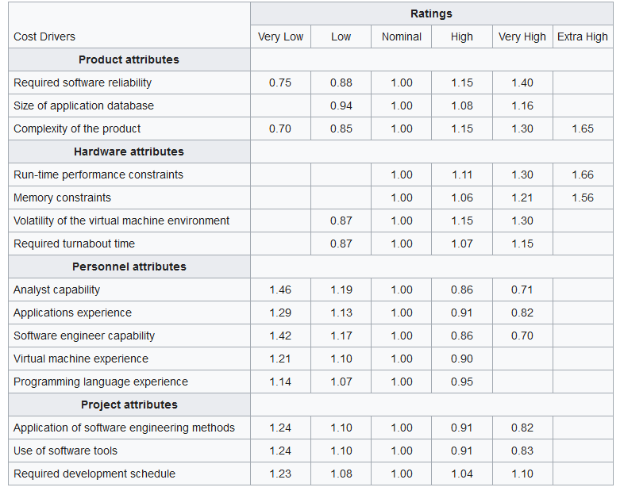

Slide 20
The Intermediate COCOMO formula now takes the form:
E=a₁*(KLoC)^{a2}(EAF)
T_{dev}=b₁*(efforts)^{b2} Months
where
  E is the effort applied in person-months,
  KLoC is the estimated number of thousands of delivered lines of code for the project, and
  EAF is the effort adjustment factor.

Slide 21
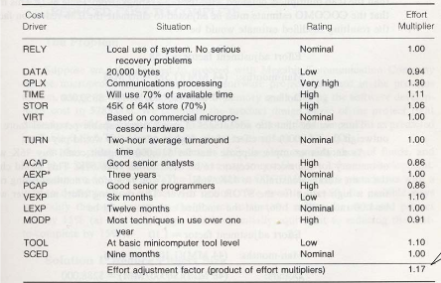

Slide 22
Example1: Suppose a project was estimated to be 400 KLOC. Calculate the effort (E) and development time (D) for each of the three model i.e., organic, semi-detached & embedded. Let EAF is 1.17
(i)Organic Mode
E = 2.4 * (400)^{1.05} *1.17 = 1515.51 PM
D = 2.5 * (1515.51)^{0.38}=40.41 PM
(ii)Semidetached Mode
E = 3.0 * (400)^{1.12} * 1.17=2881.46 PM
D = 2.5 * (2881.46)^{0.35}=40.63 PM
(iii) Embedded Mode
E = 3.6 * (400)^{1.20} * 1.17 = 5584.19 PM
D = 2.5 * (5584.19)^{0.32} = 39.53 PM

Slide 23
Detailed COCOMO
It incorporates all characteristics of the intermediate version with an assessment of the cost driver’s impact on each step of the software engineering process.
The detailed model uses different effort multipliers for each cost driver attribute.
In detailed cocomo, the whole software is divided into different modules and then we apply COCOMO in different modules to estimate effort and then sum the effort.

Slide 24
The Six phases of detailed COCOMO are
Planning and requirements
System design
Detailed design
Module code and test
Integration and test
Cost Constructive model
The effort is calculated as a function of program size and a set of cost drivers are given according to each phase of the software lifecycle.

Slide 25
Analytical Technique
Halstead's Software Metrics
According to Halstead's "A computer program is an implementation of an algorithm considered to be a collection of tokens which can be classified as either operators or operand."
All software science metrics can be defined in terms of these basic symbols. These symbols are called as a token.
The basic measures are
n1 = count of unique operators.
n2 = count of unique operands.
N1 = count of total occurrences of operators.
N2 = count of total occurrence of operands.

Slide 26
Halstead Metrics
Metric | Meaning | Mathematical Representation
n | Vocabulary | n1 + n2
N | Size | N1 + N2
V | Volume | N * Log₂ n
D | Difficulty | (n1/2) * (N1/n2)
E | Efforts | Difficulty * Volume
B | Errors | Volume / 3000
T | Testing time | Time = Efforts / S, where S=18 seconds.

Slide 27
Halstead Metrics
1. Length of the Program (N): In terms of the total tokens used, the size of the program can be expressed as:
N=N₁ + N₂
And estimated program length is denoted by N^
N^ = n1log₂n1 + n2log₂n2
The following alternate expressions have been published to estimate program length:
N_{J} = log₂ (n1!) + log₂ (n2!)
N_{B} = n1 * log₂n2 + n2 * log2n1
N_{C} = n1 * sqrt(n1) + n2 * sqrt(n2)
N_{S} = (n * log₂n) / 2

Slide 28
2. Size of Vocabulary (n)
The size of the vocabulary of a program, which consists of the number of unique tokens used to build a program, is defined as:
n = n₁ + n₂
where
n=vocabulary of a program
n1=number of unique operators
n2=number of unique operands

Slide 29
3. Program Volume (V)
The unit of measurement of volume is the standard unit for size "bits." It is the actual size of a program if a uniform binary encoding for the vocabulary is used.
V=N*log₂n
4. Program Level (L)
The value of L ranges between zero and one, with L=1 representing a program written at the highest possible level (i.e., with minimum size).
L=V*/V
Where V* is the potential minimum volume and it is computed as:
V* = (2+n2*)log2(2+n2*)
Where n2* is the number of unique input-output variable.

Slide 30
5. Program Difficulty
The difficulty level or error-proneness (D) of the program is proportional to the number of the unique operator in the program.
D= (n1/2) * (N2/n2)
6. Programming Effort (E)
The unit of measurement of E is elementary mental discriminations.
E=V/L=D*V

Slide 31
7. Language Level - Shows the algorithm implementation program language level. The same algorithm demands additional effort if it is written in a low-level program language. For example, it is easier to program in Pascal than in Assembler.
L' = V / D / D
lambda = L * V* = L² * V
8. Intelligence Content – Determines the amount of intelligence presented (stated) in the program This parameter provides a measurement of program complexity, independently of the program language in which it was implemented.
I = V / D

Slide 32
Language levels
Language | Language level λ | Variance σ
PL/1 | 1.53 | 0.92
ALGOL | 1.21 | 0.74
FORTRAN | 1.14 | 0.81
CDC Assembly | 0.88 | 0.42
PASCAL | 2.54 | -
APL | 2.42 | -
C | 0.857 | 0.445

Slide 33
Programming Time – Shows time (in minutes) needed to translate the existing algorithm into implementation in the specified program language.
T = E / (f * S)
The concept of the processing rate of the human brain, developed by the psychologist John Stroud, is also used.
Stoud defined a moment as the time required by the human brain requires to carry out the most elementary decision.
The Stoud number S is therefore Stoud’s moments per second with:
5 <= S <= 20.
Halstead uses 18.
The value of S has been empirically developed from psychological reasoning, and its recommended value for programming applications is 18.
Stroud number S = 18 moments / second
seconds-to-minutes factor f = 60

Slide 34
Counting rules for C language
Comments are not considered.
The identifier and function declarations are not considered
All the variables and constants are considered operands.
Global variables used in different modules of the same program are counted as multiple occurrences of the same variable.
Local variables with the same name in different functions are counted as unique operands.
Functions calls are considered as operators.

Slide 35
All looping statements e.g., do {...} while ( ), while ( ) {...}, for ( ) {...}, all control statements e.g., if ( ) {...}, if ( ) {...} else {...}, etc. are considered as operators.
In control construct switch ( ) {case:...}, switch as well as all the case statements are considered as operators.
The reserve words like return, default, continue, break, sizeof, etc., are considered as operators.
All the brackets, commas, and terminators are considered as operators.
GOTO is counted as an operator, and the label is counted as an operand.
The unary and binary occurrence of "+" and "-" are dealt with separately. Similarly "*" (multiplication operator) are dealt separately.

Slide 36
In the array variables such as "array-name [index]" "array-name" and "index" are considered as operands and [ ] is considered an operator.
In the structure variables such as "struct-name, member-name" or "struct-name -> member-name," struct-name, member-name are considered as operands and '.', '->' are taken as operators. Some names of member elements in different structure variables are counted as unique operands.
All the hash directive is ignored.

Slide 37
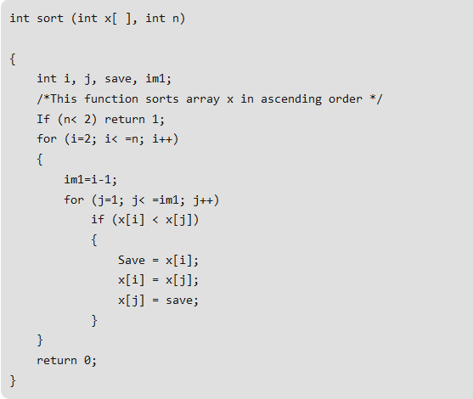
Example – List out the operators and operands and also calculate the values of software science measures.

Slide 38
operators | occurrences | operands | occurrences
int | 4 | sort | 1
() | 5 | x | 7
, | 4 | n | 3
[] | 7 | i | 8
if | 2 | j | 7
< | 2 | save | 3
; | 11 | im1 | 3
for | 2 | 2 | 2
= | 6 | 1 | 3
– | 1 | 0 | 1
<= | 2 | – | –
++ | 2 | – | –
return | 2 | – | –
{} | 3 | – | –
n1=14 | N1=53 | n2=10 | N2=38

Slide 39
Here N1=53 and N2=38.
The program length N=N1+N2=53+38=91
Vocabulary of the program n=n1+n2=14+10=24
Volume V= N * log₂N=91 x log₂ 24=417 bits.
The estimate program length N of the program
= 14 log₂14+10 log₂)10
= 14 * 3.81+10 * 3.32
= 53.34+33.2=86.45
Conceptually unique input and output parameters are represented by n2*.
n2*=3 {x: array holding the integer to be sorted. This is used as both input and output}
{N: the size of the array to be sorted}
The Potential Volume V*=5log₂5=11.6

Slide 40
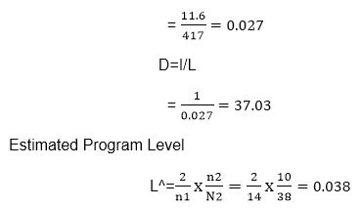
Since L=V*/V

Slide 41
Staffing Level Estimation
Once the effort required to complete a software project has been estimated, the staffing requirement for the project can be determined.
Putnam was the first to study the problem of determining a proper staffing pattern for software projects.
He extended the classical work of Norden who had earlier investigated the staffing pattern of general research and development (R&D) type of projects.
In order to appreciate the uniqueness of the staffing pattern that is desirable for software projects, we must first understand both Norden’s and Putnam’s results.

Slide 42

Norden’s Work
Norden concluded that the staffing pattern for any R&D project starting from a low level, increases until it reaches a peak value. It then starts to diminish.
This pattern can be approximated by the Rayleigh distribution curve.
Norden represented the Rayleigh curve by the following equation:
Where E is the effort required at time t. E is an indication of the number of developers (or the staffing level) at any particular time during the duration of the project.
K is the area under the curve, and
td is the time at which the curve attains its maximum value.

Slide 43
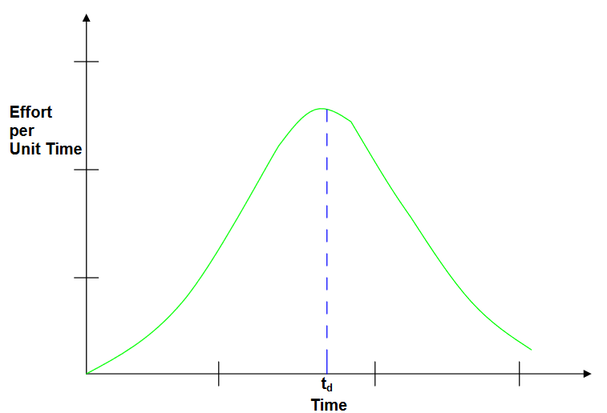

Slide 44

Putnam’s Work
Putnam found that the Rayleigh-Norden curve can be adapted to relate the number of delivered lines of code to the effort and the time required to develop the product.
By analyzing a large number of defense projects, Putnam derived the following expression:
Where K is the total effort expended (in PM) in the product development and L is the product size in KLOC.
td corresponds to the time of system and integration testing. Therefore, td can be approximately considered as the time required to develop the software.

Slide 45
C_{k} is the state of technology constant.
C_{k} = 2 for poor development environment
C_{k} = 8 for good software development environment
C_{k} = 11 for an excellent environment

