Slide 1
Activity Diagram

Slide 2
Flow Models
Every computer-based system is an
information transform ....
computer
based
system
input
output
Flow diagrams – Lots of these!
  Dataflow diagrams
  Activity diagrams

Slide 3
What Is an Activity Diagram?
An activity diagram in the use-case model can be used to capture the activities and actions performed in a use case.
It is essentially a flow chart, showing flow of control from one activity or action to another.
Flow of Events
This use case starts when the Registrar requests that the system close registration.
1. The system checks to see if registration is in progress. If it is, then a message is displayed to the Registrar and the use case terminates. The Close Registration processing cannot be performed if registration is in progress.
2. For each course offering, the system checks if a professor has signed up to teach the course offering and at least three students have registered. If so, the system commits the course offering for each schedule that contains it.
Activity 2
Activity 1
Activity 3
Notes:
The workflow of a use case describes that which needs to be done by the system to provide the value the served actor is looking for.
It consists of a sequence of activities and actions that together produce something for the actor.
The workflow often consists of a basic flow and one or several alternative flows.
The structure of the workflow can be described graphically with the help of an activity diagram.
The goal of this section is to introduce the students to the concept of an activity diagram. You are not expected to teach them everything about this diagram at this time.
Activity diagrams can also be used to model the workings of an operation, an object, business modeling, or anything that involves modeling the sequential steps in a computational process.
This course focuses on using activity diagrams to model the flow of events in a use case.

Slide 4
Example: Activity Diagram
Initial / Start
Decision
Select Course
Activity/Action
Concurrent Threads
[ delete course ]
Delete Course
[ add course ]
Synchronization
Bar (Fork)
Guard
Condition
Check
Check
Schedule
Pre-requisites
Synchronization
Bar (Join)
[ checks completed ]
[ checks failed ]
Assign to
Resolve
Transition
Course
Conflicts
Update
Merge
Schedule
Final / Termination
Notes:
An activity diagram may include the following elements:
Activity/Action represents the performance of a step within the workflow.
Transitions show the activity/action that follows.
Decisions evaluate conditions defined by guard conditions. These guard conditions determine which of the alternative transitions will be made and, thus, which activities are performed. You may also use the decision icon to show where the threads merge again. Decisions and guard conditions allow you to show alternative threads in the workflow of a use case.
Synchronization bars show parallel sub-flows. They allow you to show concurrent threads in the workflow of a use case.
Walk the students through the activity diagram and explain each component (decision, fork, join, and so on).

Slide 5
Activity Diagrams
Summary of Notation:
Action/Activity state – Action states cannot be decomposed, Activity states may be (UML 1.5 - as of UML 2.0 replaced with Activity frames)
Transition – control flow; a transition is triggered upon completion of some activity
Decision/Merge point – standard if-else style logic; also supports iteration. Guard conditions indicated in brackets in each transition.
Object node – may be (typically not) included to show where an object’s state may change.
Synchronization bar – supports fork/join semantics for concurrent processing
Swimlanes – partition by responsibility, not thread
label
Label
[state]

Slide 6
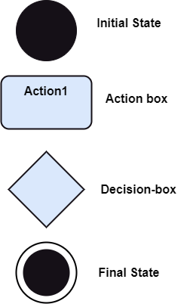

Slide 7
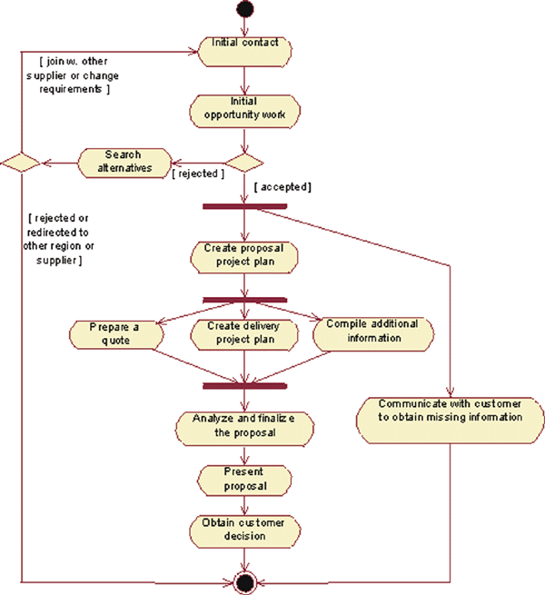
Activity Diagram
Action
A step in the flow of events
Figure from IBM
Decision
Flows split based on a guard
condition
Fork
Beginning of concurrent flows
Join
End of concurrent flow
Flow
Show the sequence of
activities
Notes:
Activities describe graphically the flow of events of a use case. The flow of events consists of a sequence of activities that together produce something of value for the actor. The flow of events consists of a basic flow and one or several alternative flows.
Actions: Represent the performance of an activity or step within the flow of events.
Flow/Edge: Show what activity state follows after another.
Decision/Merge Control which flow (of a set of alternative flows) follows once the activity has been completed, based on a guard condition. Decisions are used to show alternative threads in the flow of events of a use case.
Forks/Joins: Show the beginnings and ends of parallel subflows. Forks and joins are used to show concurrent threads in the flow of events of a use case.

Slide 8
What is an Activity (frame)?
A specification of behavior expressed as a flow of execution via sequencing of subordinate units.
  Subordinate units include nested activities and individual actions.
May have boolean constraints when activity is invoked/exited
There has been some confusion about “Action” vs. “Activity”
  UML 1.5 used both terms
  Now, an Activity is a “task” that a collection of “actions” realize
    It is structure - a collection of actions
Activity 2
<<Precondition>>
Activity 4
Boolean constraint
<<Postcondition>>
Activity 5
Boolean constraint
Notes:
An activity is notated as an activity diagram. An activity definition is shown as a large rounded border containing a graph of node symbols and flow arrows representing the decomposition of the activity into its constituents. Activity preconditions and postconditions use the note notation with the keywords <<Precondition>> and <<Postcondition>> respectively.
An action is a primitive activity which is the smallest computation that can be expressed. An action is an activity that does something to the state of the system or extracts information from it. An action is drawn as a rectangle with rounded corners. Action preconditions and postconditions use the note notation with the keywords <<localPrecondition>> and <<localPostcondition>> respectively.
If a high-level activity is viewed as a tree of nested activities, the leaves of the tree are actions.
Actions include arithmetic and string functions, manipulations of objects and their values, communications among objects, and similar things.
Kinds of actions include:
Accept call
Accept event
Apply function
Broadcast event
Call
Create
Destroy
Raise exception
Read
Reply
Return
Send
Time
Write

Slide 9
Mapping Who does What to Whom
Examples so far show us what actions happen
  But “WHO” does each action and “WHEN”?
Swimlanes
  Partition activities according to who does them
  Who can be actors, system components, whatever
  When is indicated top-to-bottom (like a sequence diagram) or left-to-right
To Whom?
  Activity diagrams can show relationships to objects that are affected by actions

Slide 10

Example by Bau Yoon Teck

Slide 11
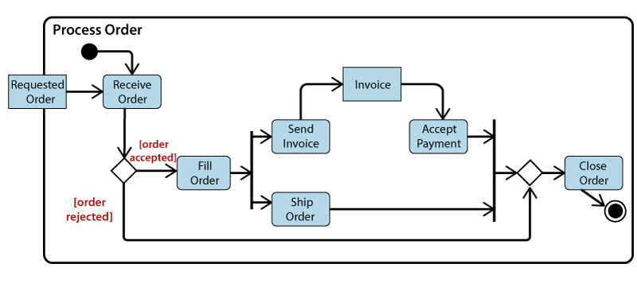

Slide 12
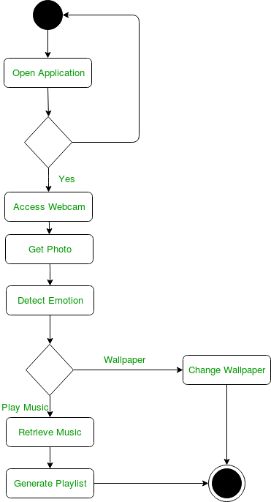

Slide 13
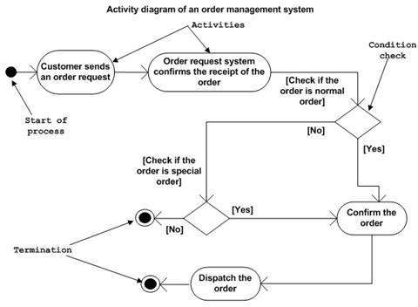

Slide 14
How do you derive Swimlanes?
Swimlanes add an analysis step
  You are assigning a responsibility to an actor
  Note we did not say to an object - to an actor
How to do?
  Technique: Return to the UC main scenario
    Outline format the steps based on who does them
PA selects “Check Out”
System renders summary
PA enters credit card
PA selects “Submit”
System asks 3rd party verify
3rd party verifies
System confirms for PA
PA selects “Check Out”
  System renders summary
PA enters credit card
PA selects “Submit”
  System asks 3rd party verify
    3rd party verifies
  System confirms for PA

Slide 15
What Role do Objects Play?
We think of UML as OO, but rarely do we see an Object on an Activity diagram
  Activity diagrams are for flow modeling
  Object behaviors are typically modeled using an UML Statechart
But yes objects can be shown:
  Do if it is important to show critical object state changes or dataflow in the activity diagram context!

Slide 16
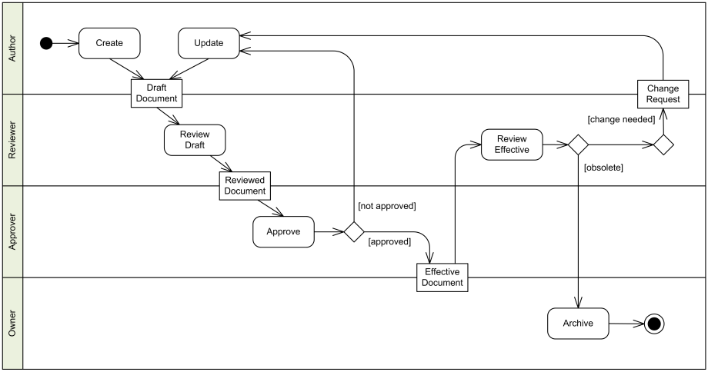
Example: Activity Diagram w/ Objects
Objects! (should really use [] for state)
Example from http://www.uml-diagrams.org/activity-diagrams-examples.html

Slide 17
Activity Diagram Summary
Pros:
  Map use case scenarios directly on to actions
  Most intuitive for most procedural programmers
  Includes constructs concurrency and task assignment
  Includes constructs for top down decomposition (activity frames)
Cons:
  Some confusion of the relationship between activity diagrams and statecharts
  Some changes in terminology from 1.5 to 2.0
  Relatively poor tool support
Recommendation: Useful early in analysis, after use cases but before interaction diagrams

