Slide 1


MIT School of Computing
SUMMER INTERNSHIP - 2025
Third Year Engineering
Summer Internship 2025 Student Name: Keya Chaudhary
Enrollment Number: ADT23SOCB0517
Internship Type: Project-Based Learning
Company Name: Google AIML Virtual Internship
Mentor Name: Prof. Anuja Jadhav
Department of Computer Science & Engineering/ IT

Slide 2
MIT School of Computing
SUMMER INTERNSHIP - 2025
Introduction
Internship Overview
The Google AI-ML Virtual Internship is a transformative educational initiative designed to bridge the critical gap between theoretical academic knowledge and practical industry application in Artificial Intelligence and Machine Learning.
Focused on practical projects in computer vision using deep learning.
Hands-on exposure to image classification, object detection, and integrated AI systems.
Builds industry-ready skills for automation, accessibility, and smart environments.

Slide 3
MIT School of Computing
SUMMER INTERNSHIP - 2025
Introduction
Project Themes
Image Classification – identifying the category of an image (e.g., recyclable vs non-recyclable).
Object Detection – detecting and labeling multiple objects within an image in real time.
Smart Desk – combining both techniques to recognize and locate items on a desk, aimed at enhancing accessibility and productivity.
These projects demonstrate how AI can understand and interpret visual data, offering practical solutions for real-world problems in areas like automation, accessibility, and smart environments.

Slide 4
MIT School of Computing
SUMMER INTERNSHIP - 2025
Introduction
Real-World Relevance
Automation – enabling machines to process visual information automatically.
Accessibility – supporting visually impaired users with AI-driven assistance.
Smart Environments – organizing and monitoring physical spaces intelligently.
A step toward practical AI systems that bridge human needs and intelligent technology.
This project suite from the Google AI-ML Virtual Internship focuses on developing intelligent visual systems using deep learning techniques.

Slide 5

MIT School of Computing SUMMER INTERNSHIP - 2025
Proposed Statement
There is a need for an intelligent system that can automatically classify and detect objects in images, as manual methods are time-consuming and error-prone. Such a system would improve real-time object localization and assist users, including the visually impaired, in dynamic environments like workspaces.

Slide 6
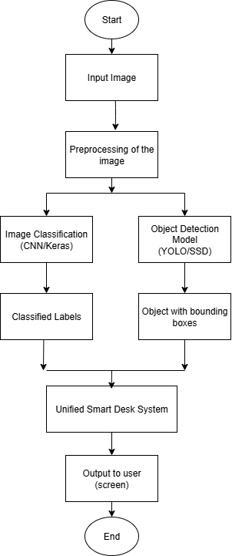
MIT School of Computing
SUMMER INTERNSHIP - 2025
Proposed Solution
Input – Capture image/video from camera.
Preprocessing – Resize and normalize image for model input.
Parallel Models –
Image Classification (CNN) → Identifies object category.
Object Detection (YOLO/SSD) → Detects multiple objects with bounding boxes.
Integration Layer (Smart Desk) – Combines classification + detection results.
Output – Provides real-time feedback via visual annotations or audio prompts.

Slide 7
MIT School of Computing
SUMMER INTERNSHIP - 2025
Key Features of the Internship
Foundational Learning: An introduction to fundamental AI/ML concepts, algorithms, and setting up the TensorFlow development environment.
Computer Vision Specialization: Focused learning on image processing, building Convolutional Neural Networks (CNNs), and implementing object detection.
Deep Learning Exploration : Building deep neural networks, working with Convolutional Neural Networks (CNNs) for NLP tasks, and mastering model evaluation and hyperparameter tuning.
Advanced Project Implementation: Developing custom models using tools like TensorFlow, utilizing the Vision API, and focusing on model optimization and deployment strategies.
Continuous Mentorship and Collaboration: Regular guidance from industry experts and collaborative projects to foster teamwork and communication skills.

Slide 8
MIT School of Computing
SUMMER INTERNSHIP - 2025
Technology Stack
Frontend
React.js
Streamlit
Programming Languages:
Python
JavaScript
HTML/CSS
AI/ML Frameworks & Libraries:
TensorFlow (v2+)
TensorFlow.js
OpenCV
NumPy
Pre-trained Models:
COCO-SSD
Custom CNN model (recycle_classifier.h5)
Development Tools & Platforms:
Google Developers Pathways
GitHub

Slide 9
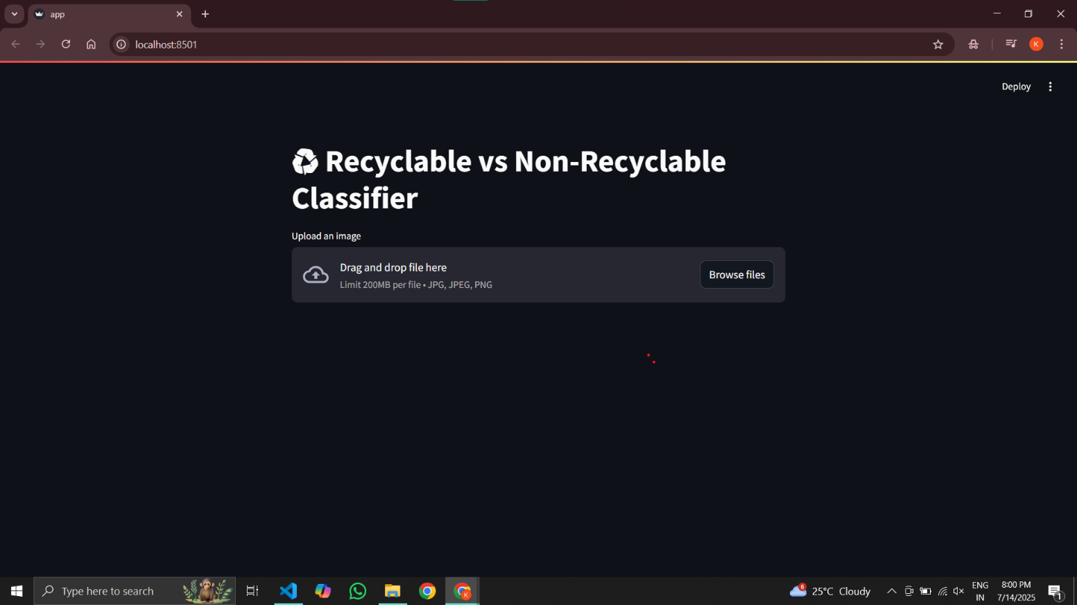
MIT School of Computing
SUMMER INTERNSHIP - 2025
Screenshots of Project
Recyclable VS Non-Recycleable
This project is a custom image classifier that detects whether an item belongs to the recyclable or non-recyclable category. Built using Python and TensorFlow, it promotes eco-friendly practices by assisting in waste categorization.

Slide 10
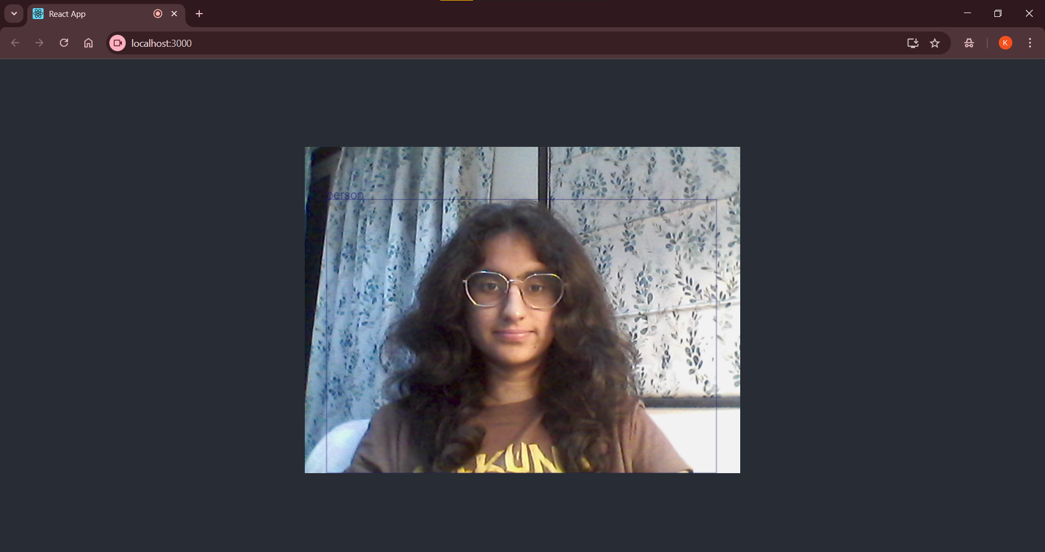
MIT School of Computing
SUMMER INTERNSHIP - 2025
Screenshots of Project
Object Detection
A real-time web application that uses TensorFlow.js and React.js to detect multiple objects in webcam feed or static images using the COCO-SSD pre-trained model. Fully runs in the browser with no backend.

Slide 11
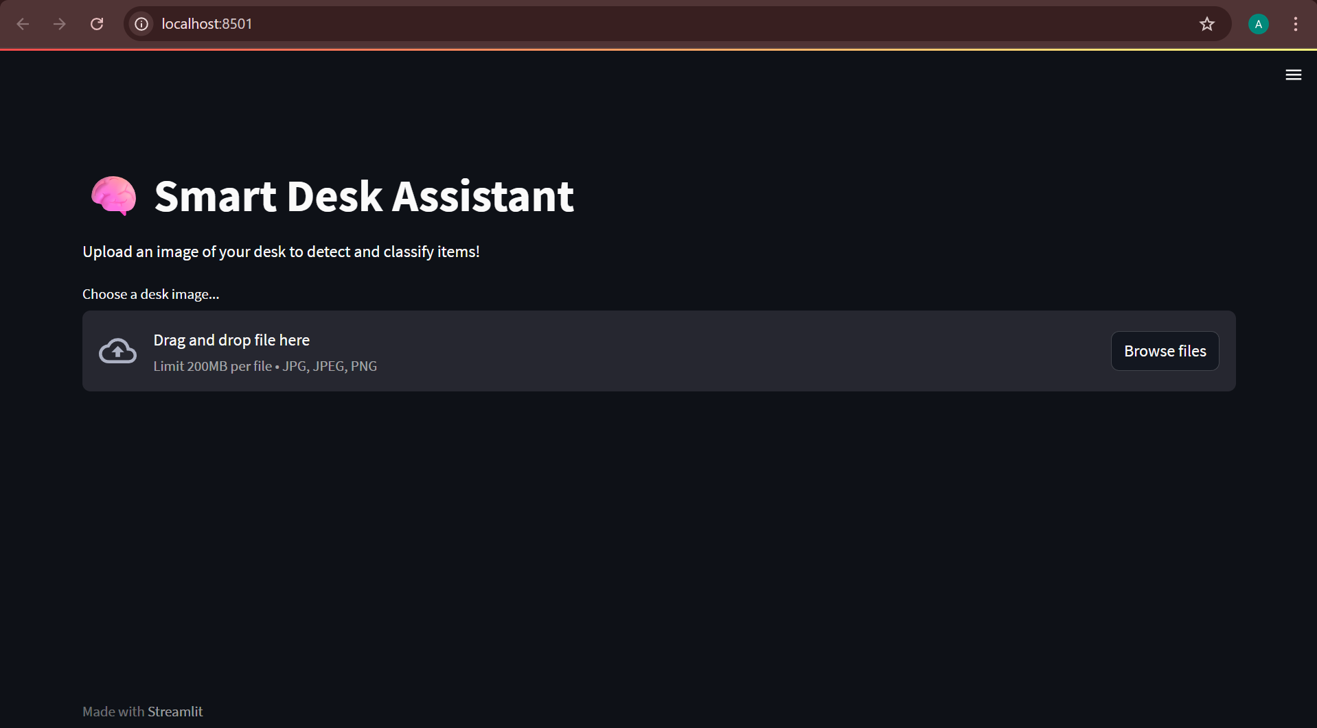
MIT School of Computing
SUMMER INTERNSHIP - 2025
Screenshots of Project
Final Project- Smart Desk
This all-in-one Smart Desk Classifier project was developed during the Google AI-ML Virtual Internship
. It combines:
Object Detection: Identifying desk items in real time
Image Classification: Determining recyclability of uploaded images

Slide 12
MIT School of Computing
SUMMER INTERNSHIP - 2025
Future Scope
Creating AI Solutions for Accessibility and Inclusive Technology Challenge
Implementing Explainable AI for Better Model Interpretability Challenge
Addressing Bias and Fairness in Machine Learning Systems Challenge

Slide 13
MIT School of Computing
SUMMER INTERNSHIP - 2025
Conclusion
The Google AI-ML Virtual Internship was a comprehensive learning journey that effectively bridged the gap between theoretical knowledge and practical application in the field of artificial intelligence. Through invaluable mentorship and exposure, we benefited from the guidance of experienced industry professionals while working with cutting-edge tools in an immersive, real-world development environment. The program facilitated end-to-end skill development, enhancing understanding of the complete machine learning workflow, including data preprocessing, exploratory analysis, model training, deployment, and monitoring. Moreover, the virtual format fostered critical professional skills such as self-directed learning, digital collaboration, and analytical thinking, all of which are essential for thriving in today’s dynamic and distributed work environments.

