Slide 1
Data Completion and Interpolation
CS:536 Final Project
Keya Desai (kd706)
Prakruti Joshi (phj15)

Slide 2
About Data
Adult dataset or the Census Income data
Extracted from the 1994 Census database and aims to predict whether income of a person exceeds $50K year based on information of age, gender, education, race, work class, and demographics.
The data has approximately 48K such instances with 14 attributes - 6 continuous and 8 categorical.

Slide 3
Data Pre-Processing and Analysis
Normalizing numerical data
One-hot encoding for categorical data
Generating missing data
Reducing features - class distribution
Correlation Analysis

Slide 4
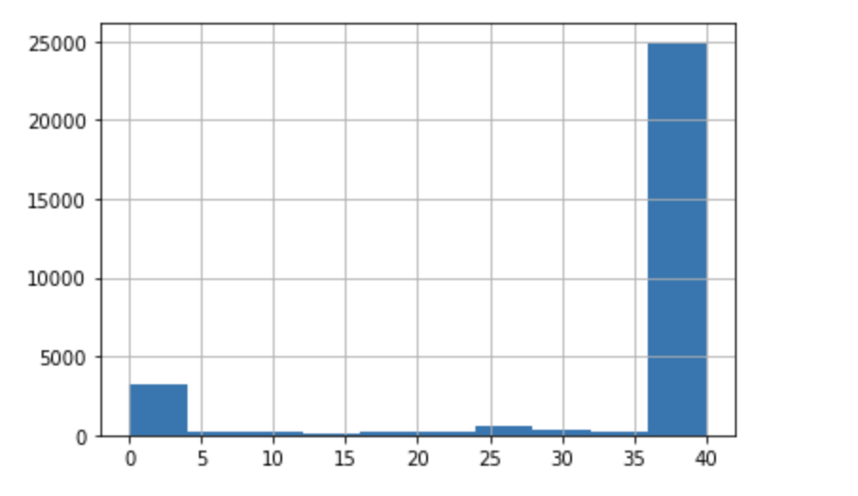
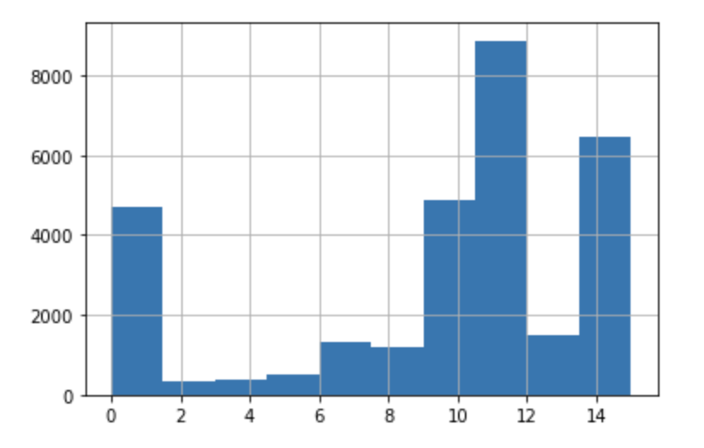
Class Distribution
Class Distribution of Native Country
Class Distribution of Education

Slide 5
Anova f - statistic
Numerical/Categorical | Income | gender | race | occupation | nativeCountry
age | 836.88 | 143.63 | 6.52 | 61.39 | 4.98
fnlwgt | 0.709 | 12.40 | 82.92 | 5.13 | 15.10
educationNum | 943.23 | 2.21 | 32.49 | 317.64 | 23.11
capitalGain | 946.88 | 56.67 | 4.47 | 29.86 | 0.71
capitalLoss | 463.92 | 50.74 | 4.33 | 15.08 | 1.35
hoursperWeek | 478.63 | 646.23 | 9.67 | 67.93 | 1.71
income | - | 862.18 | 36.38 | 207.09 | 5.97
gender | 862.19 | - | 82.27 | 242.82 | 2.83

Slide 6
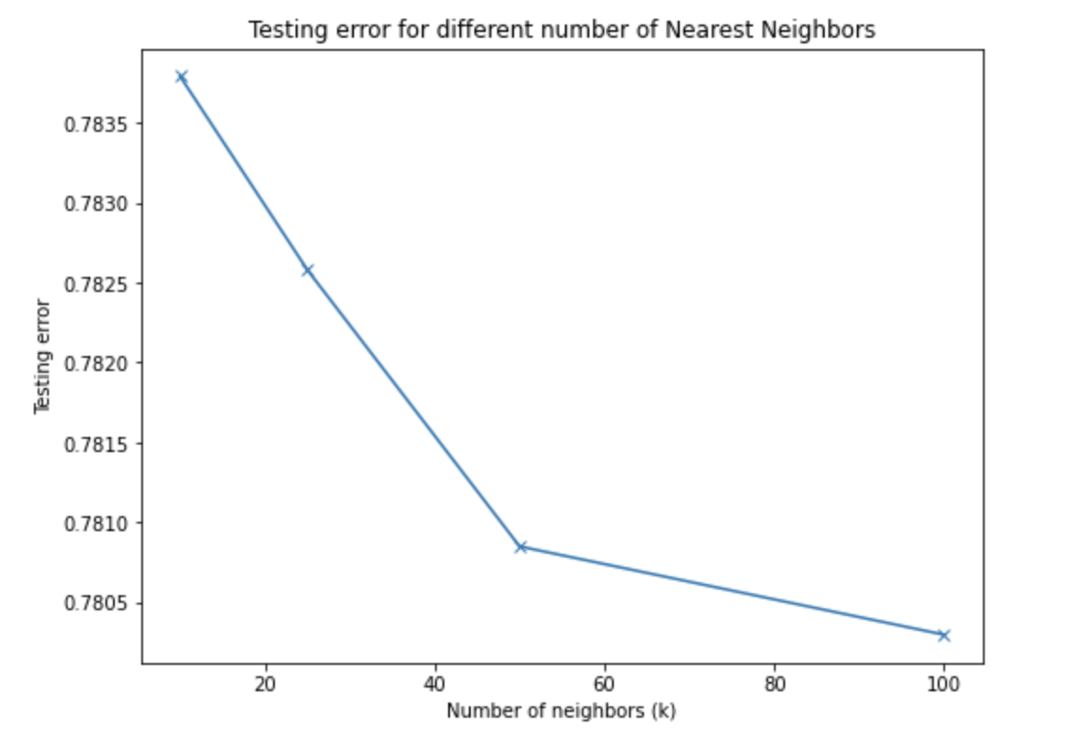
Models
Baseline Model
Mean/Mode Imputation
K - Nearest Neighbors
Sequential Prediction
Linear Regression
Softmax Regression
Linear Regression
Neural Networks

Slide 7
Sequential Prediction
Start with filling values of feature with least % of missing data - X1.
Remove rows with missing X1 and use if for testing.
Use X1 to predict X3 by -
Linear Regression if X3 is continuous
Softmax Regression if X3 is categorical.
Similarly, use X1 and X3 to predict X2.
Feature | % missing data
X1 | 1%
X2 | 10%
X3 | 5%

Slide 8
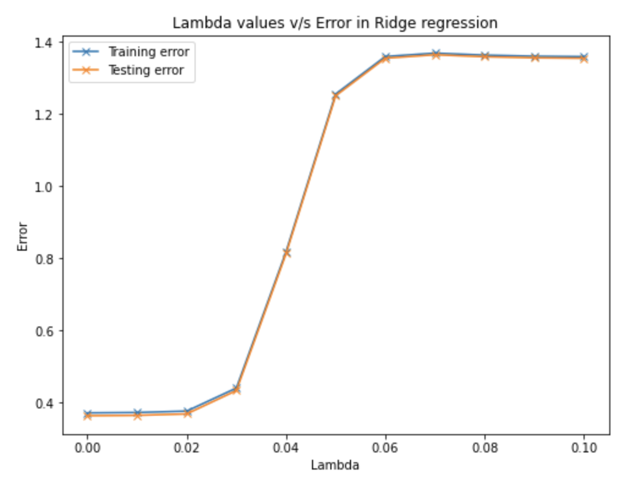


Linear Regression

Slide 9
Neural Network
Input space: X with missing values as zero and other values
Output Space: Original X vector
Training Algorithm: Stochastic Gradient Descent
Loss function : Mean Square Error
Convergence criteria: Max number of epochs is reached or validation loss does not decrease after 5 epochs.

Slide 10
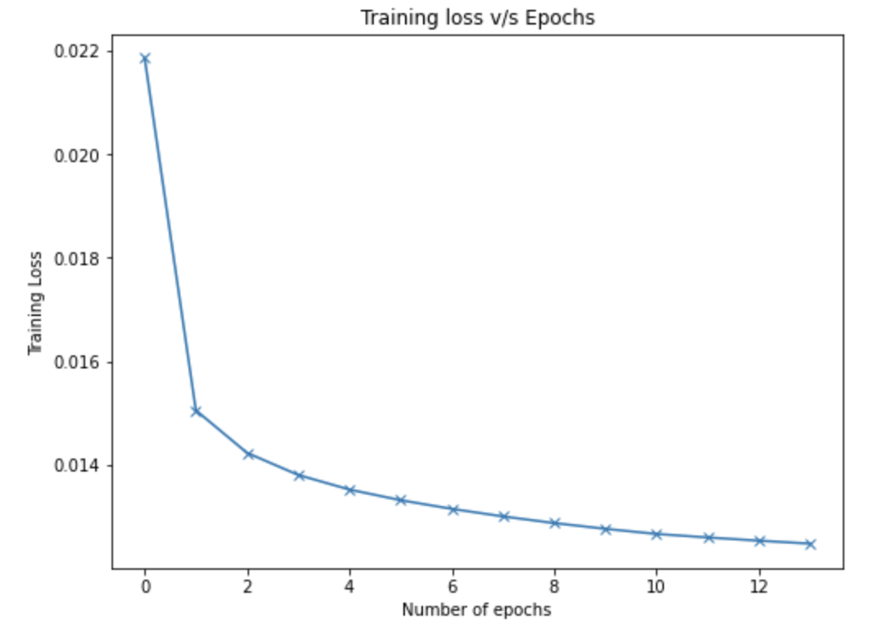
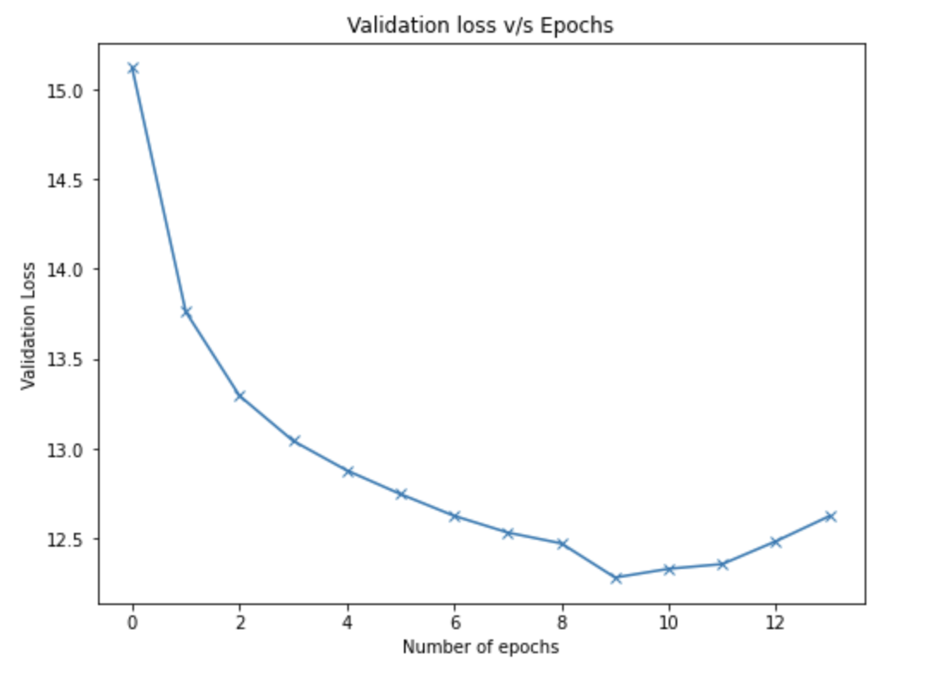
Training and Validation Loss

Slide 11
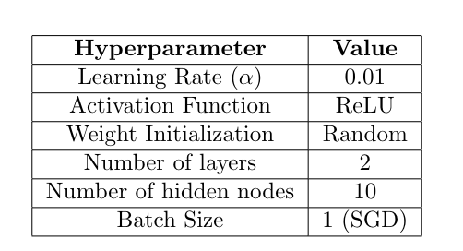
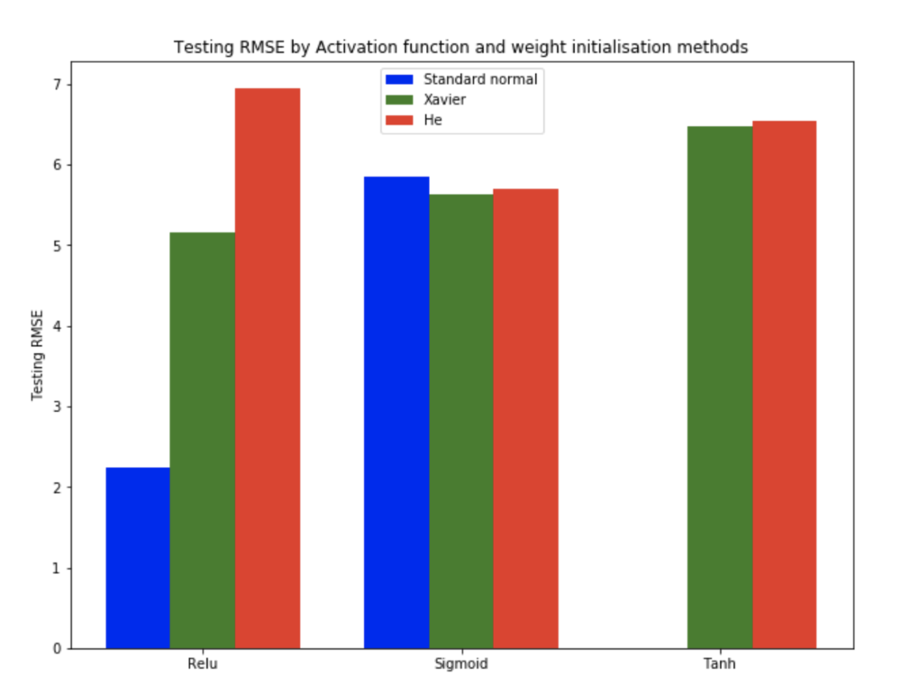
Neural Network

Slide 12
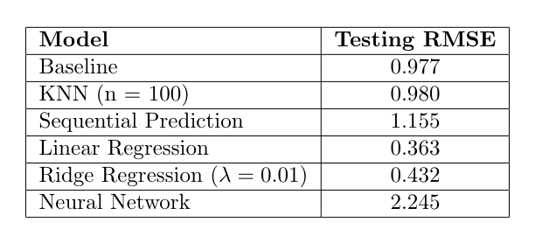
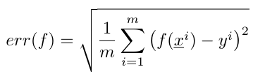
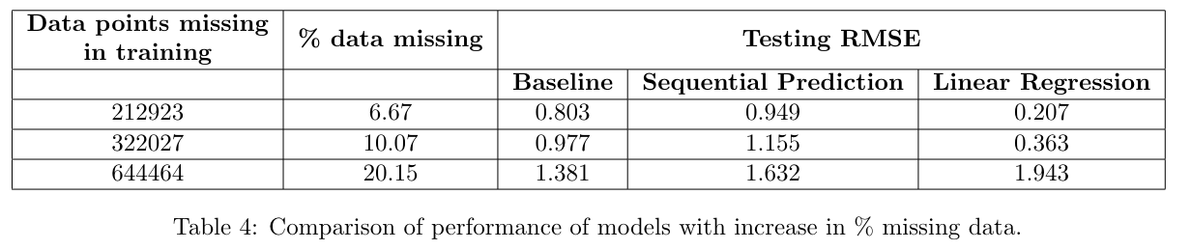
Model Evaluation

Slide 13
Generating Data
Using feature sample parameters
distribution based on mean, variance and class probabilities of features
Using linear combination of features
weights derived from linear regression are used to form linear combination of features
K-means clustering
Use similarity between features to form clusters from data
Use cluster parameters / centroid to simulate similar data

Slide 14
Code Repository: https://github.com/keya-desai/Machine-Learning-Data-Completition-and-Interpolation
Thank you!!

