Slide 1
Recommendation System for Movies
CS550 - Massive Data Mining and Learning
Group #6
Rushabh Bid (rhb86)
Fathima AlSaadeh (fya7)
Keya Desai (kd706)
Naveen Narayanan M (nm941)

Slide 2
Contents
Objectives
Dataset Description
System flowchart
Recommendation Algorithms
Results and Analysis
Conclusion and Future Work

Slide 3
Objectives/Aim
Experimenting various famous recommendation system models (e.g., KNN and SVD )
Focusing on the importance of the hybrid models.
Implementing a novel Interest Sequence-Based CF model.
Evaluating the performance of the models
Conclude the findings

Slide 4
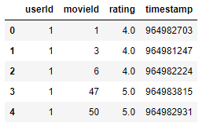
Data set description
Data Source: Movie lens Data set
4 csv files: ratings.csv, movies.csv, tags.csv and links.csv
Data taken from https://grouplens.org/datasets/movielens/latest/
Number of Ratings | 102245
Number of Movies | 9742
Number of Users | 610
Number of Genres | 20

Slide 5
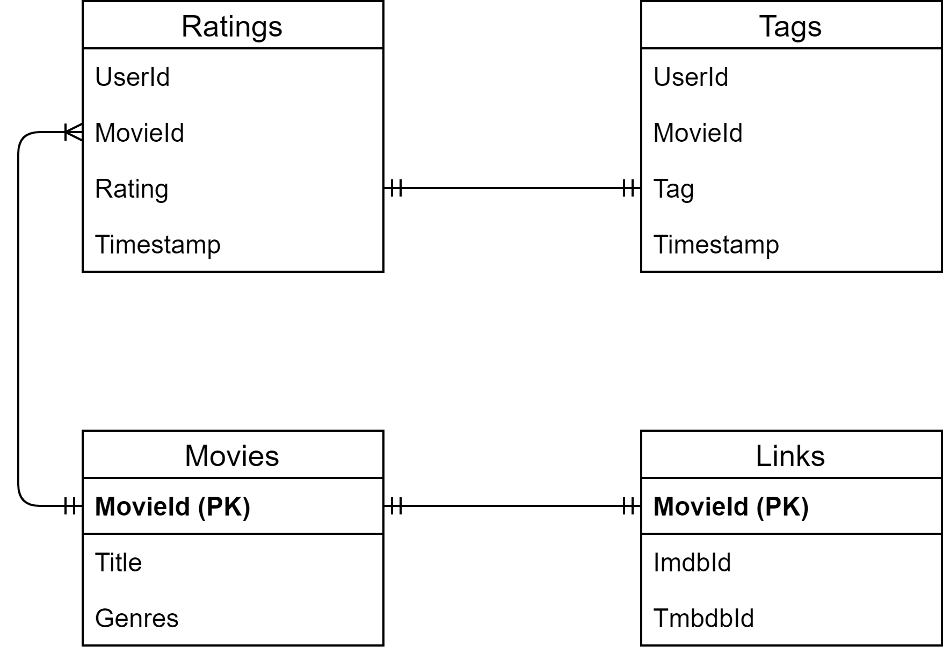
Data Model

Slide 6
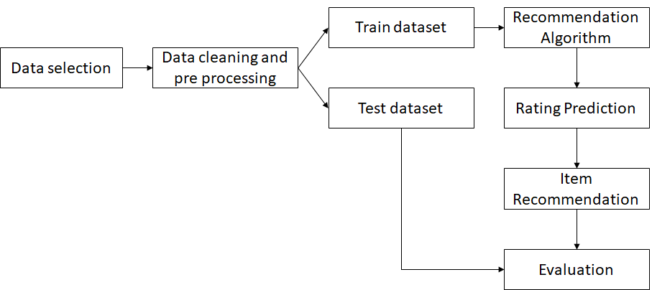
Flow chart

Slide 7
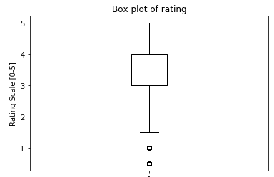
Data analysis
Statistics | Rating
Range | 0-5
Minimum | 0.5
Maximum | 5.0
Mean | 3.501
Median | 3.5
Variance | 1.08
Standard Deviation | 1.042

Slide 8
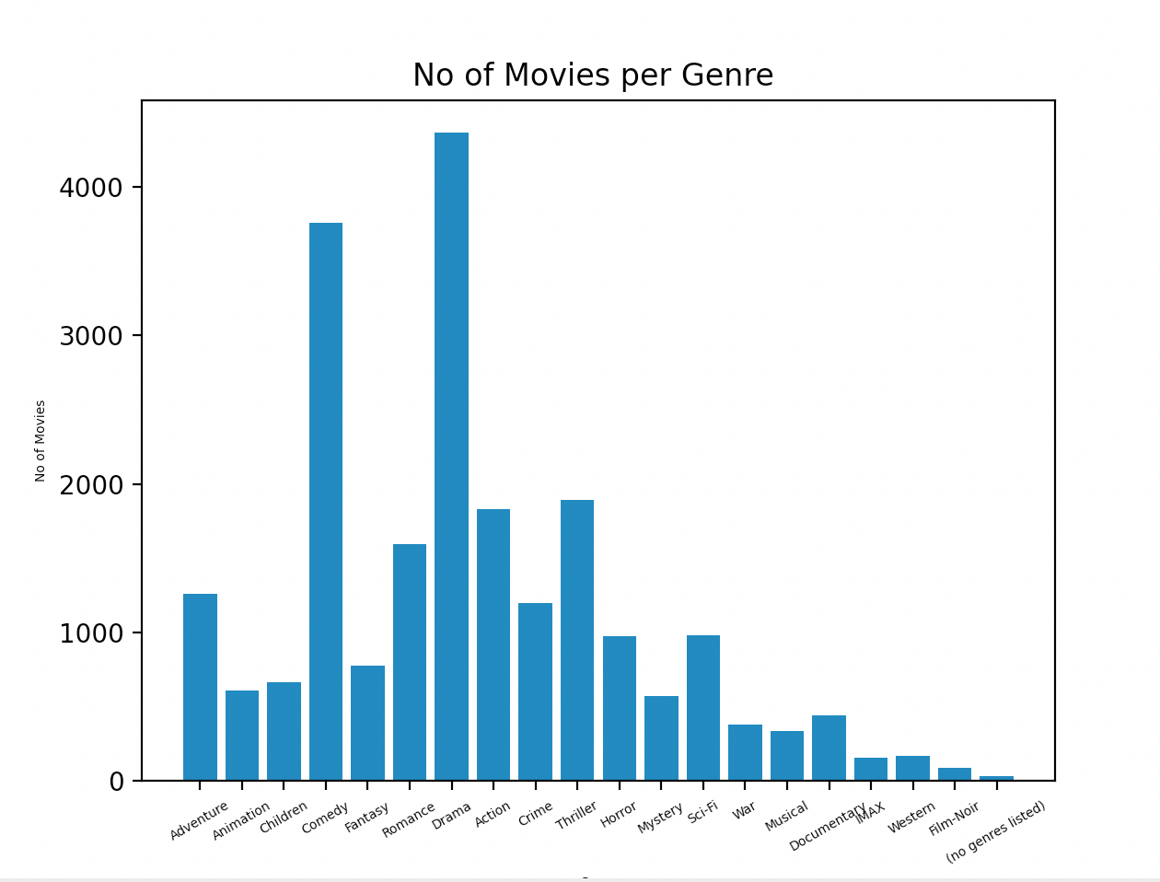
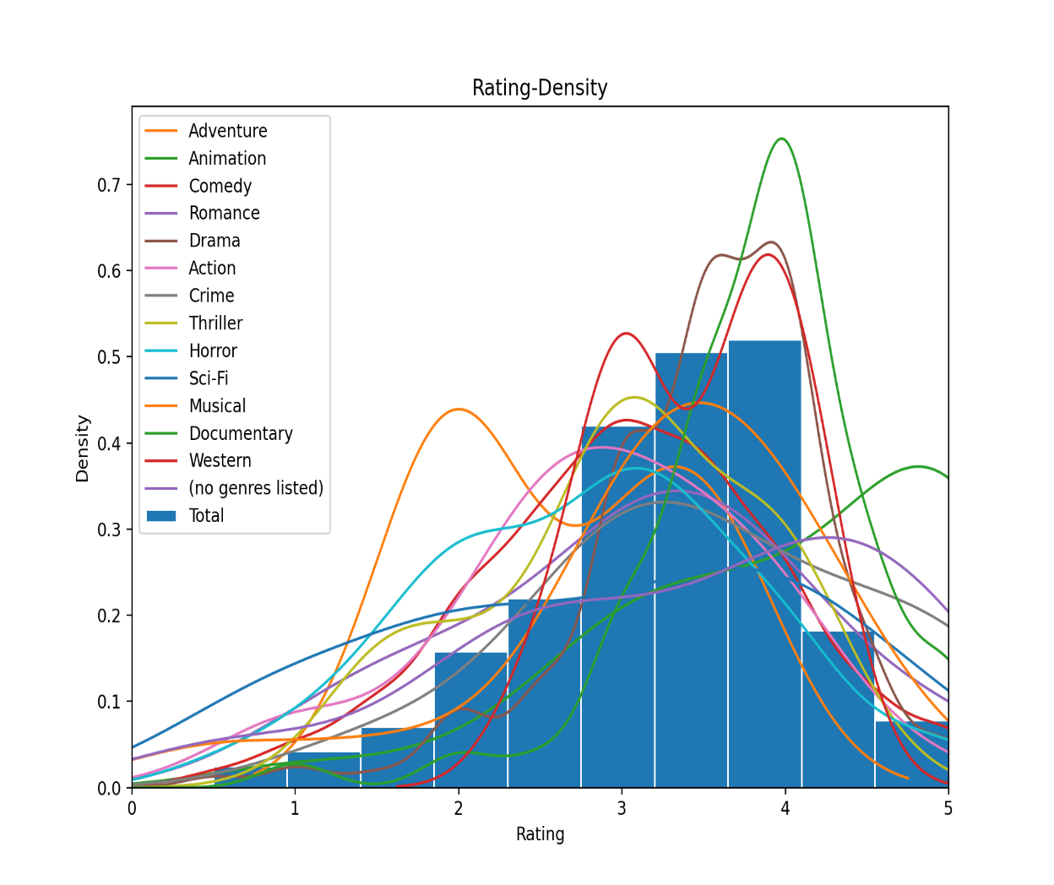
Findings

Slide 9
Recommendation Algorithms
Baseline
Singular Value Decomposition
k Nearest Neighbors
Slope One
Co Clustering
Matrix Factorization - SVD ++
Hybrid models
Interest Sequence based CF

Slide 10
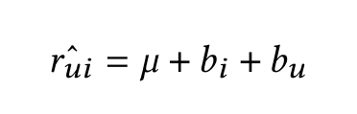
Recommendation Algorithms
Baseline
Singular Value Decomposition
k Nearest Neighbors
Slope One
Co Clustering
Matrix Factorization - SVD ++
Hybrid models
Interest Sequence based CF
r_{u}^_{i} : predicted rating
μ : average rating of user u
b_{i} : bias in rating of item i
b_{u} : bias in rating of user u

Slide 11


Recommendation Algorithms
Baseline
Singular Value Decomposition
k Nearest Neighbors
Slope One
Co Clustering
Matrix Factorization - SVD ++
Hybrid models
Interest Sequence based CF
r_{u}^_{i} : predicted rating
μ : average rating of user u
b_{i} : bias in rating of item i
b_{u} : bias in rating of user u
p_{u} : user factors
q_{i} : item factors
A : rating matrix

Slide 12
Recommendation Algorithms
Baseline
Singular Value Decomposition
k Nearest Neighbors
Slope One
Co Clustering
Matrix Factorization - SVD ++
Hybrid models
Interest Sequence based CF

Slide 13

Recommendation Algorithms
Baseline
Singular Value Decomposition
k Nearest Neighbors
Slope One
Co Clustering
Matrix Factorization - SVD ++
Hybrid models
Interest Sequence based CF
r_{vj} : rating of item j by user v
r_{ui} : rating of item i by user u
d_{ij} : average difference between ratings of i and j

Slide 14
Recommendation Algorithms
Baseline
Singular Value Decomposition
k Nearest Neighbors
Slope One
Co Clustering
Matrix Factorization - SVD ++
Hybrid models
Interest Sequence based CF

Slide 15


Recommendation Algorithms
Baseline
Singular Value Decomposition
k Nearest Neighbors
Slope One
Co Clustering
Matrix Factorization - SVD ++
Hybrid models
Interest Sequence based CF
Ř : R^{users x movies}
H : R^{users x latent factors}
W : R^{latent factors x movies}
r_{ui} : predicted rating
μ : average rating of user u
b_{i} : bias in rating of item i
b_{u} : bias in rating of user u

Slide 16


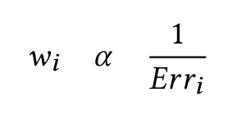
Recommendation Algorithms
Baseline
Singular Value Decomposition
k Nearest Neighbors
Slope One
Co Clustering
Matrix Factorization - SVD ++
Hybrid models
Interest Sequence based CF
where,

Slide 17
Recommendation Algorithms
Baseline
Singular Value Decomposition
k Nearest Neighbors
Slope One
Co Clustering
Matrix Factorization - SVD ++
Hybrid models
Interest Sequence based CF

Slide 18
Interest Sequence Based CF
 | HP 1 | HP 2 | HP 3 | Shrek | Twilight | LOTR | The Hobbit
User 1 | 2 (4.5) | 3 (4.4) | - | 1 (4) | - | 4 (4) | -
User 2 | - | 2 (4) | - | - | 1 (4) | - | 3 (3.7)
User 3 | 1 (4) | 2 (4.1) | 3 (3.9) | - | 5 (3.7) | 4 (4.5) | 6 (3.8)
User 4 | - | - | - | 1 | 2 | - | -
Shrek
HP 1
HP 2
LOTR
4.0
4.5
4.4
4.0

Slide 19
Recommendation Algorithms
Baseline
Singular Value Decomposition
k Nearest Neighbors
Slope One
Co Clustering
Matrix Factorization - SVD ++
Hybrid models
Interest Sequence based CF
A
B
C
D
4.0
3.8
2.9
4.0
A
F
B
D
4.0
4.3
3.6
3.0
|LCSIS|
|ACSIS|

Slide 20
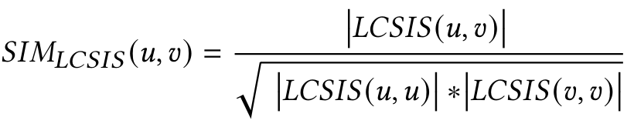
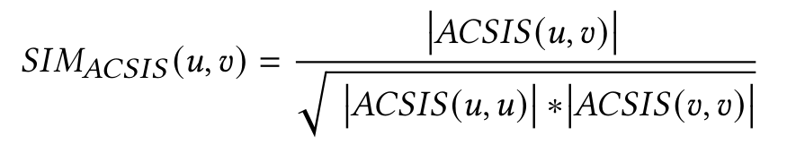
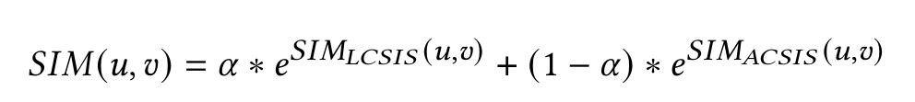
Interest Sequence Based CF

Slide 21
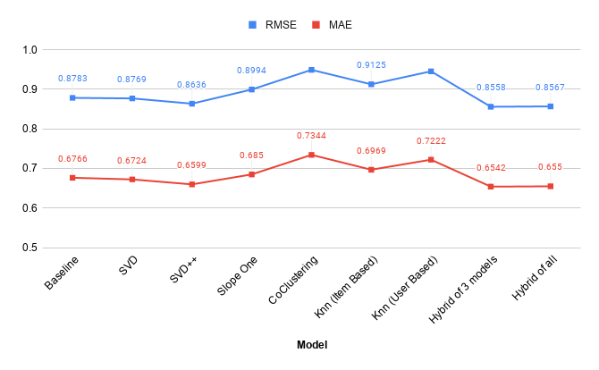
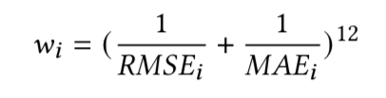
Results and Analysis
RMSE, MAE
Hybrid of SVD, SVD++ and Slope one achieves the lease RMSE of 0.8558.
Weights are set inversely proportional to RMSE and MAE.
Least error is achieved setting weights according to:

Slide 22
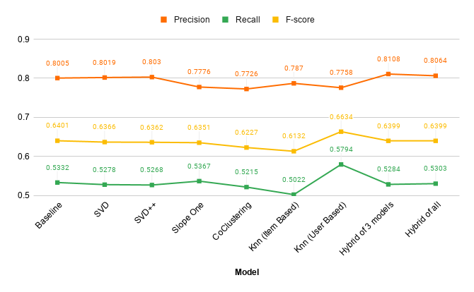
Results and Analysis
Precision, Recall, F-score
Precision, Recall and F-score are used to evaluate item recommendation.
Recall is maximum for kNN (Item-based) at 0.5794

Slide 23
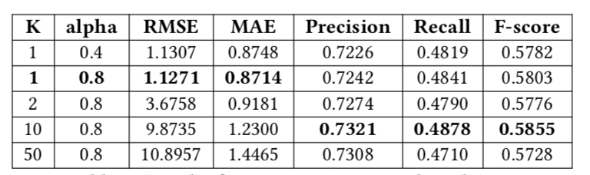
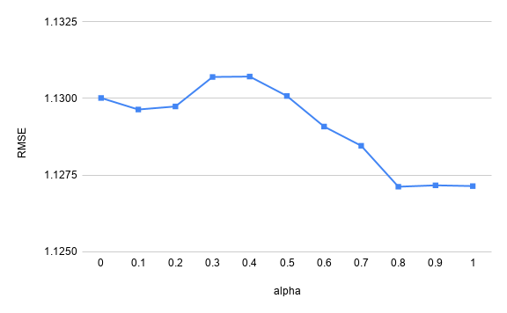
Results and Analysis
Interest Based Sequence CF
Higher values of 𝛂 and lower values of K gives better results.
Similar values of precision, recall and F-score observed.

Slide 24
Conclusion and Future work
We experimented with movielens 100K data to generate movie recommendations for users
Models: Baseline, SVD, SVD++, Slope One, Co Clustering, kNN and novel Interest Sequence Based CF
Evaluation Metrics: RMSE, MAE, Precision, Recall and F-score
Hybrid models generate the best recommendations
Interest Sequence Based CF shows promising results
Further work is required in Interest Sequence Based CF
Train the entire dataset
Integrate it in hybrid model to achieve better results

Slide 25
References
Dong Y Dong H Zhang W Cheng W, Yin G. 2016. Collaborative Filtering Recommendation on Users’ Interest Sequences.PLoS ONE 11(5): e0155739.(2016).
Simon Funk. 2006. Matrix Factorization. (2006). https://sifter.org/∼simon/journal/20061211.html
GroupLens. 2020. MovieLens Latest Datasets. (2020). https://grouplens.org/datasets/movielens/latest/
Nicolas Hug. 2016. Surprise. (2016). https://surprise.readthedocs.io/en/stable/
Jim Lambers. 2010. The SVD Algorithm. (2010).https://web.stanford.edu/class/cme335/lecture6.pdf

Slide 26
References
Maclachlan A. Lemire, D. 2009. Slope One Predictors for Online Rating-Based Collaborative Filtering. SDM 8 (2009), 1–5.
Python. 2009. Pandas. (2009). https://pypi.org/project/pandas/
scikit-learn developers. 2007. Scikit-Learn. (2007). https://scikit-learn.org/stable/modules/generated/sklearn.modelselection.traintestsplit.html
Richa Sharma and Rahul Singh. 2016. Evolution of Recommender Systems from Ancient Times to Modern Era.Indian Journal of Science and Technology (2016).

Slide 27
Thank You
Any Questions?

Slide 28
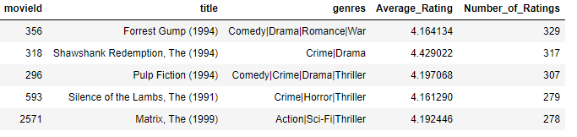
Top 5 movies with most number of ratings

