Slide 1
Network Layer
George Tsirakakis

Slide 2
Address Aggregation
One of the problems in route finding is the scale of the address space (millions of addresses)
  Memory Limitation = How to store all
  Speed limitation = How to find the exit towards one of them in the time scale of a packet interarrival
Solution : forwarding based on group of addresses (network address) or group of networks.
  (Going to Heraklion from NY we are not interested in local streets)
=> IP address hierarchy using subnet mask (like a wildcard)

Slide 3
First : Routing table (Routing Information Base) has ALL topology (routes)
Routing table created using OSPF , RIP etc which collect/distribute topology info.
Then: Forwarding table has best routes e.g. using Dijkstra (Has next hop to destination)
Forwarding: the process of moving packets from input to output based on the forwarding table.

Slide 4
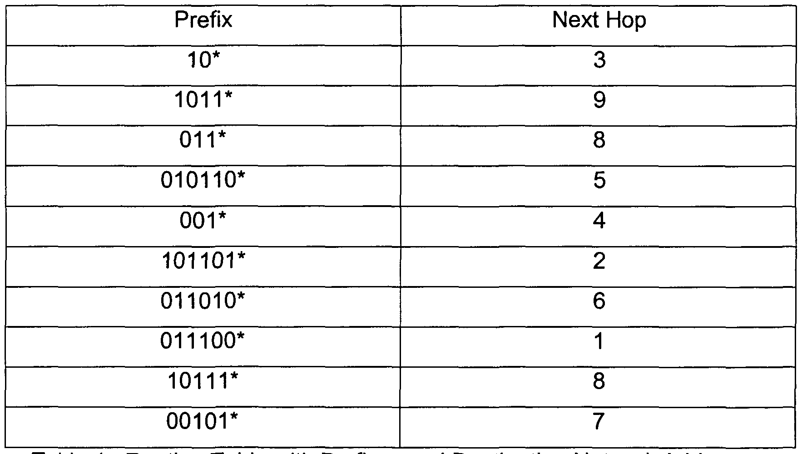
P4
Forwarding Table
Out Interface

Slide 5
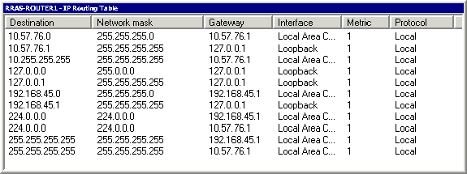
Forwarding Table
255.255.255.0 = 11111111.11111111.11111111.00000000
netmask
10.57.76.0 AND 255.255.255.0 = 10.57.76.*

Slide 6
netmask
the netmask (eg /24) is not part of the ip header, and is not transmitted on the wire. no-one knows the netmask of a device on the network, except the device itself.
11010110.01100001.11111111.00000011 / 25
Ποιές διευθύνσεις αντιπροσωπεύει :
11010110.01100001.11111111.00000011
11010110.01100001.11111111.0*
(Αρχίζουμε απο την δοθείσα διεύθυνση (32 bit) και πάνω χωρίς να πειράζουμε τα bit που είναι στο netmask)

Slide 7
P15
In Problem P10 you are asked to provide a forwarding table (using longest prefix matching). Rewrite this forwarding table using the a.b.c.d/x notation instead of the binary string notation.
11100000 00*
11100000 01000000*
Μετατρέπουμε δυαδικούς σε δεκαδικούς και μετρούμε πόσα ψηφία πριν το αστεράκι
11100000 *
11100001 0*

Slide 8
P15
In Problem P10 you are asked to provide a forwarding table (using longest prefix matching). Rewrite this forwarding table using the a.b.c.d/x notation instead of the binary string notation.
Destination Address
11100000 00 = (224.0.0.0/10)
11100000 01000000 = (224.64.0.0/16)
11100000 = (224.0.0.0/8)
11100001 0 = (225.0.0.0/9)

Slide 9
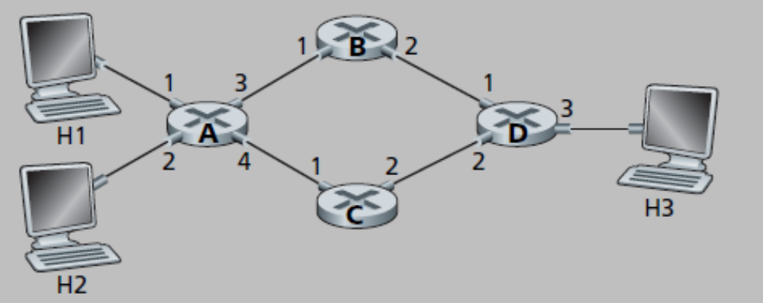
P4
Suppose that this network is a datagram network. Show the forwarding table in router A, such that all traffic destined to host H3 is forwarded through interface 3

Slide 10
P4 a. : Forwarding Table
forwarding table in router A
Prefix mask out
IP address of H3 - Subnet Mask – Out interface

Slide 11
P4 b.
Suppose that this network is a datagram network. Can you write down a forwarding table in router A, such that all traffic from H1 destined to host H3 is forwarded through interface 3, while all traffic from H2 destined to host H3 is forwarded through interface 4? (Hint: this is a trick question.)

Slide 12
P4 b.
No, because forwarding rule is only based on destination address.

Slide 13
P4 c.
Now suppose that this network is a virtual circuit network and that there is one ongoing call between H1 and H3, and another ongoing call between H2 and H3. Write down a forwarding table in router A, such that all traffic from H1 destined to host H3 is forwarded through interface 3, while all traffic from H2 destined to host H3 is forwarded through interface 4.

Slide 14
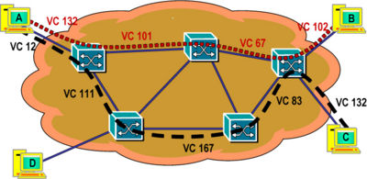
P4
  This is possible now
  Connection ID = VC number + interface ID
  The same VC number could be present on different interfaces. (no centralized VC allocation for uniqueness + VC reuse)
Because VC connections pass different interfaces, the VC numbers could actually be the same for H1 & H2.

Slide 15

P4 c.
forwarding table (VC Table) in router A

Slide 16
P4 d.
Assuming the same scenario as (c), write down the forwarding tables in nodes B, C, and D.

Slide 17
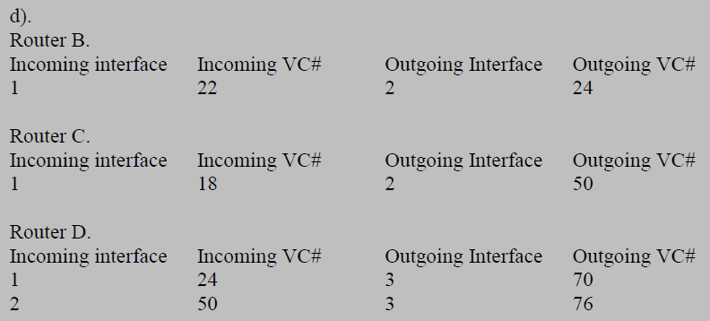
P4

Slide 18
P16
Consider a subnet with prefix 128.119.40.128/26. Give an example of one IP address (of form xxx.xxx.xxx.xxx) that can be assigned to this network.
128.119.40.128/26
10000000.01110111.00101000.10000000 / 26
to
10000000.01110111.00101000.10111111 / 26

Slide 19
P16
Suppose an ISP owns the block of addresses of the form 128.119.40.64/26. Suppose it wants to create four subnets from this block, with each block having the same number of IP addresses. What are the prefixes (of form a.b.c.d/x) for the four subnets?
128.119.40.64/26
10000000.01110111.00101000.01000000 / 26

Slide 20
P16
Suppose an ISP owns the block of addresses of the form 128.119.40.64/26. Suppose it wants to create four subnets from this block, with each block having the same number of IP addresses. What are the prefixes (of form a.b.c.d/x) for the four subnets?
10000000.01110111.00101000.01000000 / 26
10000000.01110111.00101000.01000000 / 26
128.119.40.64/28
10000000.01110111.00101000.01010000 / 26
128.119.40.80/28
10000000.01110111.00101000.01100000 / 26
128.119.40.96/28
10000000.01110111.00101000.01110000 / 26
128.119.40.112/28

Slide 21
P17
Consider the topology shown in Figure 4.17. Denote the three subnets with hosts (starting clockwise at 12:00) as Networks A, B, and C. Denote the subnets without hosts as Networks D, E, and F.
Assign network addresses to each of these six subnets, with the following constraints: All addresses must be allocated from 214.97.254/23; Subnet A should have enough addresses to support 250 interfaces; Subnet B should have enough addresses to support 120 interfaces; and Subnet C should have enough addresses to support 120 interfaces. Of course, subnets D, E and F should each be able to support two interfaces.

Slide 22
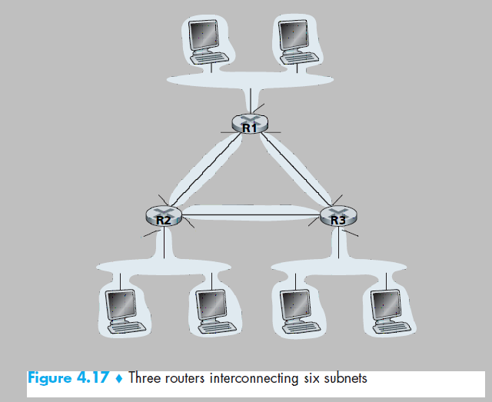
P17
A
F
D
E
C
B

Slide 23
Allocating IPs to subnets - Steps
P17
Sort address groups in descending order
Assign IP numbers to the largest, then go to smaller
Try to give as continuous as possible IP addresses to subnets which are on same router (so as to be able to do address aggregation)

Slide 24
P17
given 214.97.254/23 =
11010110.01100001.11111110.00000000 /23
For 250 hosts we need 8 bits
11010110.01100001.11111110.00000011 /24 -
11010110.01100001.11111110.11111111 /24
A (250)
= 214.97.254.3 /24
One entry in routing table for all 250 addresses
The link between routers is a subnet with two addresses
11010110.01100001.11111110.00000000
11010110.01100001.11111110.00000001
D
= 214.97.254.0 /31
One entry in routing table for the link between routers e.g as an exit point

Slide 25
P17
214.97.254/23
11010110.01100001.11111110.00000000 /23
11010110.01100001.11111111.00000011 / 25 -
11010110.01100001.11111111.01111111 / 25
B 120
214.97.255.3 /25
11010110.01100001.11111111. 00000000
11010110.01100001.11111111. 00000001
E
214.97.255.0 /31

Slide 26
P17
214.97.254/23
11010110.01100001.11111110.00000000 /23
11010110.01100001.11111111.10000011 / 25 -
11010110.01100001.11111111.11111111 / 25
C 120
214.97.255.131 /25
11010110.01100001.11111111.10000001
11010110.01100001.11111111.10000000
F
214.97.255.129 /31

Slide 27
(P17 b)
Using your answer to part (a), provide the forwarding tables (using longest prefix matching) for each of the three routers.

Slide 28
P17
net
Router 1
Outgoing Interface
A
11010110.01100001.11111110.00000000
A
B
11010110.01100001.11111111.00000000
D
C
11010110.01100001.11111111.10000000
F
A
F
D
E
C
B

Slide 29
P10
Consider a datagram network using 32-bit host addresses. Suppose a router has four links, numbered 0 through 3, and packets are to be forwarded to the link interfaces as follows:

Slide 30
P10
Destination Address Range
11100000 00000000 00000000 00000000 -
11100000 00111111 11111111 11111111
=4194304 routes
11100000 01000000 00000000 00000000 -
11100000 01000000 11111111 11111111
= 65536 routes
11100000 01000001 00000000 00000000 -
11100001 01111111 11111111 11111111
otherwise
Out Link Interface
0
1
2
3

Slide 31
P10 a
Provide a forwarding table that has five entries, uses longest prefix matching, and forwards packets to the correct link interfaces.
(generally could have more than five entries but the less entries the more efficient forwarding is)

Slide 32
Forwarding table aggregation methodology
P10
If addresses in decimal form, convert to binary
Group addresses by interface / next hop
Find identical/common bits in grouped addresses => find subnet mask
Aggregated address is based on common bits. (best if aggregated address contain exactly the addresses we want to represent – no more no less)
Crucial that there is no overlap between our aggregated addresses found! => routing errors
No overlap =
  Either same prefix but different bits (naturally no overlap)
  Or different prefix and same bits (differentiate by choosing longest prefix)

Slide 33
P10
Destination Address Range
11100000 00000000 00000000 00000000 -
11100000 00111111 11111111 11111111
=4194304 routes
11100000 01000000 00000000 00000000 -
11100000 01000000 11111111 11111111
= 65536 routes
11100000 01000001 00000000 00000000 -
11100001 01111111 11111111 11111111
Out Link Interface
0
1
2
3
√
√
?
otherwise

Slide 34
More specific (longer) entry wins!
11100000 -> 2 ?
Out Link Interface
0
1
2
11100000 00000000 00000000 00000000 -
11100000 00111111 11111111 11111111
11100000 01000000 00000000 00000000 -
11100000 01000000 11111111 11111111
11100000 01000001 00000000 00000000 -
11100000 11111111 11111111 11111111
+
11100001 00000000 00000000 00000000
11100001 01111111 11111111 11111111
otherwise 3

Slide 35
Aggregated routes
P10
11100000 00000000 00000000 00000000 -
11100000 00111111 11111111 11111111
11100000 01000000 00000000 00000000 -
11100000 01000000 11111111 11111111
11100000 01000001 00000000 00000000 -
11100000 11111111 11111111 11111111
+
11100001 00000000 00000000 00000000
11100001 01111111 11111111 11111111
11100000 00*
0
11100000 01000000*
1
11100000 *
2
11100001 0*
2
otherwise
3

Slide 36
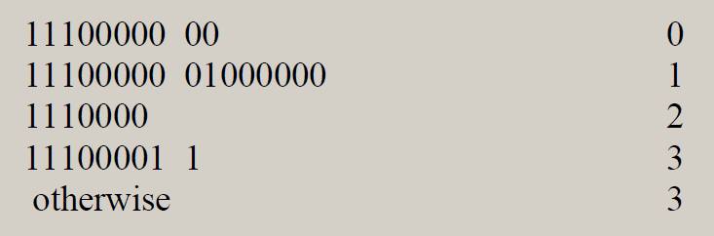
P10
Another Solution

Slide 37
P 10 b.
Describe how your forwarding table determines the appropriate link interface for datagrams with destination addresses:
11001000 10010001 01010001 01010101
11100001 01000000 11000011 00111100
11100001 10000000 00010001 01110111
Που ταιριάζουν περισσότερο?
11100000 00*
0
11100000 01000000*
1
11100000 *
2
11100001 0*
2
otherwise to interface 3

Slide 38
P 10 b.
Describe how your forwarding table determines the appropriate link interface for datagrams with destination addresses:
11001000 10010001 01010001 01010101
11100001 01000000 11000011 00111100
11100001 10000000 00010001 01110111
3
2
3
11100000 00*
0
11100000 01000000*
1
11100000 *
2
11100001 0*
2
otherwise to interface 3

Slide 39
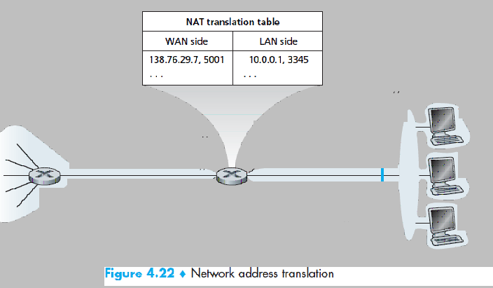
P21
Consider the network setup in Figure 4.22 Suppose that the ISP assigns the router the address 24.34.112.235 and that the network address of the home network is 192.168.1/24.
a. Assign addresses to all interfaces in the home network.
24.34.112.235
192.168.1/24

Slide 40
P21
NAT Translation Table
WAN Side LAN Side
24.34.112.235, 4000 192.168.1.1, 3345
24.34.112.235, 4001 192.168.1.1, 3346
24.34.112.235, 4002 192.168.1.2, 3445
24.34.112.235, 4003 192.168.1.2, 3446
24.34.112.235, 4004 192.168.1.3, 3545
24.34.112.235, 4005 192.168.1.3, 3546
24.34.112.235
192.168.1/24
a) Home addresses: 192.168.1.1, 192.168.1.2, 192.168.1.3 with the router interface being 192.168.1.4

Slide 41
P21
NAT :
  Different LAN addresses are mapped to one WAN address but on different ports.

Slide 42
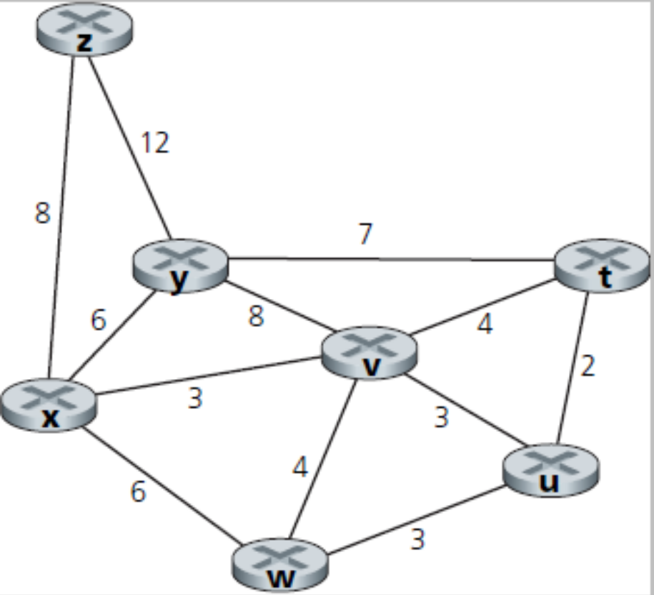
P26
Consider the following network. With the indicated link costs, use Dijkstra’s shortest-path algorithm to compute the shortest path from x to all network nodes. Show how the algorithm works by computing a table similar to Table 4.3.

Slide 43
P26
DIJKSTRA
Group N has chosen nodes-it gets filled up at each step. We work on un-chosen.
We are at source. N has source only. (non direct neighbors have cost ∞) Add in N the node X (not in N) with the least cost path to source. Then calculate new costs to other nodes (neighbors of X) not in N if going though X. (if smaller cost than previously, then set node X as previous node to them)
REPEAT : add node with less distance to source –as previously set, until N contain all nodes

Slide 44
P26
 | y | v | w | u | t | z
x | 6x | 3x | 6x | ∞ | ∞ | 8x
v | 6x | 3x | 6x | 6v | 7v | 8x
y | 6x | 3x | 6x | 6v | 7v | 8x
w | 6x | 3x | 6x | 6v | 7v | 8x
u | 6x | 3x | 6x | 6v | 7v | 8x
t | 6x | 3x | 6x | 6v | 7v | 8x
z | 6x | 3x | 6x | 6v | 7v | 8x

Slide 45
P27
Consider the network shown in Problem P26. Using Dijkstra’s algorithm, and showing your work using a table similar to Table 4.3, do the following:
a. Compute the shortest path from t to all network nodes.
b. Compute the shortest path from u to all network nodes.
c. Compute the shortest path from v to all network nodes.
d. Compute the shortest path from w to all network nodes.
e. Compute the shortest path from y to all network nodes.
f. Compute the shortest path from z to all network nodes.

Slide 46
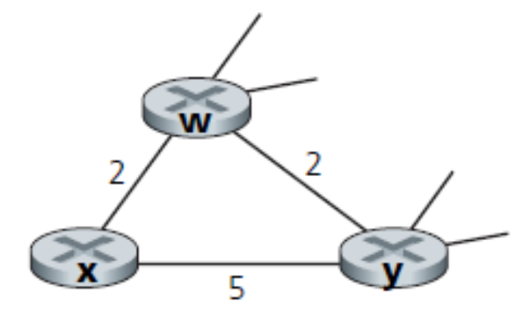
P30
Consider the network fragment shown below. X has only two attached neighbors, w and y. w has a minimum-cost path to destination u (not shown) of 5, and y has a minimum-cost path to u of 6. The complete paths from w and y to u (and between w and y) are not shown. All link costs in the network have strictly positive integer values.
u
5
6

Slide 47
P30 a
Give x’s distance vector for destinations w, y, and u.
u
5
6

Slide 48
P30 a
Give x’s distance vector for destinations w, y, and u.
Dx(w) = 2, Dx(y) = 4, Dx(u) = 7
u
5
6

Slide 49
P30 b
Give a link-cost change for either c(x,w) or c(x,y) such that x will inform its neighbors of a new minimum-cost path to u as a result of executing the distance-vector algorithm.
u
5
6

Slide 50
P30 b
First consider what happens if c(x,y) changes. If c(x,y) becomes larger or smaller (as long as c(x,y) >=1) , the least cost path from x to u will still have cost at least 7. Thus a change in c(x,y) (if c(x,y)>=1) will not cause x to inform its neighbors of any changes.
If c(x,y)= δ<1, then the least cost path now passes through y and has cost δ+6. x will inform its neighbors of this new cost.
Now consider if c(x,w) changes. If c(x,w) < 2, then the least-cost path to u continues to pass through w and its cost changes to 5 + δ;
x will inform its neighbors of this new cost.
If c(x,w) > 6, then the least cost path now passes through y and has cost 11; again x will inform its neighbors of this new cost.
u
5
6

Slide 51
P30 c
Give a link-cost change for either c(x,w) or c(x,y) such that x will not inform its neighbors of a new minimum-cost path to u as a result of executing the distance-vector algorithm.
u
5
6

Slide 52
P30 c
Any change in link cost c(x,y) (and as long as c(x,y) >=1) will not cause x to inform its neighbors of a new minimum-cost path to u
u
5
6

Slide 53
P36
Will a BGP router always choose the loop-free route with the shortest AS path length? Justify your answer.

Slide 54
P36
The chosen path is not necessarily the shortest AS-path. Recall that there are many issues to be considered in the route selection process. It is very likely that a longer loop-free path is preferred over a shorter loop-free path due to economic reason. For example, an AS might prefer to send traffic to one neighbor instead of another neighbor with shorter AS distance.

Slide 55
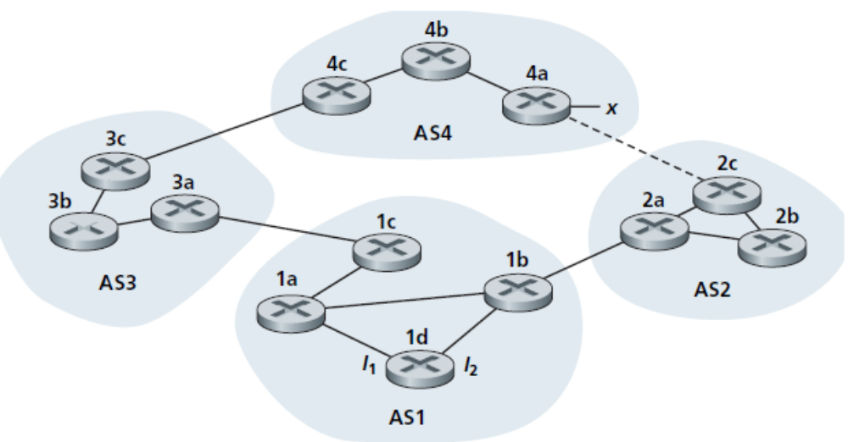
P37
Consider the network shown below. Suppose AS3 and AS2 are running OSPF for their intra-AS routing protocol. Suppose AS1 and AS4 are running RIP for their intra-AS routing protocol. Suppose eBGP and iBGP are used for the inter-AS routing protocol. Initially suppose there is no physical link between AS2 and AS4.

Slide 56
P37
a. Router 3c learns about prefix x from which routing protocol: OSPF, RIP, eBGP, or iBGP?
b. Router 3a learns about x from which routing protocol?
c. Router 1c learns about x from which routing protocol?
d. Router 1d learns about x from which routing protocol?

Slide 57
a. Router 3c learns about prefix x from which routing protocol: OSPF, RIP, eBGP, or iBGP?
eBGP
b. Router 3a learns about x from which routing protocol?
iBGP
c. Router 1c learns about x from which routing protocol?
eBGP
d. Router 1d learns about x from which routing protocol?
iBGP

