Slide 1
Lab Meeting 3/19/2020
Timothy Keyes

Slide 2
Agenda
Mini-JC: Scatterbody (Tsai et al., 2020, Nature Medicine)
New Classifier (aka Classifier 1.5)
New Classifier + AML

Slide 3
Scatterbody paper - Motivations
Cytometry analysis (clinical or research) identifies populations of cells based on their protein expression patterns (i.e. immunophenotypes)
However, tumor cells are often very similar to their native lineage in marker expression; they can also abnormally express (or lack) virtually any surface molecule.
Thus, classification schemes used on normal cell types alone may not be reliable for the identification or characterization of cancer cells.
Often, cytometric analysis and microscopic inspection of cells’ subcellular features by a pathologist must be integrated in order to get a sense of the underlying biology

Slide 4
Scatterbody paper - Main point
“Scatterbodies” are antibodies that measure cellular antigens that serve as quantitaive surrogates for cells’ shape, size, and other morphological features. These include the following:
granularity
granular color
chromatin quality
nuclear shape
nucleolar size
cytoplasmic color
cell size
Idea is to perform quantitative morphometry (the study of cell shape and size) using CyTOF.

Slide 5
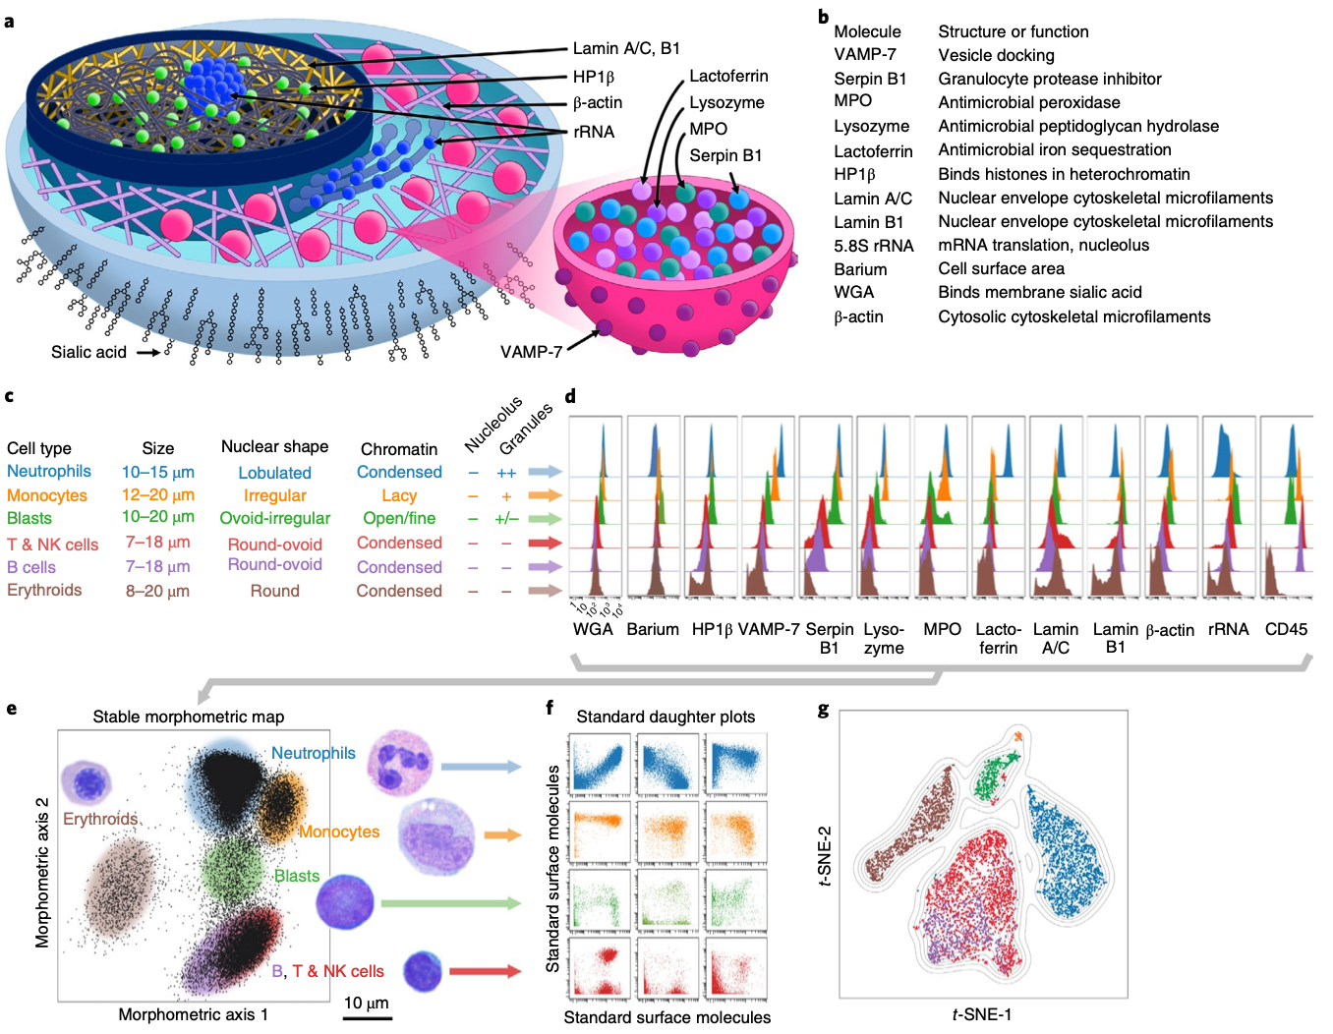
Figure 1

Slide 6
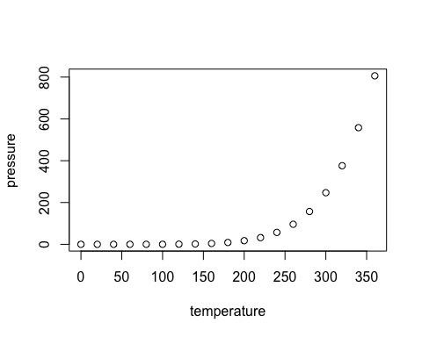
Slide with Plot

