Slide 1
Netflix: Data Analysis and visualization
Keyhan Rayati

Slide 2
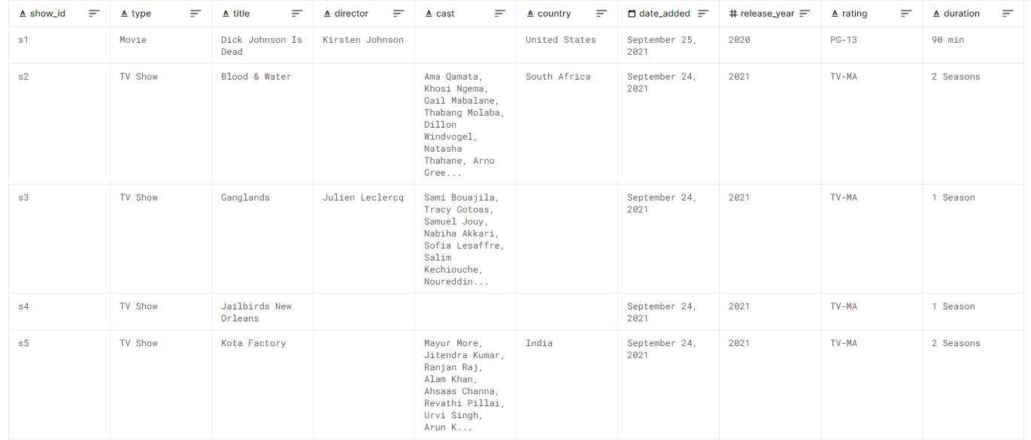
Netflix dataset

Slide 3
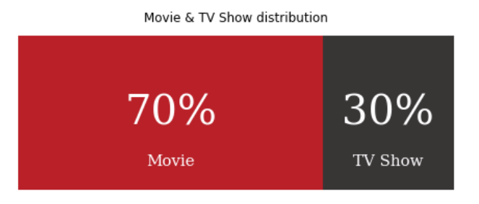
Type of contents

Slide 4
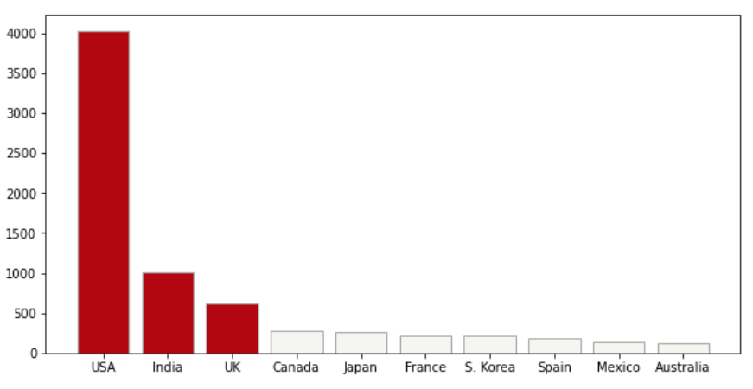
Content of countries

Slide 5
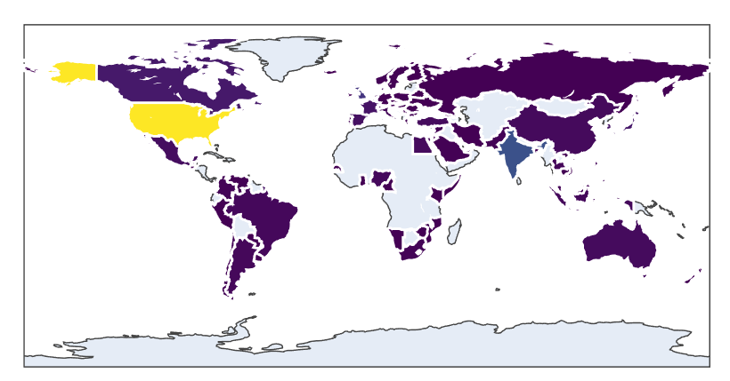
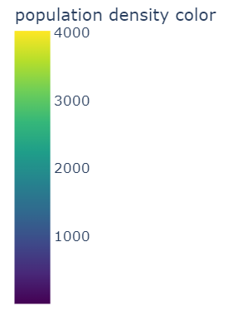
map

Slide 6
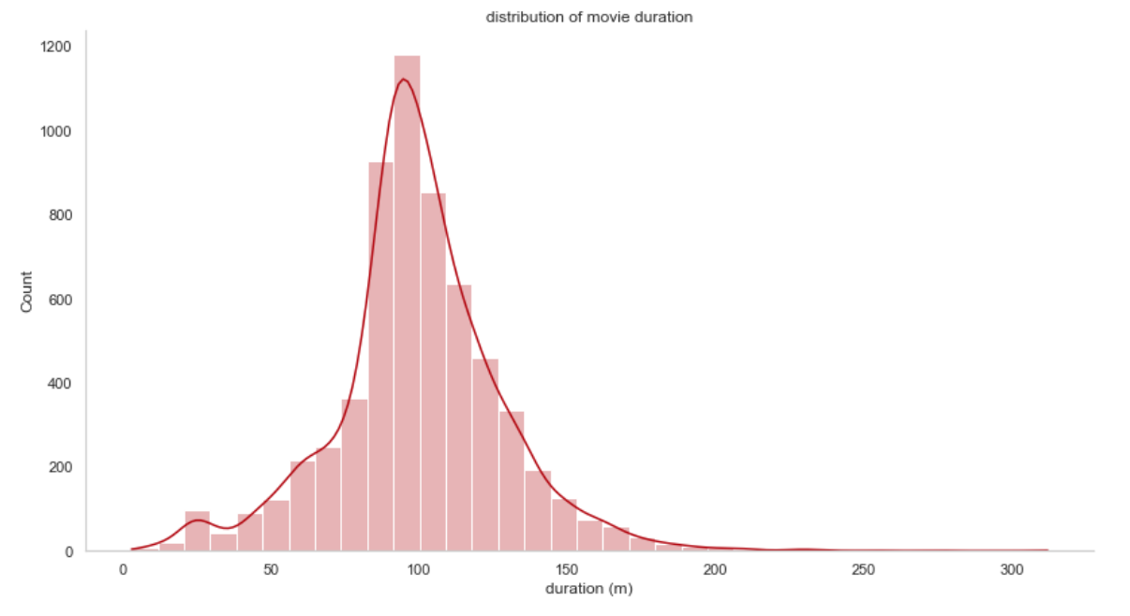
Distribution of movies’ length

Slide 7
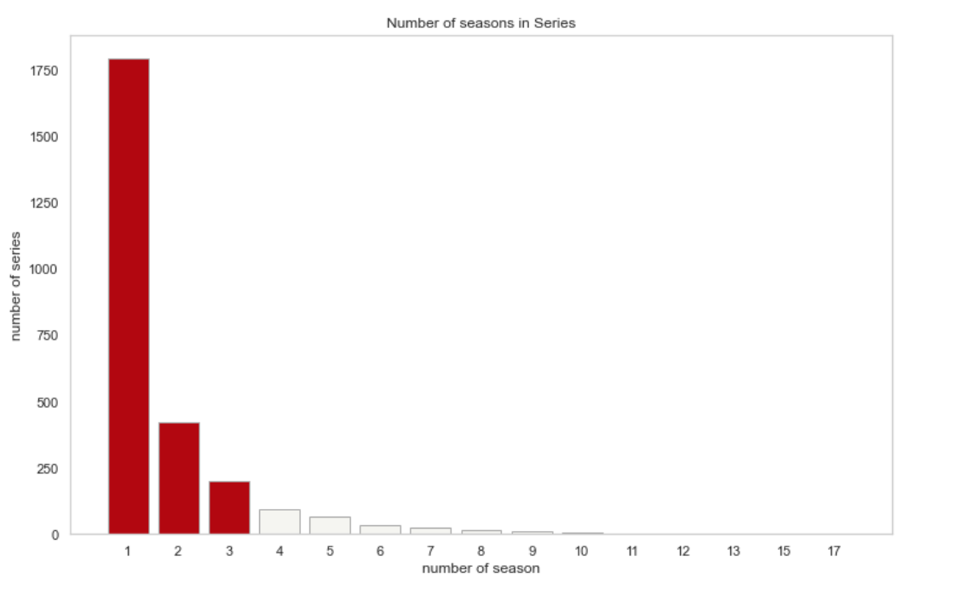
Number of Seasons

Slide 8
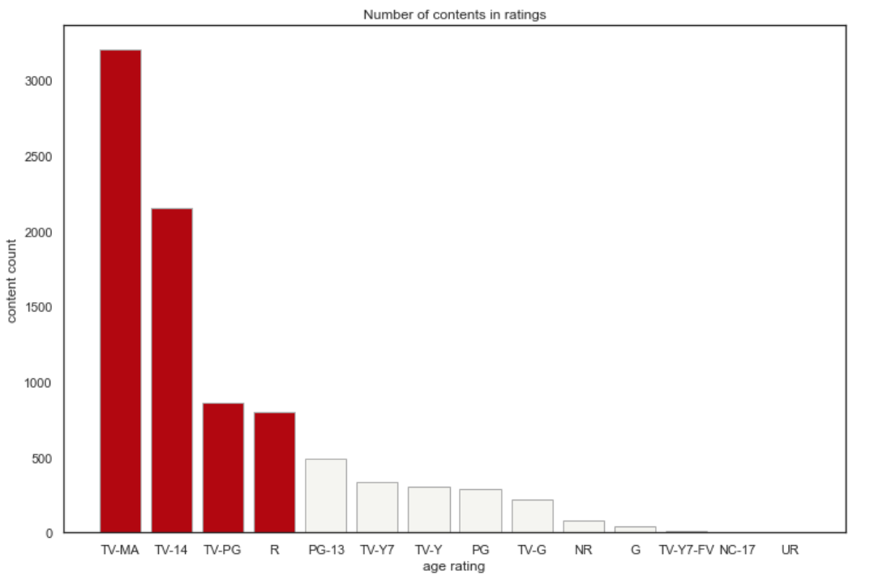
AGE Ratings

Slide 9
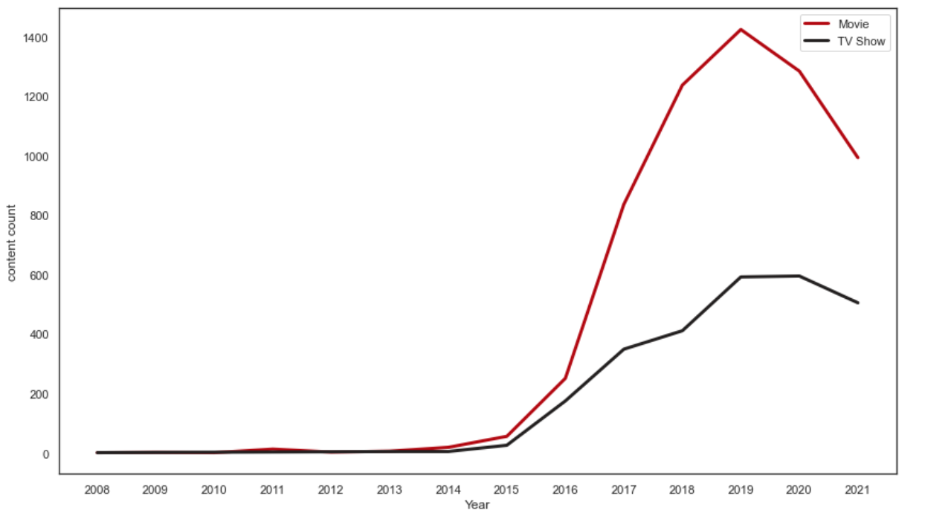
Movies and TV shows per year

Slide 10
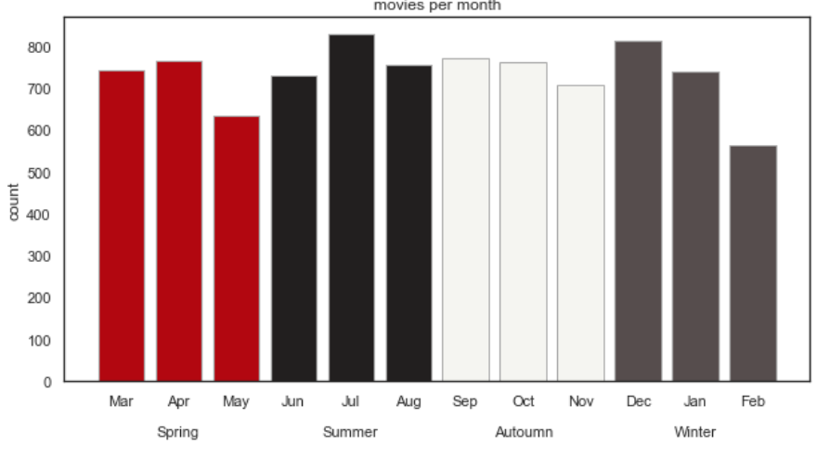
Movies Per month

Slide 11
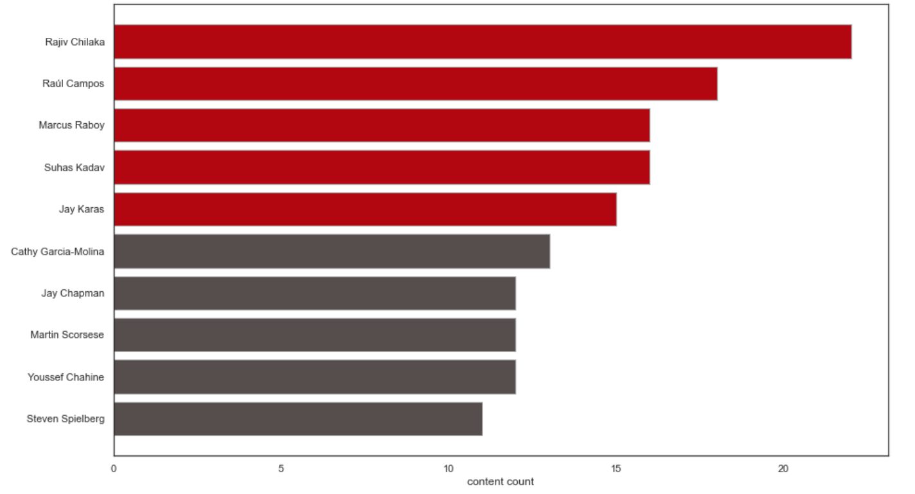
Most prolific directors on Netflix

Slide 12
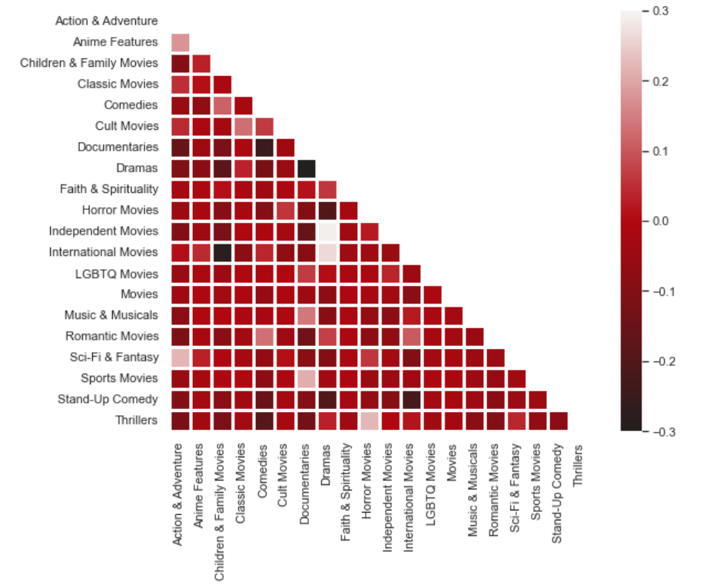
Genre correlation

Slide 13
The end

