Slide 1
Information Retrieval:
Models and Methods
October 15, 2003
CMSC 35900
Gina-Anne Levow

Slide 2
Roadmap
Problem:
  Matching Topics and Documents
Methods:
  Classic: Vector Space Model
  N-grams
  HMMs
Challenge: Beyond literal matching
  Expansion Strategies
  Aspect Models

Slide 3
Matching Topics and Documents
Two main perspectives:
  Pre-defined, fixed, finite topics:
    “Text Classification”
  Arbitrary topics, typically defined by statement of information need (aka query)
    “Information Retrieval”

Slide 4
Matching Topics and Documents
Documents are “about” some topic(s)
Question: Evidence of “aboutness”?
  Words !!
    Possibly also meta-data in documents
      Tags, etc
Model encodes how words capture topic
  E.g. “Bag of words” model, Boolean matching
  What information is captured?
  How is similarity computed?

Slide 5
Models for Retrieval and Classification
Plethora of models are used
Here:
  Vector Space Model
  N-grams
  HMMs

Slide 6
Vector Space Information Retrieval
Task:
  Document collection
  Query specifies information need: free text
  Relevance judgments: 0/1 for all docs
Word evidence: Bag of words
  No ordering information

Slide 7
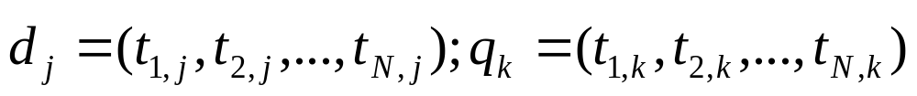
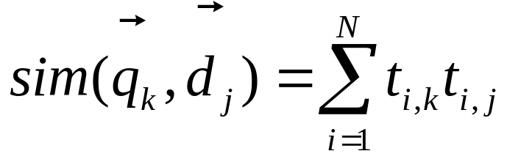
Vector Space Model
Represent documents and queries as
  Vectors of term-based features
    Features: tied to occurrence of terms in collection
  E.g.
Solution 1: Binary features: t=1 if presense, 0 otherwise
  Similiarity: number of terms in common
    Dot product

Slide 8
Vector Space Model II
Problem: Not all terms equally interesting
  E.g. the vs dog vs Levow
Solution: Replace binary term features with weights
  Document collection: term-by-document matrix
  View as vector in multidimensional space
    Nearby vectors are related
  Normalize for vector length

Slide 9
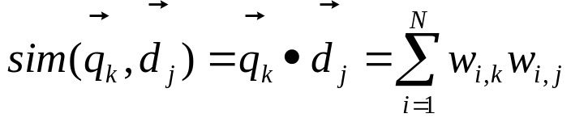
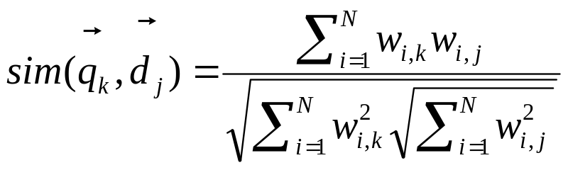
Vector Similarity Computation
Similarity = Dot product
Normalization:
  Normalize weights in advance
  Normalize post-hoc

Slide 10
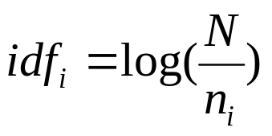
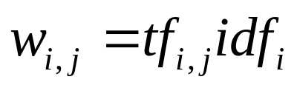
Term Weighting
“Aboutness”
  To what degree is this term what document is about?
  Within document measure
  Term frequency (tf): # occurrences of t in doc j
“Specificity”
  How surprised are you to see this term?
  Collection frequency
  Inverse document frequency (idf):

Slide 11
Term Selection & Formation
Selection:
  Some terms are truly useless
    Too frequent, no content
      E.g. the, a, and,…
  Stop words: ignore such terms altogether
Creation:
  Too many surface forms for same concepts
    E.g. inflections of words: verb conjugations, plural
  Stem terms: treat all forms as same underlying

Slide 12
N-grams
Simple model
Evidence: More than bag of words
  Captures context, order information
    E.g. White House
Applicable to many text tasks
  Language identification, authorship attribution, genre classification, topic/text classification
  Language modeling for ASR,etc

Slide 13
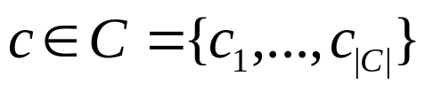
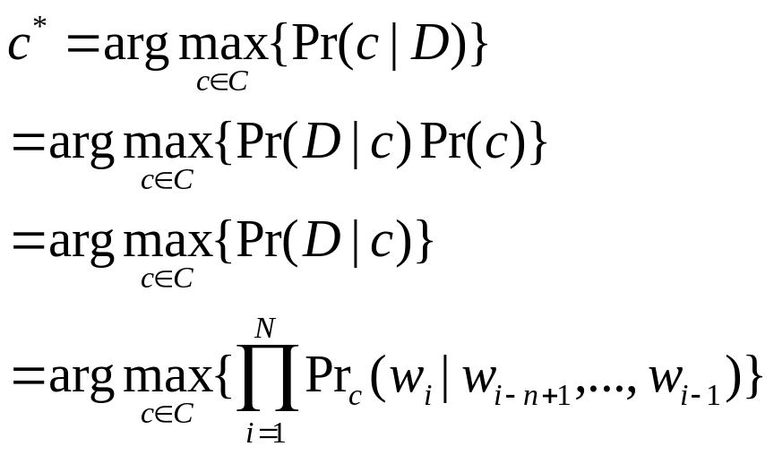
Text Classification with N-grams
Task: Classes identified by document sets
  Assign new documents to correct class
N-gram categorization:
  Text: D; category:
  Select c maximizing posterior probability

Slide 14
Text Classification with N-grams
Representation:
  For each class, train N-gram model
“Similarity”: For each document D to classify, select c with highest likelihood
  Can also use entropy/perplexity

Slide 15
Assessment & Smoothing
Comparable to “state of the art”
  0.89 Accuracy
Reliable
  Across smoothing techniques
  Across languages – generalizes to Chinese characters
n | Abs | G-T | Lin | W-B
4 | 0.88 | 0.88 | 0.87 | 0.89
5 | 0.89 | 0.87 | 0.88 | 0.89
6 | 0.89 | 0.88 | 0.88 | 0.89

Slide 16
HMMs
Provides a generative model of topicality
  Solid probabilistic framework rather than ad hoc weighting
Noisy channel model:
  View query Q as output of underlying relevant document D, passed through mind of user

Slide 17
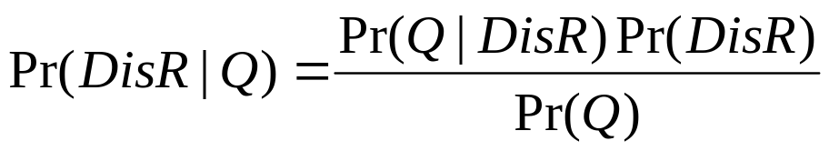
HMM Information Retrieval
Task: Given user generated query Q, return ranked list of relevant documents
Model:
  Maximize Pr(D is Relevant) for some query Q
  Output symbols: terms in document collection
  States: Process to generate output symbols
    From document D
    From General English
Pr(q|GE)
a
General
English
Query
start
Query
end
b
Document
Pr(q|D)

Slide 18
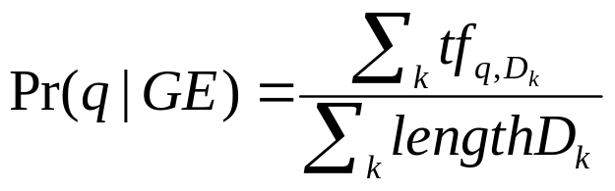
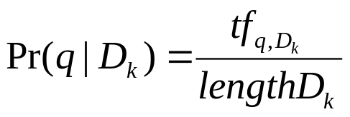
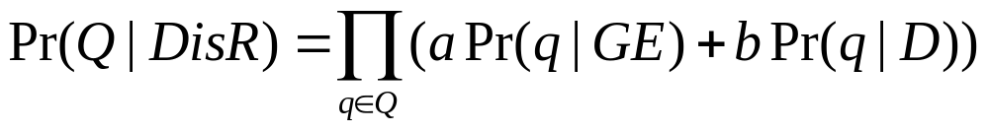
HMM Information Retrieval
Generally use EM to train transition and output probabilities
  E.g query-relevant document pairs
  Data often insufficient
Simplified strategy:
  EM for transition, assume same across docs
  Output distributions:

Slide 19
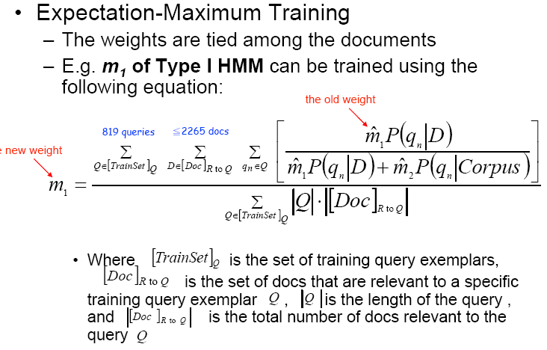
EM Parameter Update
a
a ‘
a ‘
b ‘
English
a

Slide 20
Evaluation
Comparison to VSM
  HMM can outperform VSM
    Some variation related to implementation
  Can integrate other features –e.g. bigram or trigram models,

Slide 21
Key Issue
All approaches operate on term matching
  If a synonym, rather than original term, is used, approach fails
Develop more robust techniques
  Match “concept” rather than term
    Expansion approaches
      Add in related terms to enhance matching
    Mapping techniques
      Associate terms to concepts
        Aspect models, stemming

Slide 22
Expansion Techniques
Can apply to query or document
Thesaurus expansion
  Use linguistic resource – thesaurus, WordNet – to add synonyms/related terms
Feedback expansion
  Add terms that “should have appeared”
    User interaction
      Direct or relevance feedback
    Automatic pseudo relevance feedback

Slide 23
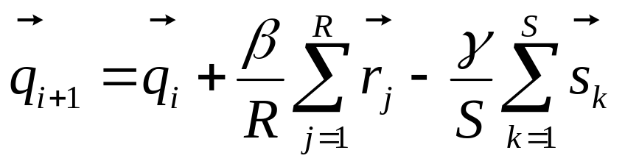
Query Refinement
Typical queries very short, ambiguous
  Cat: animal/Unix command
  Add more terms to disambiguate, improve
Relevance feedback
  Retrieve with original queries
  Present results
    Ask user to tag relevant/non-relevant
  “push” toward relevant vectors, away from nr
  β+γ=1 (0.75,0.25); r: rel docs, s: non-rel docs
  “Roccio” expansion formula

Slide 24
Compression Techniques
Reduce surface term variation to concepts
Stemming
  Map inflectional variants to root
    E.g. see, sees, seen, saw -> see
    Crucial for highly inflected languages – Czech, Arabic
Aspect models
  Matrix representations typically very sparse
  Reduce dimensionality to small # key aspects
    Mapping contextually similar terms together
    Latent semantic analysis

Slide 25
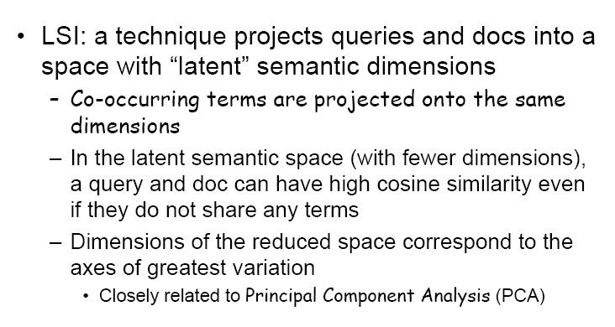
Latent Semantic Analysis

Slide 26
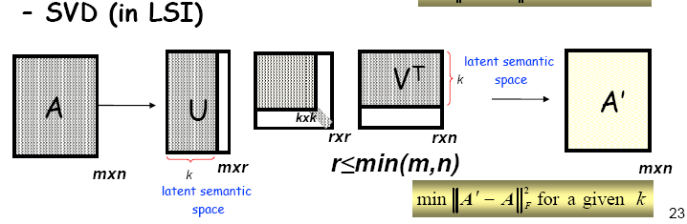
Latent Semantic Analysis

Slide 27
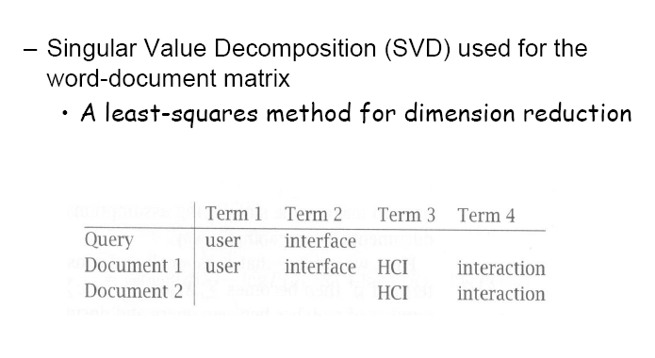
LSI

Slide 28
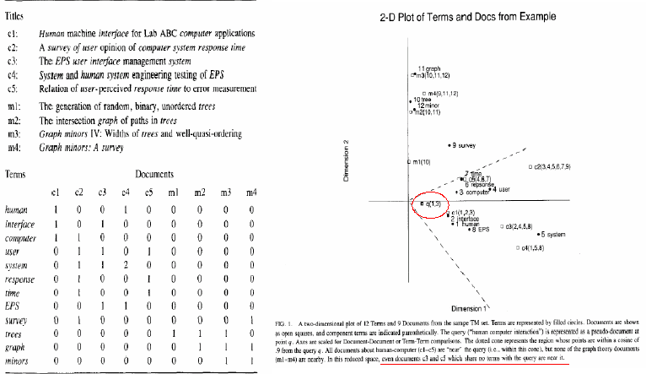
Classic LSI Example (Deerwester)

Slide 29
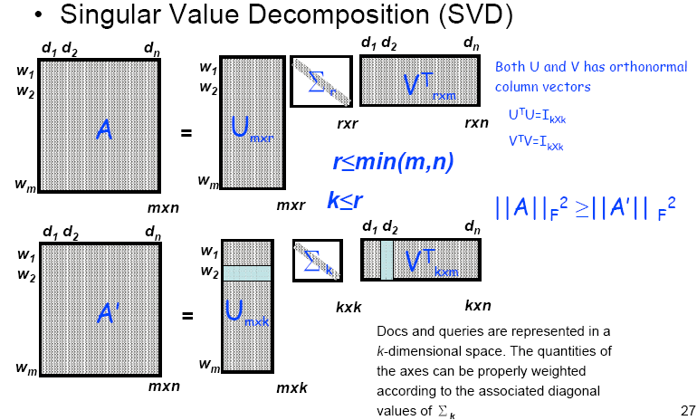
SVD: Dimensionality Reduction

Slide 30
LSI, SVD, & Eigenvectors
SVD decomposes:
  Term x Document matrix X as
    X=TSD’
      Where T,D left and right singular vector matrices, and
      S is a diagonal matrix of singular values
    Corresponds to eigenvector-eigenvalue decompostion: Y=VLV’
      Where V is orthonormal and L is diagonal
    T: matrix of eigenvectors of Y=XX’
    D: matrix of eigenvectors of Y=X’X
    S: diagonal matrix L of eigenvalues

Slide 31
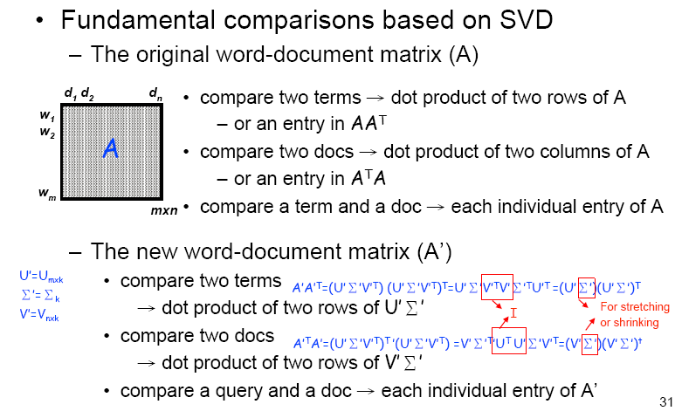
Computing Similarity in LSI

Slide 32
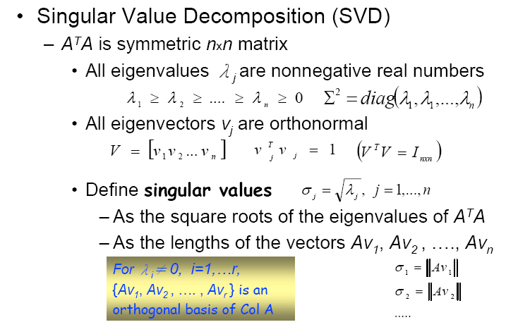
SVD details

Slide 33
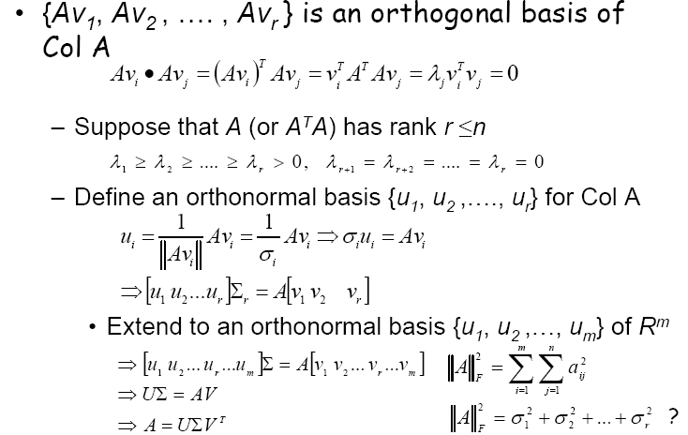
SVD Details (cont’d)

