Slide 1


Progress Meeting for the CMA ITF Project
2016-Nov-07

Slide 2
Agenda
Overview
Current Workflow
Proposed Workflow
System Architecture
System Functions
Milestones and Current Progress
Tasks involved

Slide 3
Overview
ITF: University-Industry Collaboration Programme (UICP)
Matching Grant for Joint Research (https://www.itf.gov.hk/l-eng/UICP_MGJR.asp)
Project Period: 12/9/2016 - 11/9/2018 (24 Months)
No funding will be provided after the period, please note that for new recruitment
Aim:
To construct an intelligent knowledge management system, which will enable the company to effectively and efficiently collect, extract, share, and reuse organizational knowledge.

Slide 4
Overview
Scope:
Focus on management of enquiry (from client, internal staff, overseas salesman, etc.)
Deliverables:
An Intelligent Knowledge Management System with:
A dynamic knowledge repository
Real time analysis support for business condition monitoring and R&D management
A user manual of using the system
A system performance evaluation report from both general end users and expert users

Slide 5
Current Workflow: Common Employees in B&D, C&S
Ask Operation Staff/ Other Divisions
Decide on
Final Answer and Reply
the Customer
Receive Customer
Enquiry
(which they lack of knowledge)
Local Search: Operation Database, Hard Disk Documents, Emails
Ask Their Supervisor: Seniors in BD/CS
Internet Search: Google, Baidu, Wikipedia
Priority depends on the person’s own preference.
Reference from the help of : Elvis and Anderson from B&D, and the IT Division

Slide 6
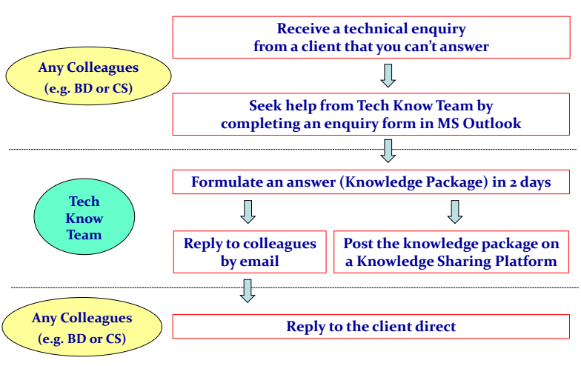
Current Workflow : Tech Know Team
Reference from the help of : YY (Facilitator of Tech Know Team)

Slide 7
Limitations of Current Workflow
Best Practices of the whole enquiry dealing flow are not defined and generalized
Enquiries are recorded in Email in unstructured way OR not recorded
Difficult to retrieve, trace and share the information and knowledge
Difficult to measure the results (e.g. the distribution of division, the processing time, successful rate, etc.)
No version control, easy to miss others comments
Lack of motivation/time/ability for most TKT members to participate
Reference from the help of : YY (Facilitator of Tech Know Team)

Slide 8
Limitation of Current Workflow
Heavy workload for facilitator
Previous knowledge cannot be reused effectively
Low usage of the Knowledge Sharing Platform
Reference from the help of : YY (Facilitator of Tech Know Team)

Slide 9









Proposed Workflow
Manager
?
Information
Needs
Enquirer:
B&D, Experts, Managers
etc.
KMS
Facilitator
Relevant
Cases
Search
R&D
BI Reports
KMS
Reference from the help of : Kenneth To

Slide 10





Proposed Workflow
Query
Tech Know
Team
?
Discussion
Posts
Enquirer:
B&D, Experts,
Managers etc.
KMS
Consolidation
Classify,
consolidate,
and save
Facilitator

Slide 11
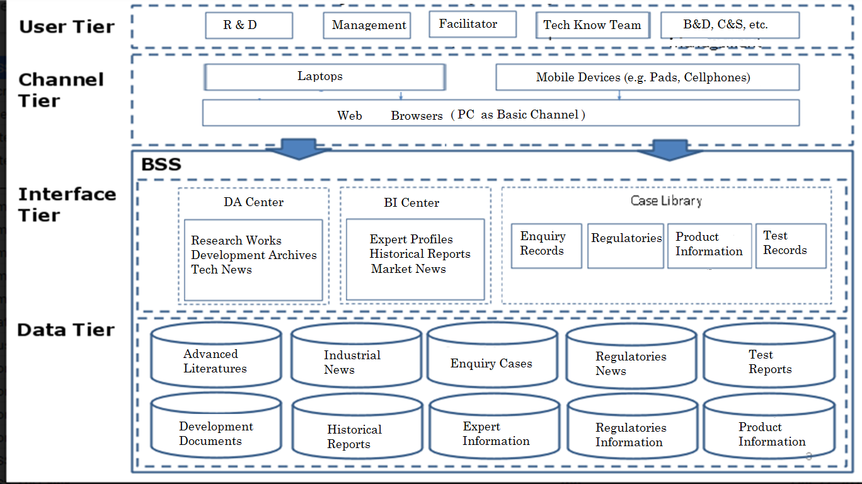
System Architecture

Slide 12
System Functions - Case Retrieval
Purpose: To provide tools to retrieve previous similar enquiries
To provide references when handling similar enquiries
To prevent reinvent the wheel and minimize duplicated work
To reduce necessary traning for new staff
Target Users:
Any colleagues who deal with enquiries

Slide 13
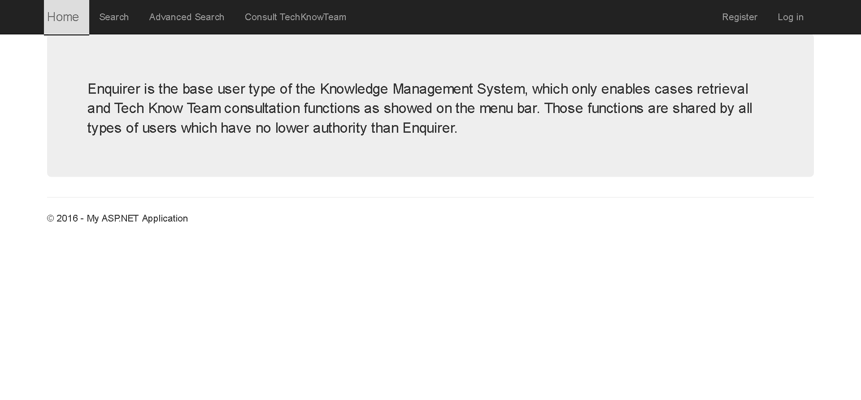
Enquirer Entrance

Slide 14
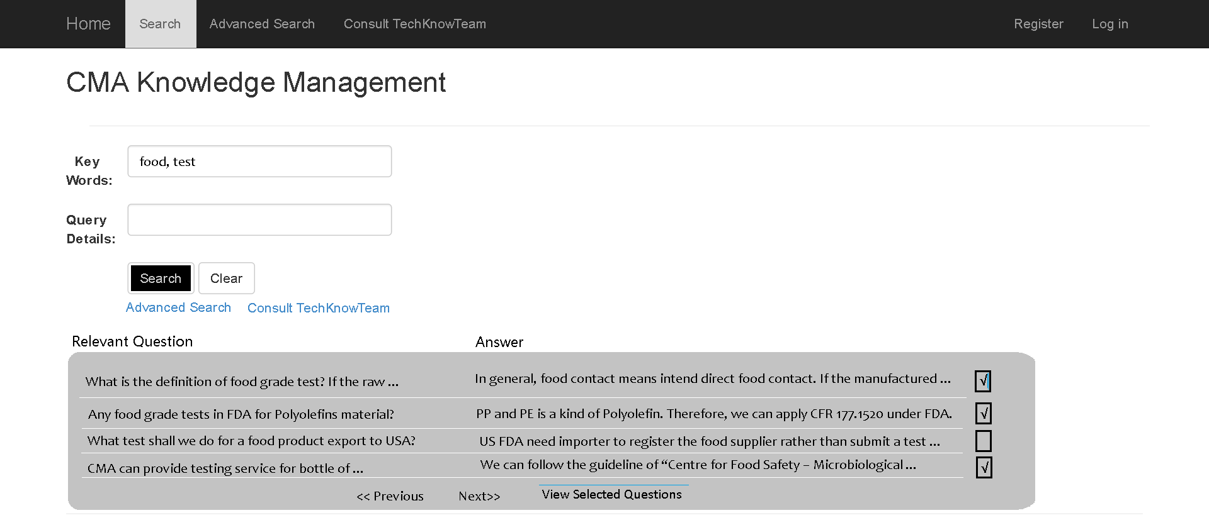

Slide 15
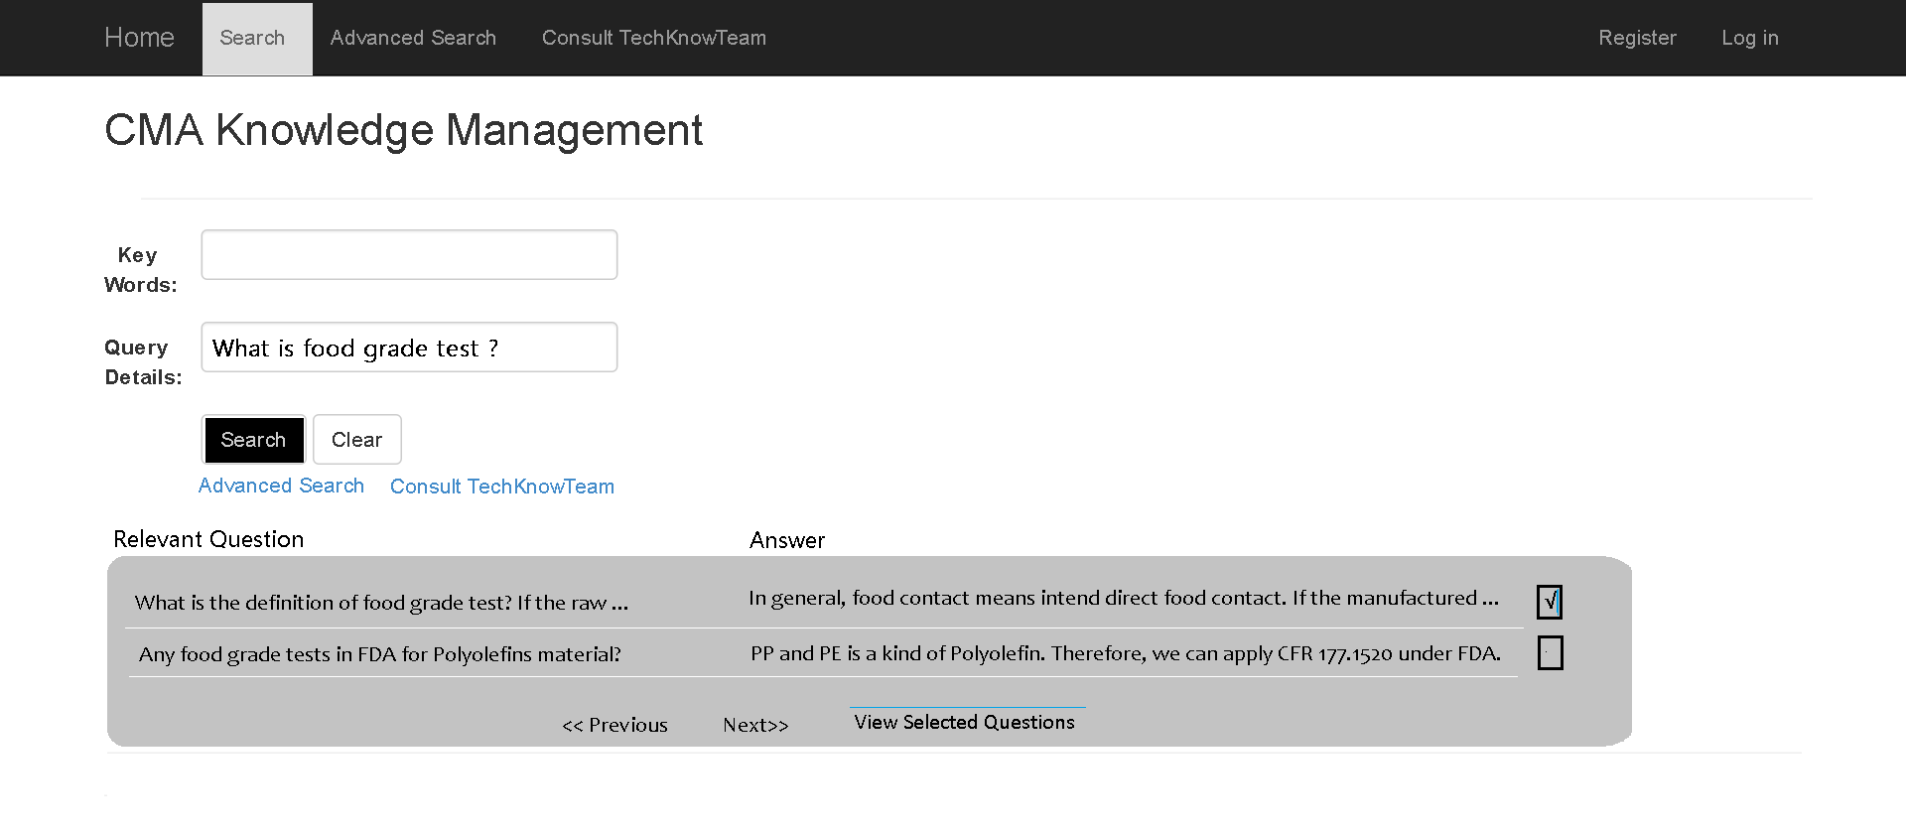

Slide 16
System Functions - Enquiry Retain
Purpose: To record the entire enquiry in a systematic manner
To retain and share information and knowledge on enquiries within the organization
To analyze the successful rate and fail reasons
To analyze the distribution of types of enquiries & their processing time
To analyze the details of enquiries
Target Users:
Any colleagues who have enquiries (e.g. BD, CS)

Slide 17
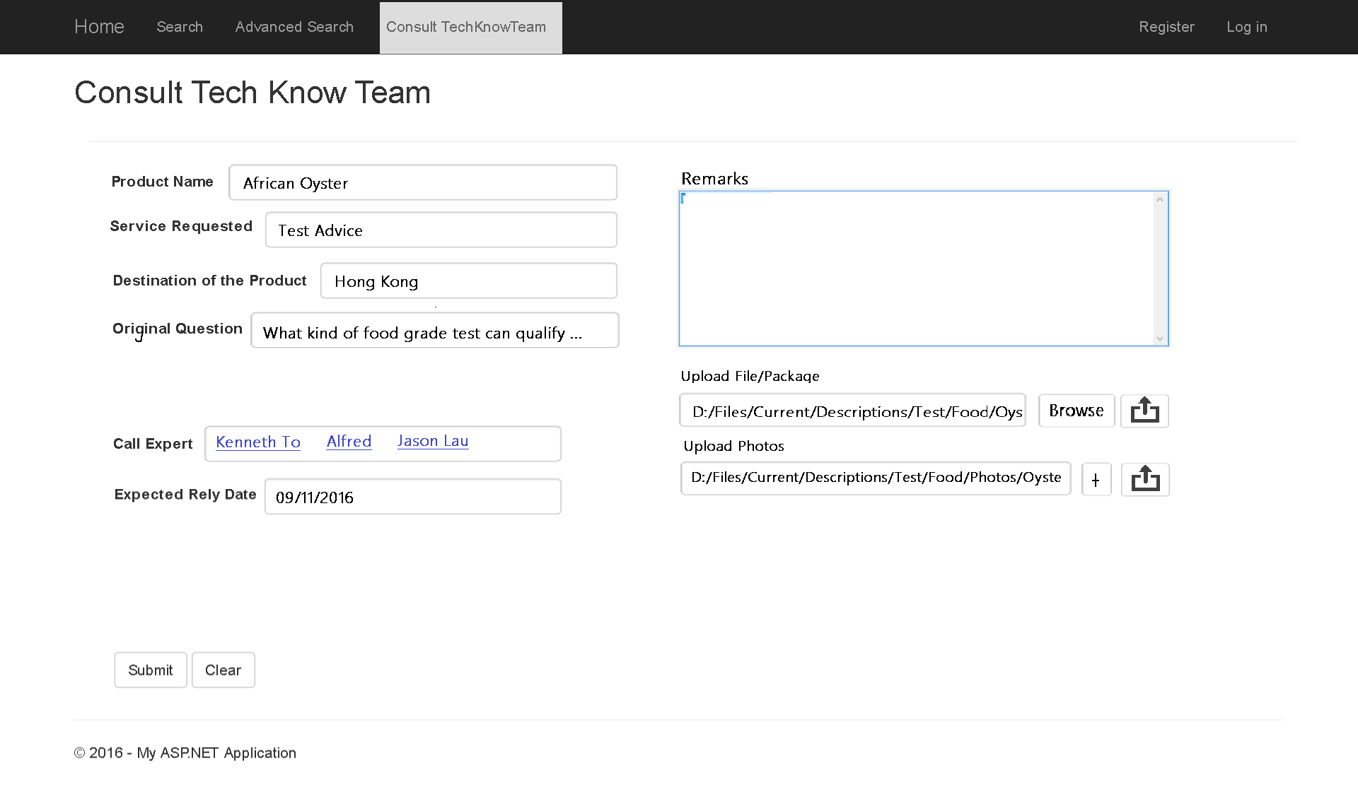

Slide 18
System Functions – Expert Group Management
Purpose: To maximize the overall contribution of knowledge holders
To facilitate effective expert group discussions
To provide tools to enhance expert group management
Target Users:
Tech Know Team and its Facilitator

Slide 19
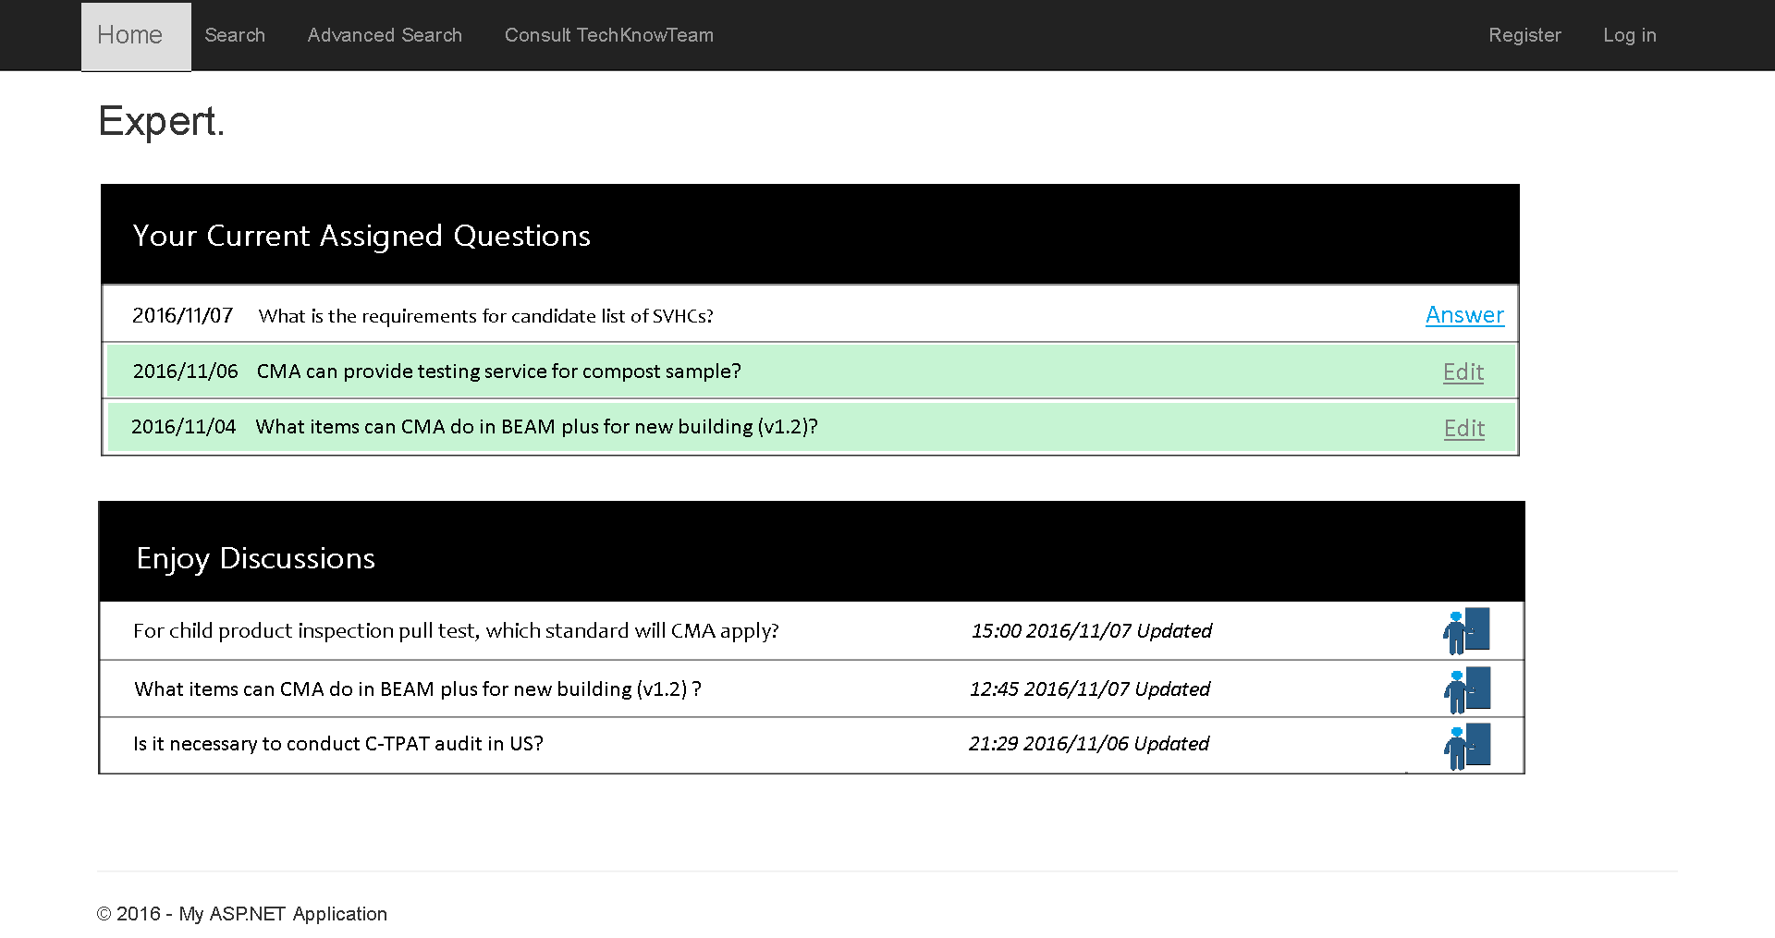
Expert Entrance

Slide 20
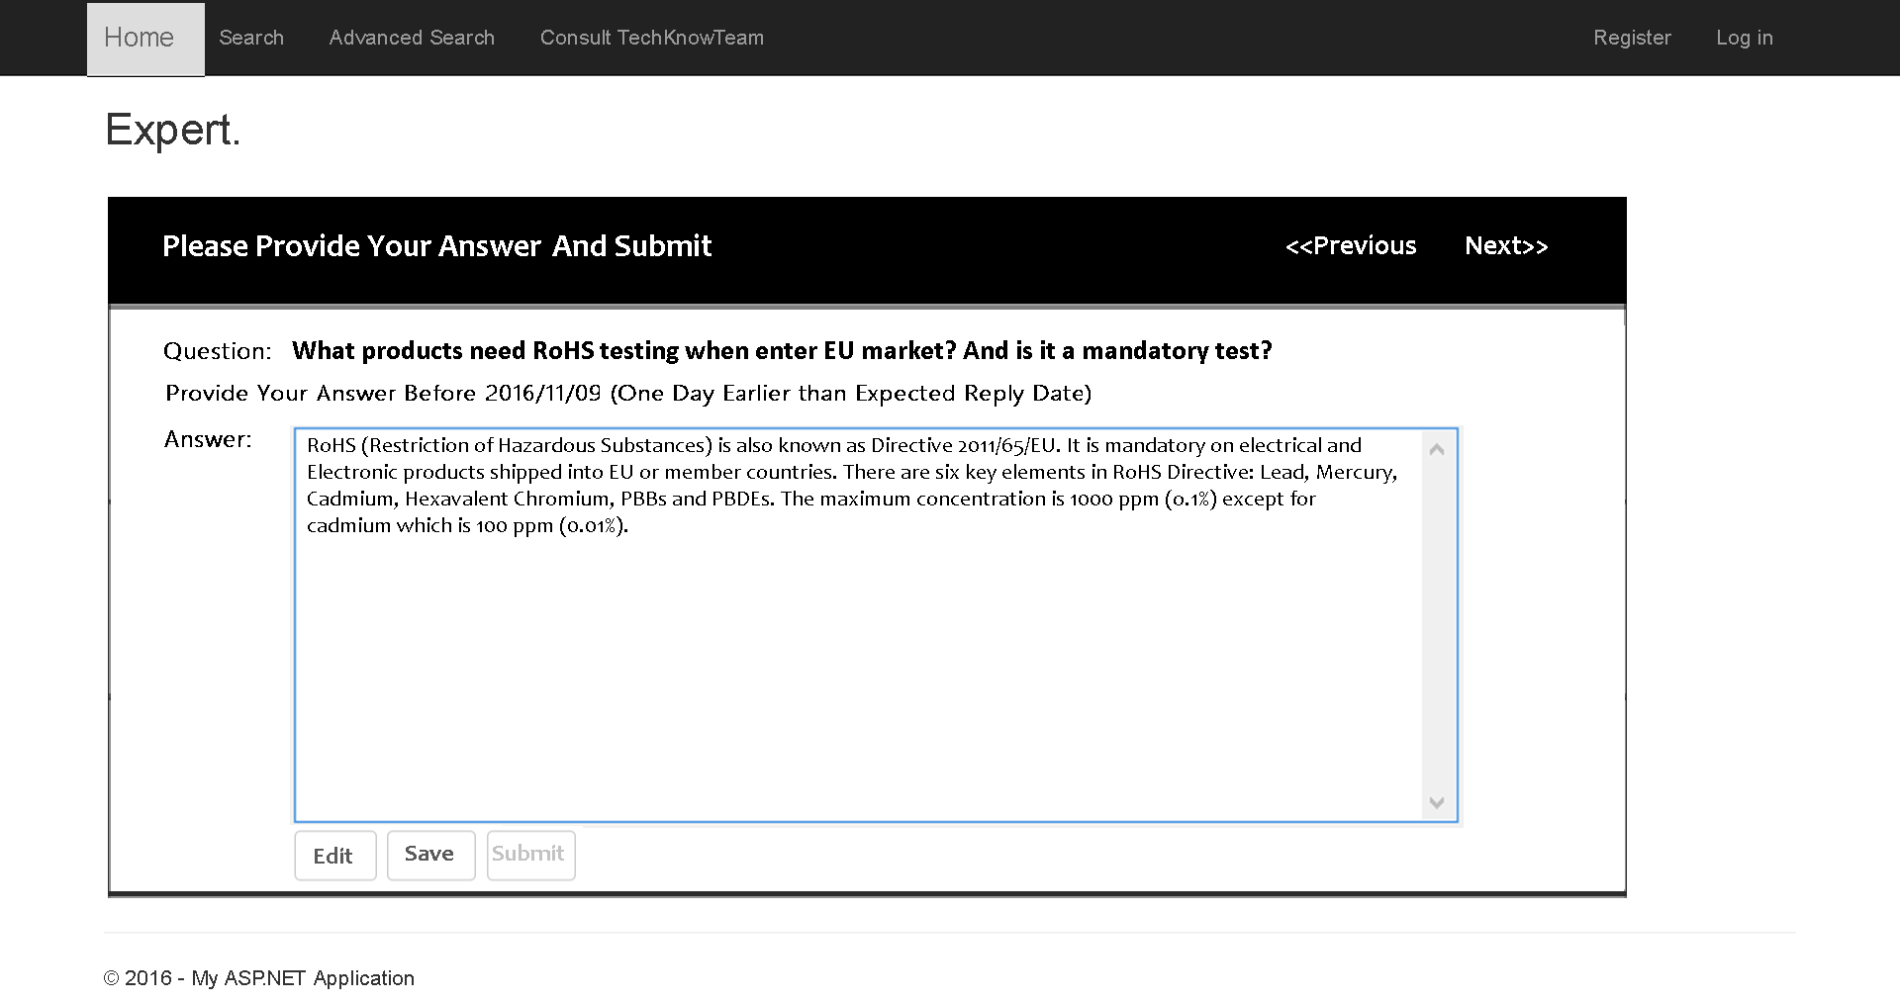

Slide 21
Expert Entrance
Include all functions for Enquirers

Slide 22
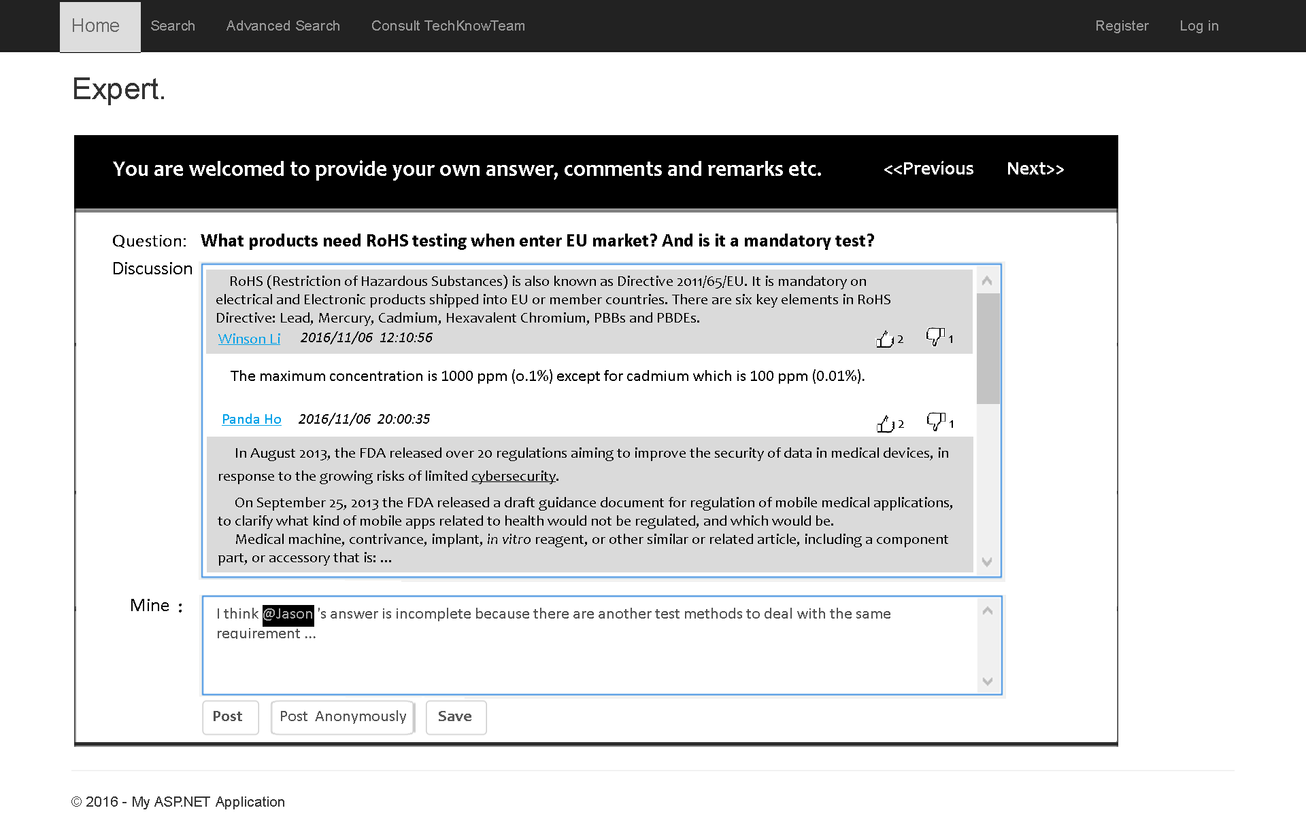

Slide 23
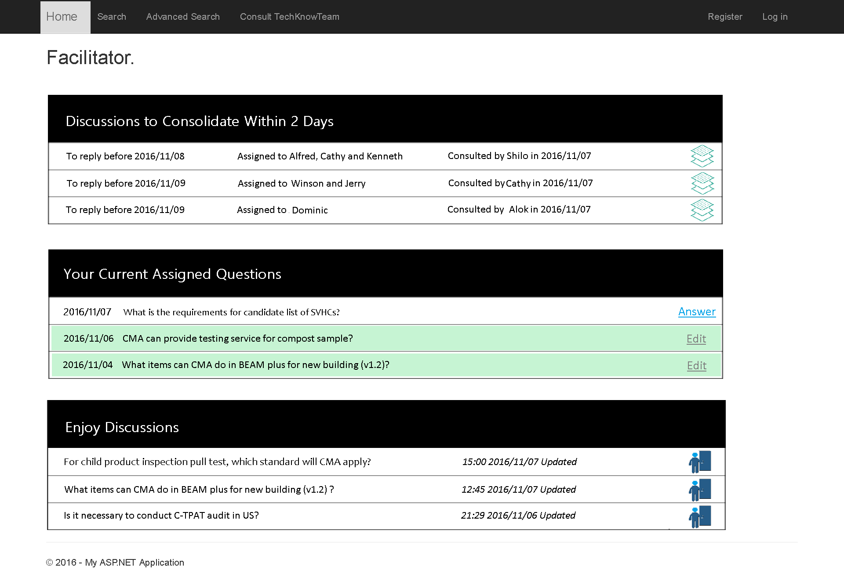
Include all functions
for Experts

Slide 24
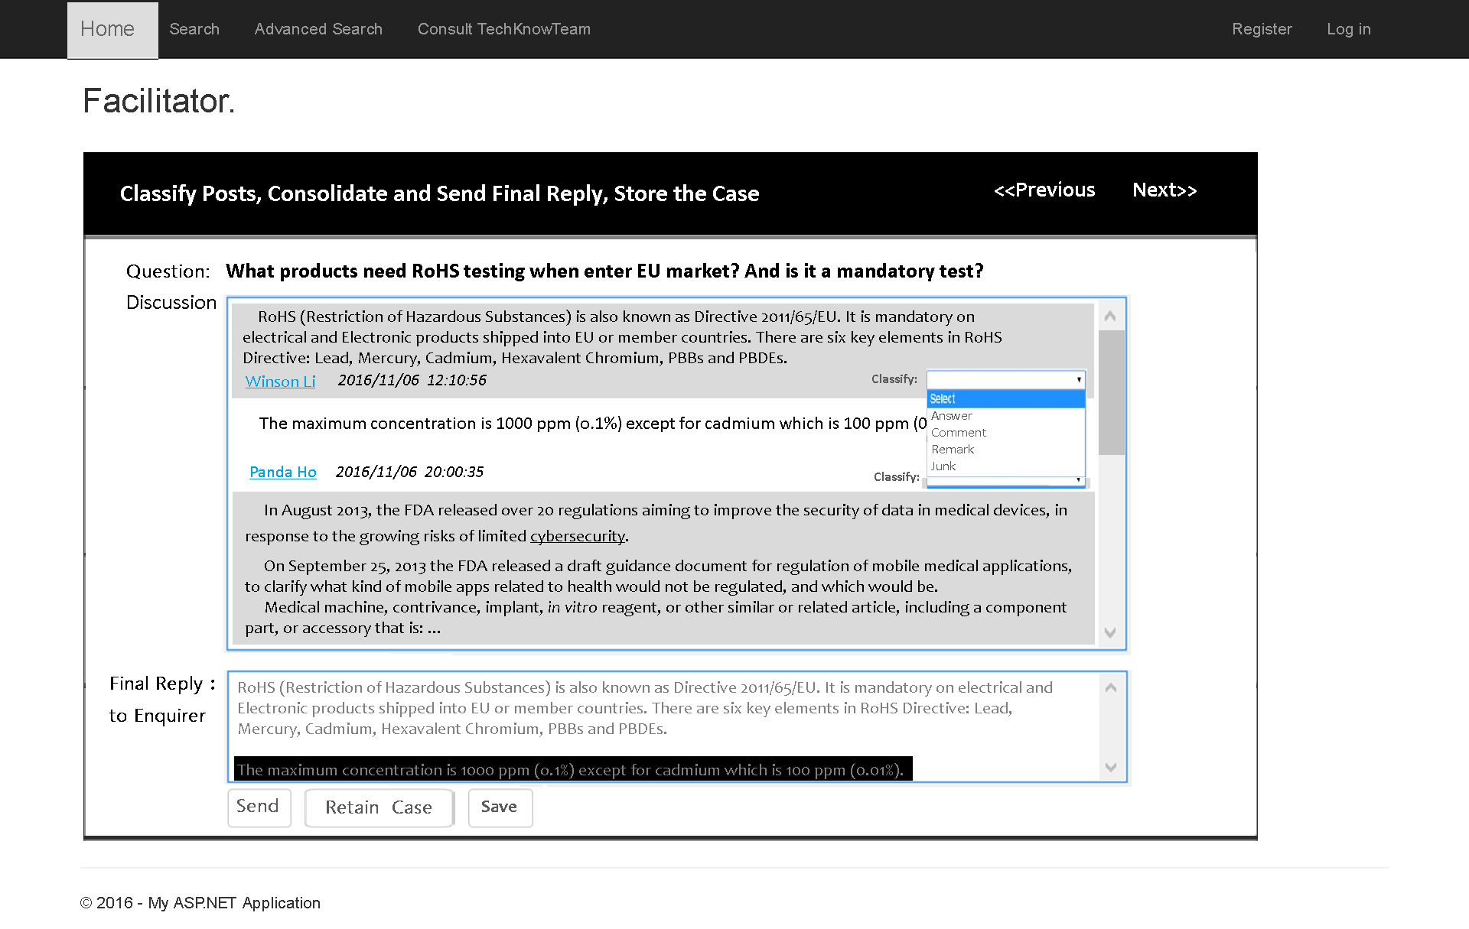

Slide 25
System Functions – Business Intelligence Reports
Purpose: To measuring the performance of knowledge intensive business
To monitor status of equiry business
To enhance motivation
To provide references for incentives
Target Users:
Management

Slide 26
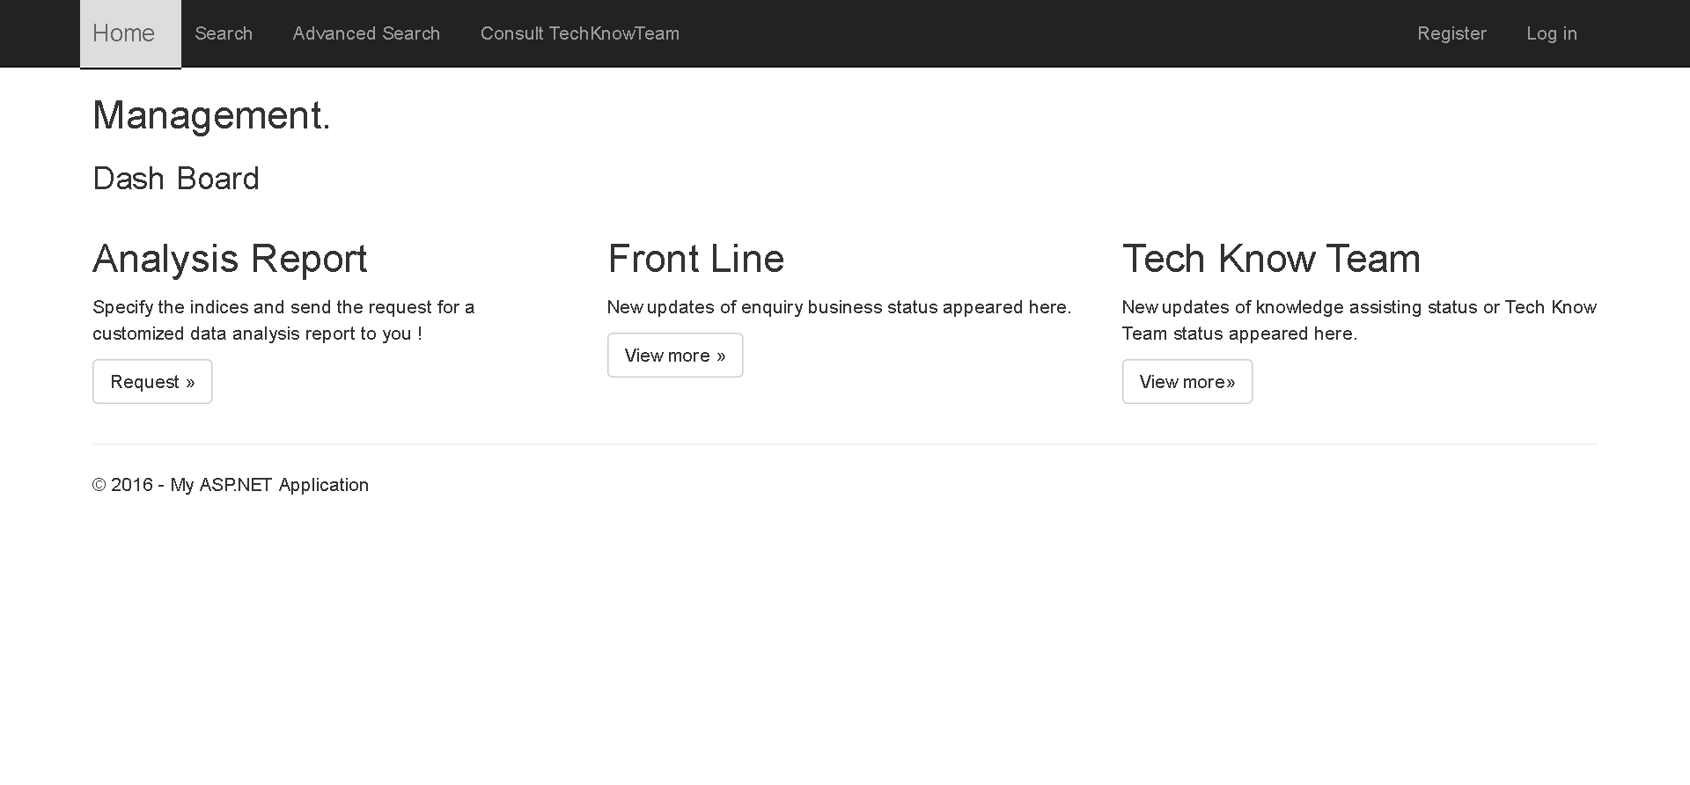

Slide 27
Milestones and Current Progress
12/9/2016 - 13/3/2017
Project Setup and data collection, and knowledge repository construction (~50%)
14/3/2017 - 14/9/2017
Development of the system core functions: case archive, enquiry handling, management review, R&D reference (~20%)
15/9/2017 - 15/3/2018
Development of the visualization module and user interface (~5%)
16/3/2018 - 11/9/2018
Integration and final refinement of the system, and user training

Slide 28
Tasks Involved
Workflow design for Enquirer, Expert and Facilitator
Database design
Implement part of the case retain and retrieval
Workflow design for Management
Data collection and analysis
UI design
System Development

Slide 29
Questions?

Slide 30
On project roles of the CMA IT Division
On project data retaining
On internet channels to receive and answer customer enquiries
On current methods used by front line employees to document customer enquiries

