Slide 1


Findings Report
DENG Yanheng
George

Slide 2

Objective
Topic---”Workflow Efficiency Improvement”;
Problem---Lacking professional knowledge;
My objective---”Reporter”(Investigate, Find problems, report, try to find out solutions);
Study objective--- Working process of BD(salesmen);

Slide 3
Defining the problem
What is the specific meaning of efficiency in the Business Development division?
Responding time to customers’ enquiries.
Target:
Within 3 days(according to the company’s website)
Current situation:
Target time can hardly be achieved, some up to 3 weeks;
30% loss of customers, within capability, due to slow response
(according to the record of 180 cases from Jan to Jun and interviews).

Slide 4
Solution--Methodology
Study and visualize the workflow;
Analyze the workflow and find out the key processes for the objective, which may contribute to long responding time;
Find out the problems of the processes and the reason behind;
Work out the solutions;

Slide 5
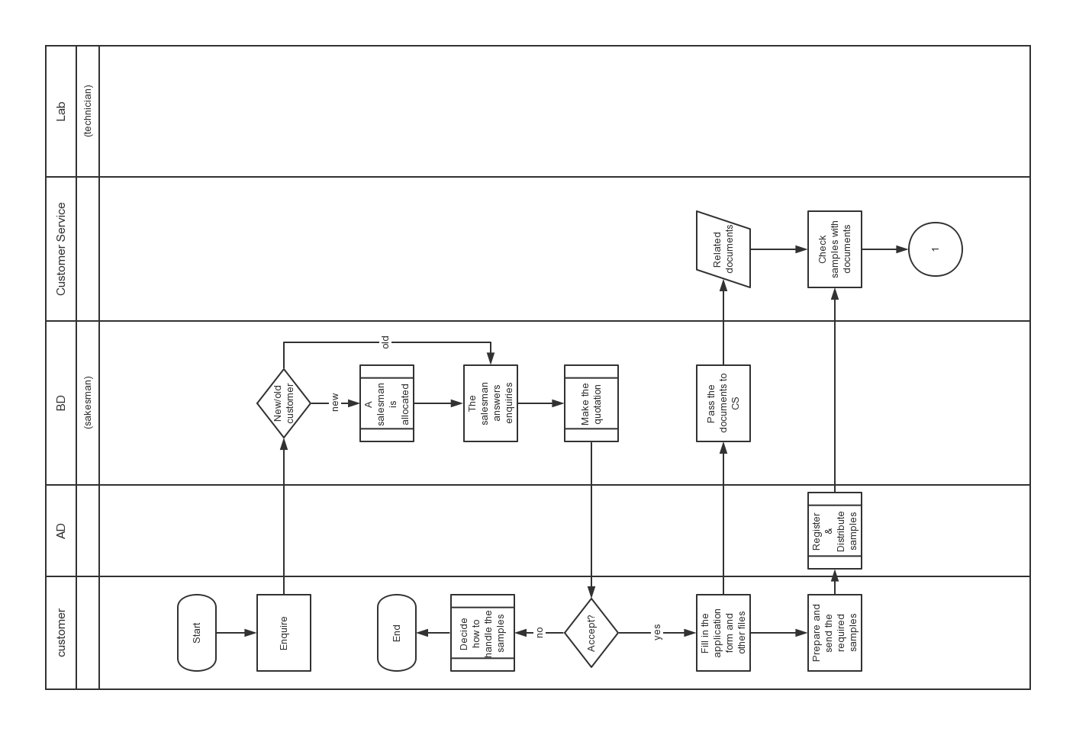
Workflow study-General

Slide 6
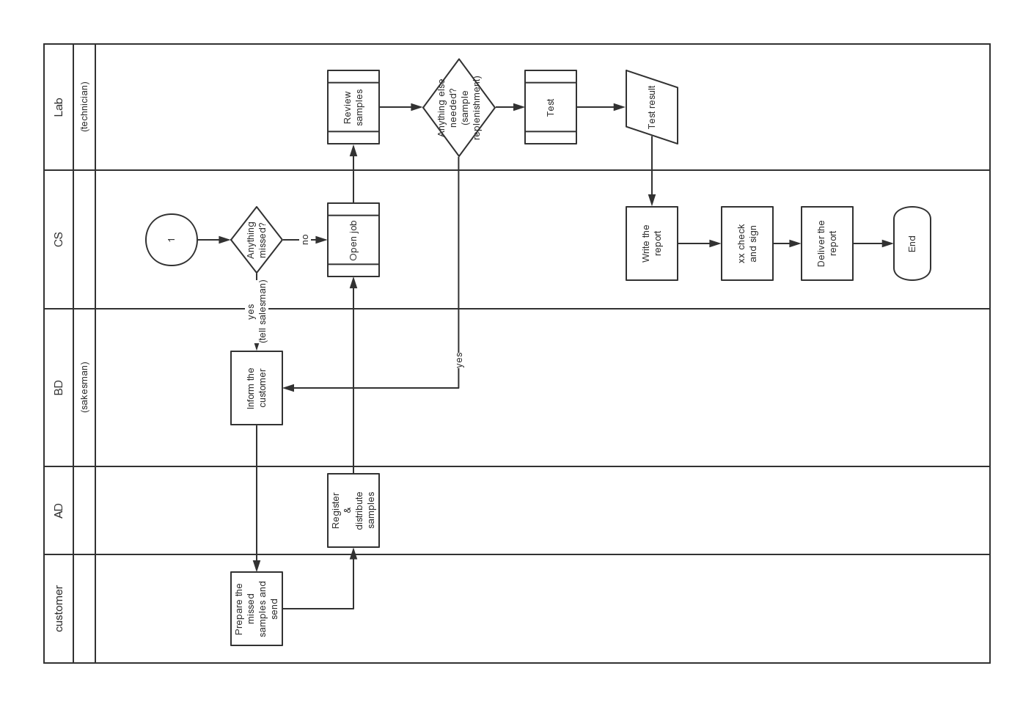
Workflow study-General

Slide 7
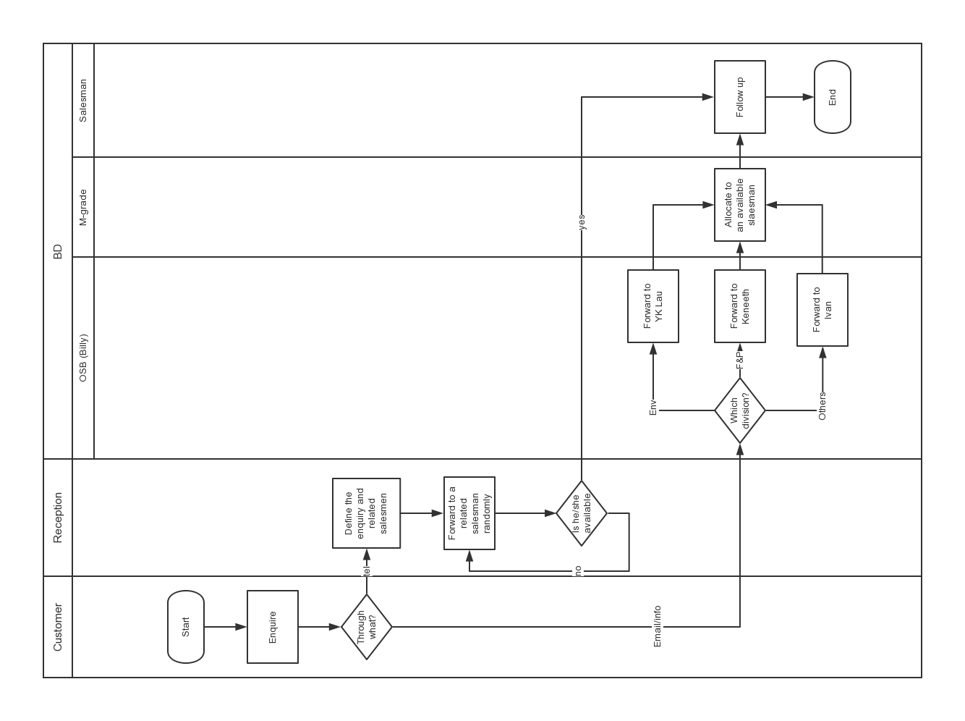
Workflow study—Customer allocation

Slide 8
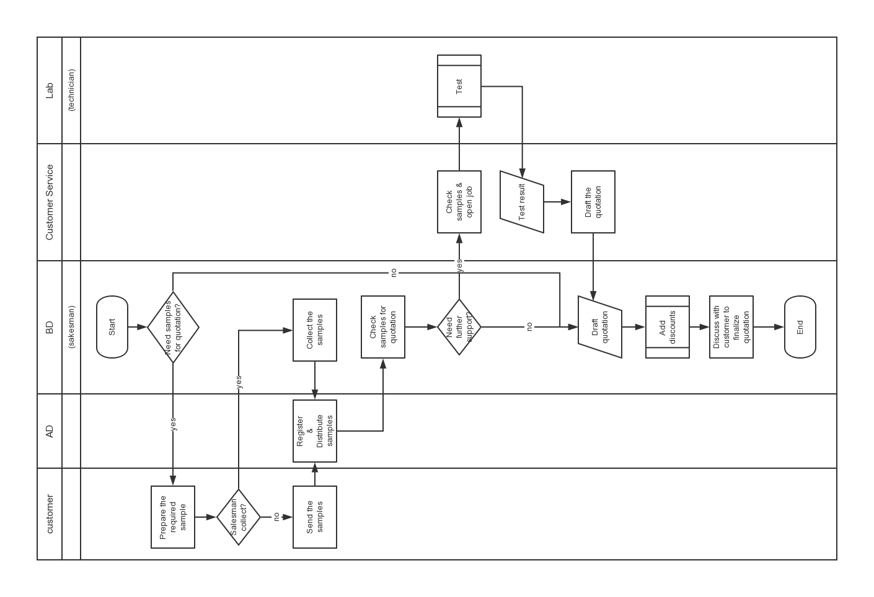
Workflow study—Making quotations

Slide 9
Workflow study--Simplified
Specific Knowledge holder
Assist
Ask for help
Salesman
Ask and answer
Allocate and assign
Customer
Related manager
OBD
(BD Division)
Email enquiry
Sort and forward

Slide 10
Key Processes Analysis—Customer allocation
Specific Knowledge holder
Assist
Ask for help
Salesman
Ask and answer
Allocate and assign
Customer
Related manager
OBD
(BD Division)
Email enquiry
Sort and forward

Slide 11
Key Processes Analysis—Customer allocation
Fact 1: Normally half a day is cost from receiving enquiry to assigning it to a salesman, providing the division manager is on job. Otherwise, the OBD will directly assign.
Solution : OBD directly assigns the customers to the salesmen;
Salesman
Ask and answer
Allocate and assign
Customer
Related manager
Sort and assign
OBD
(BD Division)
Email enquiry
Sort and forward

Slide 12
Key Processes Analysis—Customer allocation
Feasibility analysis:
13 salesmen in total, information can be shared(who is available and suitable, also the assigning record to guarantee fairness);
1.18 enquiries received per day in average;
Result: Enquiries can be assigned
to a salesmen instantly.
 | Info | Cmatcl.com | QAS | Total | Average
Jan | 10 | 3 |  | 13 | 0.65
Feb | 11 | 3 |  | 14 | 0.7
Mar | 19 | 13 | 1 | 33 | 1.65
Apr | 22 | 7 |  | 29 | 1.45
May | 14 | 7 |  | 21 | 1.05
Jun | 22 | 21 |  | 43 | 2.15
Peak days: 26-Jun: 8 enquiries;
01-Apr: 5 enquiries;
27-Mar: 6 enquiries;
18-Mar: 5 enquiries;

Slide 13
Key Processes Analysis—Customer allocation
Fact 2: OBD has no back up, which means if he is off, all the enquiries will be dragged.
Solution: Find a back up for OBD,

Slide 14
Key Processes Analysis—Respond to enquiries
Specific Knowledge holder
Assist
Ask for help
salesman
Ask and answer
Allocate and assign
Customer
Related manager
OBD
(BD Division)
Email enquiry
Sort and forward

Slide 15
Key Processes Analysis—Respond to enquiries
Fact:
Scenario for a salesman:
“wait I need to check”->find the specific knowledge holder and ask
-> wait for response;
The more important the knowledge is, the busier the holder is, the more slowly he will answer the salesman’s enquiry.
Especially for new salesmen;
On-job-learning, which means learning from mistakes.

Slide 16
Key Processes Analysis—Respond to enquiries
Cause 1: Insufficient training
“In the first few months of my job here, I have taken sufficient training courses arranged by the company to get me better prepared for my work and familiar with my business”
Average point: 2.7**
55% chose 2, I disagree.
“Then what kinds of trainings have you taken arranged by the company?”
Lab tour x 1; EASy training x 4;
Telephone skills x 2; Regulations x 2;
（**The mark used in the survey ranges from 1 to 5, namely Totally Disagree, Disagree, Not sure, Agree, Totally agree.）

Slide 17
Key Processes Analysis—Respond to enquiries
Solutions:
Build up a systematical training program for the new comers to help them equipped with sufficient skills and knowledge as soon as possible;
The training should emphasize more on the standards and case learning, if not all, at least the hot services and the frequently occurred problem;
There should be enough well organized training materials, which the staff can refer to even on their job.

Slide 18
Key Processes Analysis—Respond to enquiries
Outcomes:
Salesmen can be more professional on their business, which means they can handle the enquiries more independently;
For the long term, a culture of learning would be established, which is significant to the efficiency of salesmen in such a knowledge intensive business.

Slide 19
Key Processes Analysis—Respond to enquiries
Cause 2: No sufficient well organized and filed information
‘There are sufficient well sorted files that can be easily accessed on some standard questions(like services list and price, regulations in detail, etc), which makes me able to respond to the enquiries more quickly without consulting others.’
Average: 2.5; deleting the highest and lowest: 2.4
‘There are some common questions that are highly frequently asked by every customer.’
Average: 3.8; deleting the highest and lowest: 3.9

Slide 20
Key Processes Analysis—Respond to enquiries
Internally:
Can be used for training and reference, the salesmen can find answers they don’t know more easily and meanwhile, their expertise can be strengthened;
Motivate salesmen’s self-study, establish a culture of study in a long term, which is important to a knowledge intensive business;

Slide 21
Key Processes Analysis—Respond to enquiries
Externally:
No sufficient reference provided to the customers, namely on the website, including the FAQ, the information of services and what services they may need in what situation, etc;
(Compared with the information I can find on STC, TUV and SGS’s websites)
With sufficient information mentioned above, the number of enquiries without value adding can be decreased, which will benefit the efficiency.

Slide 22
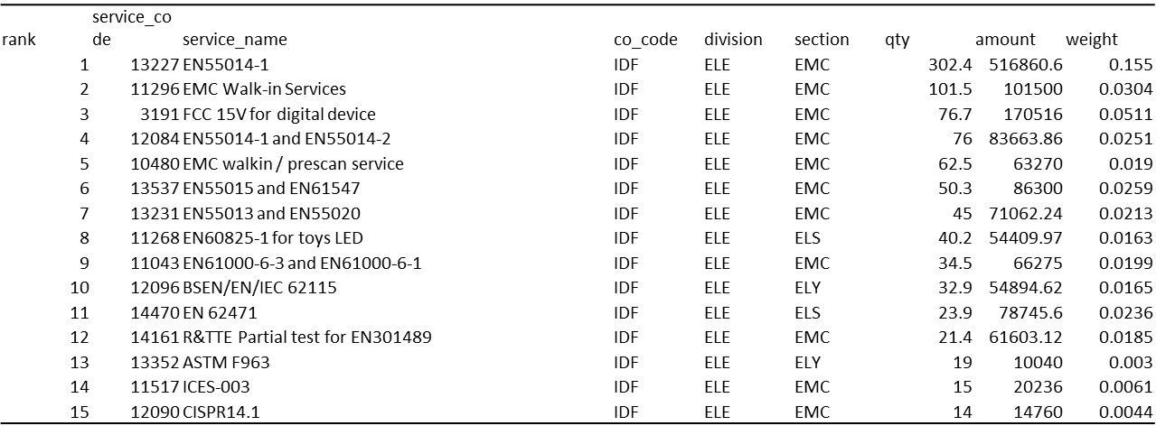
Key Processes Analysis—Respond to enquiries
Solutions:
Let experienced staff collect the useful information and knowledge, based on the hot
services or key customers;
(Some salesmen complain that study all the regulations is too hard for them)
Hottest services of ELE division
(Jan-Jul)

Slide 23
Key Processes Analysis—Respond to enquiries
Strengthen the case reviewing, not only orally, but codify the lessons learnt and file them;
Collect the FAQ and more useful information for customers, publish them on the website.

Slide 24
Key Processes Analysis—Respond to enquiries
Cause 3: Insufficient reviewing
Reviewing result and lessons learnt are not all recorded for further reference;
Salesmen don’t strictly follow the ‘Customer enquiry feedback’ recording policy, which makes the afterwards analysis difficult;
Among all 180 enquiries recorded from Jan to Jul, only 12 has reflection on ‘Reasons for not confirming the quote’; 87 of them with no ‘ Follow up’ and ‘Reasons’ record

Slide 25
Key Processes Analysis—Respond to enquiries
Solutions:
Write down the cases reviewing result, or at least for the important ones, and file them for further reference;
Make strict afterwards reflection policy, which will benefit the periodical review to improve performance.

Slide 26
Key Processes Analysis—Respond to enquiries
Cause 4: Insufficient information sharing among divisions.
‘I clearly know what’s going on with the labs. ‘
Avergae:3.2
‘I think knowing more real-time information of the labs can help improve my working performance.’
Average: 3.8
‘ what sort of information do you think is most closely related to your job?’
Service Update-41%; Working progress-29.5%;
R&D progress-23.5%;Others- 5%.

Slide 27
Key Processes Analysis—Respond to enquiries
The speed and convenience of information or knowledge flow are essential to the salesmen’s reacting speed;
Knowing more about the real time progress of the Lab or R&D can improve the salesmen’s flair to the market.

Slide 28
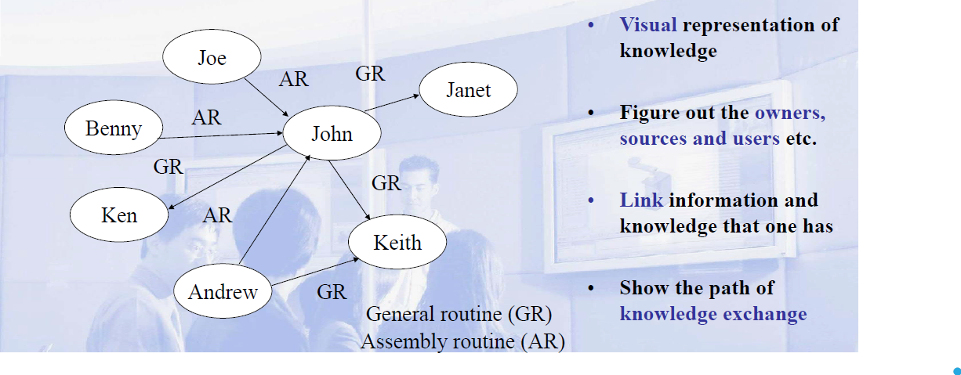
Key Processes Analysis—Respond to enquiries
Solutions:
Knowledge map: uncovers those people within the organization who are used as primary sources for knowledge. It also helps uncover how knowledge moves through the environment and determines ways to improve it;

Slide 29
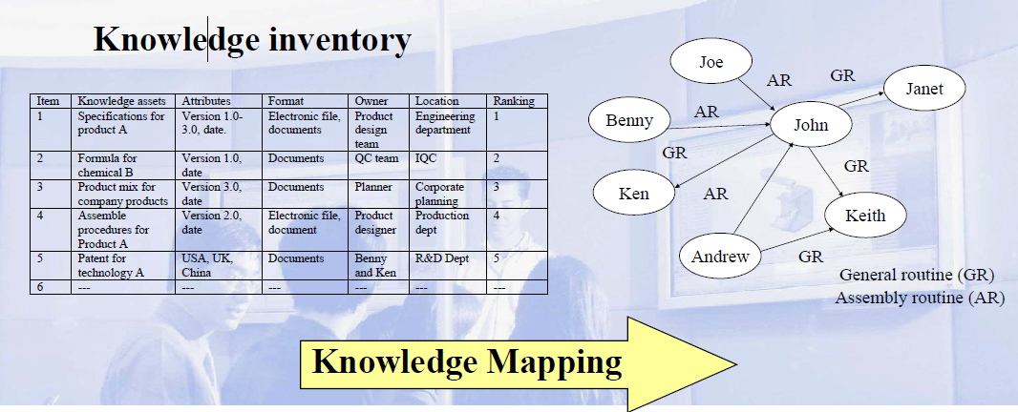
Key Processes Analysis—Respond to enquiries
Solutions:
Knowledge map(continued):The map is generated by knowledge mapping, a process of assessing and linking the information, knowledge, competence held by individual and groups within an organization.

Slide 30
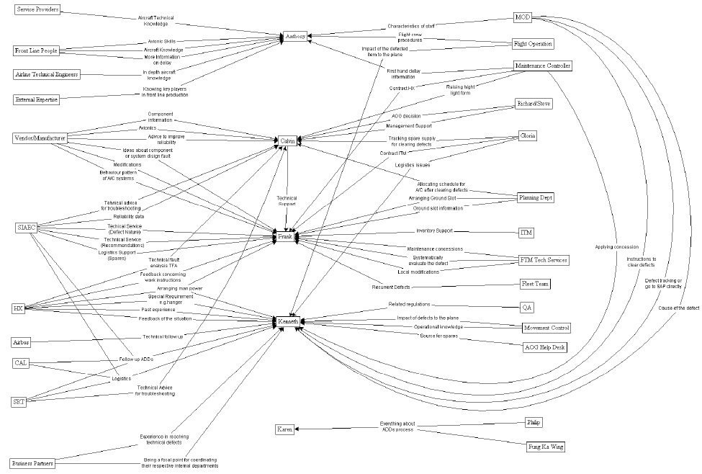

Slide 31
Key Processes Analysis—Respond to enquiries
Solutions:
An online forum: easy for information sharing, an administrator can manage the forum and collect all the useful information for further use;
Service update: inform the salesmen of any valuable progress in lab or R&D timely.

Slide 32
Conclude and extend
Conclusion:
The keys to improve the working efficiency is to strengthen the salesmen’s expertise, audit and retain the useful knowledge for reference and study and accelerate the flow of information and knowledge;
Extend to the whole CMA:
Knowledge Management System

Slide 33
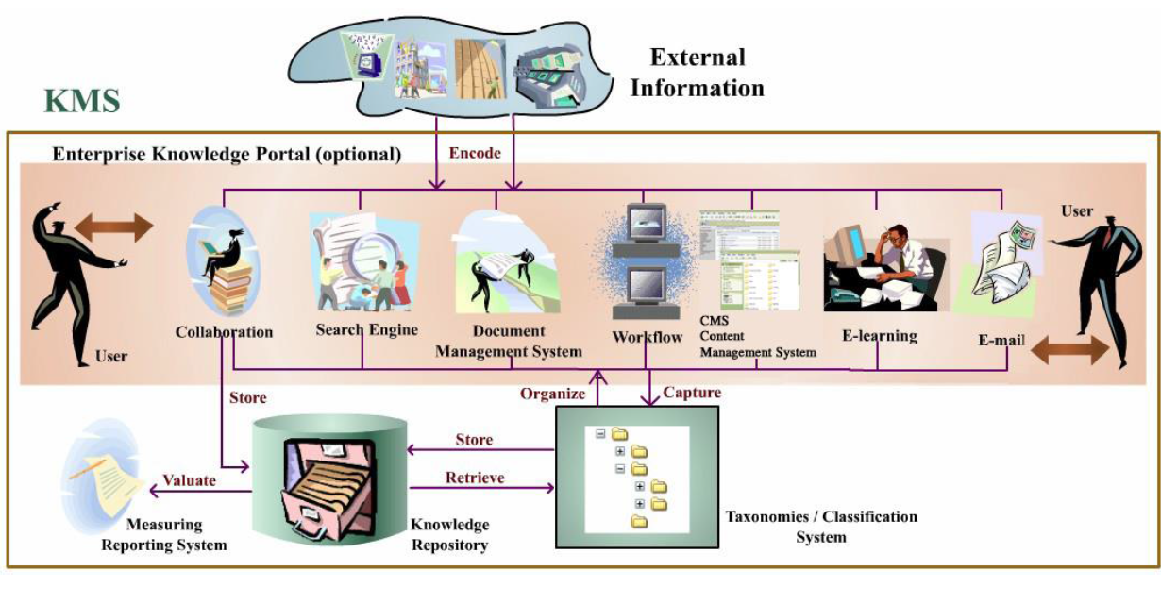
Conclude and extend

Slide 34
Knowledge Management
Why important for the division’s working efficiency?
--CMA:
A knowledge intensive business, selling knowledge and expertise;
--Knowledge Management:
A cross disciplinary practice that enables organizations to improve way they create, adopt, validate ,diffuse, store and use knowledge in order to attain the goals faster and more effectively;
The major underlying KM principle is “to provide the right knowledge to the right person at the right time in the right context”.
Leveraging collective wisdom to increase responsiveness and innovation.

Slide 35
Knowledge Management
Benefits
Faster and better innovation cycles in products and services;
Retain knowledge of retiring and resigned staff;
Increase employee productivity ;
Build sustainable competitive advantage ;
Transfer/share know-how best practices with others.

Slide 36
Knowledge Management
Examples
Buckman Laboratories
50% rise in sales from new products indicating a sharp rise in profitability from innovation;
51% rise in sales per associate;
93% increase in operating costs per associate;
Cost of training with the learning center decreased from $1,000 per hour to $25- $40;
Global speed of response to the customer has improved from days and weeks to hours;

Slide 37
Knowledge Management
A ‘Computer Software and Services Company’ in the U.S. with more than 50,000 employees
Knowledge capture, sharing and reuse is happening within and across all teams;
Knowledge created by former employees is still being reused to solve customer problems every month;
Customer satisfaction has risen on cases where KCS has been used;
KCS has contributed to overall increases in case efficiency;

Slide 38
Knowledge Management
KCS has created the foundation needed to enable customer self-help for the future;
A one-off investment costs in KCS over a 21 month period amounted c $2.3m. The basic efficiency savings in year 2000 are estimated at $1.5mwith similar efficiency savings expected in each future year. The ongoing KCS investment costs are estimated at c. $400k per annum

Slide 39
Knowledge Management
Steps
Phase 1: infrastructural evaluation
Analyze the existing infrastructure;
Align knowledge management and business strategy;

Slide 40
Knowledge Management
Phase 2: KM system analysis, design, and development
3. Design the KM infrastructure;
4. Audit existing knowledge assets and systems;
5. Design the Km team;
6. Create the Km blueprint;
7. Develop the KM system;

Slide 41
Knowledge Management
Phase 3: Deployment
8. Deploy, suing the result-driven incremental methodology;
9. Manage change, culture and reward structures;
Phase 4: Evaluation
10. Evaluate performance, and incrementally refine the KM system

