Slide 1
Keylime: Enabling Trust in the Cloud
POC: Charles Munson, Nabil Schear and Martine Kalke
keylime@ll.mit.edu
7 May 2019
DISTRIBUTION STATEMENT A. Approved for public release. Distribution is unlimited. This material is based upon work supported by the Under Secretary of Defense for Research and Engineering under Air Force Contract No. FA8702-15-D-0001. Any opinions, findings, conclusions or recommendations expressed in this material are those of the author(s) and do not necessarily reflect the views of the Under Secretary of Defense for Research and Engineering. © 2019 Massachusetts Institute of Technology. Delivered to the U.S. Government with Unlimited Rights, as defined in DFARS Part 252.227-7013 or 7014 (Feb 2014). Notwithstanding any copyright notice, U.S. Government rights in this work are defined by DFARS 252.227-7013 or DFARS 252.227-7014 as detailed above. Use of this work other than as specifically authorized by the U.S. Government may violate any copyrights that exist in this work.

Slide 2





Cloud Customer Need: Trust
Everything is moving into the cloud
Personal photos and files, collaborative editing
Consumers, industry and government all following this trend
Many cautiously waiting to move until they are sure it is safe
Can you be certain your data is kept confidential and is not being tampered with?
iCloud data leak
Ransomware attacks
Deploying these apps and data requires more trust in the cloud provider

Slide 3
Anatomy of Cyber Attacks on the Cloud Representative Example of Approaches
1
3
Conduct Recon
Profile users
Scan networks
Reverse engineer software
Establish Persistence
Install backdoor malware
Move laterally
Processing
Cloud Systems
Users and Systems
4
2
Network
Storage
Corrupt Data
Modify mission databases
Change network messages
Compromise User
Spear phishing
Watering hole attack
WAN Net
4
2
Exfiltrate Data
Leak data w/ covert channel
Develop targets from stolen data
Compromise Data
Control flow hijacking
Database injection
2
4
Compromise System
Physical tamper
Supply chain
Deny Service
Flood with unwanted traffic
Destroy data or systems
1
2
3
4
Prepare
Engage
Maintain Presence
Achieve Effect & Assess Damage
WAN: Wide Area Network

Slide 4
Secure Resilient Cloud Architecture Approach
1
Use cryptography to isolate data at rest, in transit, and in use with keys controlled by tenant
Processing
Cloud Systems
Users and Systems
Network
Storage
WAN Net
3
Where needed, trust but verify cloud provider services
2
Use diversity / randomness and data provenance to mitigate attack impact and recover
1
2
3
Isolate
Mitigate
Verify Trust
WAN: Wide Area Network

Slide 5
Outline
Cloud Customer Need
Verifying Trust Problem / Alternatives
Keylime
Architecture
Protocols and Performance
Example Workflow
Transitions
Way Forward

Slide 6
Once Upon a Time, I Started Trusting My System…
Cloud System Lifetime
System Provisioning
System Running
Establish Root of Trust
Establish Root of Trust
Monitor System Integrity
Image
SSH
cloud-init
Provider
Anti-malware
File integrity
Infrastructure automation
SSH: Secure Shell

Slide 7

Once Upon a Time, I Started Trusting My System…
Cloud System Lifetime
Component Manufacture
Firmware Install
Hypervisor Install
Hypervisor Boot
Cloud Stack Configuration
System Provisioning
System Running
Establish Root of Trust
Establish Root of Trust
Monitor System Integrity
?
Image
SSH
cloud-init
Provider
Anti-malware
File integrity
Infrastructure automation
SSH: Secure Shell

Slide 8
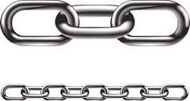
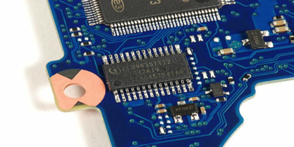
Once Upon a Time, I Started Trusting My System…
Cloud System Lifetime
Component Manufacture
Firmware Install
Hypervisor Install
Hypervisor Boot
Cloud Stack Configuration
System Provisioning
System Running
Establish Root of Trust
Monitor System Integrity
Trusted computing integrity measurement
Anti-malware
File integrity
Infrastructure automation
Trusted Platform Module (TPM)
Establish hardware root of trust early and check software integrity throughout the system’s lifetime
SSH: Secure Shell

Slide 9
Trusted Platform Module (TPM) Hardware Root of Trust
TPM answers two questions:
Which machine am I talking to?
Endorsement Key (EK): permanent, unique key that certifies device is a real TPM
Created by TPM manufacturer
Will the machine do the “right” thing?
Trusted Platform Module
The TPM is a ubiquitous, secure cryptoprocessor that acts as a hardware root of trust

Slide 10

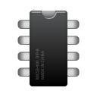
Using the TPM: Integrity
Each component measures (hashes) the next component before transferring control
App
App
Mon
Mgmt
Applications
Operating System
Measure
Operating System
Hash chain
Measure
Bootloader
TPM
hash2 || hash3
Measure
hash1 || hash2
Firmware
Measure
0 || hash1
BIOS
Change to any hash propagates up chain
Use measurements to create a hash chain rooted in the TPM storage

Slide 11
Using the TPM: Remote Attestation
Present a hash chain signed by the TPM (Quote) to other hosts to prove integrity state
Attestation Identity Key (AIK): key created by TPM owner to sign quotes
Quote
Hash chain
Does the system state match my whitelist?
Nonce
Is this quote fresh?
Signature
Is this quote signed by a real TPM?
App
App
Mon
Mgmt
Quote Verifier
Operating System
TPM: Trusted Platform Module

Slide 12

Requirements and Potential Solutions
 | Trusted Platform Module (TPM) | Commercial Cloud (Amazon, Google, etc.) | MIT LL Keylime Approach
HW Root of Trust | ✓ | ≈ | ✓
Tenant-Controlled Keys | ✓ | ✘ | ✓
Cloud Scalability | ✘ | ✓ | ✓
Cloud Compatibility | ✘ | ✓ | ✓
TPM Challenges
Very slow (~1 sec to do one crypto op)
Incompatible with VMs and existing cloud software stacks
Commercial Cloud Challenges
If available, not accessible to tenants
Tenant key management in software with no root of trust
VM: Virtual Machine

Slide 13
Outline
Cloud Customer Need
Verifying Trust Problem / Alternatives
Keylime
Architecture
Protocols and Performance
Example Workflow
Transitions
Way Forward

Slide 14
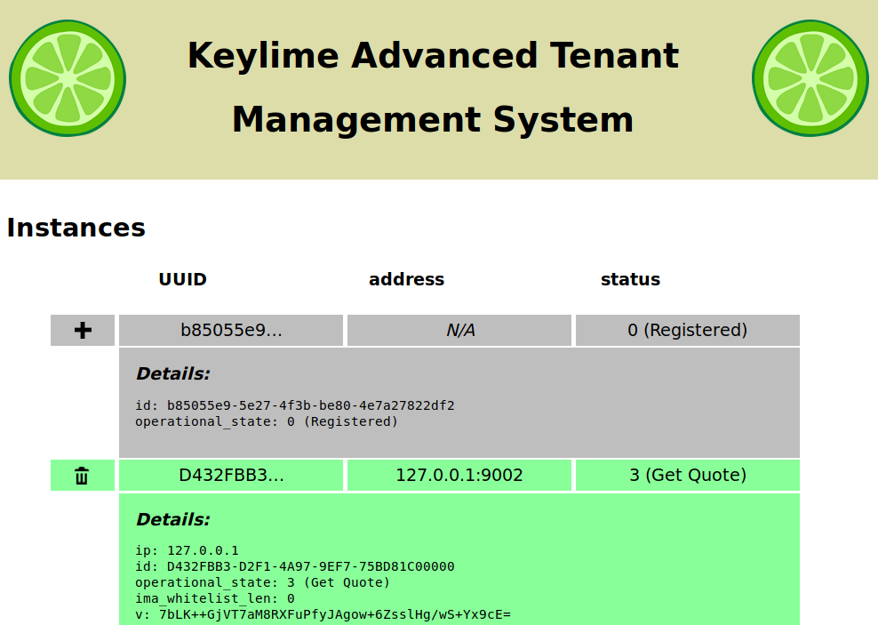
Introducing Keylime
Keylime is an integrated TPM-based key bootstrapping and integrity measurement software architecture built for the cloud
Performant: low-latency, scales to thousands of nodes
Compatible:
Works with all of your existing software and development stacks
Can be used in both a virtual machine and on bare-metal
Open Source: available to the world at https://github.com/keylime/keylime
Keylime provides a tenant-controlled, hardware-based root of trust to secure the cloud
TPM: Trusted Platform Module

Slide 15
Keylime Components
Tenant-owned verifier checks node system integrity
Tenant Cloud Verifier
Cloud user
Tenant
Tenant Registrar
Cloud Node
Stores public keys of TPMs in tenant’s environment
Machine the tenant wants to use securely
TPM
Tenant-controlled
Provider-controlled

Slide 16

Secret Keylime Sauce
1
Tenant Cloud Verifier
Check TPM Keys
Delegate Integrity Check
Check Node Integrity
Tenant
Tenant Registrar
2
Demonstrate Intent
Cloud Node
TPM
Key shares recombined to obtain bootstrap key
Tenant-controlled
Provider-controlled

Slide 17

Keylime Attestation: Identity Key Registration
Key | Type | Purpose
EK | RSA 2048 | Permanent, certifies valid TPM
AIK | RSA 2048 | TPM key to sign quotes
K_{e} | AES-256 | Ephemeral challenge key to certify AIK
AIK successfully tied to EK identity
Tenant Cloud Verifier
Challenge node to decrypt K_{e} with EK
Provide public keys
AIK_{pub}
Tenant
Tenant Registrar
ID,AIK_{pub},EK_{pub}
Enc_{EK}(H(AIK_{pub}),K_{e})
Cloud Node
TPM
Prove Node knows K_{e}
Legend
Tenant-controlled
EK_{priv}
AIK_{priv}
Mutual TLS
Server TLS
Provider-controlled
No TLS
EK: Endorsement Key
AIK: Attestation Identity Key

Slide 18
Keylime Bootstrap: Checking Integrity (Part 1)
Key | Type | Purpose
AIK | RSA 2048 | TPM key to sign quotes
K_{b} | AES-256 | Bootstrap key to deliver to node
U,V | 256bit rand | Trivial secret shares of K_{b}
NK | RSA-2048 | Protects secret shares U,V in transit
Check validity of AIK that signed the quote
Tenant Cloud Verifier
Valid AIK?
nonce
Enc_{NK}(V)
Tenant
ID, V, IP, port, whitelist
Tenant Registrar
Quote_{AIK}(nonce, PCRs),NK_{pub}
Send key share if integrity and TPM identity good
Notify verifier of new node. Delegate key share
Quote proves system integrity. Provide transport key for V
Cloud Node
TPM
Legend
Tenant-controlled
Mutual TLS
Server TLS
Provider-controlled
No TLS
AIK: Attestation Identity Key
PCR: Platform Configuration Register, where TPM stores integrity measurements

Slide 19
Keylime Bootstrap: Checking Identity (Part 2)
Key | Type | Purpose
AIK | RSA 2048 | TPM key to sign quotes
K_{b} | AES-256 | Bootstrap key to deliver to node
U,V | 256bit rand | Trivial secret shares of K_{b}
NK | RSA-2048 | Protects secret shares U,V in transit.
Tenant-controlled
Provider-controlled
Tenant Cloud Verifier
Tenant
Quote proves node identity. Provide transport key for U
Tenant Registrar
nonce
Key shares recombined to obtain bootstrap key
Quote_{AIK}(nonce),NK_{pub}
Cloud Node
Enc_{NK}(U)
Check validity of AIK that signed the quote
TPM
Send key share if TPM identity good
Legend
Mutual TLS
Server TLS
Valid AIK?
No TLS
AIK: Attestation Identity Key

Slide 20

Keylime System Integrity Monitoring
Check validity of AIK that signed the quote
Tenant Cloud Verifier
Valid AIK?
nonce
Tenant
Tenant Registrar
Random number ensures quote is fresh
Quote_{AIK}(nonce, PCRs)
Cloud Node
Quote proves system integrity
TPM
Legend
Tenant-controlled
Mutual TLS
Server TLS
Provider-controlled
No TLS
AIK: Attestation Identity Key
PCR: Platform Configuration Register, where TPM stores integrity measurements

Slide 21


Keylime System Integrity Monitoring
Report integrity violation to listeners
Tenant Cloud Verifier
nonce
Tenant
Tenant Registrar
Random number ensures quote is fresh
Quote_{AIK}(nonce, PCRs)
Cloud Node
Quote proves system integrity
TPM
Legend
Tenant-controlled
Mutual TLS
Server TLS
Provider-controlled
No TLS
AIK: Attestation Identity Key
PCR: Platform Configuration Register, where TPM stores integrity measurements

Slide 22


Virtualizing Keylime – Background
Xen hypervisor supports vTPM since version 4.3
Each vTPM is a separate Xen VM
Trust of vTPMs rooted in hardware TPM of the hypervisor
DeepQuote operation to obtain hardware TPM quote from a vTPM
Keylime
Keylime
VM1
vTPM1
VM2
vTPM2
Hardware TPM
Apply the principle of least privilege to all provider-layer resources
VM: Virtual Machine
vTPM: Virtual Trusted Platform Module

Slide 23
Virtualizing Keylime – Architecture
Validate AIK from DeepQuotes with provider
Tenant Cloud Verifier
Tenant Registrar
Use DeepQuote to bind vTPM keys with hardware TPM
Use DeepQuote instead of quote
Tenant
Provider Registrar
Cloud Node
Stores public keys of TPMs in hypervisor hosts
vTPM
Xen Hypervisor
Legend
Tenant-controlled
TPM
Mutual TLS
Server TLS
Provider-controlled
No TLS
AIK: Attestation Identity Key
vTPM: Virtual Trusted Platform Module

Slide 24
Bootstrapping the Verifier
Under Tenant’s Physical Control
Private Verifier / Registrar
Tenant Cloud Verifier
This process can also be used to bootstrap the Tenant Registrar
TPM
Tenant
E ( )
Tenant Registrar
Bootstrap key enables mutual TLS and future secure comms
Cloud Node
TPM
Legend
Tenant-controlled
Mutual TLS
Server TLS
Provider-controlled
No TLS

Slide 25
Low-Latency, High-Scalability Performance
Cloud Scalability of Keylime Verifier
Latency
Better
Latency
Can check 10,000 nodes every 4 seconds with one Keylime verifier
Scalability
Better
Keylime can derive a key in less than 2 seconds, detect integrity violations in as little as 110ms, and can scale to monitor integrity of thousands of cloud machines

Slide 26
Outline
Cloud Customer Need
Verifying Trust Problem / Alternatives
Keylime
Architecture
Protocols and Performance
Example Workflow
Transitions
Way Forward

Slide 27
Cloud Usage: Certificate Authority and Revocation
Tenant Cloud Verifier
Software CA
Tenant
Integrity measurement
Tenant Registrar
Cloud Node
Cloud Node’s private key and certificate
TPM
Legend
Tenant-controlled
Mutual TLS
Server TLS
Provider-controlled
No TLS
CA: Certificate Authority

Slide 28
Cloud Usage: Certificate Authority and Revocation
Tenant Cloud Verifier
Software CA
Revoke signed certificate
Bootstrap Key Enables
Secure config management | Secure databases
Encrypted hard disks | Data integrity
Provenance authenticity | IPsec encryption
Tenant
Integrity measurement
Tenant Registrar
Cloud Node
Cloud Node’s private key and certificate
TPM
Legend
Tenant-controlled
Mutual TLS
Server TLS
Provider-controlled
No TLS
CA: Certificate Authority

Slide 29
Cloud Usage: IPsec Encryption with Revocation
Tenant Cloud Verifier
Tenant Registrar
Tenant
Quote proves system integrity
Quote proves system integrity
Cloud Node #1
Cloud Node #2
TPM
TPM
Tenant-controlled
IPsec node-to-node communication
Provider-controlled

Slide 30

Cloud Usage: IPsec Encryption with Revocation
Cryptographic certificate revocation
Tenant Cloud Verifier
Tenant Registrar
Cryptographic certificate revocation
Tenant
Cloud Node #1
Cloud Node #2
TPM
TPM
Tenant-controlled
Node #2 cannot communicate with Node #1
Provider-controlled

Slide 31
Outline
Cloud Customer Need
Verifying Trust Problem / Alternatives
Keylime
Architecture
Protocols and Performance
Example Workflow
Transitions
Way Forward

Slide 32




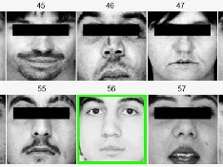
Transition: Securing the Mass Open Cloud (MOC)
Bio/Medical
Benefits:
Co-location and sharing of big data
Flexible shared compute resources
High security for government and commercial uses
Mass Open Cloud
Commonwealth
Commercial
Smart Cities IoT
USAF
Defense
Goal: Enable highly-secure open marketplace of cloud services, based in Massachusetts
IoT: Internet of Things
MOC: https://massopen.cloud

Slide 33
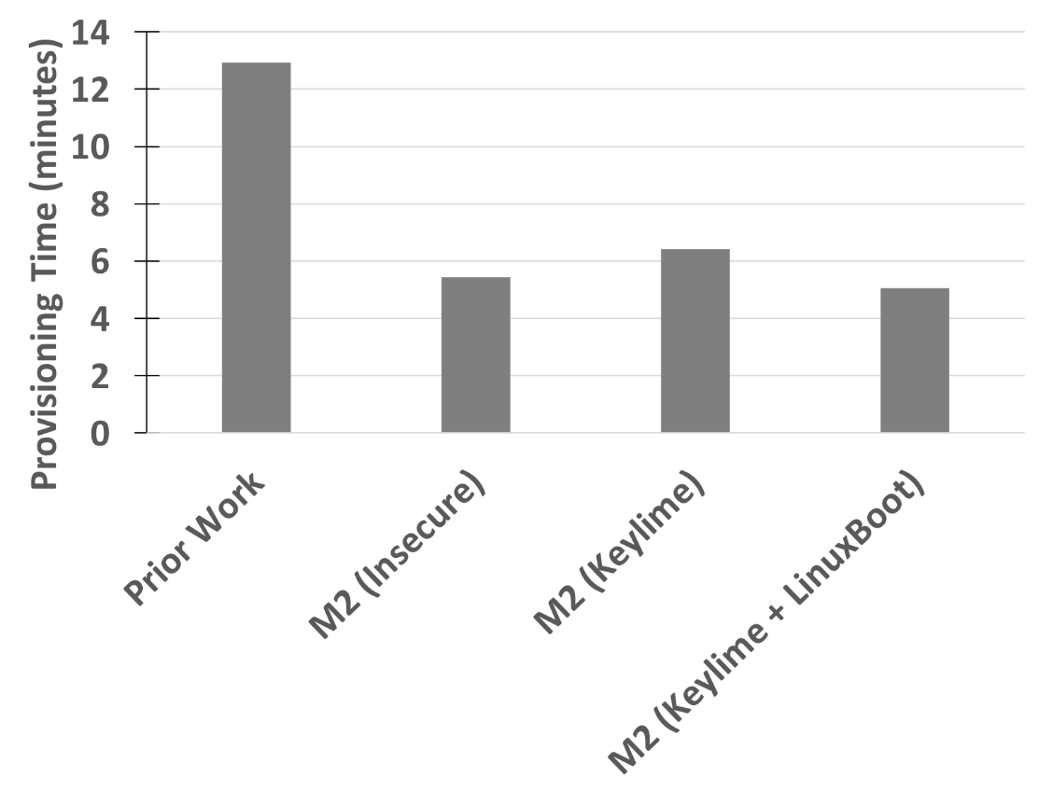
Integrating Keylime into the Mass Open Cloud
Boot Latency of End-to-End Secure Cloud System based on Keylime
16% overhead
7% faster
Provisioning Time
Better
Demonstrated cloud scalability and bare-metal provisioning at VM speeds
M2: Malleable-Metal-as-Service
LinuxBoot: https://github.com/linuxboot/linuxboot

Slide 34
Transition to Open Source
Vision: Integrate Keylime into Red Hat ecosystem to help secure enterprises and users
Include Keylime node in early boot sequence (e.g., UEFI or initrd)
Integrate Keylime with Red Hat’s infrastructure and deployment management tools
e.g., Red Hat Satellite and Foreman
Transition Goals:
Keylime should support the newer TPM 2.0 standard
Brings support for stronger encryption and hashing algorithms (vs. SHA1)
Keylime node should be converted to Rust (currently Python and C)
This is security software – we do not want Python in early boot
Stronger memory safety guarantees vs. C/C++
UEFI: Unified Extensible Firmware Interface
initrd: initial RAM disk (early Linux startup process)
TCG: Trusted Computing Group
Rust: Systems programming language with focus on safety

Slide 35
Summary
Current cloud adoption uses a “trust the cloud provider” security model
Our work shows we can trust but verify and create secure resilient cloud systems
Open source Keylime project being adopted by Mass Open Cloud and OSS community
Two conference papers:
Schear, Nabil, et al. "Bootstrapping and maintaining trust in the cloud." Proceedings of the 32nd Annual Conference on Computer Security Applications. ACM, 2016.
Mosayyebzadeh, Amin, et al. "A secure cloud with minimal provider trust." 10th USENIX Workshop on Hot Topics in Cloud Computing (HotCloud 18). 2018.
Full Keylime implementation available: https://github.com/keylime/keylime

Slide 36

Contact Information
Keylime keylime@ll.mit.edu
Nabil Schear
nabil@ll.mit.edu
Charles Munson
charles.munson@ll.mit.edu
Full Keylime implementation available: https://github.com/keylime/keylime

