Slide 1
Keylime Trust in the Cloud
Executive Summary
5 May 2018
POC: Nabil Schear, Charles Munson
DISTRIBUTION STATEMENT A. Approved for public release: distribution unlimited. This material is based upon work supported by the Assistant Secretary of Defense for Research and Engineering under Air Force Contract No. FA8721-05-C-0002 and/or FA8702-15-D-0001. Any opinions, findings, conclusions or recommendations expressed in this material are those of the author(s) and do not necessarily reflect the views of the Assistant Secretary of Defense for Research and Engineering. © 2017 Massachusetts Institute of Technology.
Delivered to the U.S. Government with Unlimited Rights, as defined in DFARS Part 252.227-7013 or 7014 (Feb 2014). Notwithstanding any copyright notice, U.S. Government rights in this work are defined by DFARS 252.227-7013 or DFARS 252.227-7014 as detailed above. Use of this work other than as specifically authorized by the U.S. Government may violate any copyrights that exist in this work.

Slide 2



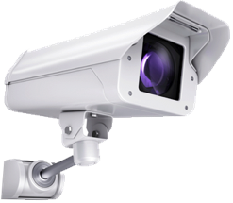

Cloud Customer Need: Trust
Everything is moving into the cloud
Personal photos and files, collaborative editing
Consumers, industry and government all following this trend
Many cautiously waiting to move until they are sure it is safe
Can you be certain your data is kept confidential and is not being tampered with?
iCloud data leak
Ransomware attacks
Deploying these apps and data requires more trust in the cloud provider

Slide 3



Approach
Ensure my rented cloud machines are not compromised
Securely provision these machines with my secrets
Detect if a cloud node becomes compromised
Works seamlessly with both virtual and bare-metal nodes
App
App
App
App
App
Mon
Mgmt
VM
Mon
VM
Mon
VM
Mon
Operating System
Hypervisor
Mgmt
How is it done today?
Notes:
Google is using similar, proprietary approach to secure their servers

Slide 4
Once Upon a Time, I Started Trusting My System…
Cloud System Lifetime
Instance Provisioning
Instance Running
Establish Root of Trust
Monitor System Integrity
Establish Root of Trust
Image
cloud-init
SSH
Amazon EC2
Anti-malware
File integrity
Puppet/Chef

Slide 5
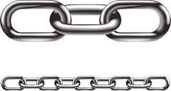
Once Upon a Time, I Started Trusting My System…
Cloud System Lifetime
Component Manufacture
Firmware Install
Hypervisor Install
Hypervisor Boot
Cloud Stack Configuration
Instance Provisioning
Instance Running
Monitor System Integrity
Establish Root of Trust
Establish Root of Trust
Monitor System Integrity
?
Establish Root of Trust
Trusted Platform Module
Trusted Computing Integrity Measurement
Image
cloud-init
SSH
Amazon EC2
Anti-malware
File integrity
Puppet/Chef
Establish hardware root of trust as early as possible; measure system integrity throughout system lifetime

Slide 6
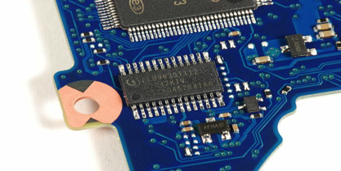
Trusted Platform Module Hardware Root of Trust
Trusted Platform Module
TPM answers two questions:
What machine am I talking to?
Endorsement Key (EK): permanent key that certifies device is a real TPM
Created by TPM manufacturer
Will it do the “right” thing?

Slide 7
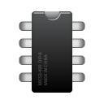
Using the TPM: Integrity
Each component during boot up process measures (hashes) the integrity of subsequent components
Attestations performed periodically to ensure integrity
App
App
Mon
Mgmt
Applications
Operating System
Measure
Operating System
Measure
Bootloader
TPM
Measure
Firmware
Measure
Bios
TPM can provide cryptographically signed proof of the system’s integrity at all layers

Slide 8
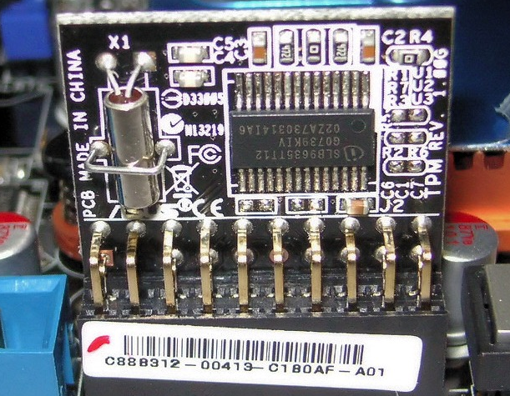
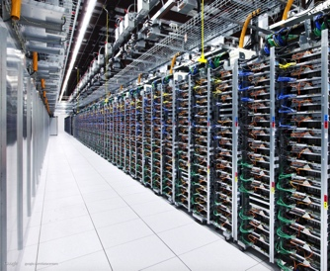
Why isn’t the TPM used in the Cloud?
Complexity – Using the TPM is cumbersome and not supported by existing cloud security tools
Performance – TPM is slow (~1 sec to cryptographically sign data), need to scale to thousands of machines
Compatibility – Virtualized cloud systems are abstracted away from physical hardware
App
App
App
VM
Mon
VM
Mon
VM
Mon
Hypervisor
Mgmt

Slide 9
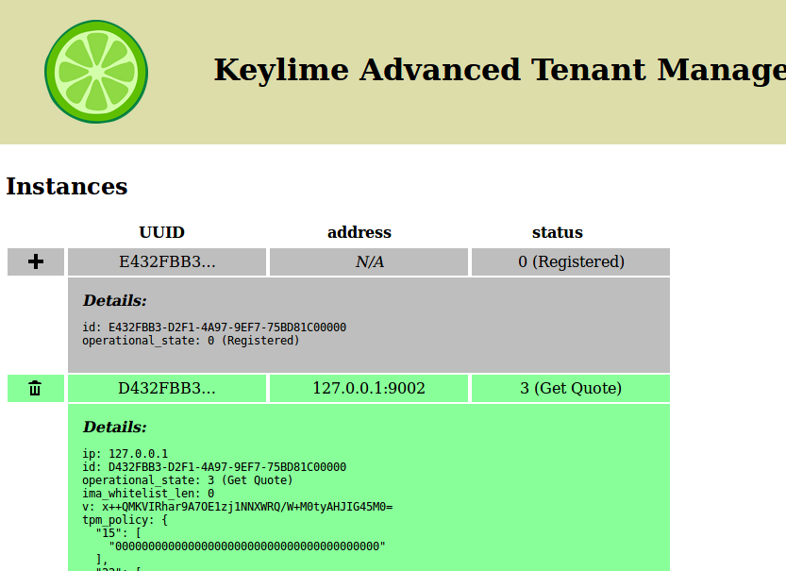
Introducing Keylime
Works transparently, behind-the-scenes with all of your existing software and development stacks
Performant: low-latency, scales to thousands of nodes
Cloud-integrated: Can be used in both a virtual machine and on bare-metal
Keylime increases the security and privacy of your data and services!

Slide 10
Keylime Architecture: Components
Tenant-owned verifier checks node system integrity
Tenant Cloud Verifier
IaaS cloud user
Tenant
Tenant Registrar
Cloud Node
Stores public keys of TPMs in tenant’s environment
Target of key bootstrapping and integrity measurement
TPM

Slide 11

Keylime: Secure Bootstrapping
Tenant Cloud Verifier
Check TPM keys
Delegate Integrity Check
Check Node Integrity
Tenant
Tenant Registrar
Demonstrate Intent
Cloud Node
TPM

Slide 12


Keylime: System Integrity Monitoring
Tenant Cloud Verifier
Check TPM keys
Integrity Violation
Check Node Integrity
Tenant
Tenant Registrar
Cloud Node
TPM

Slide 13
Performance
Latency
Scalability
Keylime can derive a key in less than 2 seconds, detect integrity violations in as little as 110ms, and can scale to monitor integrity of thousands of cloud machines

Slide 14
Benefits
Current IaaS clouds don’t provide technical means to verify trust
Keylime allows provisioning secrets to cloud nodes without divulging them
Keylime bases security on hardware root of trust
Integrates with standard cloud security/management stack, virtual and bare-metal
Cloud scalability: Keylime will grow to fit your needs!
Securely bootstrap a secret into a cloud node in less than 2s
Detect cloud node integrity violations in as little as 110ms
Keylime brings trust to the cloud

Slide 15
Ask
Keylime released as Open Source software
Keylime implementation & documentation available:
https://github.com/mit-ll/python-keylime
Using Keylime to enable security in Massachusetts Open Cloud
Looking for enhancements of Keylime features and integration with more security tools (e.g., network encryption)
Looking for partners to do pilots and grow adoption in the cloud
Full Keylime implementation available: https://github.com/mit-ll/python-keylime

Slide 16

Contact Information
Keylime
Nabil Schear
nabil@ll.mit.edu
Charles Munson
charles.munson@ll.mit.edu
Full Keylime implementation available: https://github.com/mit-ll/python-keylime

