Slide 1
Bootstrapping and Maintaining Trust in the Cloud
Nabil Schear★, Patrick T. Cable II*, Thomas M. Moyer, Bryan Richard, Robert Rudd
7 December 2016
This material is based upon work supported by the Assistant Secretary of Defense for Research and Engineering under Air Force Contract No. FA8721-05-C-0002 and/or FA8702-15-D-0001. Any opinions, findings, conclusions or recommendations expressed in this material are those of the author(s) and do not necessarily reflect the views of the Assistant Secretary of Defense for Research and Engineering. DISTRIBUTION STATEMENT A. Approved for public release: distribution unlimited.
★ Corresponding author: nabil@ll.mit.edu
* Now at Threat Stack

Slide 2


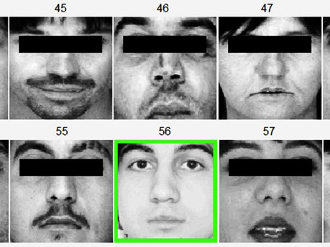


Hosting Sensitive Applications in the Cloud
Deploying these apps and data requires more trust in the cloud provider

Slide 3


Cloud Trust Challenges
Is the provider’s machine free of compromise?
How can I securely provision my rented cloud machines with my secrets?
After I provision it, how do I know my cloud machine is still good?
How to do this seamlessly with virtual and bare metal nodes?
App
App
App
App
App
Mon
Mgmt
VM
Mon
VM
Mon
VM
Mon
Operating System
Hypervisor
Mgmt

Slide 4

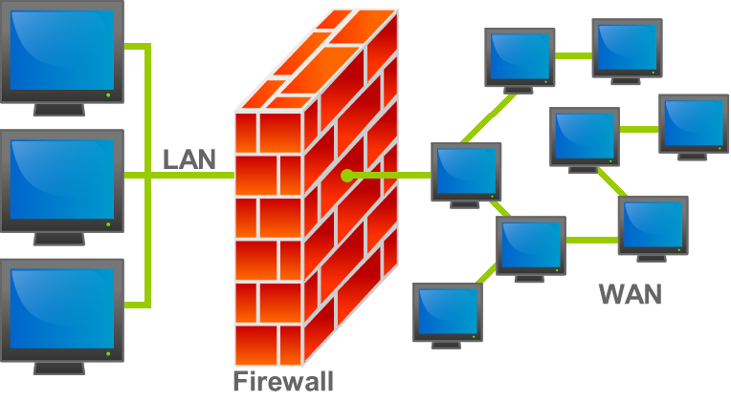


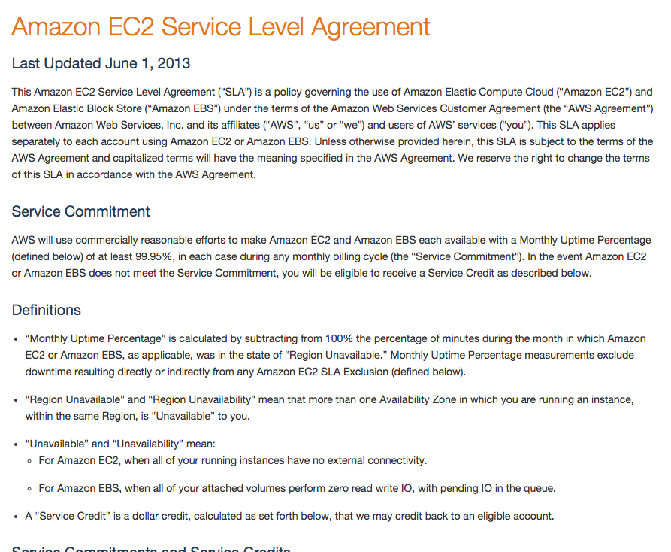
IaaS Cloud Security Today
Secured by Tenant
Traditional System Hygiene
App
App
App
VM
Mon
VM
Mon
VM
Mon
Hypervisor
Mgmt
Proprietary
Technology
Certification
Contracts
?
Secured by Cloud
Today’s cloud security offers no technical means to verify trust in the cloud provider’s resources
IaaS – Infrastructure-as-a-Service

Slide 5
Once Upon a Time, I Started Trusting my System…
Cloud System Lifetime
Instance Provisioning
Instance Running
Establish Root of Trust
Monitor System Integrity
Establish Root of Trust
Image
cloud-init
SSH
Amazon EC2
Anti-malware
Tripwire
Puppet/Chef

Slide 6

Once Upon a Time, I Started Trusting my System…
Cloud System Lifetime
Component Manufacture
Server Assembly
Hypervisor Install
Hypervisor Boot
Cloud Stack Configuration
Instance Provisioning
Instance Running
Monitor System Integrity
Establish Root of Trust
Establish Root of Trust
Monitor System Integrity
?
Establish Root of Trust
Trusted Platform Module
Trusted Computing Integrity Measurement
Image
cloud-init
SSH
Amazon EC2
Anti-malware
Tripwire
Puppet/Chef
Establish hardware root of trust as early as possible; measure system integrity throughout system lifetime

Slide 7
Outline
Introduction
Background
Keylime
Evaluation
Conclusion

Slide 8
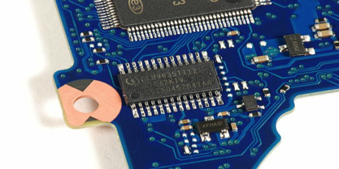
Trusted Platform Module Hardware Root of Trust
Standardized cryptographic co-processor
Not an crypto accelerator
Provides storage for:
Hash measurements
Cryptographic keys
Provides cryptographic operations
Hashing, signing, encryption, and key generation
Endorsement Key (EK): permanent key that certifies device is a real TPM
Created by TPM manufacturer
Trusted Platform Module
TPM aims to help answer two questions:
First, what machine am I talking to? Second, will it do the “right” thing?

Slide 9
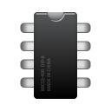
Integrity Measurement
Each component measures (hashes) the next component before transferring control
Use measurements to create a hash chain rooted in the TPM storage
Applications
Linux IMA
Measure
Operating System
TrustedGRUB
tboot / Intel TXT
Measure
Bootloader
TPM
UEFI Secure Boot
BIOS
Measure
Firmware
BIOS Static Root of Trust
Measure
Bios
Intel BootGuard

Slide 10
Attestation
Present a hash chain signed by the TPM (Quote) to other hosts to prove integrity state
Attestation Identity Key (AIK): key created by TPM owner to sign quotes
Quote
System hashes
Does the system state match my whitelist?
Nonce
Is this quote fresh?
Signature
Is the signature valid?
AIK Certificate
Did this come from a valid TPM?
App
App
Mon
Mgmt
Quote Verifier
Operating System

Slide 11
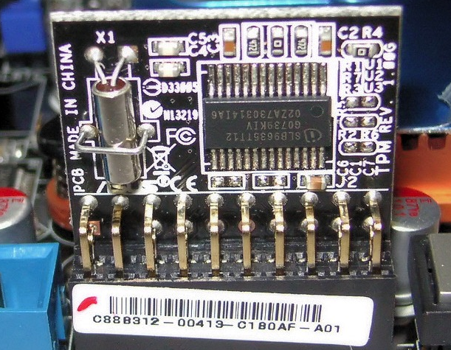

So, Why isn’t This Solved?
Complexity – Using the TPM is cumbersome and not supported by existing cloud security tools
Performance – TPM is slow (~1 sec to produce a quote), need to scale to thousands of machines
Compatibility – Virtualized cloud systems are abstracted away from physical hardware
App
App
VM
Mon
VM
Mon
Hypervisor

Slide 12
Keylime Overview
Trusted Platform Module
Keylime: an integrated TPM-based key bootstrapping and integrity measurement architecture built for the cloud
Secure Bootstrapping
System Integrity Monitoring
Secure Layering (Virtualization)
Compatibility
Cloud Scalability
EK – Endorsement Key, permanent key in TPM burned in at manufacture time

Slide 13
Related Work
 | Secure Bootstrapping | System Integrity Monitoring | Secure Layering (Virtualization) | Compatibility | Cloud Scalability
Keylime | ✔ | ✔ | ✔ | ✔ | ✔
Cloud Proxy Tao [Manferdelli et al. 2013] | ✔ |  | ✔
Excalibur [Santos et al. 2012] | ✔ |  |  |  | ✔
Cloud Verifier [Schiffman et al. 2009] |  | ✔ |  |  | ✔
ROTI [St. Clair et al. 2007] | ✔

Slide 14
Keylime Architecture
Tenant-owned verifier checks node system integrity
Tenant Cloud Verifier
IaaS cloud user
Tenant
Tenant Registrar
Cloud Node
Stores public keys of TPMs in tenant’s environment
Target of key bootstrapping and integrity measurement
TPM

Slide 15

Keylime AIK Registration
Key | Type | Purpose
EK | RSA 2048 | Permanent, certifies valid TPM
AIK | RSA 2048 | TPM key to sign quotes
K_{e} | AES-256 | Ephemeral challenge key to certify AIK
Tenant Cloud Verifier
Challenge node to decrypt K_{e} with EK
Provide public keys
Tenant
Tenant Registrar
AIK_{pub}
ID,AIK_{pub},EK_{pub}
Enc_{EK}(K_{e})
Cloud Node
TPM
Prove Node knows K_{e}
Legend
AIK_{priv}
Mutual TLS
Server TLS
No TLS

Slide 16

Keylime Bootstrap Key Derivation Details (Part 1)
Key | Type | Purpose
AIK | RSA 2048 | TPM key to sign quotes
K_{b} | AES-256 | Bootstrap key to deliver to node
U,V | 256bit rand | Trivial secret shares of K_{b}
NK | RSA-2048 | Protects secret shares U,V in transit.
Check validity of AIK that signed the quote
Tenant Cloud Verifier
Valid AIK?
nonce
Enc_{NK}(V)
Tenant
ID, V, IP, port, whitelist
Tenant Registrar
Quote_{AIK}(PCRs),NK_{pub}
Send key share if integrity and TPM identity good
Random number ensures quote is fresh
Notify verifier of new node. Delegate key share
Cloud Node
Quote proves system integrity. Provide transport key for V
TPM
Legend
Mutual TLS
Server TLS
No TLS
PCR – Platform Configuration Register, where TPM stores integrity measurements

Slide 17
Keylime Bootstrap Key Derivation Details (Part 2)
Key | Type | Purpose
AIK | RSA 2048 | TPM key to sign quotes
K_{b} | AES-256 | Bootstrap key to deliver to node
U,V | 256bit rand | Trivial secret shares of K_{b}
NK | RSA-2048 | Protects secret shares U,V in transit.
Tenant Cloud Verifier
Random number ensures quote is fresh
Tenant
Quote proves system integrity. Provide transport key for V
Tenant Registrar
nonce
Quote_{AIK}, NK_{pub}
Cloud Node
Enc_{NK}(U)
Check validity of AIK that signed the quote
Send key share if TPM identity good
TPM
Legend
Mutual TLS
Server TLS
Valid AIK?
No TLS

Slide 18

Keylime Integrity Measurement
Tenant Cloud Verifier
Integrity Violation
Valid AIK?
nonce
Tenant
Tenant Registrar
Quote_{AIK} (PCRs)
Cloud Node
TPM
Legend
Mutual TLS
Server TLS
No TLS

Slide 19
Keylime Software Certificate Authority
Tenant Cloud Verifier
Software CA
Revocation Notifications
Bootstrap Key Enables
Secure config management | Secure databases
Encrypted hard disks | Data integrity
IPsec encryption | Provenance authenticity
Tenant
Integrity Measurement
Tenant Registrar
Cloud Node
TPM
Legend
Mutual TLS
Server TLS
No TLS

Slide 20


Virtualizing Keylime – Background
Keylime
Keylime
VM1
VTPM1
VM
VTPM2
Hardware TPM
Xen supports vTPM since version 4.3
Each vTPM is a separate Xen domain
Trust of vTPMs rooted in hardware TPM of the hypervisor
DeepQuote operation to obtain hardware TPM quote from a vTPM
Apply the principle of least privilege to all provider-layer resources

Slide 21
Virtualizing Keylime – Architecture
Validate AIK from DeepQuotes with provider
Tenant Cloud Verifier
Tenant Registrar
Use DeepQuote to certify vTPM keys with hardware TPM
Use DeepQuote instead of quote
Tenant
Provider Registrar
Cloud Node
Stores public keys of TPMs in hypervisor hosts
vTPM
Xen Hypervisor
Legend
TPM
Mutual TLS
Server TLS
No TLS

Slide 22
Evaluation – Latency
Bootstrap key derivation adds minimal delay to IaaS instance provisioning.
Integrity checking limited by TPM quote latency.

Slide 23
Options for Cloud Verifier Deployment
Bare metal in the cloud
6 Core Xeon 2.5GHz, 64G RAM
Another IaaS VM
m1.large 4 vCPU, 8G RAM
m1.small 1 vCPU, 2G RAM
Raspberry Pi in the Cloud
4 Core ARMv7 900Mhz, 1G RAM
On-premises bare metal
Assessed various network RTT
2500 TPM quotes checked per second!
In the Paper
Just add more cloud verifiers to scale horizontally!

Slide 24

Summary
Current IaaS offerings don’t provide technical means to verify trust
No way to provision a cryptographic key to cloud node without divulging it
Keylime is a cloud-based trust system that relies on a hardware root of trust
Securely bootstrap a cryptographic key into a cloud node in less than 2s
Monitor cloud nodes and revoke access to sensitive data in as little as 110ms
Integrated with standard cloud security and management stack
Way ahead
DHS Transition to Practice Program: see me if you want to deploy Keylime
Using Keylime to enable security in the Massachusetts Open Cloud
Full Keylime implementation available: https://github.com/mit-ll/python-keylime

Slide 25
Legal Notices
© 2016 Massachusetts Institute of Technology.
Delivered to the U.S. Government with Unlimited Rights, as defined in DFARS Part 252.227-7013 or 7014 (Feb 2014). Notwithstanding any copyright notice, U.S. Government rights in this work are defined by DFARS 252.227-7013 or DFARS 252.227-7014 as detailed above. Use of this work other than as specifically authorized by the U.S. Government may violate any copyrights that exist in this work.

Slide 26
Backup

Slide 27
Some Keys to Remember

Slide 28
Keylime Registration
Key | Type | Purpose
EK | RSA 2048 | Permanent, certifies valid TPM
AIK | RSA 2048 | TPM key to sign quotes
K_{e} | AES-256 | Ephemeral challenge key to certify AIK
Tenant Cloud Verifier
Tenant
Tenant Registrar
AIK_{pub}
ID,AIK_{pub},EK_{cert}
Enc_{EK}(H(AIK_{pub}),K_{e})
Cloud Node
TPM
AIK_{priv}

Slide 29
Keylime Bootstrap Key Derivation Details
Tenant Cloud Verifier
ID, V, IP, port, whitelist
Valid AIK?
Tenant
n_{CV},
mask
Quote_{AIK}(n_{CV},16:H(NK_{pub}) ,x_{i} :y_{i}),NK_{pub}
Tenant Registrar
Enc_{NK}(V)
n_{t}
Quote_{AIK}(n_{t},16:H(NK_{pub)})),NK_{pub}
Cloud Node
TPM
Legend
Mutual TLS
Valid AIK?
Server TLS
No TLS

Slide 30
Keylime Bootstrap Key Derivation Overview
Notify verifier of new node. Delegate key share
Tenant Cloud Verifier
Validate TPM registration
4
Bootstrap key, securely share with Node
1
Check system integrity and TPM identity. Provide key share if ok.
Tenant
3
Tenant Registrar
2
Cloud Node
Validate TPM registration
Check TPM identity. Demonstrate intent by providing key share.
5
TPM
Derive bootstrap key
4

