Slide 1
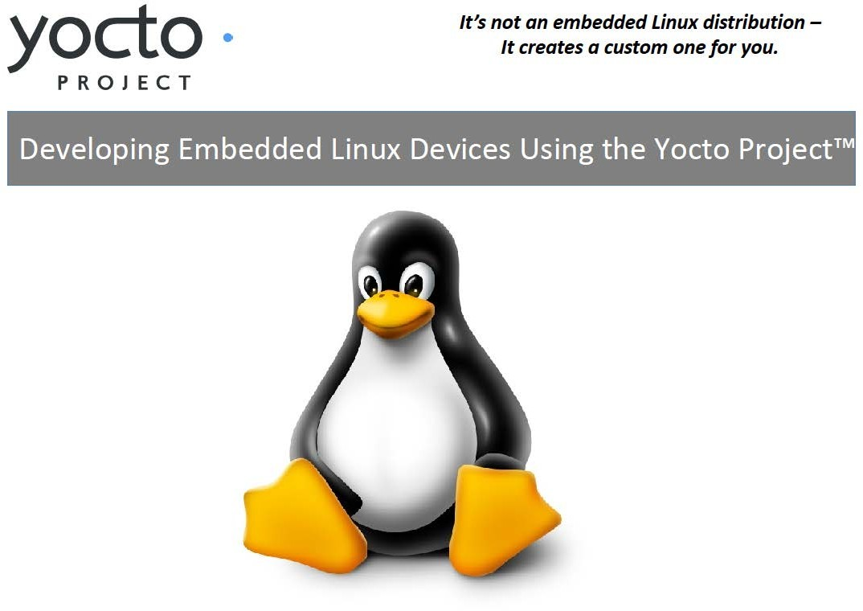

Slide 2
Agenda
What is the Yocto Project (YP)? … and what’s new
How does it work?
How to get started with building OS, apps, and debugging
What’s Next?
Q&A
2/25

Slide 3
What is the Yocto Project? The Story
Linux is becoming increasingly popular for Embedded
Non-commercial and commercial embedded Linux has many distros
Result is:
Developers spend lots of time porting or making build systems
Leaves less time/money to develop interesting software features
The industry needs a common build system and core technology
Industry leaders have joined together to form the Yocto Project
The benefit of doing so is:
Less time spent on things which don’t add value (build system, core Linux components)
Linux grows more in embedded
3

Slide 4
What is the Yocto Project?
Distribution build environment and tools for embedded
Supports ARM, PPC, MIPS, x86 (32 & 64 bit)
Open source project with a strong community
Content
Complete Linux OS with package metadata
Releases every 6 months with latest (but stable) kernel,
toolchain, and package versions
Place for Industry to publish BSPs
App Dev Tools which allow development against the stack,
including Eclipse plug-ins and emulators
Full documentation representative of a consistent system
It’s not an embedded Linux distribution – it creates a custom one for you

Slide 5
Why Should a Developer Care?
Build a complete Linux system in about an hour from sources (about 90 minutes with X).
Start with a validated collection of packages (toolchain, kernel, user space).
Access to a great collection of app developer tools (performance, debug, power analysis, Eclipse). We distinguish app developers system developers and we support both.
Manage patches with included kernel development tools.
Supports all major embedded architectures (x86, x86-64, ARM, PPC, MIPS), just change a line in a config file and rebuild.
Easy path to a commercial embedded Linux (Mentor Graphics, Montavista, Timesys, Wind River).

Slide 6
What’s new in Yocto v1.1
Hob – graphical interface for selecting options and packages and doing a build
Multilib –
mix and match 32 and 64 bit binaries on the target
Pick the architecture on a per package basis
https://wiki.yoctoproject.org/wiki/Multilib for more
Initial x32 support –
X86-64 systems running 64 bit registers and 32 bit data types – see meta-x32 repository
System builder tasks now in Eclipse

Slide 7
How Does It Work? – Quick Start
Go to http://yoctoproject.org, click “documentation” and consult the Quick Start guide
Set up your Linux system with the right packages (and firewall access, if needed)
Click “Download” and download the latest stable release (or check out “bernard” from the git repo)
Edit conf/local.conf and set MACHINE, BB_NUMBER_THREADS and PARALLEL_MAKE
Source oe-init-build-env script
Run $ bitbake –k core-image-sato
7. Run $ runqemu qemux86
Note: File or command names in this presentation are subject to change, several are different now in master.
(if MACHINE=qemux86)

Slide 8













YP = Poky + Upstreams + Tools
Poky
OpenEmbedded-Core
Bitbake
Build system upstream components
Yocto Documentation
Poky
Meta-Yocto
Reference Images
Upstream Software Projects
Reference BSP Metadata (one per arch)
Prebuilt Build State
Yocto Project components
Software Releases
ADT Tools (Eclipse Plugin)
ADT Components
Yocto Project
Pseudo
Swabber
Yocto Project Output
Embedded Kernel Tools
YP provides best of upstream for a stable base

Slide 9
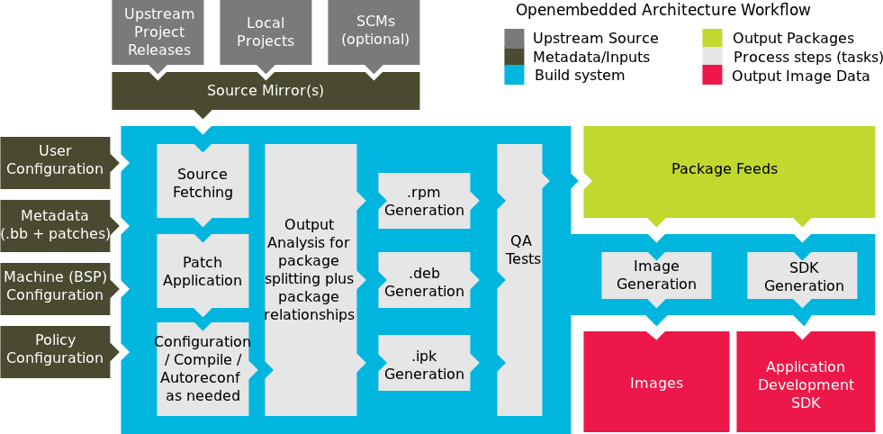
How Does It Work? More Depth
Look here for links to slides and video tutorials!
More info: http://bit.ly/it9rkB

Slide 10

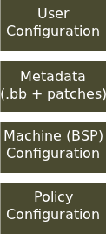
How Does it Work? Configuration
Configuration (*.conf) – global definition of variables
build/conf/local.conf (local user-defined variables)
distro/poky.conf (Yocto policy config variables)
machine/routerstationpro.conf (machine-specific variables)

Slide 11
How Does It Work? Configuration
User configuration:
conf/local.conf – some things to set:
Set BB_NUMBER_THREADS and PARALLEL_MAKE, based on the number of threads in the machine
Set MACHINE=“foo” for the CPU architecture
EXTRA_IMAGE_FEATURES adds features (groups of
packages)
INCOMPATIBLE_LICENSE = “GPLv3” eliminates packages using this license (for example)

Slide 12
How Does It Work? Metadata
Metadata and patches:
Recipes for building packages
Eg, meta/recipes- core/coreutils/coreutils_6.9.bb builds the core utilities (version 6.9) and installs them
meta-recipes-core/coreutils/coreutils-6.9/ includes patches, also could include extra files to install

Slide 13
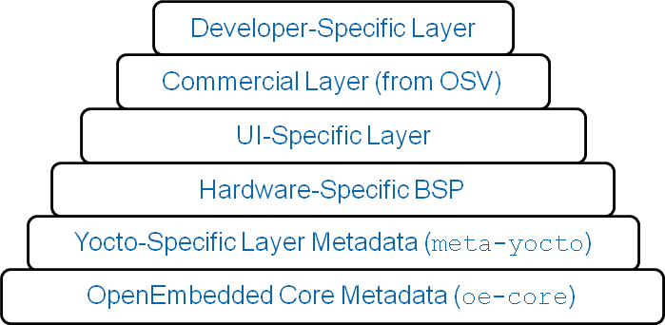
How Does It Work? Layers

Slide 14
BSP “Layers”
Layers contain extensions and customizations to base system
Can include image customizations, additional recipes,
modifying recipes, adding extra configuration
Really just another directory to look for recipes in
Added to the BBLAYERS variable in build/conf/bblayers.conf
BSPs are layers that add machine settings and recipes
Machine settings are specified in a layer's conf/machine/xxx.conf file(s)
Examples:
Sandy Bridge + Cougar Point:
meta-intel/conf/meta-sugarbay/machine/sugarbay.conf
Routerstation Pro (MIPS)
yocto/meta/conf/machine/routerstationpro.conf
More info: bit.ly/lWaszt & bit.ly/m8nirP

Slide 15
Kernel Development
We try to develop upstream wherever possible
Two major advances in the Yocto Project:
Branching tools: Per-BSP git branches contain machine-specific kernel sources. Tools collect up the relevant tree of branches
Kernel features: patches and configuration fragments managed as a functional block
Results:
Can turn on a collection of features for a given BSP
Less code duplication
Easier to choose a config fragment and patches
More info: bit.ly/iZUkvk & bit.ly/jRSfwO

Slide 16
Kernel Tools Details
Components
Kernel class
meta/classes/kernel.bbclass
Linux-Yocto recipe
meta/recipes-kernel/linux/linux-yocto*bb
Linux-Yocto git repository
http://git.pokylinux.org/cgit/cgit.cgi/linux-yocto-2.6.37
Kernel Versions
linux-yocto-stable: 2.6.34
linux-yocto: 2.6.37
linux-yocto-dev: 2.6.39 (meta-kernel-dev) (soon 3.0)
linux-2.6: current mainline git (meta-kernel-dev)

Slide 17
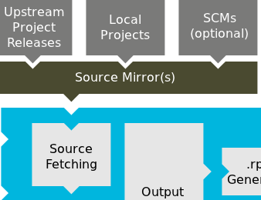


Source Fetching
Recipes call out location of all sources, whether on the internet
or local (Look for SRC_URI in *.bb files)
Bitbake can get sources from git, svn, bzr, from tarballs, and many, many more*
Versions of packages can be fixed or updated automatically (Add SRCREV_pn- PN = "${AUTOREV}” to local.conf)
Yocto Project sources mirror available as a fallback, if the sources move on the internet
* Complete list includes: http, ftp, https, git, svn, perforce, mercurial, bzr, cvs, osc, repo, ssh, and svk and the unpacker can cope with tarballs, zip, rar, xz, gz, bz2, and so on.

Slide 18
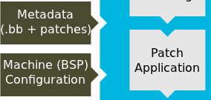
Patching
Once sources are obtained, the patches are applied
This is a good place place to patch the software yourself
However, we encourage you to contribute development upstream whenever possible (we try to)

Slide 19
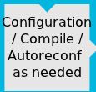
Configure/Compile
Autoconf can be triggered automatically to ensure latest libtool is used
DESCRIPTION = "GNU Helloworld application“ SECTION = "examples"
LICENSE = "GPLv2+"
LIC_FILES_CHKSUM = "file://COPYING;md5=751419260aa954499f7abaabaa882bbe" PR = "r0"
SRC_URI = "${GNU_MIRROR}/hello/hello-${PV}.tar.gz" inherit autotools gettext
CFLAGS can be set
CFLAGS_prepend = "-I ${S}/include "
Install task to set modes, permissions, target directories, done by “pseudo”
do_install () {
oe_runmake install DESTDIR=${D} SBINDIR=${sbindir} MANDIR=${mandir}

Slide 20
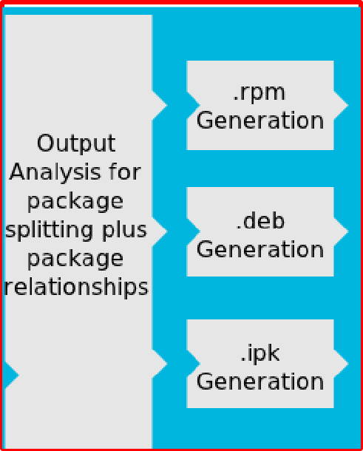
Packaging
Once configure/compile/install is completed, packaging commences
The most popular package formats are supported: RPM, Debian, and ipk
Set PACKAGE_CLASSES in conf/local.conf
You can split into multiple packages using PACKAGES and FILES in a *.bb file:
PACKAGES =+ "sxpm cxpm" FILES_cxpm = "${bindir}/cxpm" FILES_sxpm = "${bindir}/sxpm"

Slide 21
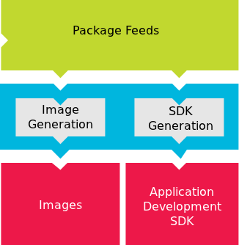
Image Generation
Images are constructed using the packages built earlier in the process
Uses for these images:
Live Image to boot a device
Root filesystem for QEMU emulator
Sysroot for App development
YP lets you customize your embedded Linux OS

Slide 22
ADT Generation
Cross toolchain and installation script generated.
This can be used to set up an application developer’s cross development environment to create apps
MACHINE=qemuarm bitbake poky- image-sato-sdk meta-toolchain package-index
QEMU built for target architecture emulation

Slide 23

Setting up the App Developer
System Developer
Package Repository (networked or local)
App Developer
Sysroot (Bootable Linux
filesystem tree with
development headers)
Yocto plug-ins
Cross toolchain installation
(such as: /opt/poky)
YP helps set up the embedded app developer
More info: bit.ly/mz6uRv & bit.ly/j55IQ3

Slide 24
Use NFS/Local Disk, Pkg Manager
Package Repository
System Developer
App Developer
QEMU
Device emulator
Sysroot
Device under development

Slide 25
Use NFS/Local Disk, Pkg Manager
Package Repository
System Developer
Package Manager
App Developer
QEMU
Device emulator
Sysroot
Device under development
Both Device and App Development Models Supported

Slide 26
What’s Next?
Constantly improve the developer’s experience
Identify areas which are confusing and constantly improve them
Improvements on the Hob
Isolate all Linux development system uncertainties
Updated kernel, toolchain, user land packages
More partner’s products

Slide 27
How to Get Started
Download the software today
Be sure you read the Quick Start to set up your system to use the Yocto Project
Build, test on QEMU or real hardware, develop apps
Join the community to get help
#yocto on freenode and yocto@yoctoproject.org (http://lists.yoctoproject.org/listinfo/yocto)
Getting started with the Yocto Project is easy

Slide 28
Get Involved
The Yocto Project is a collaboration of individuals, non-profits, and corporations under the Linux Foundation
We urge you or your organization to join
yoctoproject.org/documentation/getting-started has a number of ways to learn and contribute
Contribute code, documentation, fix bugs, provide BSPs
Use YP for your embedded projects
Work with the community to make YP better
Make an impact – collaboration in its purest sense

Slide 29
It’s Time to Take Action
It’s not an embedded Linux distribution – it creates a custom one for you
YP lets you customize your embedded Linux OS
YP helps set up the embedded app developer
Both device and app development models supported
Getting started is easy
Make an impact – collaboration in its purest sense

Slide 30
Thanks!
Q & A

