Slide 1
Facilitating Linux Kernel Heap Vulnerability Exploitation: an idea
韩天硕

Slide 2
Table of Content
Overview
Example & Enlights
Related work
unsolved challenges & thingking
Possible Solution

Slide 3
Overview
Kernel heap vulnerability form:
double free
use after free
out of bound read / write
.....

Slide 4
Overview
Kernel heap vulnerability capability model:
the chunk size
readable/writable bytes within(around) the chunk

Slide 5
Overview
General pattern to exploit a heap vul model:
identify an useful kernel object from kernel code space
allocate such an object to region under control
untilizing an execution path(related to the object) to finish exploition / help with exploitation

Slide 6
Overview
General patterns to exploit a heap vul model:
identify an useful kernel object from kernel code space
allocate such an object to region under control
untilizing an execution path(related to the object) to finish exploition / help with exploitation
all are unsolved challenges

Slide 7
Overview
I want to build a database/tool that, given a vul model, can indicate me: what can be done with such a model
more specifically:
list candidate objects, that can fit in the evil chunk size and may be useful for exploitation
syscall sequences to allocate such useful objects
list the objects’ capability and syscall sequences to trigger

Slide 8
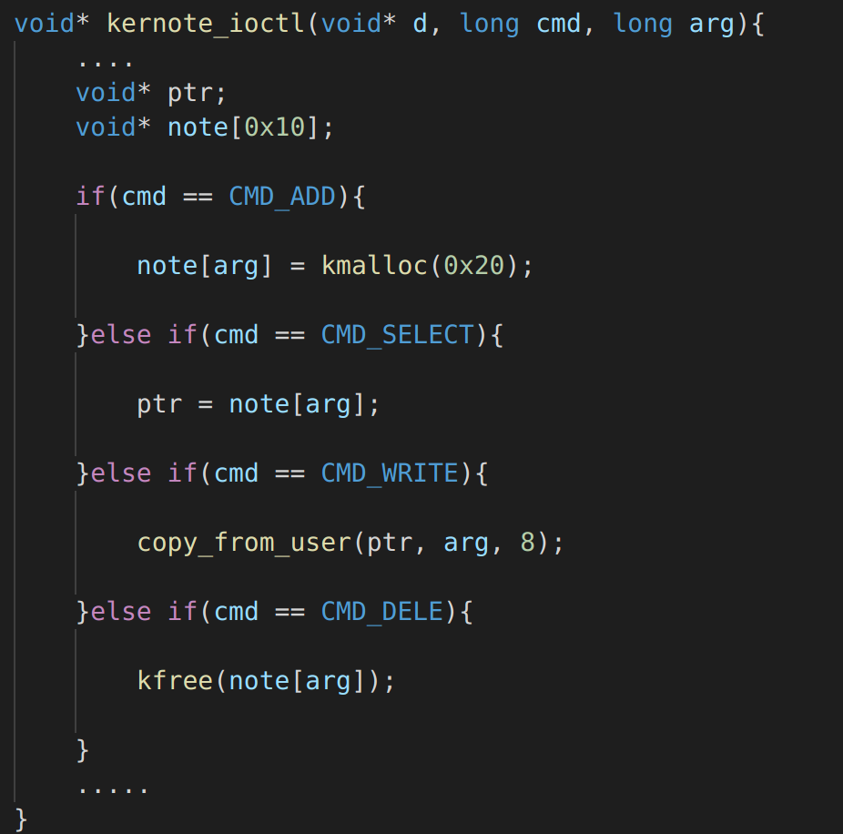
Example1
0CTF 2021 Final - kernote

Slide 9
Example1
0CTF 2021 Final - kernote
vulnerability model:
chunk size: one kmalloc-32 chunk
readable bytes: none
writable bytes: the first 8 bytes
exploitation: ldt_struct

Slide 10
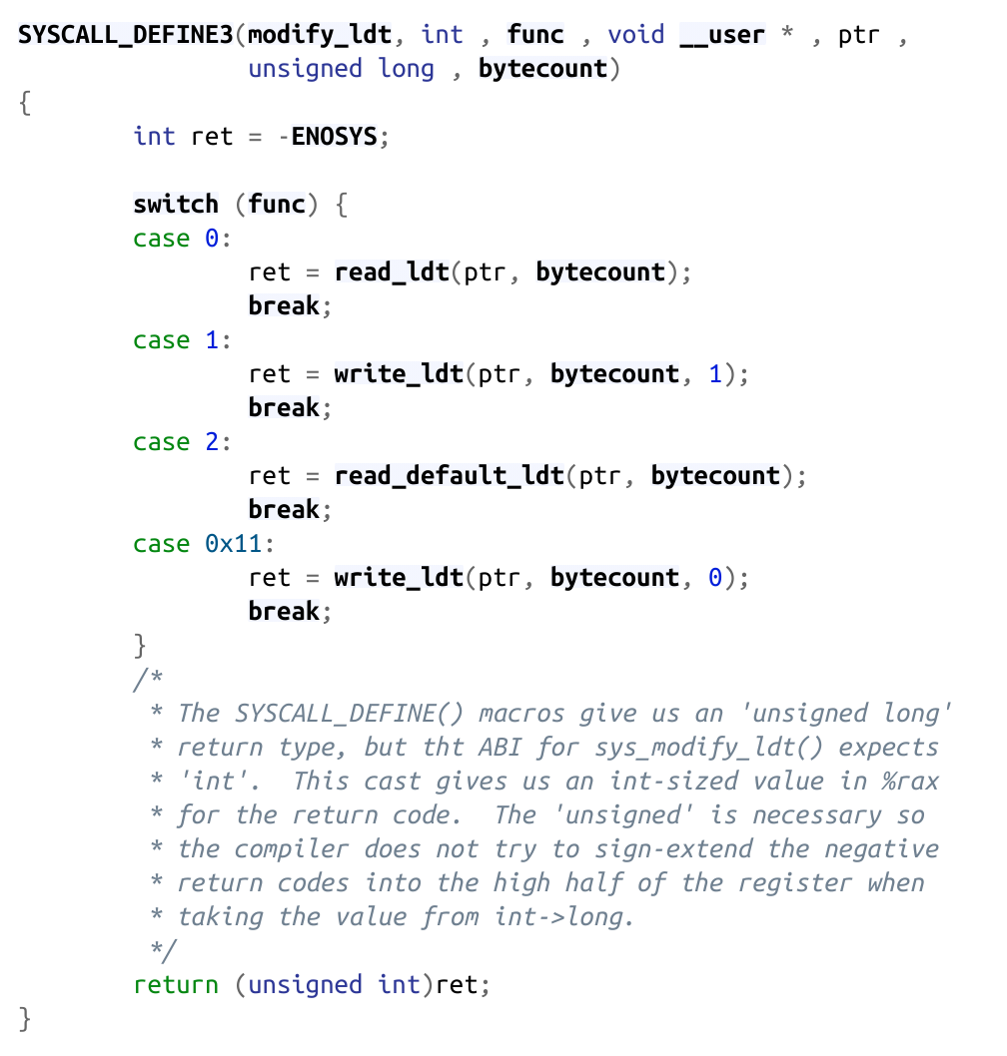
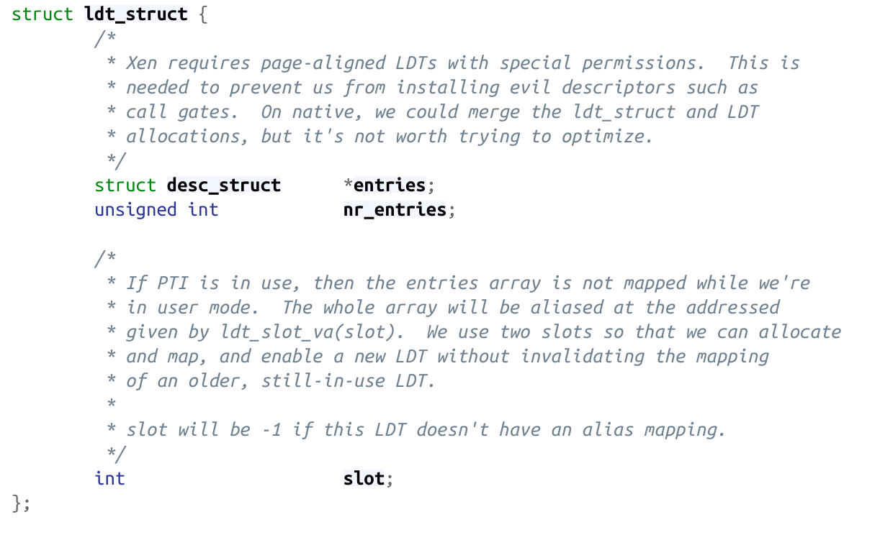
Example1
0CTF 2021 Final - kernote

Slide 11
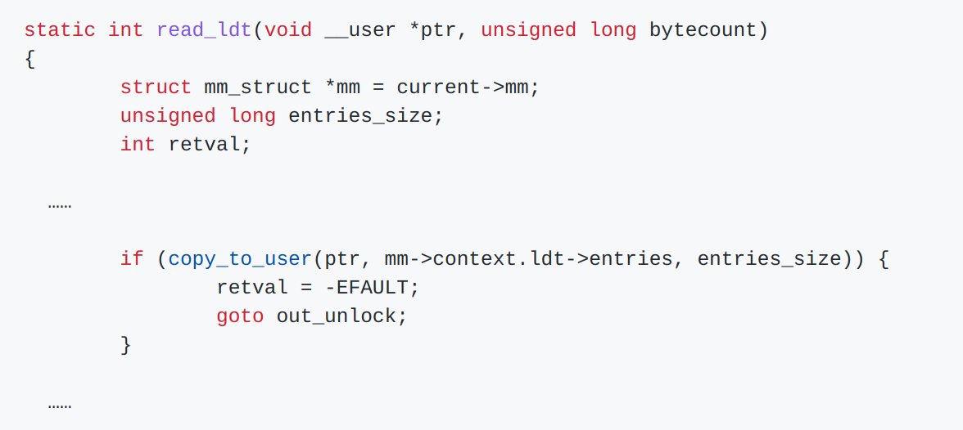
Example1
0CTF 2021 Final - kernote

Slide 12
Example1
0CTF 2021 Final - kernote
two solves during the contest, both unintended:
@Balsn gave a 1-day exp, unrelated to the vulnerability at all
@Organizor gave a kernel ROP solve, too delicate and complicated to reproduce
conclusion: Identifying proper structs and its useful execution path is vital for kernel heap exploitation

Slide 13
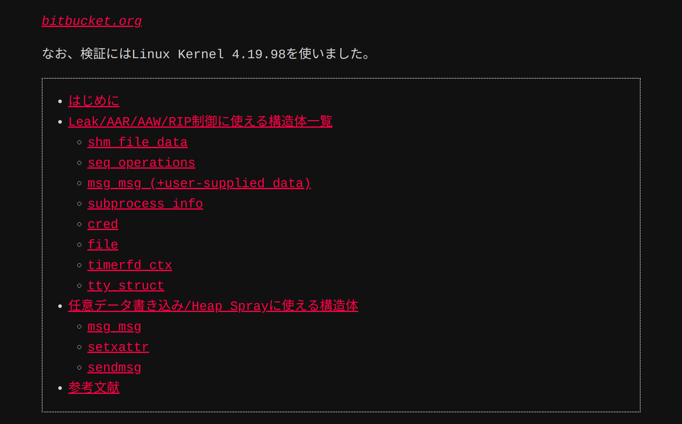
Example1
0CTF 2021 Final - kernote
Q1: where do these structs and execution path come from?

Slide 14
Example2
CVE-2021-26708
vulnerability model:
chunk size: one kmalloc-64 chunk
readable bytes: none
writable bytes: 4 bytes at offset 40

Slide 15
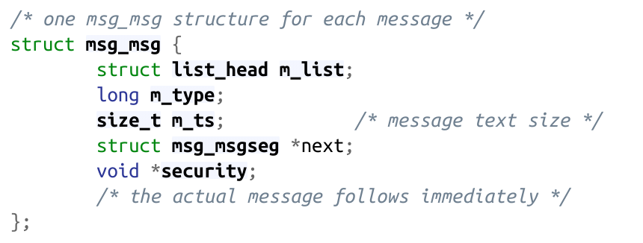
Example2
CVE-2021-26708
the pointer security is at offset 40, and it will be passed to kfree() resulting to arbitrary free, and can be transformed into UAF

Slide 16
Example2
CVE-2021-26708
Combining with the vul other capabilities, the vulnerability pattern can be transformed:
UAF size: one kmalloc-64 chunk
readable bytes: none
writable bytes: the first 40 bytes

Slide 17
Example2
CVE-2021-26708
Conclusion: some execution path does not follow general exploitation paradigm, but may work at specific vul context
Q2: finding such execution path needs extensive expertise in kernel and intensive manual efforts. Can it be automatized?

Slide 18
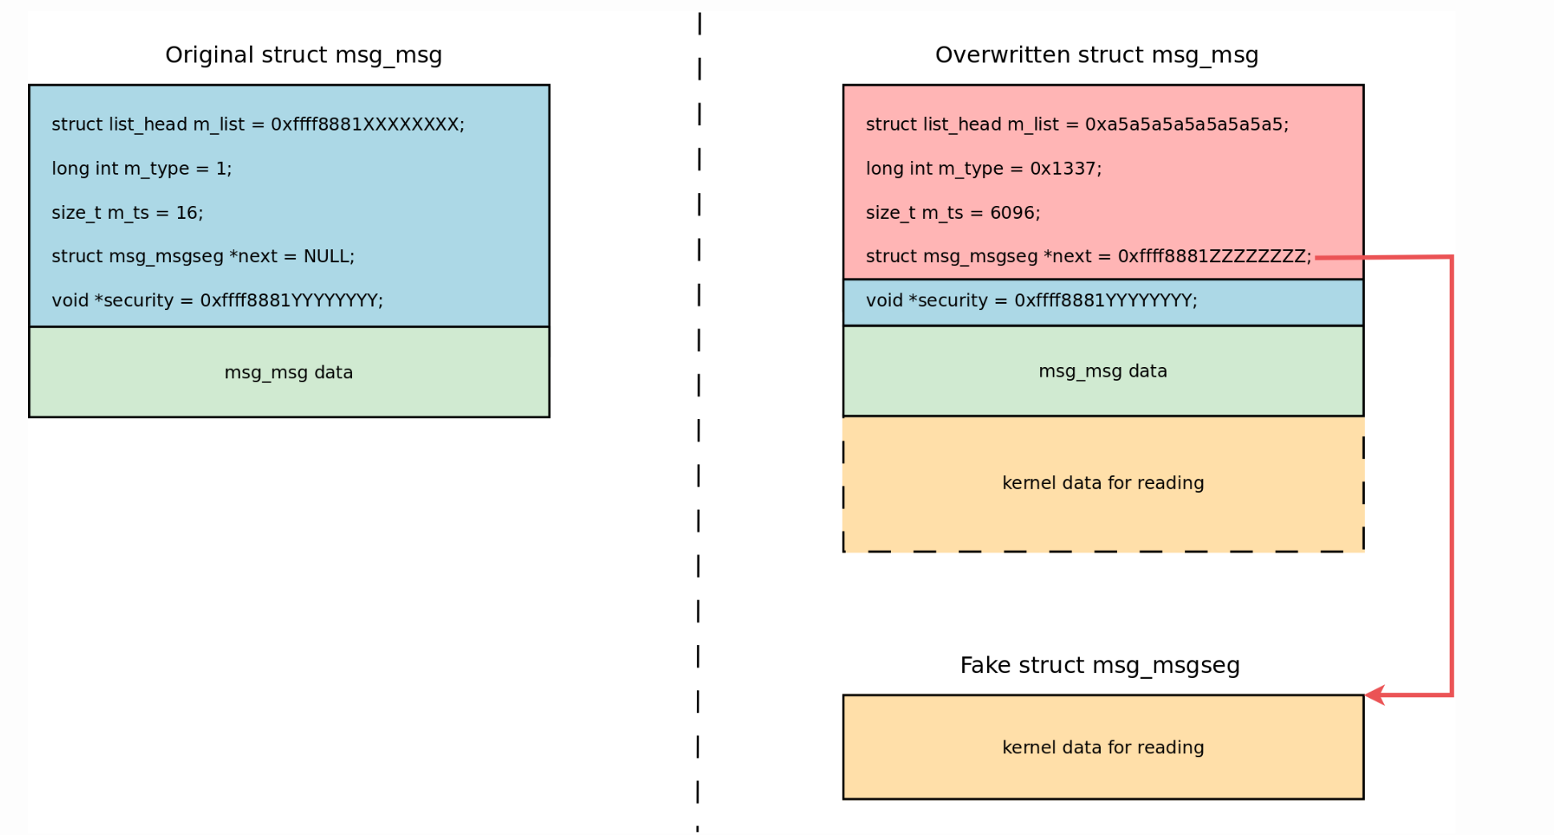
Example2
CVE-2021-26708
arbitrary read:

Slide 19
Example2
CVE-2021-26708
execution path around msg_msg struct can be extended, achieving both arbitrary read and write (corCTF 2021 Finals - Fire of Salvation)
Q2: finding such execution path needs extensive expertise in kernel and intensive manual efforts. Can it be automatized?

Slide 20
Example3
QWB2021 - notebook
vulnerability model:
UAF size: one kmalloc-0x400 chunk
readable bytes: the first 0x60 bytes
writable bytes: the first 0x60 bytes

Slide 21
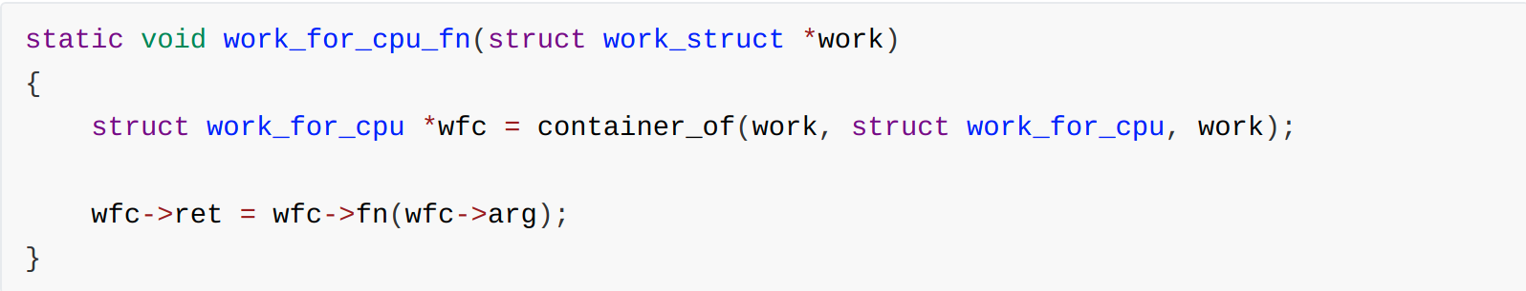
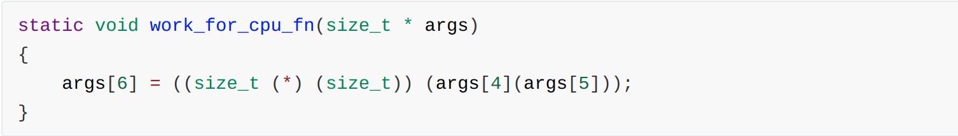
Example3
QWB2021 - notebook
a fancy function, available in kernels who enable multi-cpu support:
after compilation:

Slide 22
Example3
QWB2021 - notebook
perfect for us to execute commit_creds(prepare_kernel_cred(0))
hijack ioctl() of a tty struct to work_for_cpu_fn()
set tty_struct[4]=prepare_kernel_cred, tty_struct[5]=0
invoke ioctl() and the new generated cred struct will be placed at tty_struct[6], and we can read it
do the trick again to invoke commit_creds()

Slide 23
Example3
QWB2021 - notebook
conclusion 1: execution path of exploit is not limited to syscall sequences, sometimes can be subtle.
conclusion 2: overread is as important as overwrite.
Q3: by taking extra dimensions of vul capability into consideration, is it possible to identify more exploit paradigm?

Slide 24
Related Work
Wu, W., Chen, Y., Xu, J., Xing, X., Gong, X., & Zou, W. (2018). FUZE: Towards facilitating exploit generation for kernel use-after-free vulnerabilities. Proceedings of the 27th USENIX Security Symposium, 781–797.
Chen, Y., & Xing, X. (2019). Slake: Facilitating slab manipulation for exploiting vulnerabilities in the linux kernel. Proceedings of the ACM Conference on Computer and Communications Security
Chen, Y., Lin, Z., & Xing, X. (2020). A Systematic Study of Elastic Objects in Kernel Exploitation. Proceedings of the ACM Conference on Computer and Communications Security

Slide 25
Related Work: SLAKE
SLAKE: identify kernel objects that enclose at least one function pointer, then filter out objects that may be utilized for RIP hijacking
the object can be allocated from user land
the function pointer can be called from user land

Slide 26
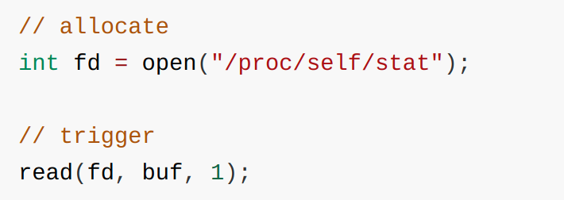
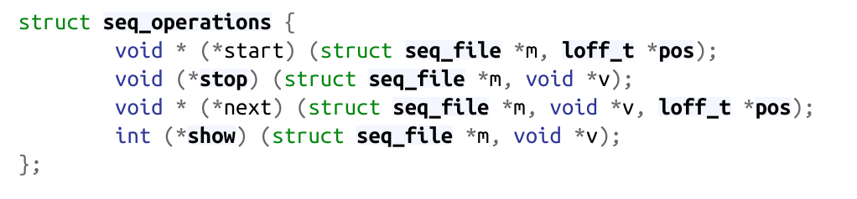
Related Work: SLAKE
e.g.

Slide 27
Related Work: SLAKE
SLAKE answered such a question: I have a heap chunk overwrite primitive and I want to do a RIP hijacking, how can I do it?
The identified useful kernel objects are stored in a database, and will be paired with vul capability model

Slide 28
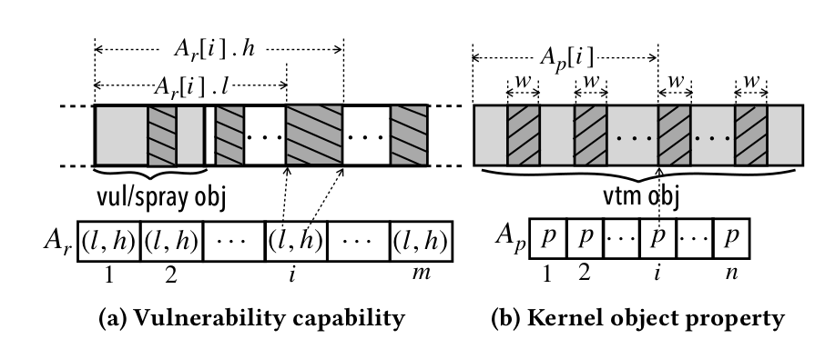
Related Work: SLAKE
SLAKE vul capability model

Slide 29
Related Work: ELOISE
ELOISE: focuses on elastic kernel objects, identify kernel objects and execution path for kernel space memory leaking
ELOISE answerd such a question: I have a kernel heap chunk overwrite primitive and I want to do a kernel space memory leaking, how can I do it?

Slide 30
Related Work: ELOISE
e.g.

Slide 31
Unsolved challgenges & thinking
1. there is a great number of exploitation paradigms, besides RIP hijacking and kernel space memory leaking
reading kernel space memory to a readable region(besides transfer them directly to user space)
kernel space memory overwrite
arbitrary kfree()
leaking not by elastic objects
critical kernel data corruption
spraying data into kernel heap chunk
.....
digging the kernel according to known exploitation paradigms can be inefficient and unscaleble

Slide 32
Unsolved challgenges & thinking
2. the vul capability model is inadequate to fully describe a vul’s capability
chunk size
chunk number I can control
times I can control for the same chunk
is the chunk at same address
writable bytes
times I can write
readble bytes
times I can read
.....
chunk size
writable bytes
stronger the vul capability indicates more possible exploitation path

Slide 33
Unsolved challgenges & thinking
3. in many situations, I only know the vul capability at hand, I have no idea what to do next
RIP hijacking is impossible
kernel memory leaking is unlikely to work
what I do with this primitive?
CVE-2021-26708 vulnerability model:
chunk size: one kmalloc-64 chunk
readable bytes: none
writable bytes: 4 bytes at offset 40
knowing what can be done with a vul primitive can greatly indicate how to perform exploit

Slide 34
Possible Solution
loose the constraint
SLAKE and ELOISE digs the kernel strictly subject to constraints, to make sure the found objects and syscall sequences follows the desired exploitation paradigm

Slide 35
Possible Solution
mining the kernel not according to known exploitation paradigms, but by considering value and reachability
value: heuristicly definning valuable operations
reachability: filter out operations can be triggerd by syscall sequences from user land

Slide 36
Possible Solution
value:
definning valuable operations: memory read/write, call/jmp, critical kernel functions like kfree(), .....
mark controllable bytes as taint source / symbolic value
checking if valuable operations can be tainted / controlled by symbolic values

Slide 37
Possible Solution
reachability:
identify all valuable operation sites in execution path related to the kernel object
fuzz syscalls, until valuable operation sites reached

Slide 38
Possible Solution
store identified kernel objects, syscalls and corresponding capability in a database, and give an algorithm that retrieve information from the database. Given a vul model such a database can:
greatly indicate exploitation path by knowing all possible operations
give indications on how to implement an eploitation path

Slide 39
Thanks!

