Slide 1
Facilitating Kernel UAF Vulnerability Exploitation: an idea
韩天硕

Slide 2
Table of Content
Overview
Example & Enlights
Possible Solution

Slide 3
Overview
UAF vulnerability pattern:
UAF chunk size
certain bytes readable
certain bytes writable

Slide 4
Overview
Given an UAF vul pattern, I want to:
identify candidate objects that can be sprayed to the UAF region
figure out syscalls with proper arguments to perform the spray
find proper approach to exploit

Slide 5
Example1
0CTF 2021 Final - kernote
UAF vulnerability pattern:
UAF size: one kmalloc-32 chunk
readable bytes: none
writable bytes: the first 8 bytes
exploitation: ldt_struct

Slide 6
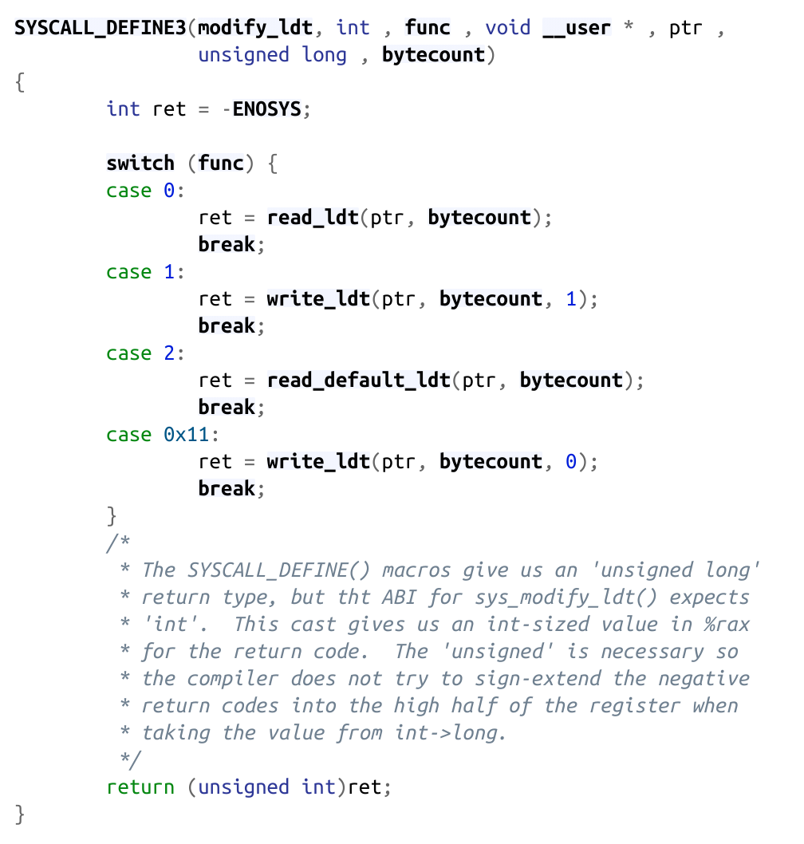
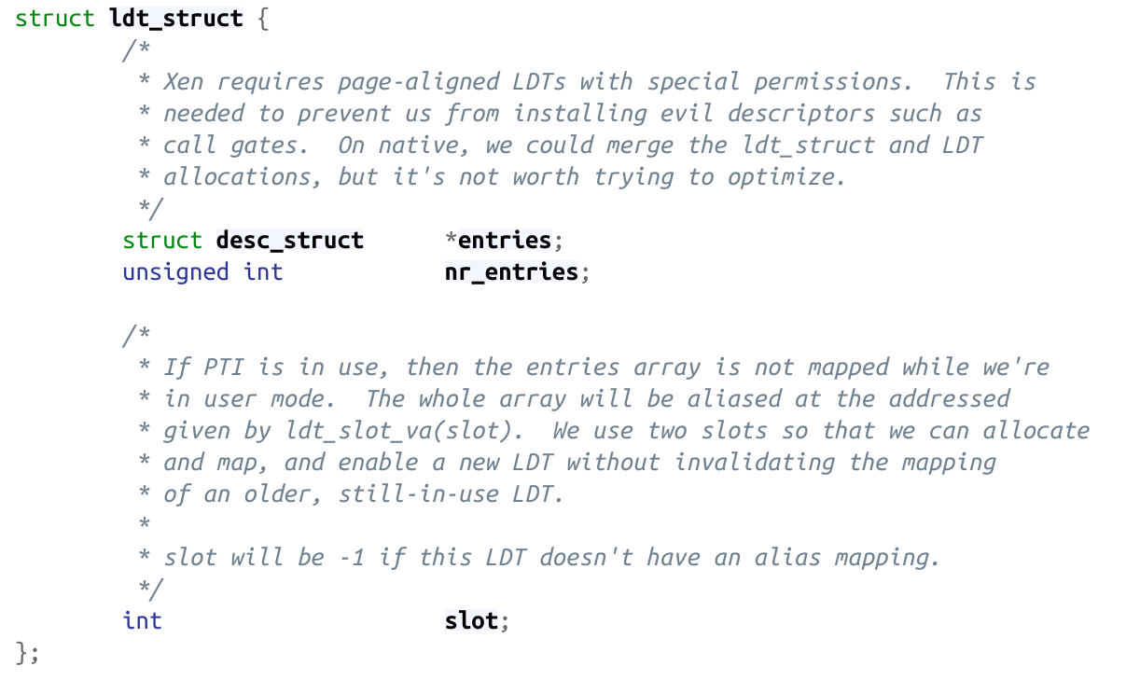
Example1
0CTF 2021 Final - kernote

Slide 7
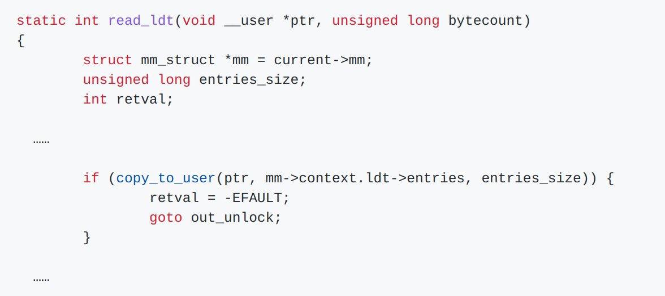
Example1
0CTF 2021 Final - kernote

Slide 8
Example1
0CTF 2021 Final - kernote
two solves during the contest, both unintended:
@Balsn gave a 1-day exp, unrelated to the vulnerability at all
@Organizor gave a kernel ROP solve, too delicate and complicated to reproduce
conclusion: Identifying proper structs is vital for UAF exploitation

Slide 9
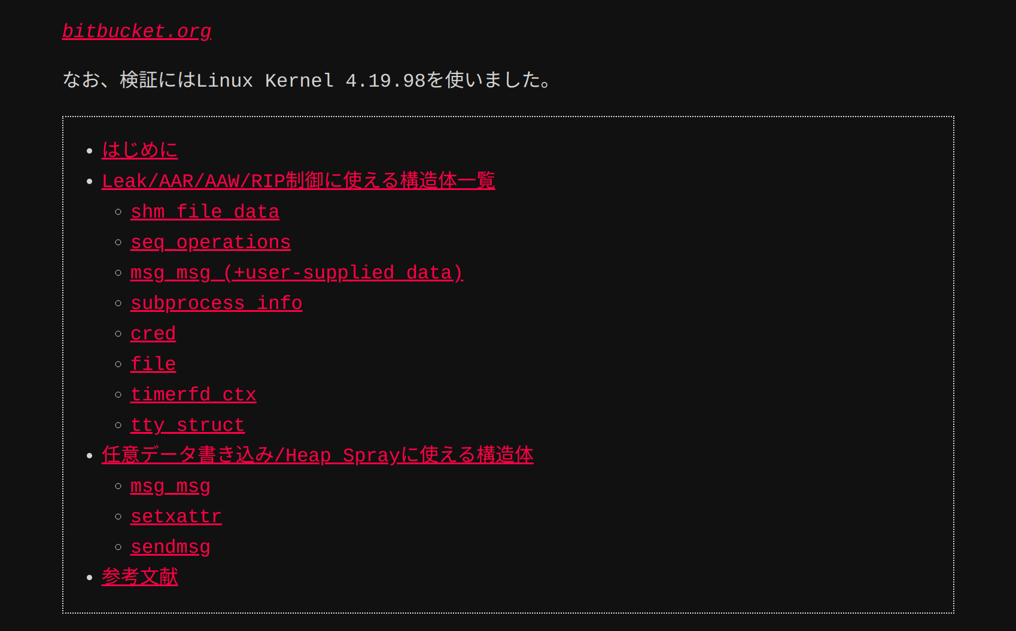
Example1
0CTF 2021 Final - kernote
Q1: where do these structs come from?

Slide 10
Example2
CVE-2021-26708
UAF vulnerability pattern:
UAF size: one kmalloc-64 chunk
readable bytes: none
writable bytes: 4 bytes at offset 40

Slide 11
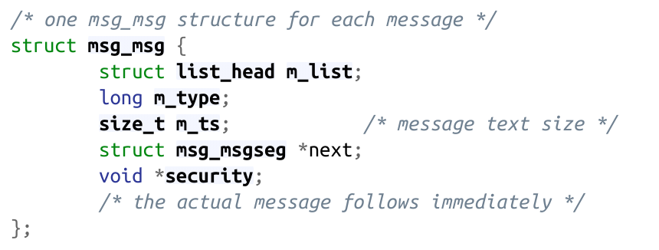
Example2
CVE-2021-26708
the pointer security is at offset 40, and it will be passed to kfree() resulting to arbitrary free, and can be transformed into UAF

Slide 12
Example2
CVE-2021-26708
New UAF vulnerability pattern:
UAF size: one kmalloc-64 chunk
readable bytes: none
writable bytes: the first 40 bytes

Slide 13
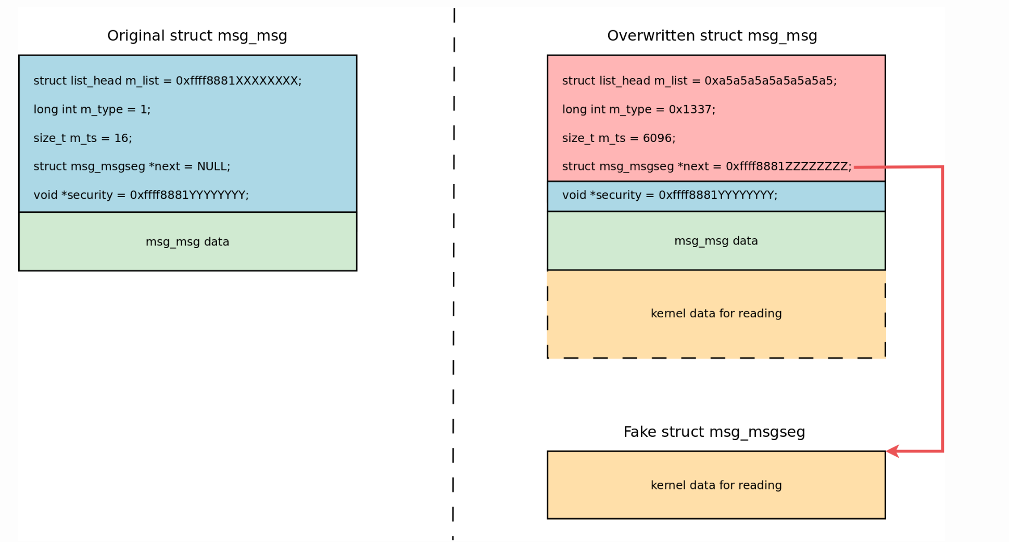
Example2
CVE-2021-26708
arbitrary read:

Slide 14
Example2
CVE-2021-26708
execution path around msg_msg struct can be extended, achieving both arbitrary read and write (corCTF 2021 Finals - Fire of Salvation)
Q2: finding such execution path needs extensive expertise in kernel and intensive manual efforts. Can it be automatized?

Slide 15
Example3
QWB2021 - notebook
UAF vulnerability pattern:
UAF size: one kmalloc-0x400 chunk
readable bytes: the first 0x60 bytes
writable bytes: the first 0x60 bytes

Slide 16
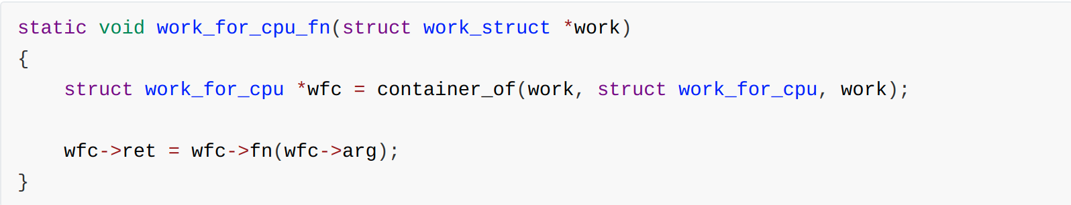
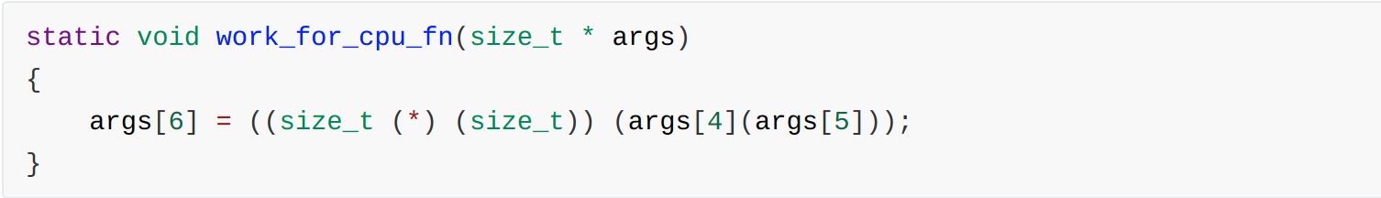
Example3
QWB2021 - notebook
a fancy function, available in kernels who enable multi-cpu support:
after compilation:

Slide 17
Example3
QWB2021 - notebook
perfect for us to execute commit_creds(prepare_kernel_cred(0))
hijack ioctl() of a tty struct to work_for_cpu_fn()
set tty_struct[4]=prepare_kernel_cred, tty_struct[5]=0
invoke ioctl() and the new generated cred struct will be placed at tty_struct[6], and we can read it
do the trick again to invoke commit_creds()

Slide 18
Example3
QWB2021 - notebook
conclusion: execution path of exploit is not limited to syscall sequences, sometimes can be delicate.
Q3: Is it possible to identify more such fancy functions?

Slide 19
Possible Solution
Q1: where do these structs come from?
manually create an UAF chunk
trace kmalloc()
fuzz the kernel until the UAF chunk is taken

Slide 20
Possible Solution
Q2: finding such execution path needs extensive expertise in kernel and intensive manual efforts. Can it be automatized?
one possible solution...
if we can identify all control flow related to the struct, we can symbolicly execute them until we meet instructions like
call/jmp SYMBOLIC_VALUE ------ control flow hijack
mov [SYMBOLIC_VALUE], rsi ------ arbitrary read
.....

Slide 21
Possible Solution
Q3: Is it possible to identify more such fancy functions?
heuristic rules

Slide 22
Related work
Wu, W., Chen, Y., Xu, J., Xing, X., Gong, X., & Zou, W. (2018). FUZE: Towards facilitating exploit generation for kernel use-after-free vulnerabilities. Proceedings of the 27th USENIX Security Symposium, 781–797.
Chen, Y., & Xing, X. (2019). Slake: Facilitating slab manipulation for exploiting vulnerabilities in the linux kernel. Proceedings of the ACM Conference on Computer and Communications Security, 1707–1722. https://doi.org/10.1145/3319535.3363212

Slide 23
Thanks!

