Slide 2
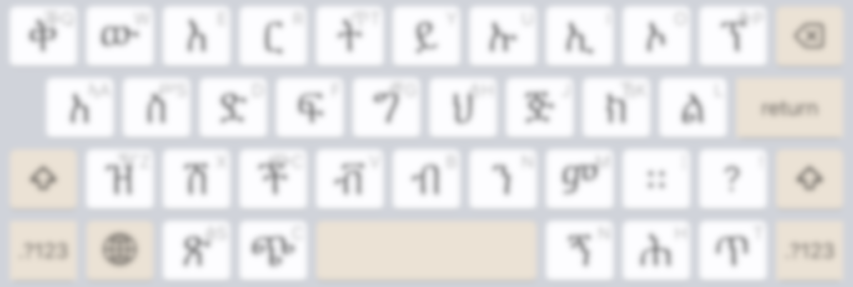
Flick Typing
ኅ
when applicable
ሃ
ህ
ሀ
ህ
no layout change

Slide 3

Multitap Typing
ህ
ሀ
ኀ
when applicable
1
2
3

Slide 4
Multitap Typing
when applicable
ህ
ሀ
ኀ
1
2
3

Slide 5
Flick Typing
ኅ
when applicable
ሃ
ህ
ሀ
ህ
no layout change

Slide 6
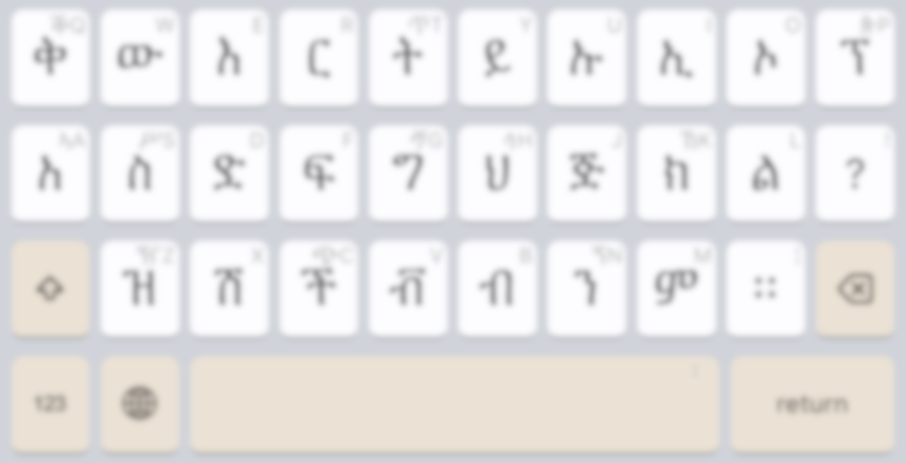
Flick Typing
ኅ
when applicable
ሃ
ህ
ሀ
ህ
no layout change

Slide 7
Multitap Typing
when applicable
ህ
ሀ
ኅ
1
2
3

Slide 8
Multitap Typing
when applicable
ህ
ሀ
ኀ
1
2
3

