Slide 1
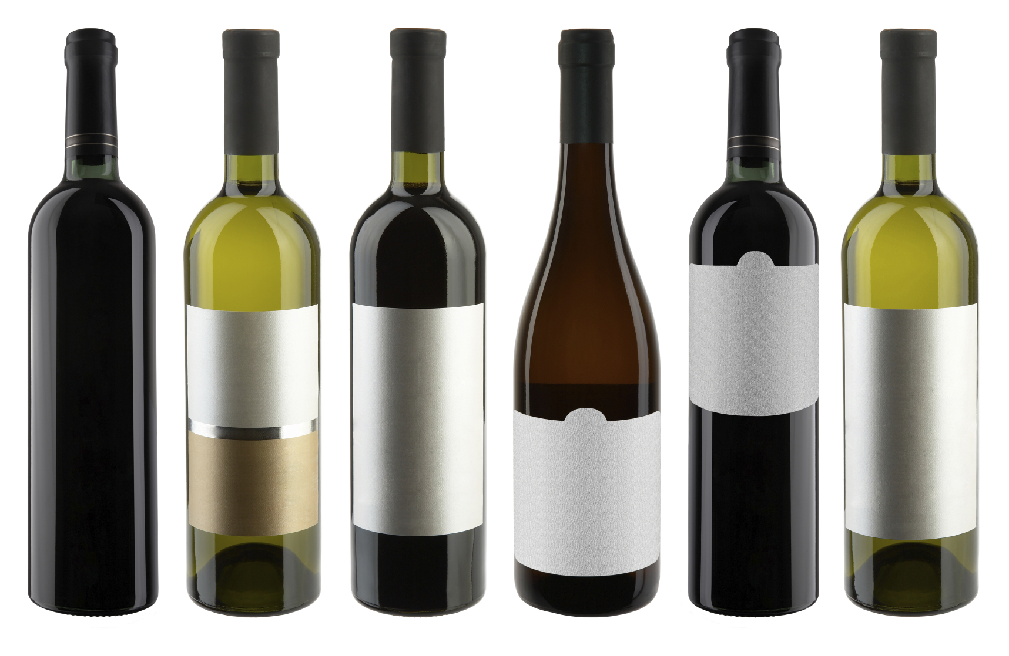
BTC Wine and Cheese Night!
sample 8 different Wines!!!
Hosted by Eric Winters of PRP wines
Cheese, chocolate, and light snacks provided
Group/couples portraits before start
Limited tables available
When: Friday, September 15th 7:00 – 9:00 pm
Where: BTC Parish Hall
Cost: $25/person; $200/table (8)
RSVP to Tom Judkins
b1gcountry@Hotmail.com

