Slide 1
KLYARA
THE BACK OFFICE FOR BUILDING FIRMS
Business Plan
Guildford, Surrey · Launch Monday 14 September 2026
No clients yet. Not yet AML supervised. Every number here is a model, built on real published market prices and stated assumptions.

Slide 2
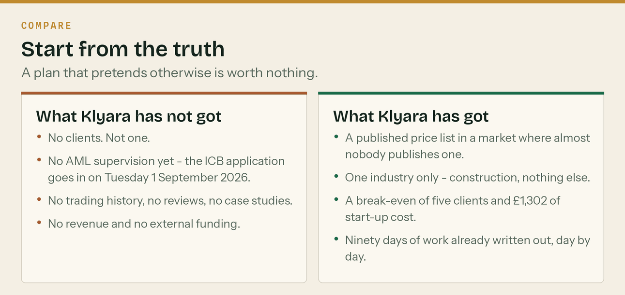
A plan that pretends otherwise is worth nothing, and in front of a licence application it is dangerous.

Slide 3
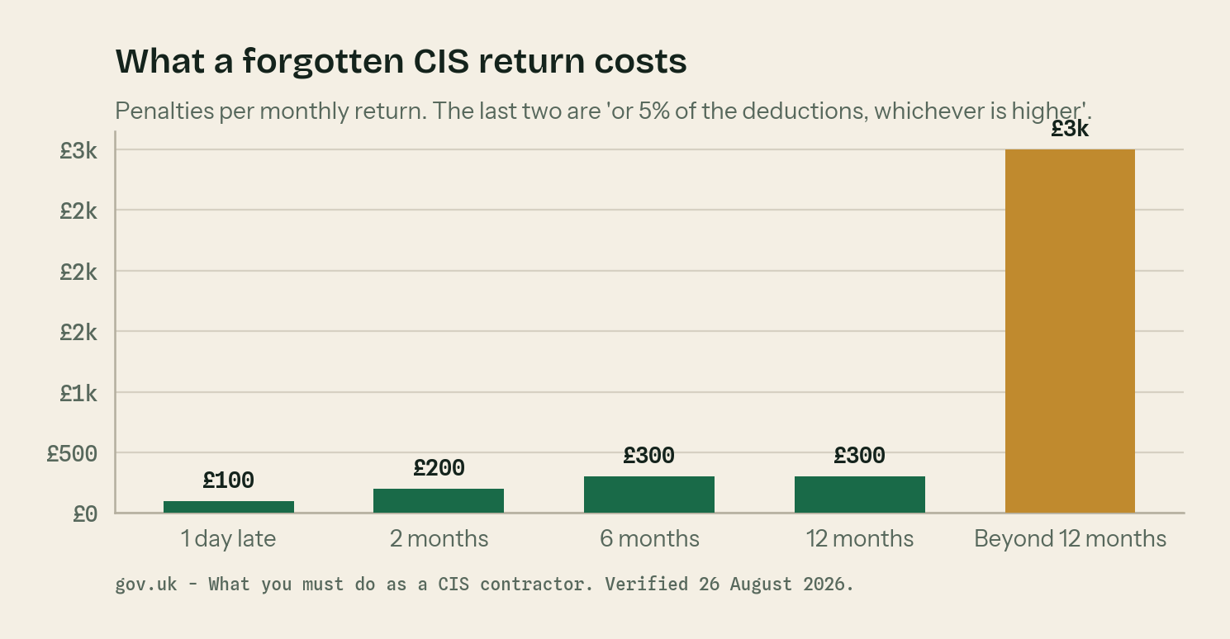
THE PROBLEM
A builder's admin is not hard. It is relentless.
A return every month, on the 19th
Whether or not anyone got paid. £100 the day it is late.
Paid 43 days after the invoice
Materials were paid for in week one.
Reverse charge VAT
Most general bookkeepers get it wrong in at least one direction.
Making Tax Digital, April 2027
Another wave of sole traders into quarterly filing.

Slide 4
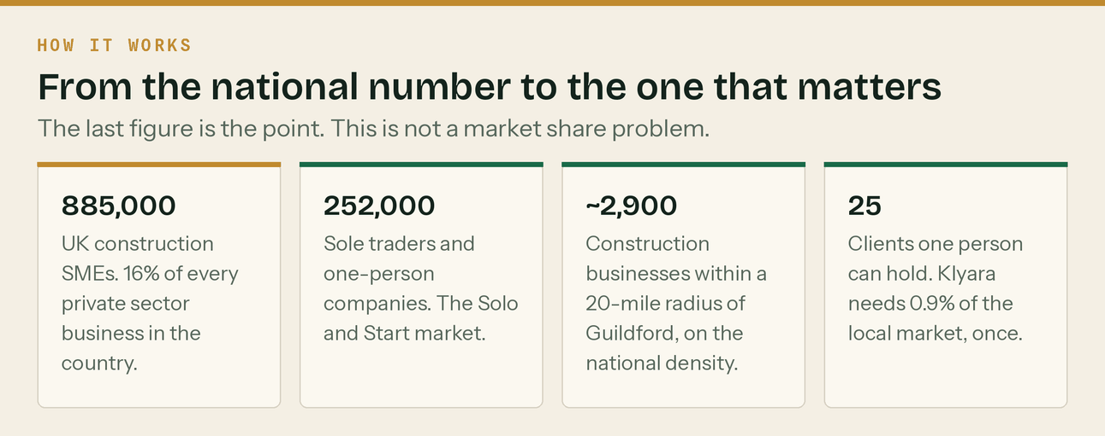
Klyara does not need market share. It needs twenty-five clients. Sources: Dept for Business and Trade, ONS, BEIS.

Slide 5
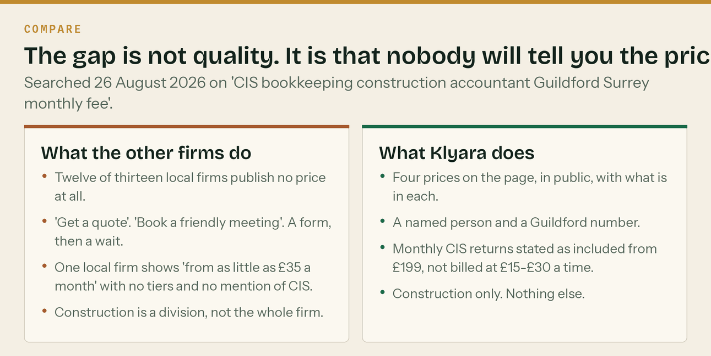
Thirteen firms surface for the search. One publishes a full price list, and it is the London one.

Slide 6
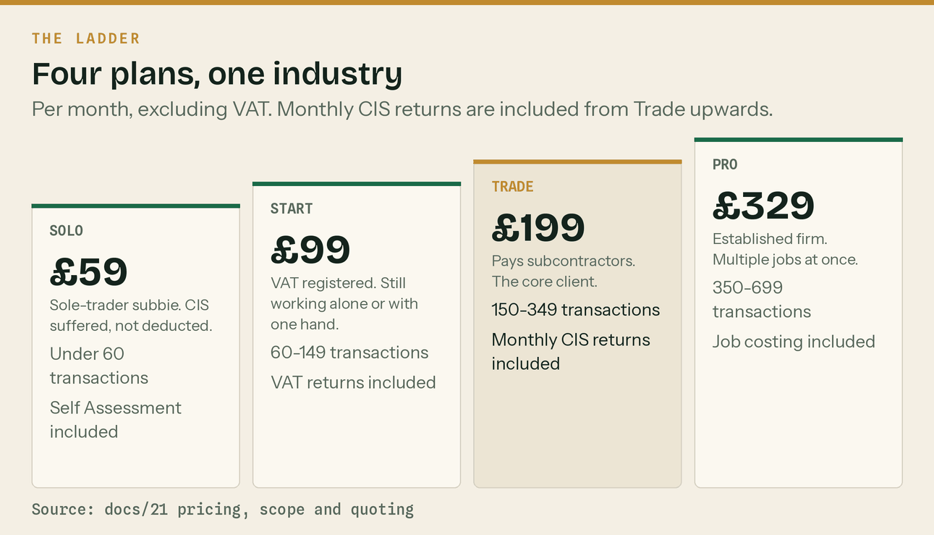
Per month, excluding VAT. Monthly CIS returns are included from Trade upwards. Founding rate held for twelve months.

Slide 7
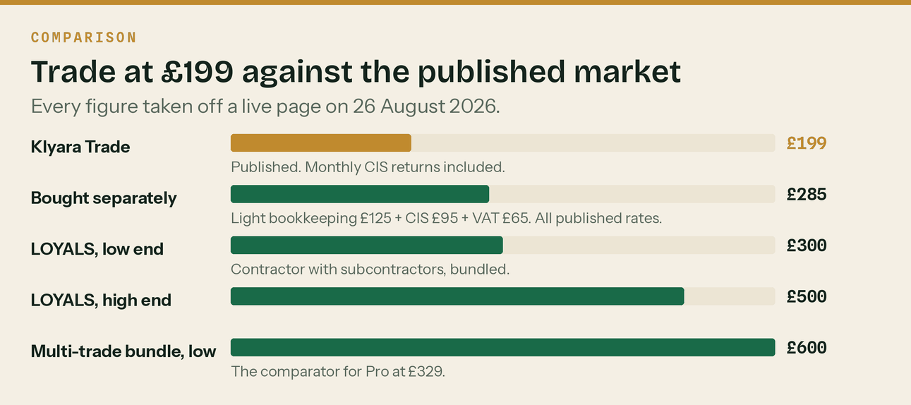
PRICE
Trade at £199 against the published market
Every figure came off a live page on 26 August 2026. Sources: LOYALS, A One Outsourcing, Gro.

Slide 8
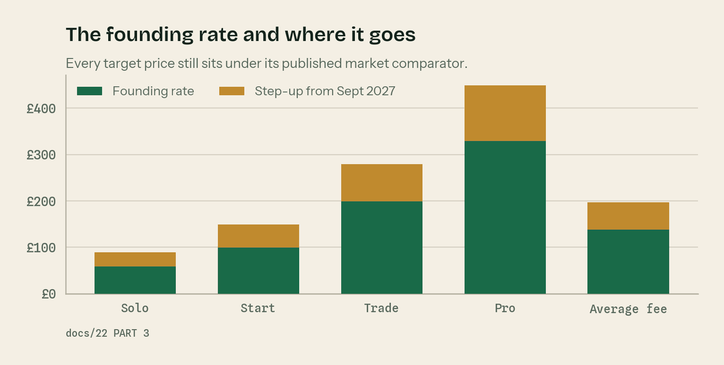
PRICING
The founding rate is the whole pricing strategy
Say it on day one
'Founding client rate, held for twelve months from the date you join.' It costs nothing now.
Show the £285 comparison
Bought separately at published rates, the work in Trade is about £285 a month.
Diarise 1 September 2027
Average fee moves from £138 to £197. That is £14,160 a year on twenty clients.
You can lose five of twenty
And still be ahead. The downside is bounded at two clients.

Slide 9
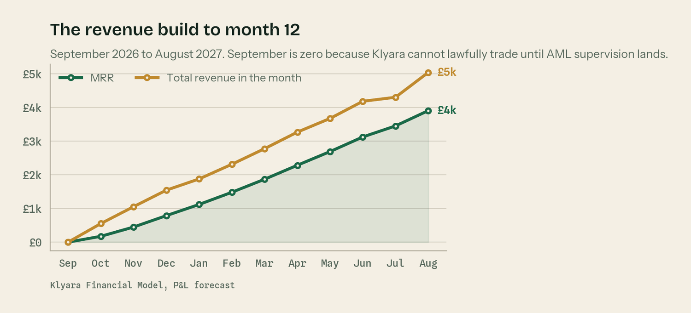
YEAR ONE
The revenue build to month twelve
September 2026 is deliberately zero. Klyara cannot lawfully trade until AML supervision lands.

Slide 10
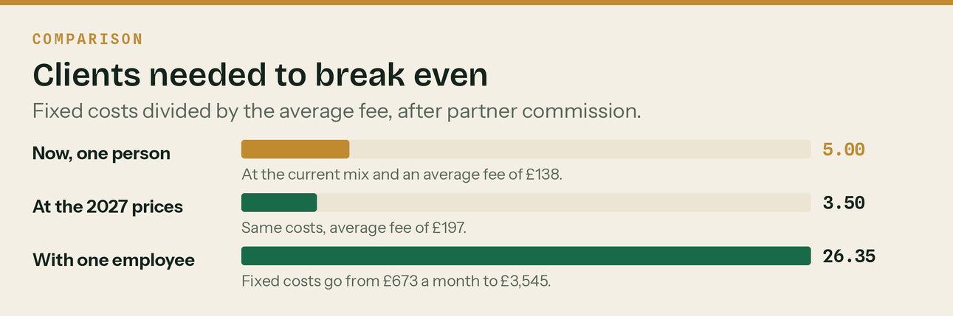
THE NUMBERS
Five clients cover every fixed cost in the business
£1,302 to start trading. £673 a month of fixed cost. The book reaches five clients in December 2026.

Slide 11
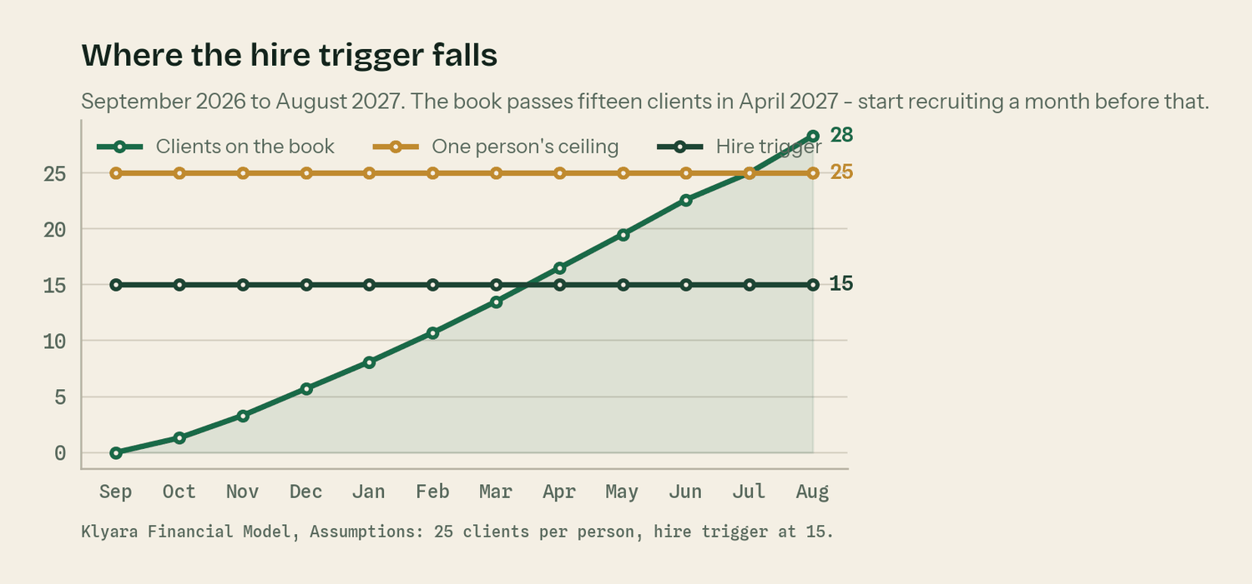
CAPACITY
Where the hire falls
Twenty-five clients is about 71 hours of delivery a month. The hire trigger is fifteen, and it is passed in April 2027.

Slide 12
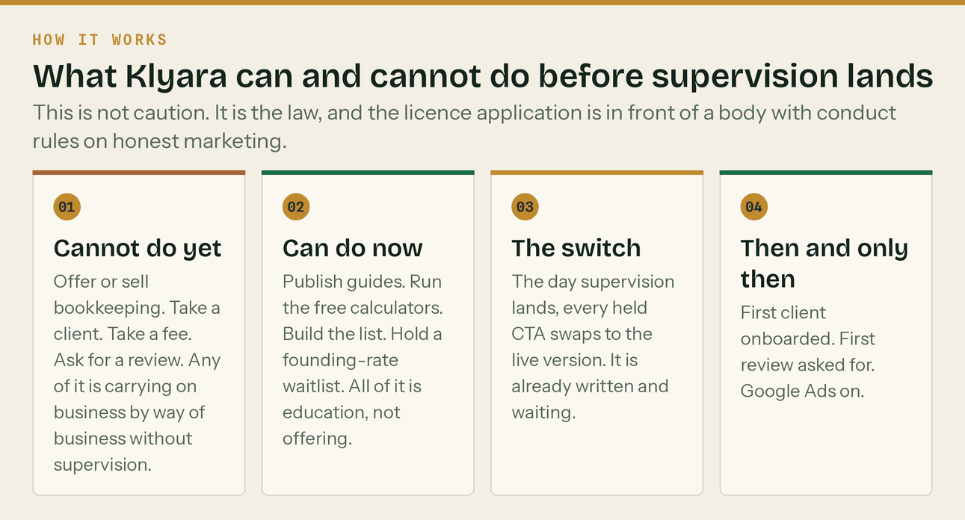
ICB practice licence: £94 to apply, about 28 days, AML supervision included. The application goes in on Tuesday 1 September 2026.

Slide 13
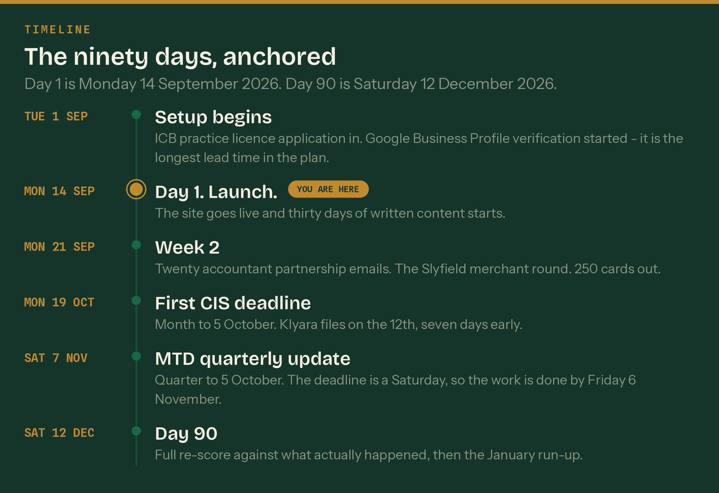
Nothing for Key or Craig is scheduled before Tuesday 1 September 2026. Every date is computed, not typed.

Slide 14
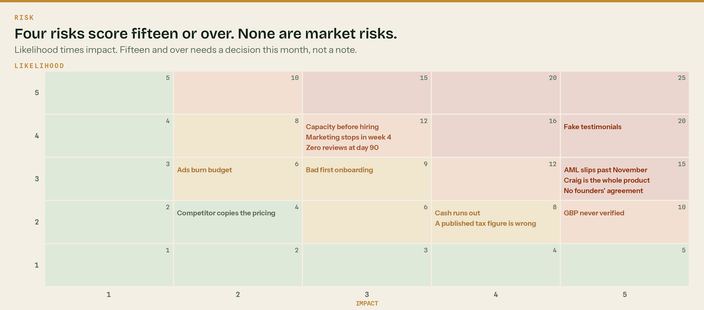
Three of the four are closed by paperwork this month. One is closed in ten minutes.

Slide 15
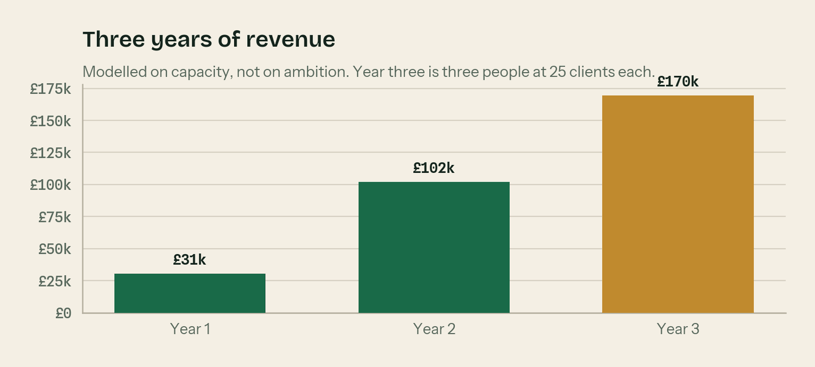
YEARS TWO AND THREE
Two things drive it, and neither is finding more customers
The founding-rate step-up
Average fee goes from £138 to £197 across the year from September 2027, without a single new client.
Capacity
The book hits the wall twice. Each time: hire, or hold a waitlist and let the price do the work.
Year 2 — £102,020
Two people, fifty clients.
Year 3 — £169,575
Three people, seventy-five clients. Then a decision about whether to keep going.

Slide 16
WHAT HAPPENS NEXT
Four things, and then it is a business
1
Pull the testimonials
Ten minutes. The highest-severity item on the register.
2
Get the licence in
Tuesday 1 September 2026. £94. About 28 days.
3
Sign the founders' agreement
Heads of terms this month. It does not need to be elaborate.
4
Send twenty emails
Week 2. Local accountants. The fastest route to clients one to five.
Klyara · klyara.com · hello@klyara.com · 020 8058 1496

