Slide 1
Annotation de données capteurs pour apprentissage machine
Hui Chen
3/23/2022
hui.chen@usherbrooke.ca

Slide 2
Project
Architecture
Front-end
Back-end
Deployment & Improvement with seniors’ feedback
Documentation
Project management

Slide 3
Project
Problem:
Machine learning models need groud truth for daily activities to analyze the older people’s activities.
It is expensive to annoate the activities by researchers long-term in real smart home.
Goal:
To provide the older people with tools that allow them to provide chronology of their day in terms of activities of daily living(ADLs)
The list of ADLs is predetermined, they can calibrate these ADLs.
The ADLs timeline will label the sensor events in database.
Improve the quality of the labelling activities.

Slide 4
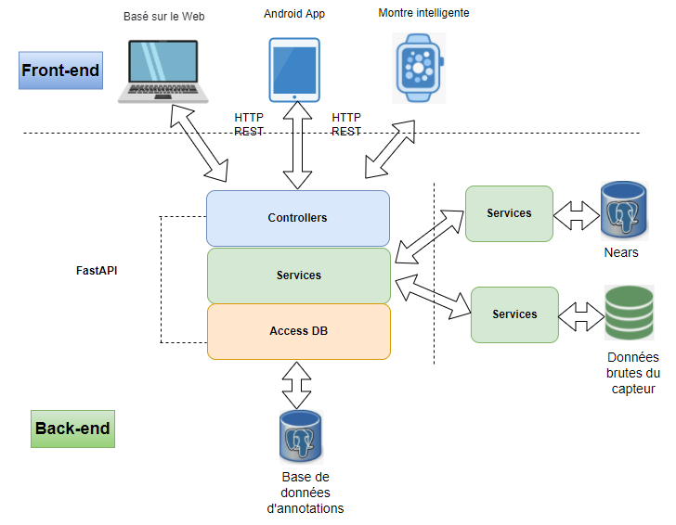
Architecture

Slide 5
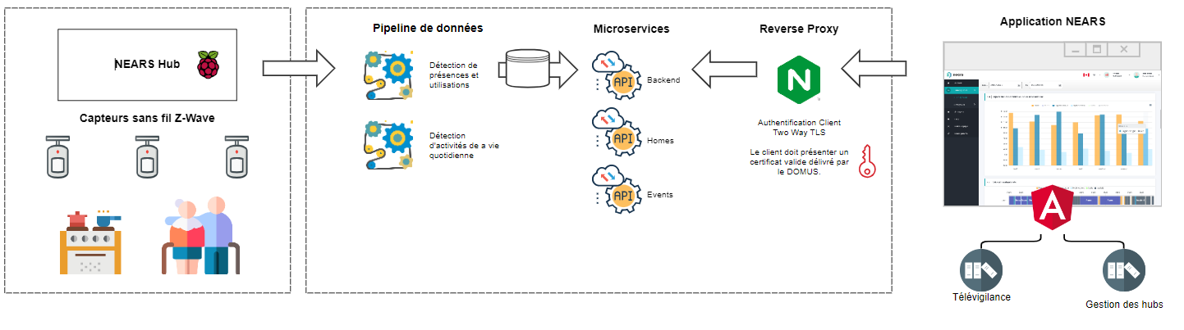

Slide 6
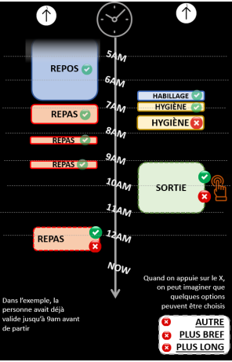
Front-end
Users authenticate with Keycloak. https://www.keycloak.org/
Display the timeline ADLs from Nears (Hygiène court,
Hygiène long, Repas, repos, Inactivité)
User can add/delete more activities into the timeline.
The activity box can be move to right time.
User can adjust the size according to duration of time.
For more problematic activities, additional questions
may be posed.
The user can update answered questions.
The interface always show the unconfirmed activities.
Save answers real time into database.
Angular, Vuejs

Slide 7
Back-end(Fast API )
Controllers:
Transmit data between front-end(web application, Andriod application, smartwatch) and processing component.
It should be general and support other kinds of front-end.
Database access:
Support different databases (MongoDB, Postgres, Mysql).
Create/delete database, select/delete/insert/update/drop tables for different databases.
Use Postgres for store annoated activities and timeline of ADLs.

Slide 8
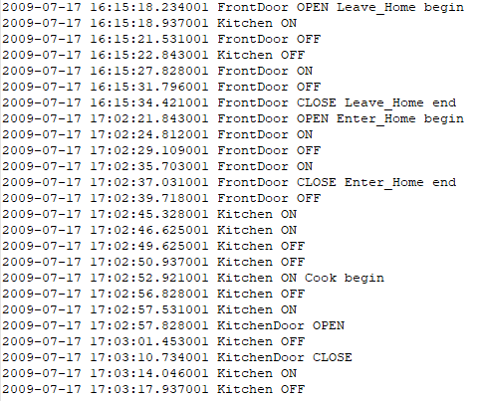
Service:
Manage the high level activities from NEARS and adjust the activities as timeline for Front-end needs.
Manage timeline of ADLs from seniors and save to postgres database.
Create a table to store low level sensor events with timelines of ADLs.
Use algorithm to decide popup which questions.
How to handle conflict with users’ timeline ADLs
and Nears referenced activities.
(Ex. Seniors confused their activities )
Use machine learning to predict activities and
confirm with the users?

Slide 9
More requirements:
Real-time annotations :
As soon as an activity is recognized, it is displayed, mechanisms can be added to ask immediately the user.
The user can indicate when he will start an activity.
A framework for exploring the annotated data
Displaying what is recognized and what is annotated and
Rerunning recognition with different algorithm with the possibility to explore various parameters
Displaying annotation, data, recognition for the ADLs

Slide 10
Deployment & Improvement with seniors’ feedback
Deployment: Docker containers, virtual machine
Improvement with seniors’ feedback
Idealy have 2~3 days for seniors to use the applications in their daily life.
Improve the application with seniors’ feedback
Documentation
All the components architectures
Design details for each components
Comments in codes
Test reports

Slide 11
Project management
Meeting everyweek, time?
Attending scrum demo

Slide 12
Merci!

