Slide 1
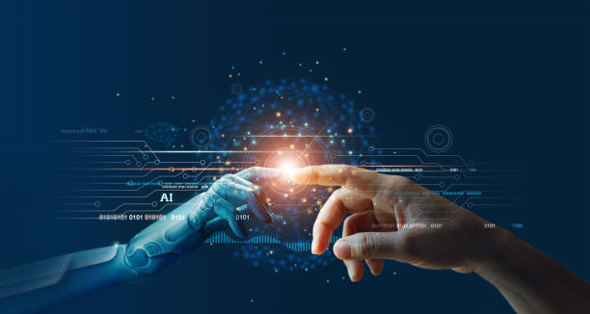
Book Recommendation System
Ai – Artificial Intelligence

Slide 2
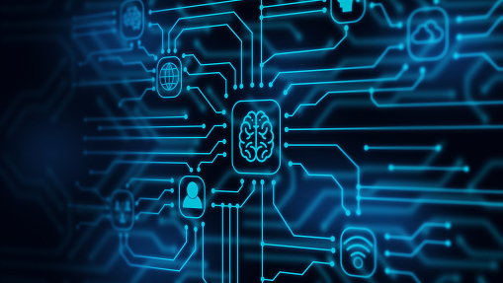
AI Concept used
Computer learning without explicit programming is the subject of the scientific field known as machine learning. One of the most fascinating technologies I have ever come across is machine learning. It gives the computer the ability to learn, as the name suggests, which gives it a more human-like quality. Machine learning is currently being actively used, possibly in a lot more places than one might think.
Types of Machine Learning:
Supervised Learning:
Unsupervised Learning:
Reinforcement Learning:

Slide 3
Supervised learning:
As the name suggests, supervised learning calls for the involvement of a supervisor who also serves as a teacher. In a nutshell, supervised learning is the process of teaching or training a computer system using labeled data. This indicates that the right answer has already been assigned to some data. In order for the supervised learning algorithm to assess the training data (set of training instances) and generate an accurate output from labeled data, the machine is then given a fresh set of examples (data).
Advantages of Supervised Learning:
The collecting of data and the production of data output from prior experiences are both made possible by supervised learning.
Performance criteria can be improved with the aid of experience.
A wide variety of problems involving computing in the real world can be solved with supervised machine learning.
Disadvantages of Supervised Learning:
Classification of big data can be challenging.
A large amount of computing time is required for supervised learning training. Consequently, it requires a lot of time.

Slide 4

Unsupervised Machine learning:
Unsupervised learning is the process of teaching a computer to use unlabeled or unclassified data and then allowing the algorithm to use that data unchecked. Without any prior data training, the machine's goal in this scenario is to categorize unsorted data based on similarities, patterns, and differences. The absence of an instructor, in contrast to supervised learning, prevents the computer from receiving training. As a result, the machine is only capable of independently identifying the hidden structure in unlabeled data.
Unsupervised learning algorithms are divided into two types:
The goal of a clustering problem is to find the underlying groupings in data, such as grouping customers according to their purchasing patterns.
Association: The search for rules that adequately represent significant portions of your data, such as people who purchase X also frequently purchase Y, is known as an association rule learning problem.

Slide 5
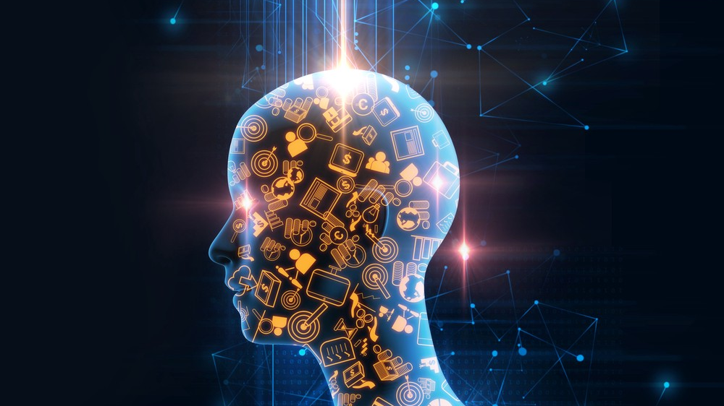
Reinforcement Machine Learning:
Reinforcement learning is a component of machine learning. It involves acting in a way that will maximize benefits in a certain circumstance. It is used by a variety of software programs and computers to decide the most practical action to perform in each circumstance. In contrast to supervised learning, where the solution key is present in the training data and allows the model to be taught with the appropriate response, reinforcement learning lacks this information and instead relies on the reinforcement agent to determine how to carry out the task at hand. In the absence of a training dataset, it must learn from its experience.
The most important aspects of reinforcement learning –
Input: The model's initial state should be provided as input.
Output: There are numerous alternative outputs because there are numerous solutions to a specific problem.
Training: The model will return a state and the user will select whether to reward or punish the model depending on its output.
The model is always learning.
The optimal solution is determined by the highest possible payment.

Slide 6
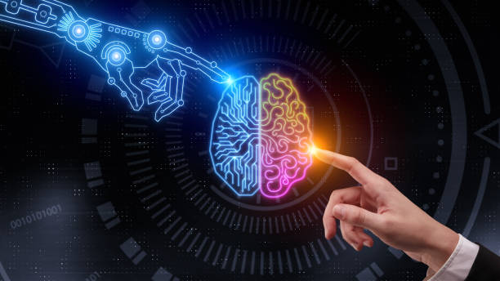
Research Evidences
I have acquired the critical expertise necessary to work on artificial intelligence after conducting extensive research on a variety of AI-related problems. Aside from deep learning, adversarial search, and other areas, I also learned a lot about current AI trends.

Slide 7
Research evidences
research on machine learning, detailed understanding of the various machine learning systems.

Slide 8
Research evidences
Learning about Book Recommendation System using machine language.

Slide 9
Research evidences
Research on similar projects, for learning purposes.

Slide 10
Research work Done on good book recommendation System
Goodreads was formed to get people interested in reading. And the key to getting people enthused about reading is to assist them to choose books they'll enjoy and then allow them to share their views and experiences with others.

Slide 11
Research work done on bookish recommendation system
Through book lists, staff reads, author interviews, and guest pieces, the Bookish website provides readers with the finest suggestions available. All books are recommended to the user, which may have been enjoyed by another user in the past.

Slide 12
Research work done on amazon book recommendation system
The Amazon book suggestion system presents a list of books that have previously been enjoyed by other readers. The preferences of numerous book readers are compiled and then offered to the new user.

Slide 13
Reason for Topic selection
Finding a new book to read may be tough for both newcomers and readers. I'm hoping that by developing the recommendation system, I'll be able to tackle the problem of readers being unable to find new books.

Slide 14

How the system work
Using powerful python modules, a pre-built dataset from Kaggle, collaborative filtering, and content-based filtering.
a system is constructed that proposes books to the user based on books they've already read or ratings they've given to other books.

Slide 15
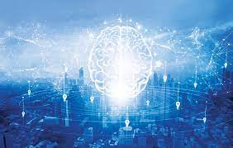
How it solves real world problems?
Recommendation systems can save time while looking for recommendations. This project will be tremendously useful to readers who are fresh to the world of books.
This project will surely help novices who want to learn about machine learning. They are encouraged to use it as a starting point or to improve the functioning of the system.

Slide 16
Thank you

