Slide 1


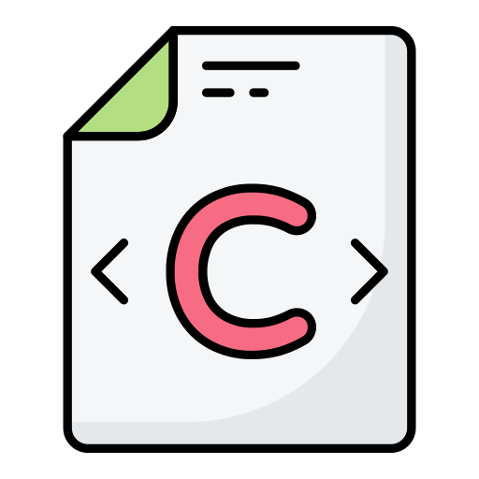



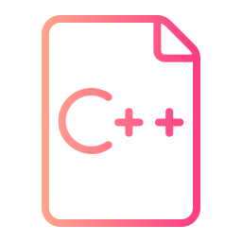


introduction
RUST
“My goal is to eliminate every line of C and C++ from Microsoft by 2030.”
Distinguished Engineer at Microsoft

Slide 2
Contents
Key Developments & How It Works
Impact on Software Development
Challenges, Risks & Future Outlook

