Slide 1
ParaRC: Embracing Sub-Packetization for Repair Parallelization in MSR-Coded Storage
Xiaolu Li¹, Keyun Cheng², Kaicheng Tang², Patrick P. C. Lee², Yuchong Hu¹, Dan Feng¹, Jie Li³, Ting-Yi Wu³
¹HUST ²CUHK ³Huawei
USENIX FAST 2023

Slide 2
Introduction
Erasure coding provides low-cost fault tolerance
Reportedly deployed in Google, Facebook, Azure, CERN
(n, k) Reed-Solomon (RS) codes (where k < n)
Encode k uncoded blocks to n coded blocks (i.e., redundancy = n/k)
Each coded block is a linear combination of any k blocks under Galois Field arithmetic
MDS: any k of n coded blocks can recover all data, with minimum redundancy
(14,10) RS codes → redundancy 1.4x
5x replication → redundancy 5x
Drawback: High repair penalty
Tolerate any four block failures
Notes:
Erasure coding is a promising redundancy technique for distributed storage systems to achieve fault tolerance with low storage overhead. It has been widely deployed in production.
There are many ways to construct erasure coding, while Reed-Solomon codes are the most common construction used in practice.
There are two configurable parameters k and n where k is less than n.
We encode a set of k uncoded blocks into a stripe of n coded blocks, where
each coded block can be expressed as a linear combination of any k blocks under Galois Field arithmetic. Note that the redundancy overhead is n/k.
RS codes satisfy the MDS property, meaning that any k out of n blocks can recover all original data, while the redundancy overhead n/k is the minimum among all possible erasure code constructions.
It significantly reduces the storage overhead compared with replication.
(14,10) RS codes used by Facebook can tolerate any four block failures with redundancy overhead of 1.4 times only
Replication needs to have five copies in order to tolerate any four block failures. The redundancy overhead is 5 times.
Despite the storage efficiency of RS codes, RS codes are known to have high penalty in repair performance.

Slide 3
Repair Penalty of RS Codes
Repair penalty comes in two aspects:
Repair bandwidth
Amount of traffic transferred over the network
Maximum repair load
Maximum amount of traffic that a node sends or receives among all nodes
N₀
N₁
N₂
N₃
B₀
B₁
B₂
B₃
Example: (4, 2) RS code; block size = 256 MiB
Repair bandwidth: 512 MiB
Maximum repair load: 512 MiB
B₁
B₂
N₀
B₀
B₀ = a₁B₁₊a₂B₂
Notes:
So how does the repair penalty comes from? There are two factors that cause the high repair penalty
The first one is the high repair bandwidth. Repair bandwidth is the amount of traffic transferred over the network.
The second one is the high maximum repair load. Maximum repair load is the maximum amount of traffic that a node sends or receives among all the nodes.
For example, consider the (4,2) RS code, where the block size is 256 MiB. N0 fails and is to be repaired. Since RS codes need to collect k blocks to repair N0 and k is equal to 2 , the repair bandwidth is 512 MiB. Also, N0 receives two blocks, which is the largest among all the nodes. Thus, the maximum repair load is also 512 MiB.

Slide 4
Reducing Repair Bandwidth
New erasure code constructions
Minimum-storage regenerating (MSR) codes [Dimakis, TIT’10]
Minimum repair bandwidth, satisfying MDS
Sub-packetization: dividing a block into w sub-blocks in construction
Examples:
Butterfly codes [Pamies-Juarez, FAST’16]
Require n = k + 2
Clay codes [Vajha, FAST’18]
Minimum repair bandwidth and I/O
Repair bandwidth = amount of I/O to local storage for repair (both are minimum)
General parameters n and k (k < n)
Notes:
There are many erasure code constructions proposed in the literature to reduce repair bandwidth.
In this work, we focus on MSR codes, which achieve the minimum repair bandwidth and satisfy the MDS property (i.e., storage optimal). The core idea of MSR codes is sub-paceketization, which divides a block into w sub-blocks, so that the repair only needs to retrieve a subset of sub-blocks.
Examples of MSR codes are Butterfly codes, but they require n = k+2. We in particular focus on Clay codes, which achieve minimum repair bandwidth and also I/O to local storage, and the also support general parameter n and k.

Slide 5
Clay Codes
Centralized repair for Clay codes
N₀
N₁
N₂
N₃
b_{3,0}
b_{1,0}
b_{2,0}
b_{3,0}
b_{0,0}
b_{1,0}
b_{2,0}
b_{1,1}
b_{2,1}
b_{3,1}
b_{0,1}
b_{1,1}
b_{2,1}
b_{3,1}
b_{0,2}
b_{1,2}
b_{2,2}
b_{3,2}
b_{0,3}
b_{1,3}
b_{2,3}
b_{3,3}
B₀
B₁
B₂
B₃
b_{1,0}, b_{1,1}
b_{2,0}, b_{2,1}
b_{3,0}, b_{3,1}
b_{0,0}
Example: (4, 2) Clay code; block size = 256 MiB
Repair bandwidth: 384 MiB
Maximum repair load: 384 MiB
b_{0,1}
N₀
b_{0,2}
b_{0,3}
B₀
Notes:
For example, consider the (4,2) Clay code, where the sub-packetization level w = 4.
Each block is divided into 4 sub-blocks, and the repair of N0 only needs to download two sub-blocks from each of the three nodes. The repair bandwidth is 384 MiB, and the maximum repair load (which appears in N0) is also 384 MiB.

Slide 6
Reducing Maximum Repair Load
Decomposing and parallelizing repair operations
Repair pipelining [Li, TOS’21]
Divide a block into slices
Repair slices in parallel
Example: (4, 2) RS code; block size = 256 MiB
Repair bandwidth: 512 MiB
Maximum repair load: 256 MiB
a₁b_{1,0}
a₁b_{1,0}+a₂b_{2,0}
N₁
N₂
N₀
N₁
N₂
N₀
N₁
N₂
N₀
N₁
N₂
N₀
N₁
N₂
N₀
time
N₁
N₂
N₀
Notes:
To reduce the maximum repair load, existing approaches propose to decompose and parallelize repair operations across multiple nodes. We consider a repair pipelining approach to reduce the maximum repair load as much as possible..
Consider the (4,2) RS code. We divide a block to repair into multiple slices. Initially, N1 sends a partial linear combination a1b1,0 to N2, which sends the repaired slice to N0. While N2 sends the results to N0, N1 can start the repair of the next slice and the transmissions can be done in parallel.
In repair pipelining, the maximum repair load is minimized to 256 MiB as each node sends/receives a size of one block. The repair bandwidth remains 512 MiB, as it still needs to read k blocks for the repair.

Slide 7
Repair Parallelization for MSR Codes
Can we apply repair pipelining for MSR codes?
Unfortunately, NO.
Repair pipelining relies on additive associativity of RS codes
Repair of MSR codes solves a system of linear combinations
Opportunity: exploiting sub-packetization of MSR codes
Repair of a sub-block requires a subset of available sub-blocks
We can distribute repair of sub-blocks across multiple nodes for load balancing
Notes:
A natural question is, can we apply repair pipelining for MSR codes? Unfortunately the answer is negative. The reason is that repair pipelining is based on the additive associativity to decompose a linear operation into partial operations, but the repair of MSR codes needs to collect enough sub-blocks and solve a system of linear equations for the repaired sub-blocks.
Nevertheless, we can leverage the sub-packetization nature of MSR codes. Our observation is that the repair of each sub-block requires a subset of available sub-blocks. Thus, we can distribute the repair of sub-blocks across multiple nodes for load balancing

Slide 8
Motivating Example
Example: (4, 2) Clay code; block size = 256 MiB
Repair bandwidth: 448 MiB
Maximum repair load: 320 MiB
Parallel repair for Clay codes
N₀
N₁
N₂
N₃
b_{0,0}
b_{1,0}
b_{2,0}
b_{3,0}
b_{0,1}
b_{1,1}
b_{2,1}
b_{3,1}
b_{0,2}
b_{1,2}
b_{2,2}
b_{3,2}
b_{0,3}
b_{1,3}
b_{2,3}
b_{3,3}
B₀
B₁
B₂
B₃
b_{1,1}
b_{0,1} = <b_{3,1}, c₁>₄
c₀ = <b_{2,1}, b_{3,0}>₀
c₁
c₃ = <b_{3,1}, c₁>₅
c₁ = <b_{2,1}, b_{3,0}>₁
b_{3,0}
b_{0,0}
b_{0,3} = <b_{1,1}, c₃>₇
b_{0,0} = <b_{2,0}, c₀>₂
c₂
b_{0,2}
b_{0,2} = <b_{1,0}, c₂>₆
c₂ = <b_{2,0}, c₀>₃
N₁
N₂
b_{3,1}
Notes:
For example, to apply the parallel repair for the (4,2) Clay code, N2 first collects b3,0 from N3 to repair b0,0 and intermediate sub-blocks c0, c1, and c2. N1 collects c2 from N2 to reconstruct b0,2. And finally N0 collects the sub-blocks from N1, N2, and N3 and repairs the remaining sub-blocks. For this particular case, the repair bandwidth is 448MiB and the maximum repair load is 320MiB.

Slide 9
Summary
Comparison of repair bandwidth and maximum repair load, where (n, k) = (4, 2)
Challenge: How do we model the trade-off and design a parallel repair approach for general MSR codes?
Repair Approach | Repair Bandwidth (MiB) | Maximum Repair Load (MiB)
RS; centralized | 512 (highest) | 512 (highest)
Clay; centralized | 384 (lowest) | 384 (high)
RS; parallel | 512 (highest) | 256 (lowest)
Clay; parallel | 448 (medium) | 320 (medium)
Notes:
We see that the parallel repair of MSR codes makes a trade-off between the repair bandwidth and maximum repair load. The challenge is, how do we model the trade-off, and furthermore, how do we design a parallel repair approach, for general MSR codes?

Slide 10
Our Contributions
ParaRC: A Parallel Repair Framework for MSR Codes
Model parallel repair as a DAG coloring problem
Show the trade-off between repair bandwidth and maximum repair load
Identify MLP (min-max repair load point), which minimizes repair bandwidth given the minimum maximum repair load
Propose a heuristic to find approximate MLP
Prototype ParaRC atop Hadoop 3.3.4 HDFS and evaluate on Alibaba Cloud
Notes:
Here comes our contributions. We propose ParaRC, a parallel repair framework for MSR codes by leveraging the sub-packetization nature of MSR codes.
We model the parallel repair as a DAG coloring problem and show the trade-off between repair bandwidth and maximum repair load. We also identify an MLP, a min-max repair load point that minimizes the repair bandwidth given the minimum maximum repair load. We propose a heuristic to efficiently find an approximate MLP. And we prototype ParaRC on Hadoop HDFS and evaluate it on Alibaba Cloud.

Slide 11
pECDAG
A pECDAG is a directed acyclic graph that defines a parallel repair operation
Built on ECDAG [Li, FAST’19]
Vertex v_{l}
Refers to a sub-block b_{i,j} (l = i × w + j) or an intermediate sub-block (l ≥ n × w)
Edge e(v_{l1}, v_{l2})
Sub-block v_{l1} is an input to the linear combination for forming sub-block v_{l2}
Color for each vertex
Refers to a node that computes or stores a sub-block
Notes:
We extend our previous work and propose an abstraction called the pECDAG, a erasure-coding-based directed acyclic graph that defines the workflow of a parallel repair operation.
A vertex vl represents a sub-block or an intermediate sub-block. An edge connects a vertex vl1 to another vertex vl2 if vl1 is an input to the linear combination for forming the sub-bloc vl2. We also color each vertex, and a color refers to a node that computes or stores a sub-block.

Slide 12
pECDAG
Example of a pECDAG for repairing B₀ in (4,2) Clay code:
4
8
9
12
13
5
l | v_{l} | Node
4,5 | b_{1,0}, b_{1,1} | Stored in N₁
8,9 | b_{2,0}, b_{2,1} | Stored in N₂
12,13 | b_{3,0}, b_{3,1} | Stored in N₃
16,17,18,19 | c₀, c₁, c₂, c₃ | Computed in N₂
0 | b_{0,0} | Computed in N₂
2 | b_{0,2} | Computed in N₁
1,3 | b_{0,1}, b_{0,3} | Computed in N₀
Node
16
17
N₀
18
19
N₁
2
0
1
3
N₂
N₃
R
B₀ is denoted as <0,1,2,3>
Notes:
Here’s an example of a pECDAG for repairing a block B0 in the (4, 2) Clay Code. If an edge connects a pair of vertexes with different colors, this implies a transmission.

Slide 13
Traffic Table
T: traffic table that records repair load of each node
T.In: number of incoming sub-blocks
T.Out: number of outgoing sub-blocks
Maximum repair load: 5 sub-blocks
4
8
9
12
 | In | Out
N₀ | 5 | 0
N₁ | 1 | 2
N₂ | 1 | 3
N₃ | 0 | 2
13
5
Node
16
17
N₀
18
19
N₁
Repair bandwidth: 7 sub-blocks
2
0
1
3
N₂
N₃
R
Notes:
Given a pECDAG, we can construct a traffic table that records the repair load (or the amount of data sent or received) of each node. T.in represents the number of incoming sub-blocks and T.out represents the outgoing sub-blocks. The sum of number of sub-blocks in a column is the repair bandwidth, which is 7 in this case. Also, the maximum number of sub-blocks in an entry is the maximum repair load, which is 5 here. Thus, the traffic table enables us to find the repair bandwidth and maximum repair load.

Slide 14
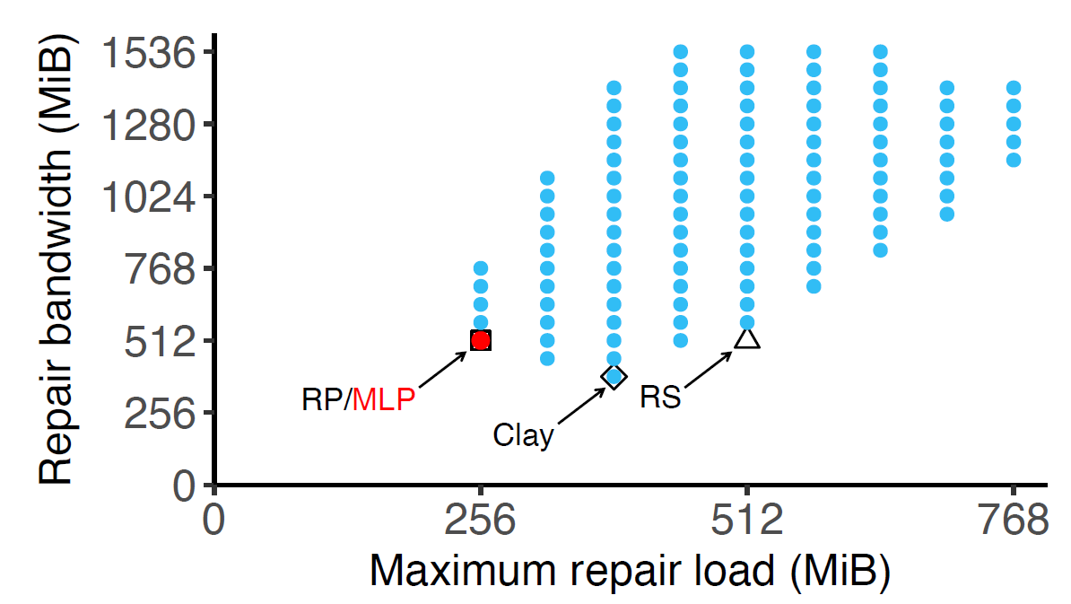
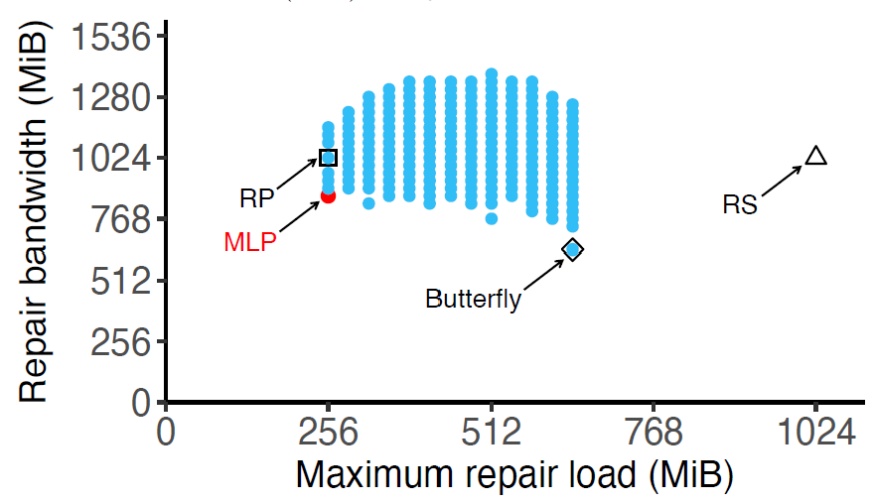
Trade-off Analysis
(4,2) Clay code (w=4)
(6,4) Butterfly code (w=8)
MLP (Min-max repair load point)
Minimizes repair bandwidth given the minimum maximum repair load
Finding the MLP by brute-force is computationally infeasible
Notes:
By examining different color combinations of a pECDAG, we can show a spectrum on the repair bandwidth and the maximum repair load. Here, we show the examples of two MSR codes. In particular, we are interested in a point called the MLP, the min-max repair load point that minimizes the repair bandwidth given the minimum repair load. This gives us the best possible parallel repair solution with the minimum possible repair bandwidth.
However, finding the trade-off spectrum and hence the MLP by brute-force is expensive, as there is an exponential number of color combinations to examine.

Slide 15
Heuristic
Search all color combinations for a pECDAG
Start with a pECDAG
Examine each of its neighbors (with one vertex of a different color)
Prune sub-optimal solutions
Intuition: search on Pareto frontier and prune dominated solutions
Notes:
The high-level idea of our heuristic is to search all the color combinations for a pECDAG and prune some branches based on our heuristic.
Intuitively, we can view this as a multi-objective optimization problem and the idea is to search the MLP on the Pareto frontier and prune dominated solutions.
There are three steps.

Slide 16
Heuristic
Step 1: Initialization
Generate a pECDAG with random color combination
Put it into an un-searched pool
Keeps pECDAGs that will be searched
Put it into a candidate pool
Keeps candidate pECDAGs to be returned
4
8
9
12
13
5
16
17
Repair bw
18
19
2
0
1
3
Maximum repair load
Un-searched pool
Candidate pool
R
Notes:
We start with a pECDAG with random color combination. We maintain an un-searched pool and a candidate pool.
The un-searched pool keeps pECDAGs that will be searched in the future, and the candidate pool keeps candidate pECDAG solutions to be returned.

Slide 17
Heuristic
Step 2: Searching
Retrieve a pECDAG from un-searched pool
Examine all its neighbors
4
8
9
12
13
5
16
17
18
19
2
0
1
3
R
Un-searched pool
Candidate pool
Neighbors
Notes:
In the second step, we retrieve a pECDAG from un-searched pool.
We first enumerate all its neighbors, represented by the white point, and then remove the original pECDAG, which is represented by a black point from the un-searched pool. Such that there is no more pECDAGs in the un-searched pool, while there is still a pECDAG in the candidate pool.

Slide 18
Heuristic
Step 3: Pruning
Compare each neighbor pECDAG with those in candidate pool
Repair bw
Un-searched pool
Candidate pool
Maximum repair load
Notes:
In step 3, we compare each neighbor pECDAG with those in candidate pool and remove the solutions that don’t give better results.

Slide 19
Heuristic
Step 3: Pruning
Case 1: Blue points are worse than the black point in candidate pool
Repair bw
Un-searched pool
Candidate pool
Maximum repair load
Notes:
In Case 1, the blue points are all worse than the solution in the candidate pool.

Slide 20
Heuristic
Step 3: Pruning
Case 1: Prune blue points
Repair bw
Un-searched pool
Candidate pool
Maximum repair load

Slide 21
Heuristic
Step 3: Pruning
Case 2: Green points have the least repair bandwidth or least maximum repair load compared with solutions in candidate pool
Repair bw
Un-searched pool
Candidate pool
Maximum repair load
Notes:
In Case, 2, the green points are not worse than the candidate solution.

Slide 22
Heuristic
Step 3: Pruning
Case 2: Add green points to candidate pool
Repair bw
Un-searched pool
Candidate pool
Maximum repair load

Slide 23
Heuristic
Step 3: Pruning
Case 3: Yellow point lies between the solutions in candidate pool
Repair bw
Un-searched pool
Candidate pool
Maximum repair load
Notes:
In Case 3, the yellow point lies between two points in candidate pool.

Slide 24
Heuristic
Step 3: Pruning
Case 3: Add yellow point to candidate pool
Repair bw
Un-searched pool
Candidate pool
Maximum repair load
Notes:
So we still add it into the candidate pool.

Slide 25
Heuristic
Step 3: Pruning
Case 4: Red points are better than some solutions in candidate pool
Repair bw
Un-searched pool
Candidate pool
Maximum repair load
Notes:
In Case 4, the red points are better than some solutions in the candidate pool.

Slide 26
Heuristic
Step 3: Pruning
Case 4: Prune the worse candidate solutions
Repair bw
Un-searched pool
Candidate pool
Maximum repair load
Notes:
Prune the solutions from the candidate pool.

Slide 27
Heuristic
Step 3: Pruning
Case 4: Add two red points to candidate pool
Repair bw
Un-searched pool
Candidate pool
Maximum repair load
Notes:
Then, we add the two red points in candidate pool.

Slide 28
Heuristic
Finally, add all candidate solutions to un-searched pool for the next iteration
Repair bw
Un-searched pool
Candidate pool
Maximum repair load
Notes:
Finally, we add the two red points and the one green point in un-searched pool, such that we can search them in future iterations.

Slide 29
Heuristic
Repeat steps 2 and 3 until un-searched pool is empty
Return the point with least maximum repair load in candidate pool
Approximate MLP
Notes:
We repeat step 2 and step 3 for many iterations, until the un-searched pool is empty.
And we return the point with minimum maximum repair load in candidate pool.

Slide 30
ParaRC
Built on Hadoop 3.3.4 HDFS
PRS Generator
Pre-computes approximate MLP offline for all failure combinations
Controller
Maintains stripe metadata
Parses pECDAG
Coordinates repair among agents
Agent
Performs actual repair
control flow
data flow
metadata flow
NameNode
PRS
Generator
Controller
Agent
Agent
Client
Agent
...
DataNode
DataNode
DataNode
Notes:
We build ParaRC atop Hadoop 3 HDFS to perform parallel repair for MSR-coded storage systems.
Here is the architecture. PRS Generator generates MLP for parallel repair solution in offline.
Controller maintains stripe metadata and the generated MLP. It also parses a pECDAG and coordinates the parallel repair operations.
Agent performs actual parallel repair sub-operations instructed by the Controller.

Slide 31
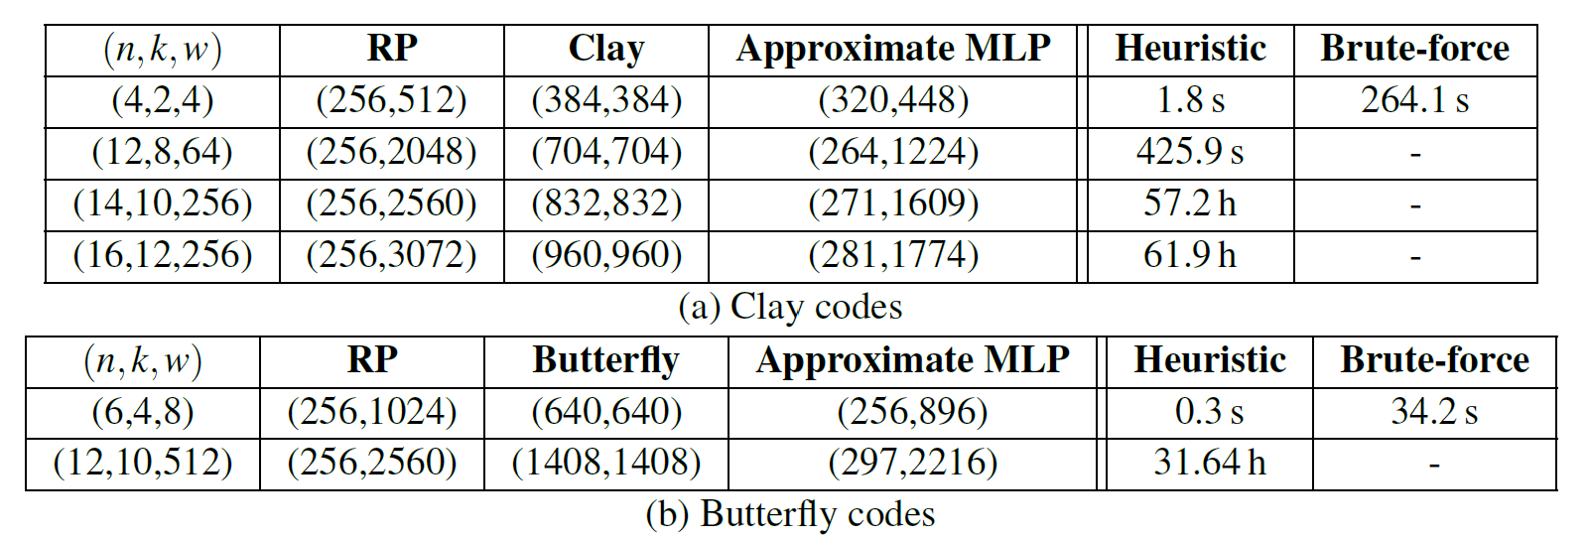
Finding Approximate MLP
(maximum repair load, repair bandwidth)
Approximate MLP balances repair bandwidth and maximum repair load, while our heuristic has feasible running time
Notes:
We first compare the running time of our heuristic algorithm with the brute-force search for small parameters. We reduce the running time from 264.1s to 1.8s for (4,2) Clay codes, while we reduce the running time from 34.2 s to 0.3s for (6,4) Butterfly codes.
We also compare the maximum repair load and repair bandwidth compared with centralized repair of Butterfly codes and Clay codes, as well as repair pipelining of RS codes. The maximum repair load of the approximate MLP is much less than that of the centralized repair of Clay codes or Butterfly codes. For example, for the (14,10) Clay code (w = 256) the maximum repair load of the MLP decreases to 271 MiB, which is 67.4% less than that of the centralized repair for Clay codes (i.e., 832 MiB).

Slide 32
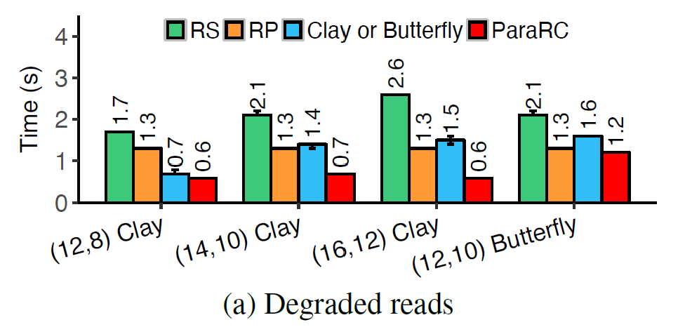
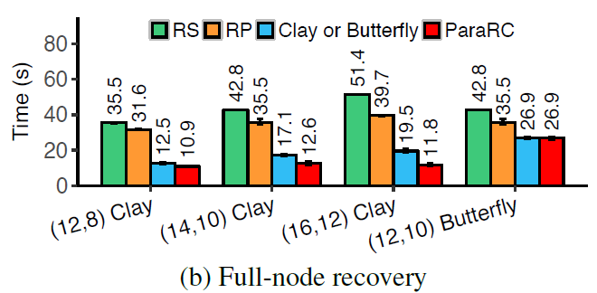
ParaRC Performance on Alibaba Cloud
(16, 12) Clay code
ParaRC reduces degraded read time by 76.4%, 51.9%, and 59.3%, respectively compared with RS, RP, and Clay
ParaRC reduces full-node recovery time 76.9%, 70.2%, and 39.2%, respectively compared with RS, RP, and Clay
Notes:
Here is the evaluation results of different repair methods.

Slide 33
Conclusions
ParaRC is a parallel repair framework for MSR codes
Exploits sub-packetization and balances the trade-off between repair bandwidth and maximum repair load
Future work:
Theoretical analysis of trade-off
Co-design with the intra-stripe parallelism and inter-stripe parallelism
Design for small blocks and wide stripes
Source code:
http://adslab.cse.cuhk.edu.hk/software/pararc
Notes:
To conclude, we propose ParaRC, which is a parallel repair framework that improves the repair performance of MSR-coded distributed storage systems exploiting the sub-packetization nature of MSR codes.
In this work, we only explore the possibility of improve the repair performance of large-scale distributed storage systems by parallel repair of MSR codes and come up with methods from empirical experience. There are still many open questions.
First, the theoretical analysis of ParaRC is still an open question, including the formulation of a multi-objective optimization problem, the difference between the solutions that are on the Pareto frontier, the convergence of the heuristic, and whether there exists faster heuristics.
Second, in this work we focus on the parallelism inside a stripe. How to extend the inter-stripe parallelism to multiple stripes with intra-stripe parallelism is still an open question. This issue is important for declustered settings.
What’s more, currently, ParaRC targets large blocks and popular n, k parameters. How to apply this technique for small blocks and wide stripes are still open questions.
We consider these problems as our future work.
We open source our code in our project website. verifications and extensions are also welcome.

