Slide 1
Balancing Repair Bandwidth and Sub-Packetization in Erasure-Coded Storage via Elastic Transformation
Kaicheng Tang¹, Keyun Cheng¹, Helen H. W. Chan¹, Xiaolu Li² Patrick P. C. Lee¹, Yuchong Hu², Jie Li³, and Ting-Yi Wu³
¹CUHK ²HUST ³Huawei
INFOCOM 2023

Slide 2
Introduction
Erasure coding provides low-cost fault tolerance
Reportedly deployed in Google, Facebook, Azure, CERN
RS(n, k): Reed-Solomon (RS) codes (where k < n)
Encode k data packets to a stripe of n-k parity packets
Properties:
Generality: any general parameters n and k are supported
MDS: any k out of n packets can recover all k data packets, with minimum redundancy
Systematic: original k data packets are kept in a stripe
Drawback: High repair bandwidth
Repairing any lost packet retrieves k packets from other nodes (i.e., k times bandwidth)

Slide 3
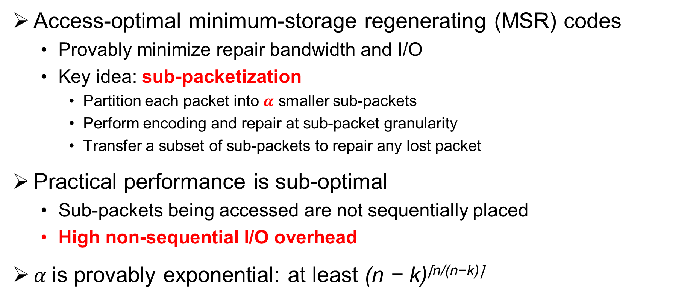
New Erasure Codes
Access-optimal minimum-storage regenerating (MSR) codes
Provably minimize repair bandwidth and I/O
Key idea: sub-packetization
Partition each packet into $α$ smaller sub-packets
Perform encoding and repair at sub-packet granularity
Transfer a subset of sub-packets to repair any lost packet
Practical performance is sub-optimal
Sub-packets being accessed are not sequentially placed
High non-sequential I/O overhead
$α$is provably exponential: at least (n − k)^{⌈n/(n−k)⌉}

Slide 4
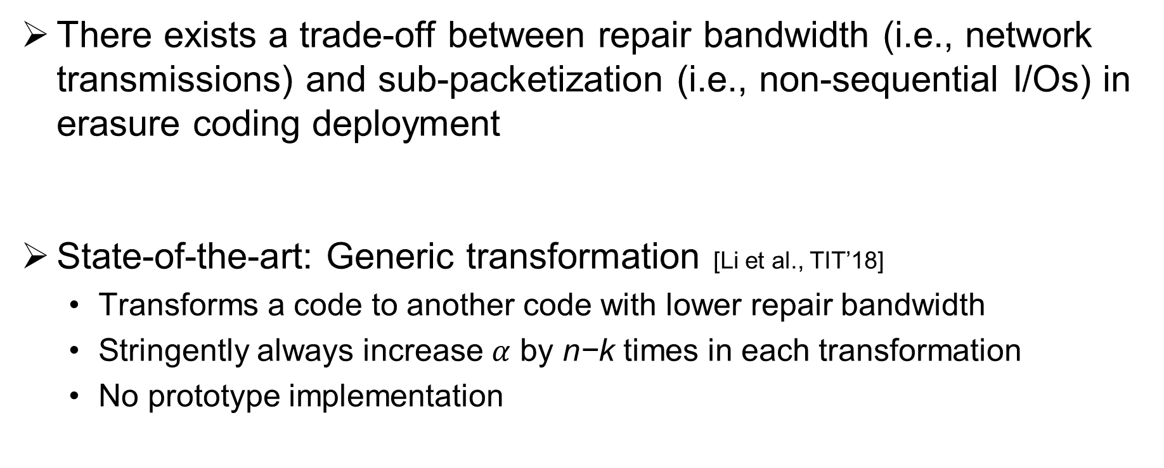
Our Insight
There exists a trade-off between repair bandwidth (i.e., network transmissions) and sub-packetization (i.e., non-sequential I/Os) in erasure coding deployment
State-of-the-art: Generic transformation [Li et al., TIT’18]
Transforms a code to another code with lower repair bandwidth
Stringently always increase $α$ by n−k times in each transformation
No prototype implementation

Slide 5
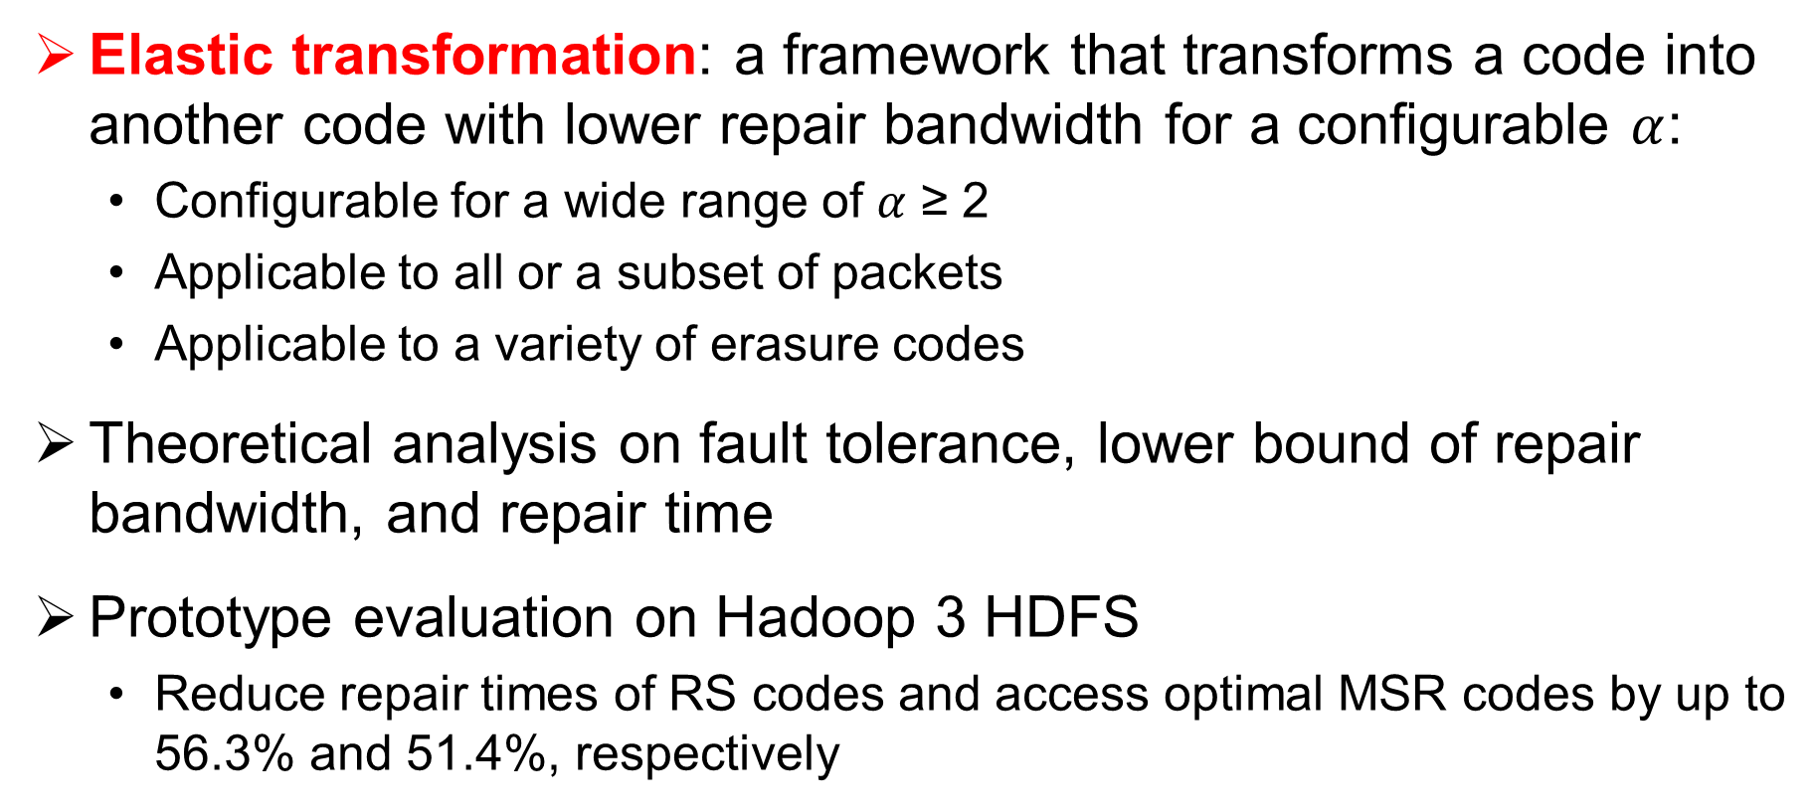
Our Contributions
Elastic transformation: a framework that transforms a code into another code with lower repair bandwidth for a configurable $α$:
Configurable for a wide range of $α$ ≥ 2
Applicable to all or a subset of packets
Applicable to a variety of erasure codes
Theoretical analysis on fault tolerance, lower bound of repair bandwidth, and repair time
Prototype evaluation on Hadoop 3 HDFS
Reduce repair times of RS codes and access optimal MSR codes by up to 56.3% and 51.4%, respectively

Slide 6
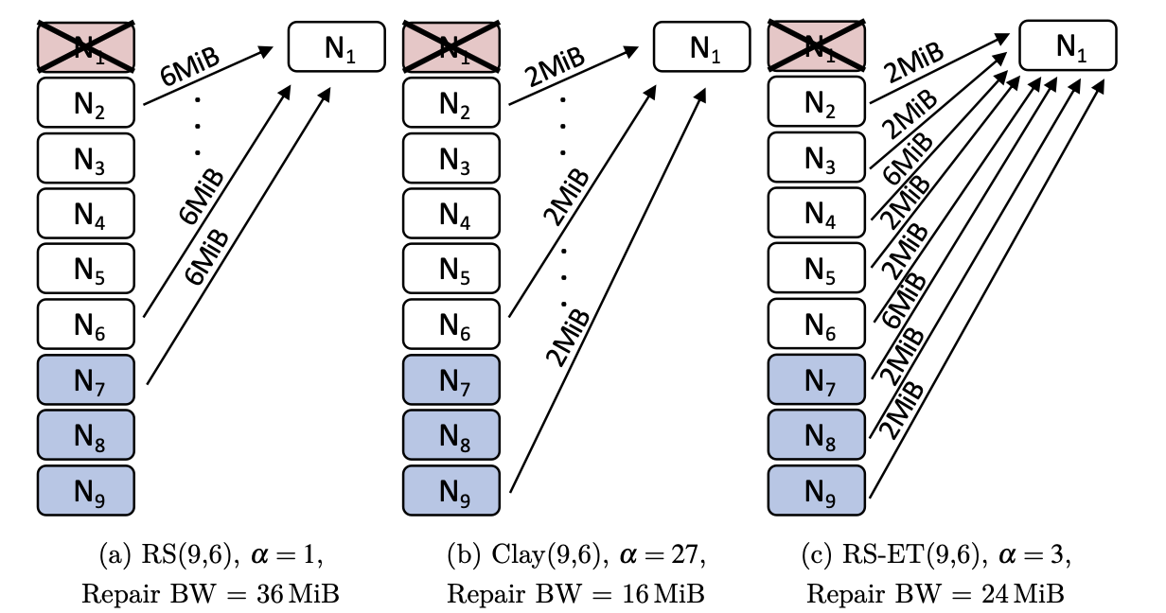
Motivating Example
RS vs. Clay [Vajha et al., FAST’18] vs. RS-ET
Clay: state-of-the-art access-optimal MSR codes
(n, k) = (9, 6); Packet size = 6 MiB

Slide 7
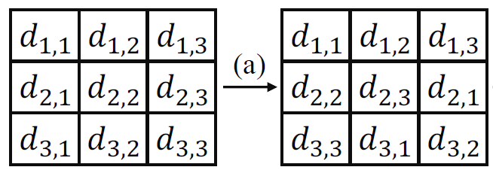
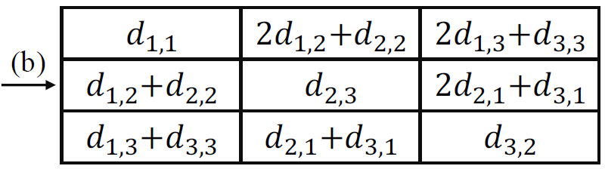
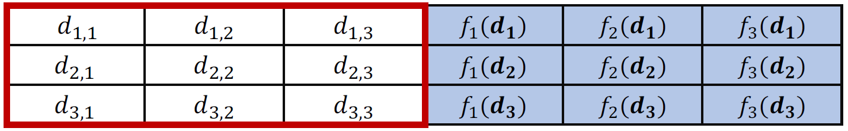
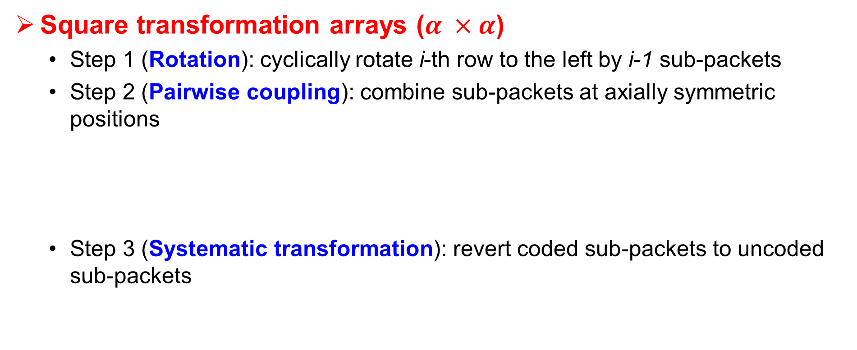
Transformation Arrays
Square transformation arrays ($α ×α$)
Step 1 (Rotation): cyclically rotate i-th row to the left by i-1 sub-packets
Step 2 (Pairwise coupling): combine sub-packets at axially symmetric positions
Step 3 (Systematic transformation): revert coded sub-packets to uncoded sub-packets

Slide 8
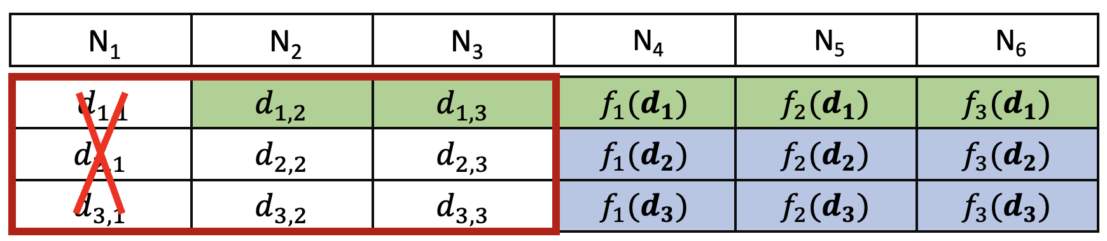

Transformation Arrays
Repair in a square transformation array
Repair $N_{1}$:
Read $f_{1}(d_{1})$, $f_{2}(d_{1})$, $f_{3}(d_{1})$ to solve $d_{1,1}, d_{1,2}−d_{2,1}$, $d_{1,3}−d_{3,1}$
Read $d_{1,2}$, $d_{1,3}$ and use them with $d_{1,2}−d_{2,1}$, $d_{1,3}−d_{3,1}$ to solve $d_{2,1},d_{3,1}$
5 sub-packets (reduce repair bandwidth by 44.4% compared with RS(6, 3))

Slide 9
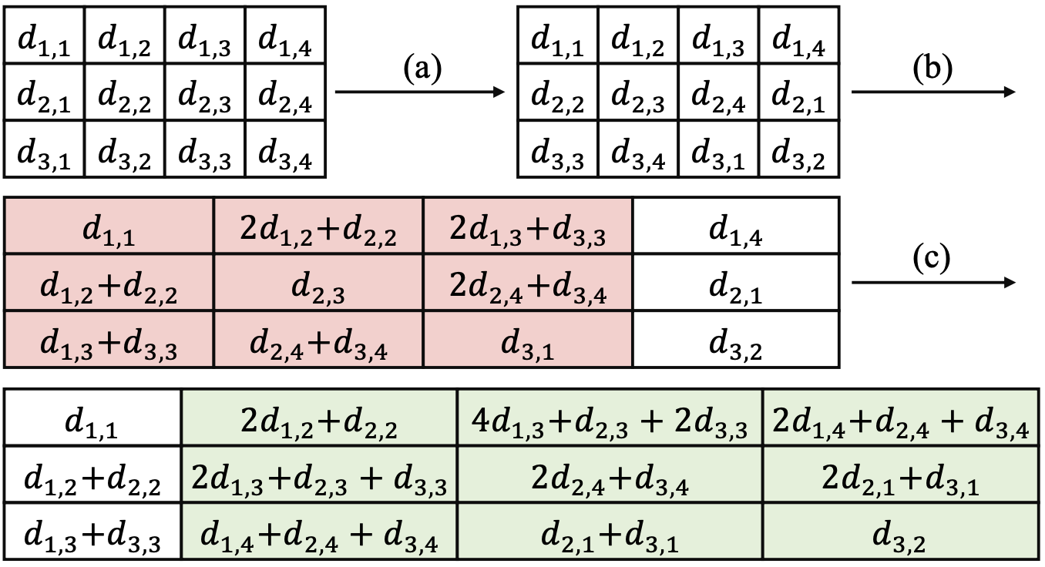
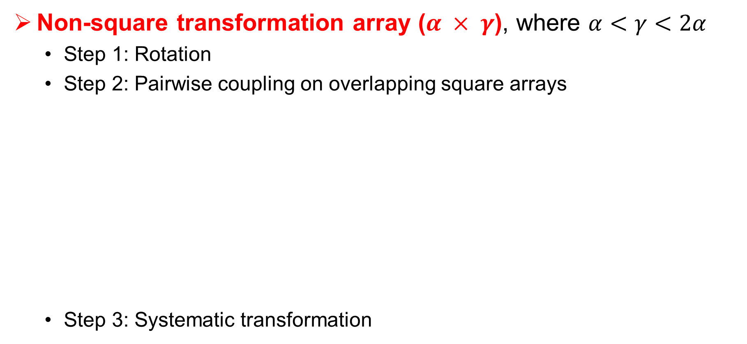
Transformation Arrays
Non-square transformation array ($α × γ$), where $α<γ<2α$
Step 1: Rotation
Step 2: Pairwise coupling on overlapping square arrays
Step 3: Systematic transformation

Slide 10
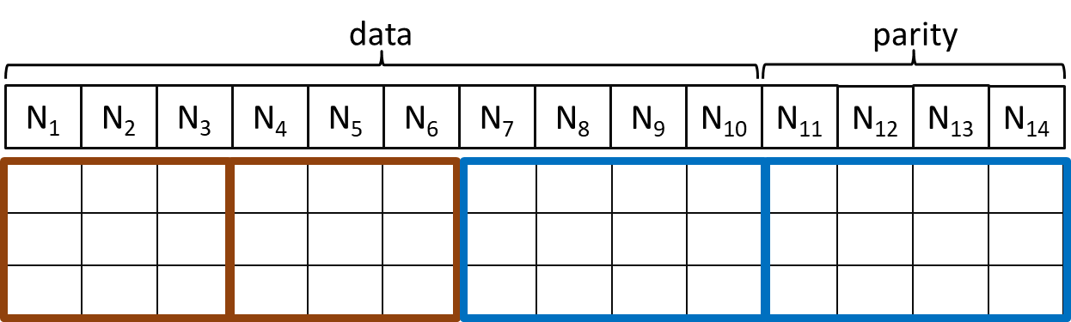
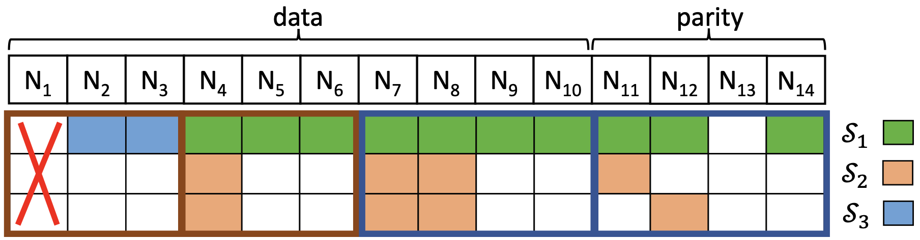

Elastic Transformation
Example: RS(14, 10), $α=3$
Repair: read $S_{1}$, $S_{2}$, $S_{3}$ (20 sub-packets, 33.3% less than RS)
Major
sub-stripe

Slide 11
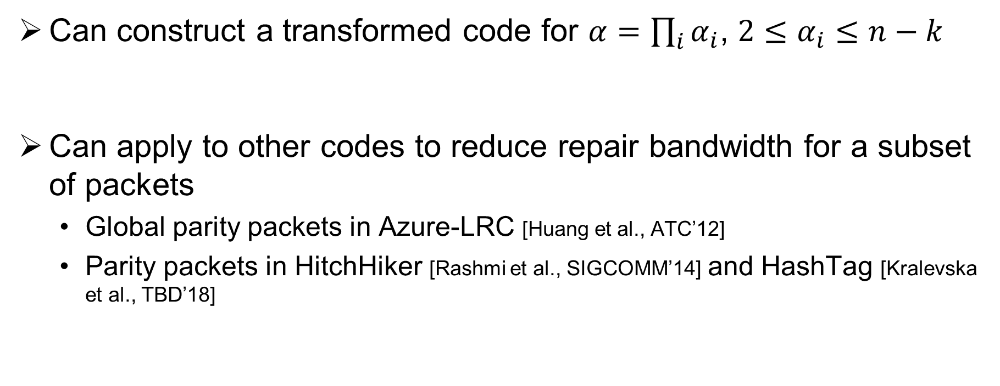
Elastic Transformation
Can construct a transformed code for $α=\prod_{i}{α_{i}}$, $2≤α_{i}≤n−k$
Can apply to other codes to reduce repair bandwidth for a subset of packets
Global parity packets in Azure-LRC [Huang et al., ATC’12]
Parity packets in HitchHiker [Rashmi et al., SIGCOMM’14] and HashTag [Kralevska et al., TBD’18]

Slide 12
Theoretical Analysis
Proof of the lower bound of field size to maintain MDS in transformation
Modeling of single-packet repair bandwidth
Modeling of single-packet repair time
Details in paper

Slide 13
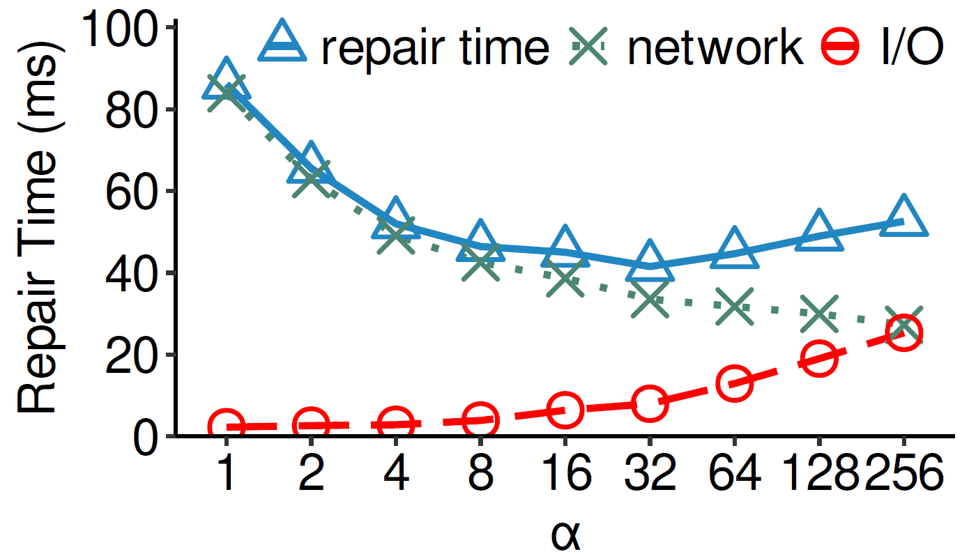
Modeling of Single-Packet Repair Time
Trade-off between repair bandwidth and sub-packetization
RS(14,10)

Slide 14
Implementation and Evaluation
Implemented elastic transformation on OpenEC [Li et al., FAST’19], a middleware for supporting erasure coding atop Hadoop 3 HDFS
Supported codes: RS, LRC, HitchHiker, and HashTag
Intel ISA-L for fast erasure coding operations
Evaluation on a cluster with 17 machines
Metric: single-block repair time
Average over all data and parity blocks of a stripe
Default: block size = 64 MiB; packet size = 1 MiB; bandwidth = 1 Gb/s

Slide 15
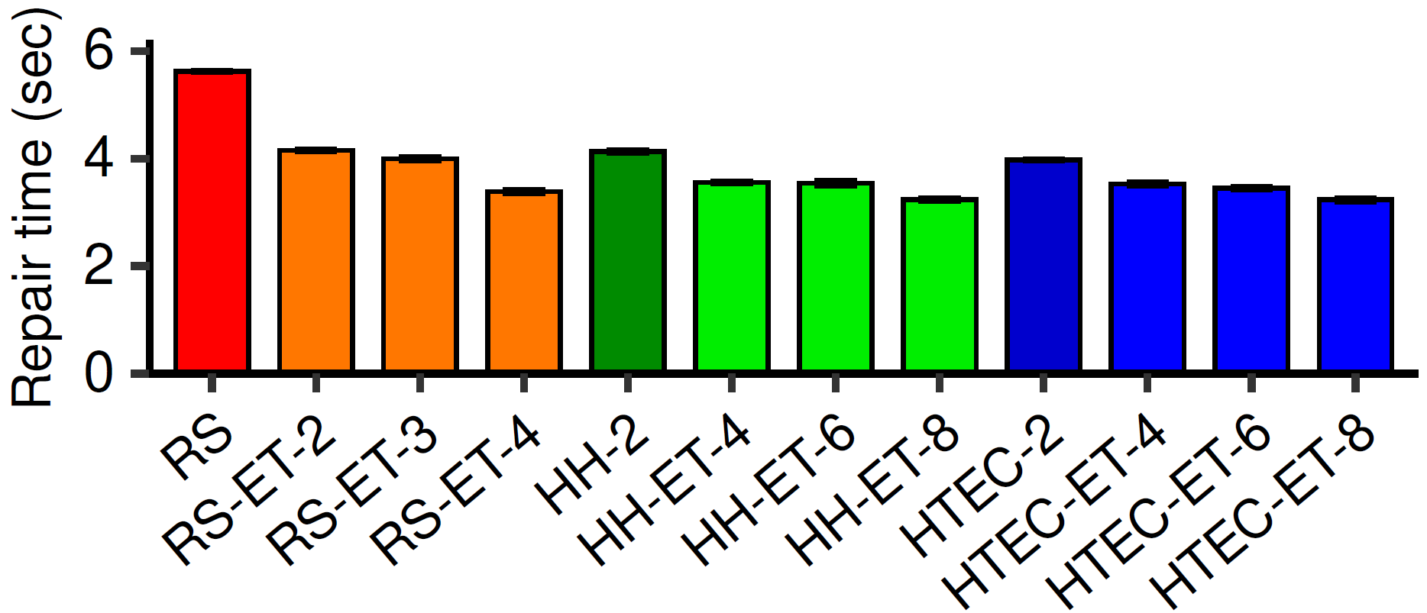
Overall Repair Performance
(n,k) = (14,10)
ET reduces repair times of RS codes, Hitchhiker, and HashTag by 26.2-39.8%, 13.9-21.6%, and 11.3-18.6%, respectively

Slide 16
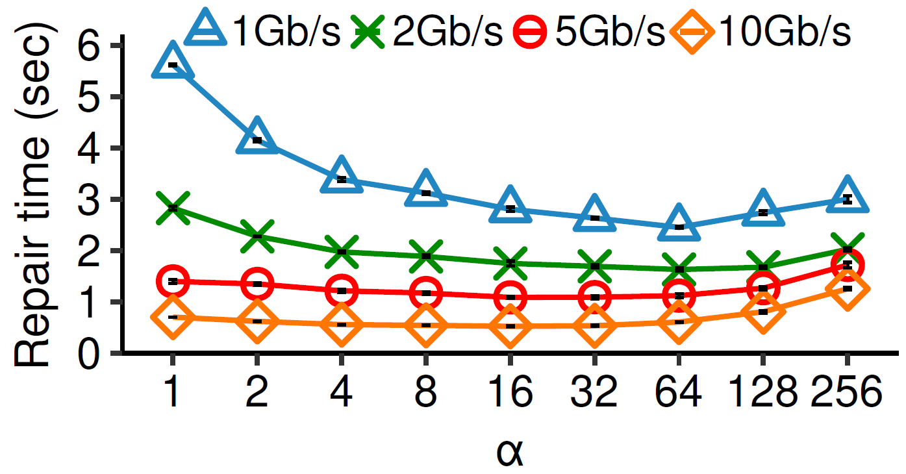
Impact of Sub-Packetization and Network Bandwidth
RS(n,k) = (14,10)
For 1 Gb/s, RS-ET(14,10) with $α$=64 reduces repair times of RS(14,10) ($α$=1) and access-optimal MSR point ($α$=256) by 56.3% and 18.3%, respectively

Slide 17
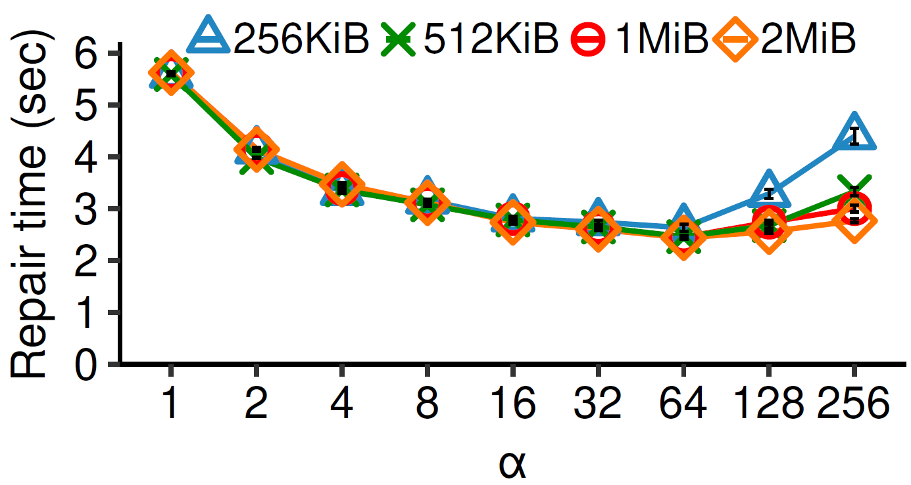
Impact of Packet Size
RS(n,k) = (14,10)
A small packet size (e.g., 256 KiB) aggravates I/O overhead
RS- ET(14,10) with α = 64 reduces the repair time of access-optimal MSR point by 40.1% when the packet size is 256 KiB

Slide 18
Conclusions
Propose elastic transformation, a framework to transform any base code into another code with smaller repair bandwidth and configurable sub-packetization level
Present fault tolerance proof and numerical analysis for elastic transformation
Prototype and evaluate elastic transformation on HDFS
Source code: http://adslab.cse.cuhk.edu.hk/software/openec-et

