Slide 1
LESS is More for I/O-Efficient Repairs in Erasure-Coded Storage
Keyun Cheng¹, Guodong Li², Xiaolu Li³, Sihuang Hu², Patrick P. C. Lee¹
¹The Chinese University of Hong Kong ²Shandong University ³Huazhong University of Science and Technology
USENIX FAST 2026

Slide 2
Erasure Coding
Erasure coding provides storage-efficient fault tolerance
Widely adopted in production: Google, Facebook, Azure, CERN …
(n, k) Reed-Solomon (RS) codes (where k < n)
Encode k uncoded blocks to n coded blocks (a stripe)
Maximum distance separable (MDS) → any k out of n blocks can recover all data with minimum redundancy n/k
(14,10) RS codes → redundancy 1.4x
5-way replication → redundancy 5x
Drawback: High repair penalty
Single-block repair accesses and transfers multiple blocks
Tolerate any four block failures

Slide 3


Repair-friendly Erasure Codes
Improve repair performance, yet with different design trade-offs
Clay codes _{[FAST’18 Vajha]}
Minimum single-block repair I/O (amount of data read), satisfying MDS
Exponential sub-packetization → substantial non-contiguous I/O seeks
Locally repairable codes (LRCs) _{[ATC’12 Huang]}
Local-group repair (< k blocks)
Non-MDS → higher redundancy
MDS codes with small sub-packetization
Reduced repair I/O and I/O seeks
Constraints in code constructions
_{[SIGCOMM’14, Rashmi}
_{INFOCOM’23, Tang}
IEEE Trans. Big Data’18, Kralevska]

Slide 4
I/O-efficient Repair
I/O efficiency is more critical than bandwidth efficiency
E.g., emerging high-speed network technologies
Goals
Preserving RS code properties: MDS, systematic, general in (n,k)
I/O-efficient repair
Reduced repair I/O (amount of data read)
Reduced I/O seeks (number of non-contiguous accesses)
Balanced reductions across all data and parity blocks
Single- and multi-block repair efficiency
Single-block failures dominate in practice
Multi-block failures are more common for wide stripes _{[FAST’23, Kadekodi]}
Can we achieve all these properties?

Slide 5
Our Contributions
LESS: a family of erasure codes for I/O-efficient repair
Layering extended sub-stripes
Readily builds on RS codes
Single-block repair (and some cases of multi-block repair) retrieves sub-blocks within a single extended sub-stripe
Allows small and configurable sub-packetization
Implementation on Hadoop HDFS 3.3.4
Up to 83.3% and 36.6% less single-block repair and full-node recovery times than Clay codes

Slide 6
LESS’s Idea
Input: (n, k, α)
α = number of sub-blocks per block (i.e., sub-packetization level)
Construct extended stripes (n’, k’)
n’ = n + n(α-1)/(α+1); k’ = k + n(α-1)/(α+1)
E.g., (n, k, α) = (6, 4, 2) → (n’, k’) = (8, 6)
Idea:
Layering multiple (n’, k’) extended sub-stripes on a regular (n, k) stripe
Repairing a block in (n, k) stripe → repairing α sub-blocks in (n’, k’) stripe
E.g., (n, k, α) = (6, 4, 2)
Traditional erasure codes: Repairing a block retrieves k = 4 blocks
LESS: Repairing a block retrieves k’ = 6 sub-blocks → 3 blocks (25% less)
* See paper on how we handle the case where n is not divisible by α+1.

Slide 7






Vandermonde-based RS codes
Parity-check equation
Encoding
Decoding (similar to encoding)
B₁
B₂
B₁
_{Generator (encoding) matrix}
_{Parity-check matrix}
B₃
B₂
B₄
$$−1$$
B₃
1⁰
2⁰
3⁰
4⁰
5⁰
6⁰
7⁰
8⁰
0
B₇
7⁰
8⁰
1⁰
2⁰
3⁰
4⁰
5⁰
6⁰
$$×$$
B₅
$$=$$
$$=$$
$$×$$
$$×$$
1¹
2¹
3¹
4¹
5¹
6¹
7¹
8¹
0
B₈
7¹
8¹
1¹
2¹
3¹
4¹
5¹
6¹
B₄
B₆
B₅
P
B₇
P⁽²⁾
P⁽¹⁾
B₆
B₈
_{Data Blocks}
_{Parity Blocks}
(8,6) Vandermonde-based RS code

Slide 8
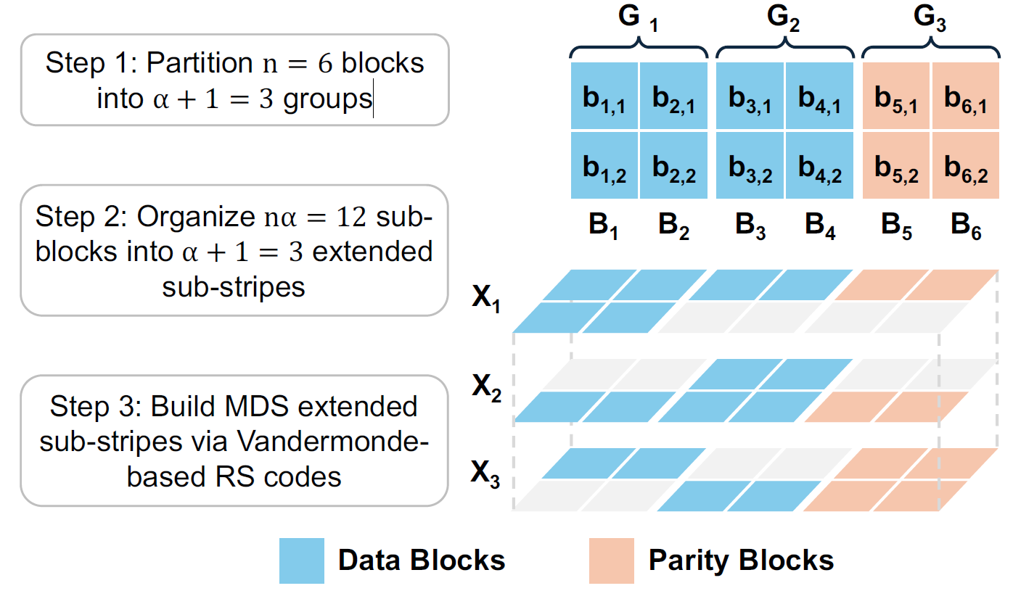
LESS Construction
Extended Sub-stripes
(n, k, α) = (6, 4, 2) LESS
b_{1,1}
b_{1,2}
b_{1,1}
b_{2,1}
b_{2,2}
b_{2,1}
b_{3,1}
b_{3,2}
b_{3,2}
b_{4,1}
b_{4,2}
b_{4,2}
b_{1,2}
b_{3,1}
b_{5,1}
(8,6) Vandermonde-based RS codes
b_{2,2}
b_{4,1}
b_{6,1}
b_{5,1}
b_{5,2}
b_{5,2}
b_{6,1}
b_{6,2}
b_{6,2}
X₁
X₂
X₃

Slide 9





Extended Sub-stripes
Each has a longer stripe length than a regular stripe
Satisfies parity-check equation: any n – k sub-block failures tolerable
b_{1,1}
b_{1,2}
b_{1,1}
b_{2,1}
b_{2,2}
b_{2,1}
b_{3,1}
b_{3,2}
b_{3,2}
P₁
0
P₂
0
P₃
0
$$×$$
b_{4,1}
$$=$$
$$×$$
b_{4,2}
$$=$$
$$×$$
b_{4,2}
$$=$$
0
0
0
b_{1,2}
b_{3,1}
b_{5,1}
b_{2,2}
b_{4,1}
b_{6,1}
b_{5,1}
b_{5,2}
b_{5,2}
X₁
X₂
X₃
b_{6,1}
b_{6,2}
b_{6,2}

Slide 10






LESS Encoding
Encodes the first α extended sub-stripes in sequence
The (α+1)-th extended sub-stripe inherently forms an RS stripe
b_{1,1}
b_{1,2}
b_{2,1}
b_{2,2}
b_{5,1}
$$−1$$
b_{5,2}
$$−1$$
P₁⁽²⁾
P₁⁽¹⁾
b_{3,1}
P₂⁽²⁾
P₂⁽¹⁾
b_{3,2}
$$=$$
$$×$$
$$×$$
$$=$$
$$×$$
$$×$$
b_{6,1}
b_{6,2}
b_{4,2}
b_{4,1}
b_{1,2}
b_{3,1}
X₁
b_{2,2}
X₂
b_{4,1}
With carefully chosen coding parameters, X₃ inherently forms an (8,6) stripe, without explicit encoding

Slide 11
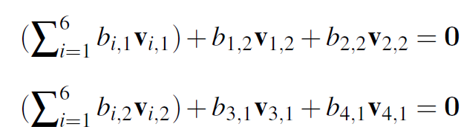
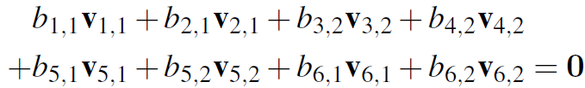
LESS Encoding
Encoding of X₁ and X₂:
X₃ is the sum of the parity-check equations of X₁ and X₂, and also satisfies the parity-check equation in Vandermonde-based form

Slide 12
Single-block Repair
Retrieves sub-blocks within a single extended sub-stripe
Reduced repair I/O
Keeps small α and contiguous sub-block access
One seek per block
G₁
X₁
b_{1,1}
b_{2,1}
b_{3,1}
b_{4,1}
b_{5,1}
b_{6,1}
b_{1,1}
b_{2,1}
b_{3,1}
b_{4,1}
b_{1,2}
b_{2,2}
b_{5,1}
b_{6,1}
b_{1,2}
b_{2,2}
b_{3,2}
b_{4,2}
b_{5,2}
b_{6,2}
To repair B₁, (6,4,2) LESS retrieves 6 sub-blocks
→ 25% less than (6,4) RS codes
B₁
B₂
B₃
B₄
B₅
B₆

Slide 13
Balanced I/O Reductions
Each block belongs to one extended sub-stripe
B₁ , B₂ (in G₁): use X₁ to repair
B_{3 ,} B₄ (in G₂): use X₂ to repair
B₅ , B₆ (in G₃): use X₃ to repair
Similar repair I/O and I/O seeks across all blocks
All extended sub-stripes have similar stripe lengths
G₁
G₂
G₃
b_{1,1}
b_{2,1}
b_{3,1}
b_{4,1}
b_{5,1}
b_{6,1}
b_{1,2}
b_{2,2}
b_{3,2}
b_{4,2}
b_{5,2}
b_{6,2}
B₁
B₂
B₃
B₄
B₅
B₆

Slide 14

Multi-block Repair
LESS benefits multi-block repairs when
$\left\lfloor \frac{n−k}{α}\right\rfloor ≥2$, and at most $\left\lfloor \frac{n−k}{α}\right\rfloor$ failed blocks
All failed blocks belong to a single extended sub-stripe
G₁
G₂
G₃
B₁ | B₂ |  | B₃ | B₄ | B₅ |  | B₆ | B₇ | B₈ | B₉ | B₁₀ |  | B₁₁ | B₁₂ | B₁₃ | B₁₄
X₁
To repair B₁ and B₂, (14,10, 2) LESS retrieves 15 sub-blocks
→ 25% less than (14,10) RS codes

Slide 15
Preserving RS Code Properties
MDS
LESS’s coding coefficients are carefully chosen to ensure MDS property
Check our paper for detailed proofs
Systematic
All data blocks are kept for direct access
General in (n, k)
Supports commonly used coding parameters with GF(2⁸) and GF(2¹⁶)
2 ≤ α ≤ n - k

Slide 16
Evaluation
Implementation
We implement LESS on OpenEC _{[Li, FAST’19]} running on Hadoop 3.3.4
Numerical analysis
LESS reduces repair I/O and I/O seeks
Testbed experiment
LESS reduces single-block repair and full-node recovery times

Slide 17
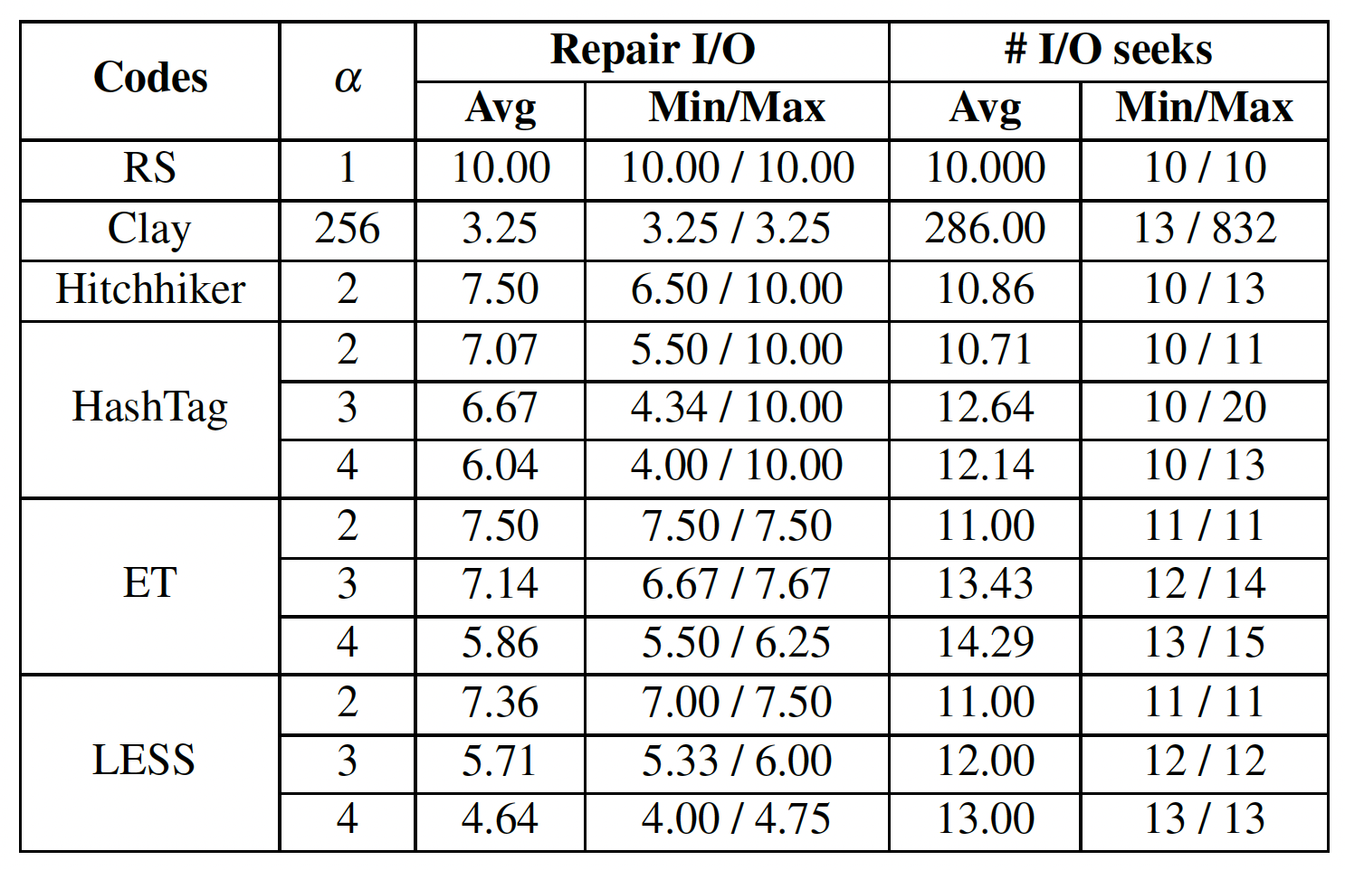
Numerical Analysis: Single-Block Repair
(n, k) = (14,10)
For (14,10), LESS (α = 4) reduces average repair I/O of RS, Hitchhiker, HashTag (α = 4), and ET (α = 4) by 53.6%, 38.1%, 23.1%, and 20.7%, respectively, and reduces average number of I/O seeks of Clay by 95.5%

Slide 18
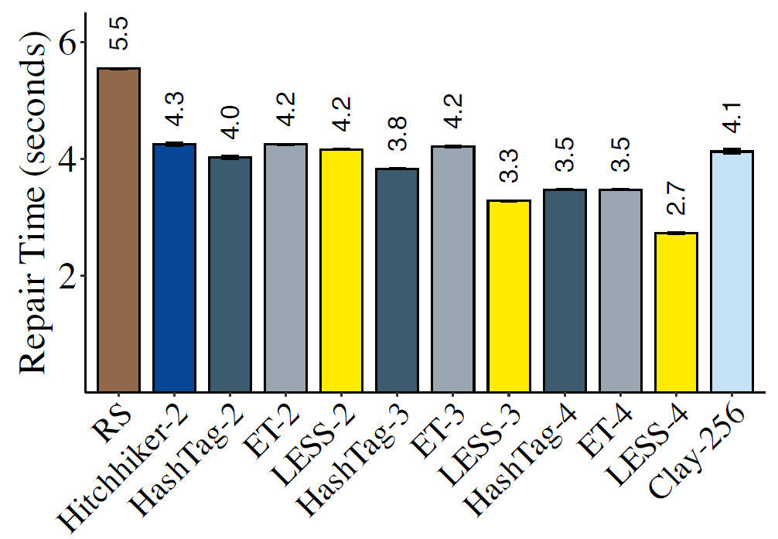
Testbed Experiments: Single-Block Repair
(n, k) = (14,10)
95% confidence intervals based on
Student’s t-distribution over 10 runs
LESS (α = 4) reduces single-block repair times of RS, Hitchhiker, HashTag (α = 4), ET (α = 4), and Clay by 50.8%, 35.9%, 21.5%, 21.5%, and 33.9%, respectively.

Slide 19
Impact of Hardware Specifications
We reproduced our results in Chameleon cloud in FAST’26 AE
LESS achieves consistent repair performance improvement
 | FAST’26 AE | Our paper
Machine | Chameleon cloud cluster, bare-metal | Local cluster, bare-metal
CPU | Intel(R) Xeon(R) Gold 6240R CPU @ 2.40GHz 24-core 48-threads | Intel i5-7500 CPU @ 3.80 GHz 4-core 4-threads
Memory | 192 GiB | 16 GiB
Disk | MTFDDAK480TDS 400 GiB SATA SSD | TOSHIBA 7200 RPM 1 TB SATA HDD
Network | 10 Gbps | 10 Gbps
Summary of results
LESS shows similar repair times and consistently outperforms the baselines in different network bandwidths and packet sizes
LESS and RS achieve 4.5 GiB/s and 7.9 GiB/s encoding throughput in Chameleon with improved CPUs, respectively (1.6 GiB/s and 2.8 GiB/s in our paper)

Slide 20


Conclusions
LESS: a family of repair I/O efficient erasure codes
Builds on RS codes by layering extended sub-stripes
Reduced repair I/O and I/O seeks for single- and multi-block repairs
Implementation atop Hadoop HDFS
Source code: https://github.com/adslabcuhk/less

Slide 21
Backup

Slide 22
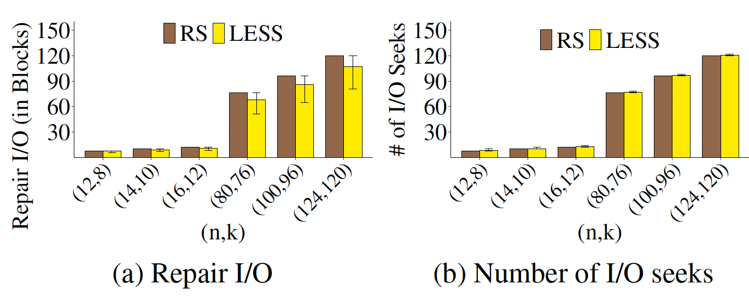
Numerical Analysis
Multi-block repairs
For (14,10), LESS (α = 2) reduces the average repair I/O of RS by 7.4%, and improves repairs for 28.6% of cases
For (124,120), LESS (α = 2) reduces the average repair I/O of RS by 10.8%, and improves repairs for 32.8% of cases

Slide 23
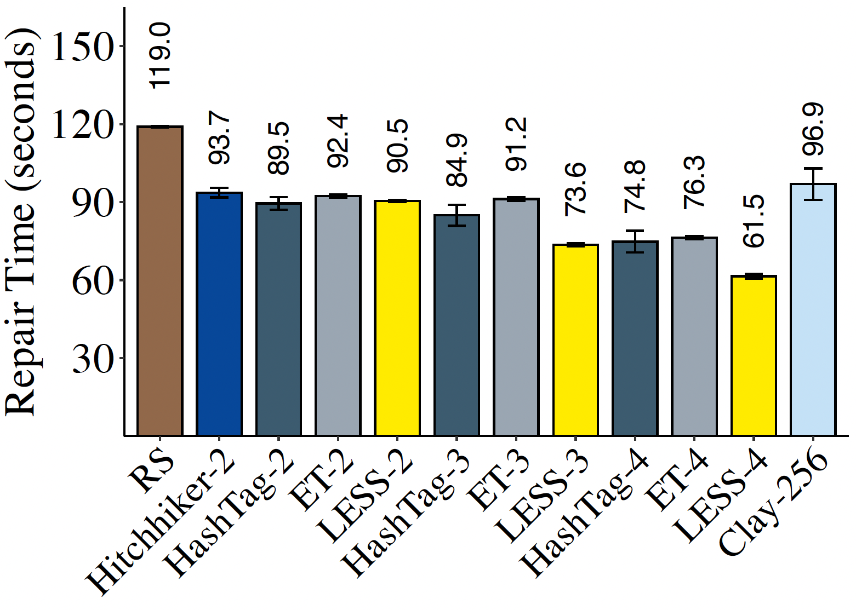
Testbed Experiments: Full-node Recovery
(n, k) = (14,10)
95% confidence intervals based on
Student’s t-distribution over 10 runs
LESS (α = 4) reduces the full-node recovery times of RS, Hitchhiker, HashTag (α = 4), ET (α = 4), and Clay by 48.3%, 34.3%, 17.8%, 19.4%, and 36.6%, respectively.

Slide 24
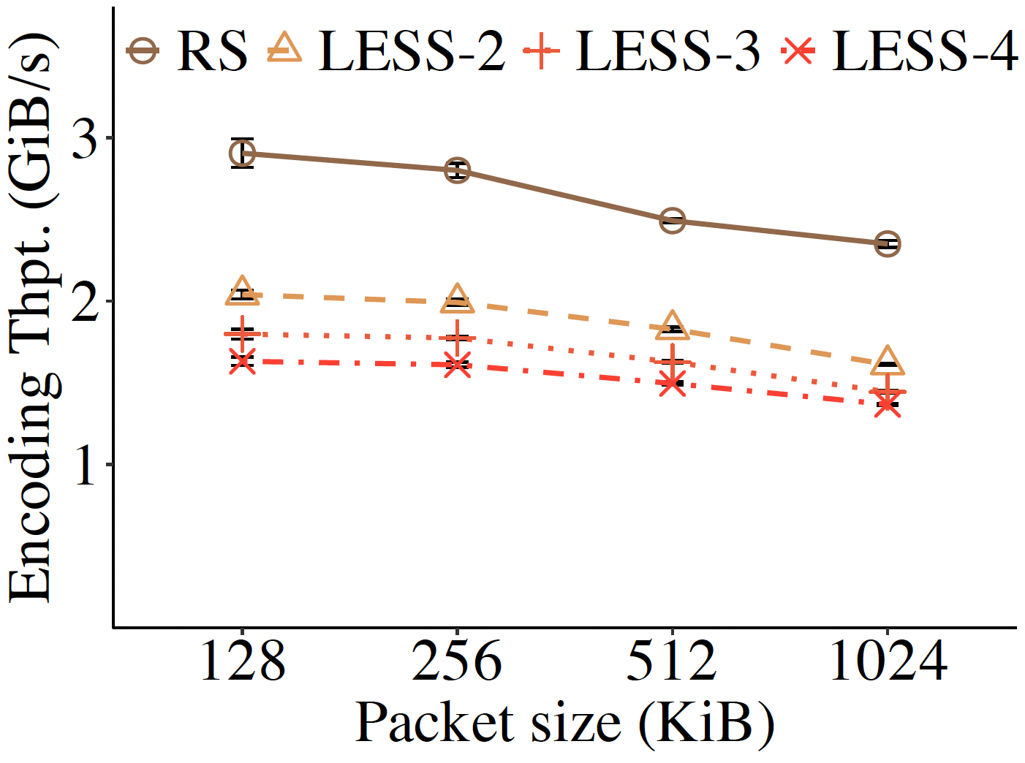
Encoding Overhead
(n, k) = (14,10)
LESS has lower encoding throughputs than RS, due to sub-packetization
Coding computation overheads are limited, compared with bandwidth and I/Os (often on the order of MiB/s)

Slide 25
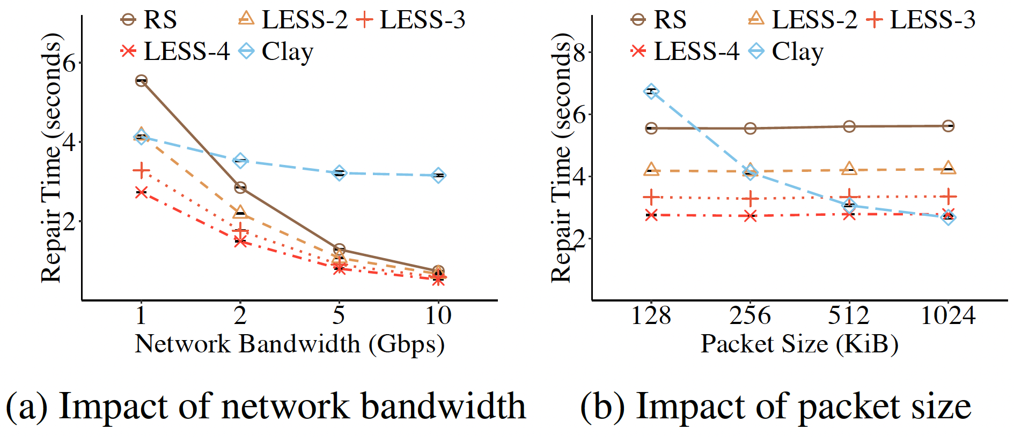
Impact of Configurations
(n, k) = (14,10)
Clay suffers from I/O seek overhead (in faster networks and small packet sizes), due to high sub-packetization overhead
LESS keeps stable repair performance in different configurations, due to small sub-packetization

