Slide 1
Cloud platform
Cloud platform offers enterprises an alternative to building their in house infrastructure.
With cloud platform anybody using Internet can enjoy scalable computing power on plug and play basis.
And this saves organizations from need to invest and maintain costly infrastructure
Many company offers cloud platform for develop, manage and deploy the applications.
Following are the market leaders
1. AWS
2. Microsoft Azure
3. Google cloud

Slide 2
Following table shows the major component comparison between three clouds.
 | AWS | Microsoft Azure | Google Cloud
Caching | Elastic Cache | Redis Cache | Cloud CDN
Processor | In AWS, 128 can be the maximum processor in VM | In Azure, it can be 128 | In Google cloud, it is only 96.
Platform as service | Elastic Beanstalk | Cloud Services | Google App Engine
Storage of Object | S3 | Block Blob | Cloud Storage
Serverless computing | Lambda is being used for serverless computing | In Azure, Azure functions are used. | In google cloud, Cloud functions are used.
API management | Amazon API Gateway | Azure API gateway | Cloud endpoints
Media services | Amazon Elastic Transcoder | Azure media services | Cloud video intelligence API
Pricing | per hour billing | Per minute billing | Per minute billing

Slide 3
All of three clouds provides almost same services but there are some pros and cons,
Following are the Strength and weakness for all three clouds.
Vendor | Strength | Weakness
AWS | Dominant market position Extensive, mature offerings Support for large organizations Extensive training Global reach | Cost management Overwhelming options
MS Azure | Second largest provider Integration with Microsoft tools and software Broad feature set Hybrid cloud Support for open source | Issues with documentation Incomplete management tooling
Google Cloud | Designed for cloud-native businesses Commitment to open source and portability | Late entrant to IaaS market Fewer features and services Historically not as enterprise focused

Slide 4
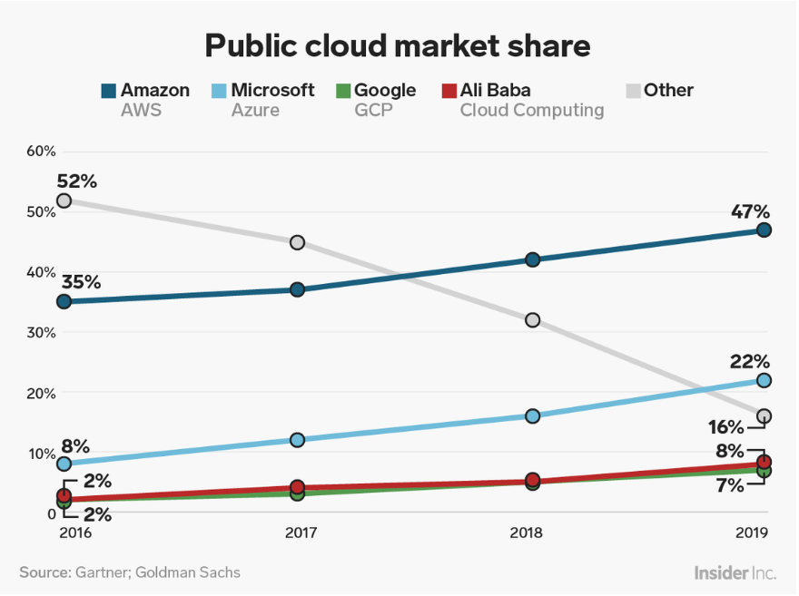
AWS is the oldest and dominating the cloud market single handed, and still shows the sign of continuous growth.
Following is the projection of market share for year 2019

Slide 5
References :
https://www.parkmycloud.com/blog/aws-vs-azure-vs-google-cloud-market-share/
https://www.datamation.com/cloud-computing/aws-vs-azure-vs-google-cloud-comparison.html
https://www.educba.com/aws-vs-azure-vs-google-cloud/

