Slide 1

ML-(Module-2)
Linear Model for Classification
Made By : Keyur Patel
Roll No : 16010421073

Slide 2
Topics
Linear Basis Function Models
Bayesian Linear Regression
Discriminant Functions
Probabilistic Generative Models
Probabilistic Discriminative Models

Slide 3
Linear Basis Function Models
In machine learning, linear basis function models are a way to represent and analyze data. Imagine you have a set of data points on a graph, and you want to find a simple way to understand and predict patterns in that data.
Linear basis function models use a straightforward idea: they break down the complex relationships in your data into simpler pieces. These simpler pieces are like building blocks or "basis functions." You can think of them as simple shapes, like lines, curves, or waves, that you use to approximate the data.

Slide 4
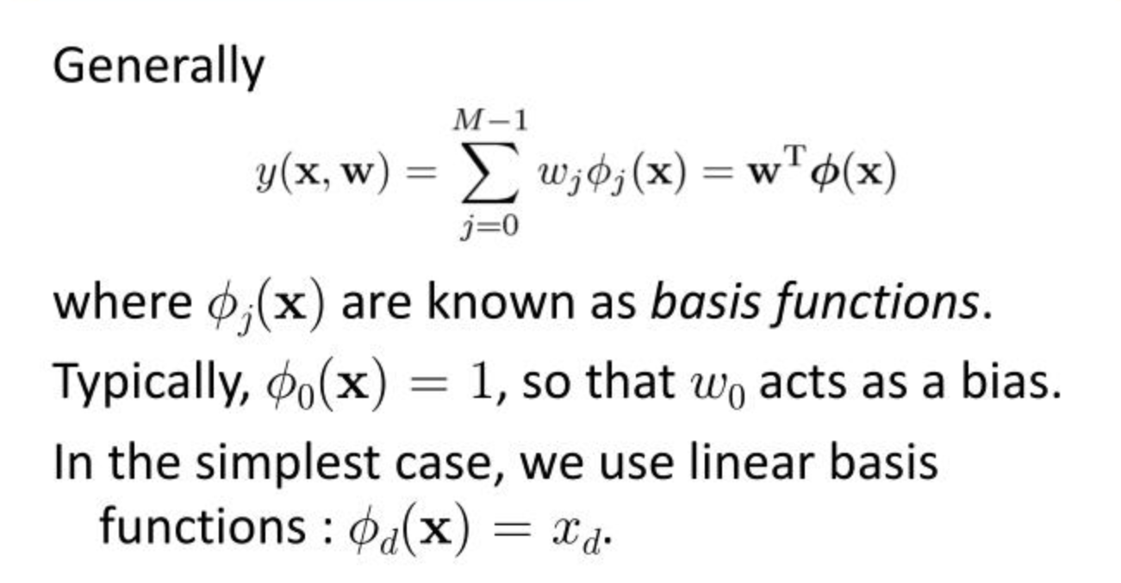
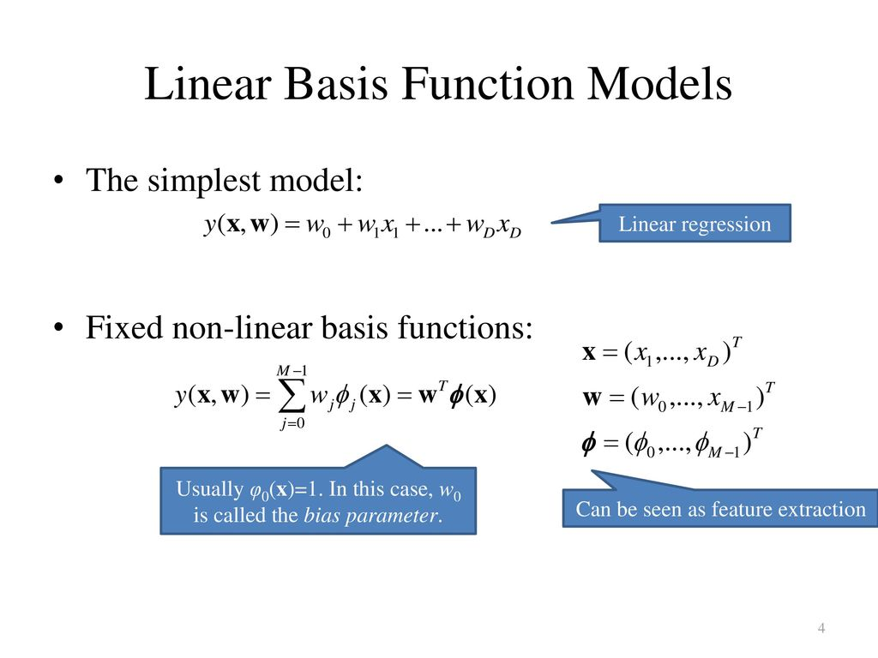
Linear Basis Function Models (Regression)

