Slide 1
Using Discrete Event Simulation to Analyze Pricing Strategies for Same-Location Car Rentals
Presented by:
Keyur Patel- 16010421073
Krishiv Patel - 16010421074

Slide 2
Objective
The key objective of this research is to analyze and understand the effects of employing dynamic pricing strategies for same-location and different-location car rentals at a rental company.
Specifically, the researchers aim to study pricing policies involving:
Discounts offered to customers for rentals where the pick-up and drop-off location are the same place.
Price increases applied to rentals where the pick-up and drop-off locations differ.
The main goal is to identify optimized combinations of same-location discounts and different-location price increases in order to maximize total revenue for a car rental company.

Slide 3
Resources
The paper utilized several key resources to develop the discrete event simulation model.
Discrete event simulation model
Created using ExtendSim software.
Interviews with industry experts
Provided real-world input to establish model requirements.
Car rental demand data
Based on actual rental company information from Saudi Arabia
Captures real-world customer arrival patterns
Pricing scenarios
195 experimental simulations testing different combinations of:
• Discounts for same-location rentals
• Price increases for different-location rentals.

Slide 4
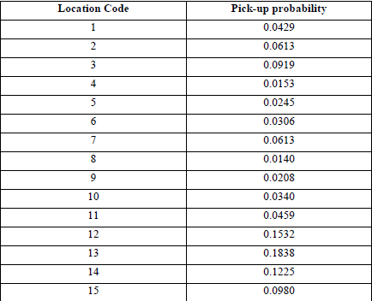
Modelling
A discrete event simulation model was developed using ExtendSim to represent the complex operations of a car rental network.
The model incorporates:
Multiple rental locations (at least 15 branches)
5 vehicle classes (categories)
Customer types:
Walk-in rentals
Reservations
Key rental parameters modeled probabilistically:
Customer arrival times (exponential distribution)
Rental duration (empirical distribution)
Time between reservation and pickup
Vehicle class preference
Pick-up and drop-off location preferences (see table)
Customer arrival probabilities to each pick-up location of car rental company.

Slide 5
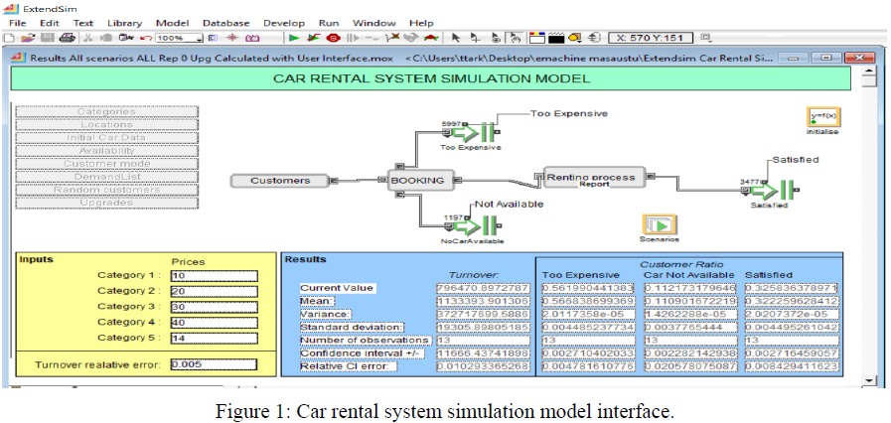
Simulation:
Pricing strategies implemented by:
Adjusting rental fees in different simulation scenarios
Applying discounts for same-spot rentals
Increasing prices for different-location rentals
Outputs:
Total rental revenue
Customer satisfaction
Percentage of Unavailable cars
Percentage Budget exceeded
Car rental system simulation model interface.
The model captures the random and dynamic nature of demands and operations. By flexibly implementing different pricing policies, their impact could be reliably evaluated. This enabled finding revenue-maximizing discount and price increase levels.

Slide 6
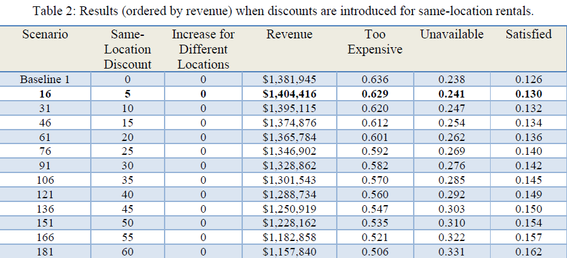
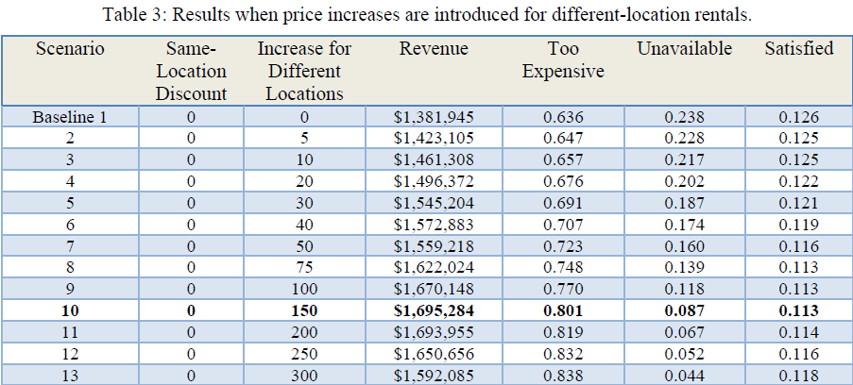
Results
The table-2 presents the results of various scenarios, ordered by revenue, where different discount percentages are offered for same-location rentals.
The findings indicate that offering a 5% discount for same-location rentals results in the highest revenue, yielding $1,404,416, which is 1.6% higher than the scenario with no discount.
However, it is important to note that additional discounts result in lower revenue for the company.
The baseline scenario (Scenario 1) represents the revenue without any price increase for different-location rentals.
The results show that introducing a 150% to 200% price increase for different-location rentals leads to the highest revenues.
For example, Scenario 10, with a 150% price increase, results in a revenue of $1,695,284, which is the highest among the scenarios. This represents a revenue increase of 22.7% compared to the baseline scenario.

Slide 7
Inferences
The discrete event simulation method used is flexible for modeling complex rental systems and experiments showed it can provide useful insights for increasing revenues.
Offering a small discount (5%) for same-location rentals (pickup and drop-off at the same place) can increase revenue compared to no discount. But larger discounts reduce revenue.
Increasing prices significantly (150-200%) for different-location rentals (picking up at one location and dropping off elsewhere) can increase revenue substantially (over 20% in the study). This works due to high imbalance between pickup and drop-off locations.
Simulation model allows testing pricing strategies with historiacal demand company data to find optimal dynamic pricing policies.

Slide 8
References:
Alabdulkarim, A. 2018. “Simulating Different Levels of Car Class Upgrades in a Car Rental Company’s Operations”. In Proceedings of the 2018 Winter Simulation Conference, edited by M. Rabe, A. A. Juan, N. Mustafee, A. Skoogh, S. Jain, and B. Johansson, 1539–1550. Piscataway, NJ: Institute of Electrical and Electronics Engineers.
Auto Rental News. 2015. “U.S. Car Rental Revenue and Fleet Size Comparisons 2005–2015”.
http://www.autorentalnews.com/fileviewer/2230.aspx, accessed 14th April.
Bitran, G. and R. Caldentey. 2003. “An Overview of Pricing Models for Revenue Management”. Manufacturing and Service
Operations Management 5(3):203–229.
Borshchev, A. and A. Filippov. 2004. “From System Dynamics and Discrete Event to Practical Agent Based Modeling: Reasons,
Techniques, Tools”. In Proceedings of the 22nd International Conference of the System Dynamics Society, 25th–29th June,
Oxford, England.
ExtendSim. 2019. “ExtendSim Power Tools for Simulation.” www.extendsim.com, accessed 03.12.2019.
Fink, A. and T. Reiners. 2006. “Modeling and Solving the Short-term Car Rental Logistics Problem”. Transportation Research
Part E: Logistics and Transportation Review 42(4):272–292.
Haensel, A., M. Mederer, and H. Schmidt. 2012. “Revenue Management in the Car Rental Industry: A Stochastic Approach”.
Journal of Revenue and Pricing Management 11(1):99–108.
Li, Z. and F. Tao. 2010. “On Determining Optimal Fleet Size and Vehicle Transfer Policy for a Car Rental Company”. Computer
and Operations Research 37(2):341–350.
Oliveira, B., M. Carravilla, and F. Oliveira. 2017. “Fleet and Revenue Management in Car Rental Companies: A Literature Review
and an Integrated Conceptual Framework”. Omega 71:11–26.
Pachon, J., E. Iskovou, C. Ip, and R. Aboudi. 2006. “Synthesis of Tactical Fleet Planning Models for the Car Rental Industry”.
IEEE Transactions 35(9):907–916.
Pannirselvam, G. P., L. A. Ferguson, R. C. Ash, and S. P. Siferd. 1999. “Operations Management Research: An Update for the
1990s”. Journal of Operations Management 18(1):95–112.

