Slide 1
Presentation on “IBM University Engagement Project Submission”
Domain of Project – Social Media Intelligence & Analytics
Project Title – Social Media Agent using Agentic AI
Problem Statement No.10: Social Media Agent

Slide 2

Project Title – Social Media Agent using Agentic AI
Challenge:
Brands struggle to track trends, sentiment, competitors, and engagement across multiple platforms.
Objective:
Build an Agentic AI companion that collects, analyzes, predicts, and visualizes social media insights in real time.
Student Name | Photo | Email. ID | Mobile No
Dr. Keyur Brahmbhatt |  | Keyur.brahmbhatt @bvmengineering.ac.in | 9428900107

Slide 3
Tech Stack
LangFlow + IBM watsonx.ai + IBM Granite Models + RAG + ChromaDB
Technology Used:
LangFlow
IBM watsonx.ai
IBM Granite Models
ChromaDB
Streamlit Dashboard
Python APIs

Slide 4
Proposed Solution
A multi-agent Social Media Intelligence platform that aggregates posts, comments, hashtags, influencer content, and competitor activity. RAG retrieves trusted context while Granite models generate insights, content suggestions, and forecasts.

Slide 5
LangFlow Components Used
1. Chat Input
2. IBM watsonx Model
3. Granite Model
4. Social Media Data Loader
5. Text Splitter
6. Embeddings
7. Chroma Vector Store
8. Retriever
9. Agent Component
10. Chat Output

Slide 6
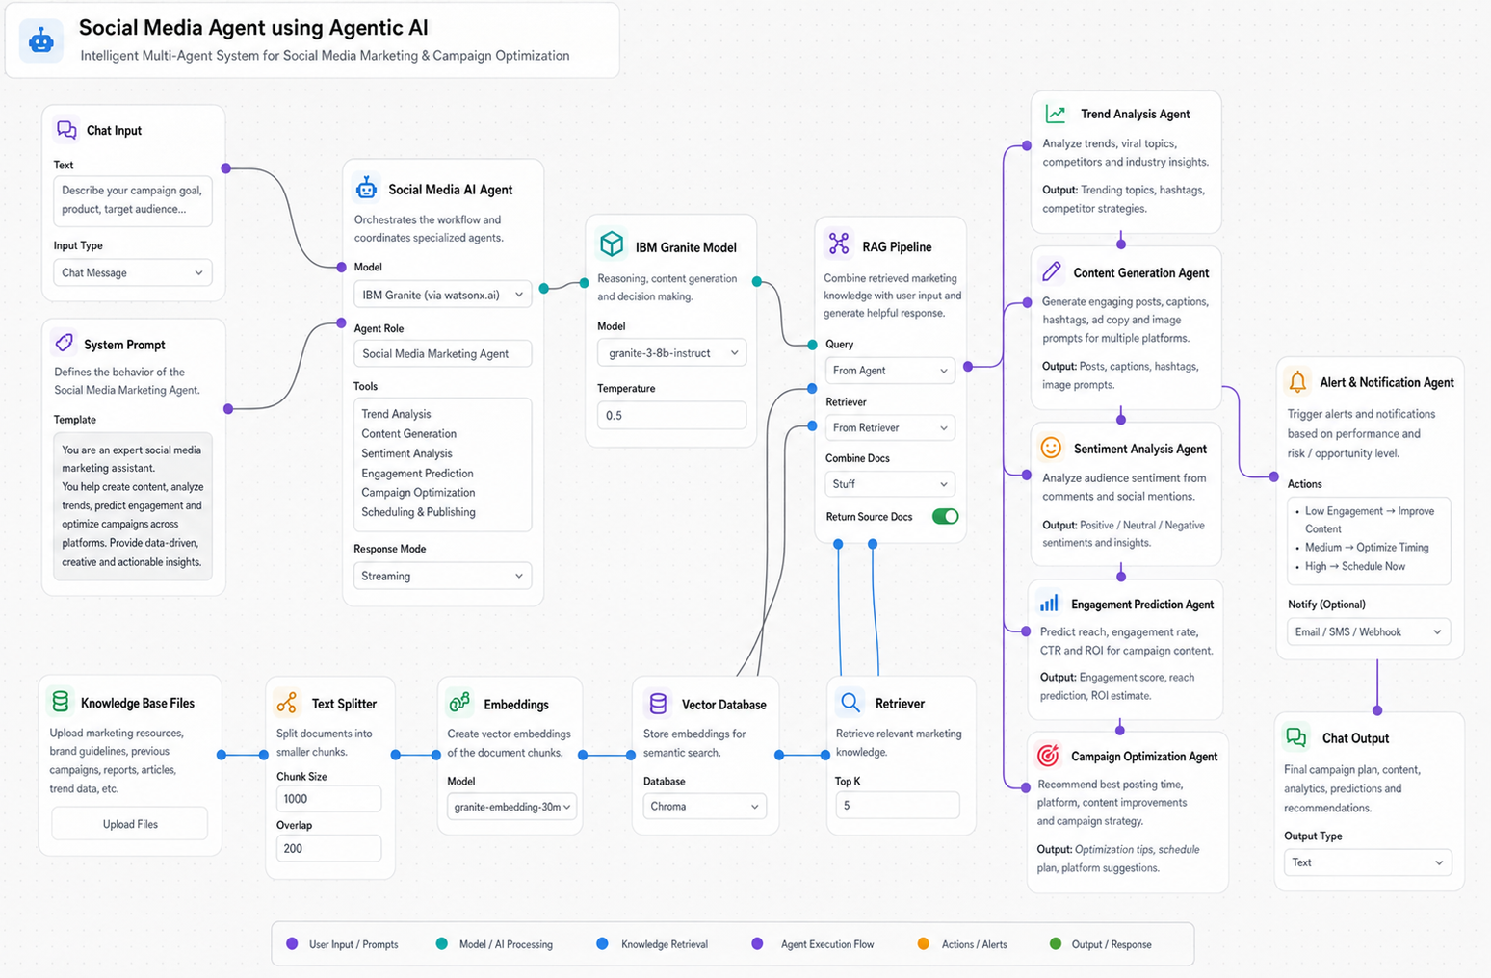
LangFlow Workflow

Slide 7
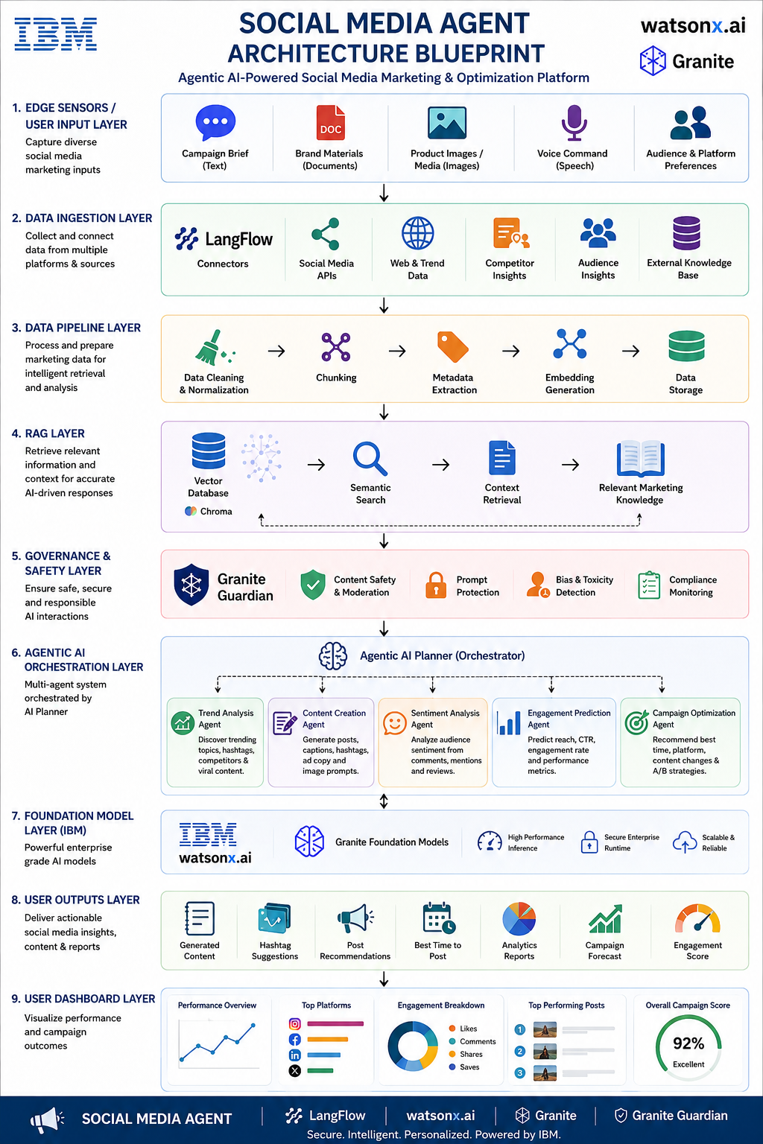
Architecture Blueprint

Slide 8
Role of Agentic AI
• Autonomous monitoring of social platforms
• Multi-agent collaboration
• Sentiment analysis
• Trend forecasting
• Competitor intelligence
• Content recommendation

Slide 9
Technology Used
LangFlow, IBM watsonx.ai, IBM Granite Models, ChromaDB, RAG, Python, Streamlit, REST APIs, IBM Cloud

Slide 10
Token Usage
Average Query: 2,000–4,000 tokens
Content Generation: 3,000–6,000 tokens
Daily Analytics Cycle: ~15,000 tokens

Slide 11
Multichannel Data Fusion
Collect and synthesize:
• Posts
• Comments
• Hashtags
• Influencer Content
• Competitor Activity
• Audience Feedback

Slide 12
Novelty & Uniqueness
• Multi-Agent Social Intelligence
• Real-time Trend Detection
• Predictive Engagement Forecasting
• AI-generated Campaign Ideas
• Multimodal Inputs (Text/Image/Voice)
• Enterprise-ready IBM AI Stack

Slide 13
GitHub Repository Structure
GITHUB LINK: https://github.com/keyurbrahmbhatt-eng/social-media-agent-repo/tree/main

Slide 14
Future Scope
1. Cross-platform campaign automation
2. Influencer collaboration recommendations
3. Voice-enabled social media assistant
4. Multilingual content generation
5. Advanced audience segmentation
6. Real-time ad performance optimization

