Slide 1

Iris Tumour Detection Using Convolutional Neural Networks
Under the guidance of -
Mentor : Mr. Pravin Fernando
Team No. - 6
Team Members :
Keyuri Milind Patil
Jyothika Kakulapati

Slide 2
INTRODUCTION
Project Statement – To develop a Convolutional Neural Networks model capable of detecting tumor in iris images.
The project, "Iris Tumor Detection Using Convolutional Neural Networks (CNN)," aims to introduce students to deep learning techniques in medical imaging, focusing on detecting tumors in iris images.
By using CNNs, for image classification, this project will help to understand how medical imaging tasks can benefit from deep learning, enabling early and accurate diagnosis of potential tumors.

Slide 3
TECHNICAL APPROACH
Development & Programming Languages:
Python – For ML model development & backend processing.
Html5, CSS3, Bootstrap – For styling web pages.
JavaScript – For designing dynamic web pages.
Libraries & Frameworks:
Tensorflow / Pytorch, Keras, scikit-learn – Core libraries used for developing deep-learning model.
OpenCV, pillow(PIL) – For image localization, image processing such as resizing and augmenting images.
NumPy - For numerical operations and handling image arrays.
Pandas - For data manipulation and organization (if tabular data is used).
Django – Core frameworks to handle API requests for the platform.

Slide 4


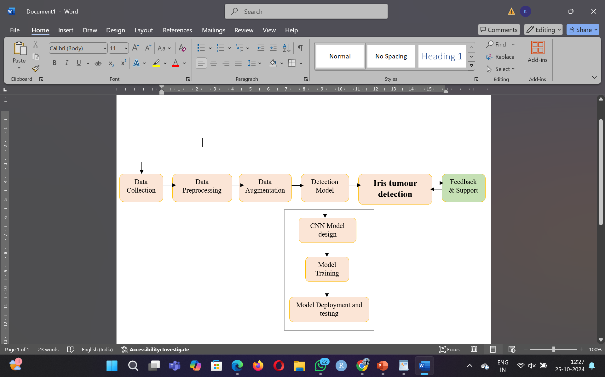
PROCESS FLOW DIAGRAM
Iris image Dataset
User

Slide 5
USER INTERFACE FUNCTIONALITIES
Register a New User Account
Upload Iris Images for Analysis
1
3
User can create a secure account to access the application.
Users can upload high-quality iris images directly into the system for tumor detection.
2
4
Title text added
Login with Username and Password
View Tumor Detection Results
Provides secure access to system features through a login portal.
The system displays results indicating whether a tumor is detected.

Slide 6
UNIQUE VALUE PROPOSITION
1
Focuses On Early Detection
2
User-friendly Interface
3
No-specialized hardware required

Slide 7
FUTURE SCOPE
1
Extension to Detect Other Eye Conditions
2
Mobile App Development
3
AI Model Improvements
4
Cross-Platform Accessibility

Slide 8
THANK YOU

