Slide 1

Note: The data and information in this document is reflective of a hypothetical situation and client. This document is to be used for KPMG Virtual Internship purposes only.
Sprocket Central Pty Ltd
Data analytics approach
Keyur Kulkarni

Slide 2
Note: The data and information in this document is reflective of a hypothetical situation and client. This document is to be used for KPMG Virtual Internship purposes only.
Agenda
Introduction
Data Exploration
Model Development
Interpretation

Slide 3
Note: The data and information in this document is reflective of a hypothetical situation and client. This document is to be used for KPMG Virtual Internship purposes only.
Introduction
Identify and Recommend High Value Customers
Outline of the problem -
Sprocket Central Pty Ltd is a company that specializes in high quality bikes and accessories.
The marketing team is looking to boost sales by optimizing marketing strategy.
They are targeting new 1000 customers that will bring highest value to the business.
Approach for Data Analysis-
Bike related purchases based on gender
Bike related purchases based on industries.
Profit based on wealth segment and Age category.
Number of cars owned in each state.
Profit based on Industry sector.
Customer classification - platinum, gold, silver, bronze.

Slide 4
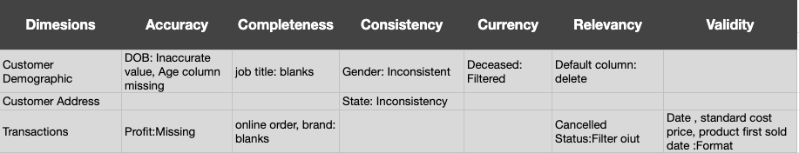
Note: The data and information in this document is reflective of a hypothetical situation and client. This document is to be used for KPMG Virtual Internship purposes only.
Data Quality Assessment
Key issues dealt for the data quality issues-

Slide 5
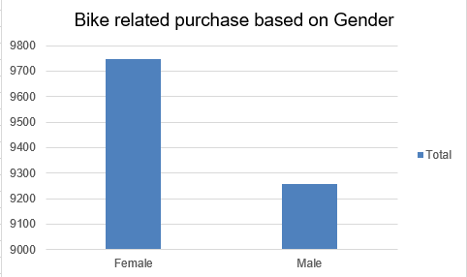
Note: The data and information in this document is reflective of a hypothetical situation and client. This document is to be used for KPMG Virtual Internship purposes only.
Data Exploration
Bike related purchases based on gender
As per the data, we can see that females have high bike related purchases than Males.
On an average Females have around 3% higher bike related purchases.

Slide 6
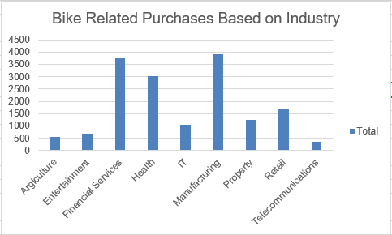
Note: The data and information in this document is reflective of a hypothetical situation and client. This document is to be used for KPMG Virtual Internship purposes only.
Data Exploration
Bike related purchases based on industries.
Top 3 industries for bike related purchases are Health, Financial services and Manufacturing.
These are obvious as Health and Financial Services, Manufacturing would be located within the cities.

Slide 7
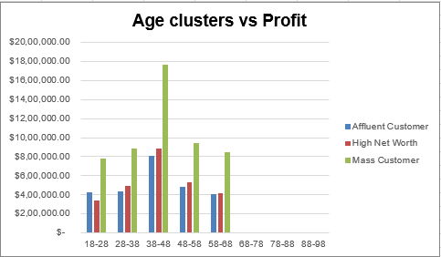
Note: The data and information in this document is reflective of a hypothetical situation and client. This document is to be used for KPMG Virtual Internship purposes only.
Data Exploration
Profit based on wealth segment and Age category.
As we can see in the graph, mass customer segment makes maximum profit across different age groups.
Mass Customer segment with age groups between 38-48 are more likely to bring profit to the business as compared to other age groups.
This maybe obvious as buying power is more in this age group.

Slide 8
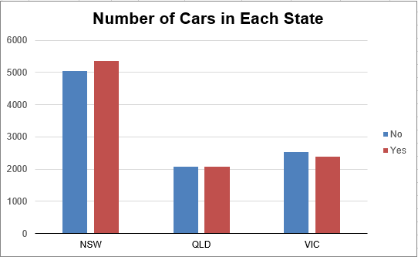
Note: The data and information in this document is reflective of a hypothetical situation and client. This document is to be used for KPMG Virtual Internship purposes only.
Data Exploration
Number of cars owned in each state.
NSW has highest number of cars owned in Australia.
In NSW, number of people who own a car is same as number of people who don't own a car. So there is an opportunity to find high valued customers.

Slide 9
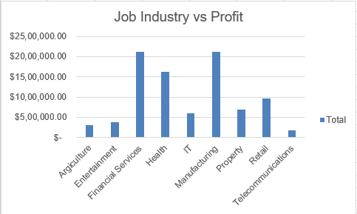
Note: The data and information in this document is reflective of a hypothetical situation and client. This document is to be used for KPMG Virtual Internship purposes only.
Data Exploration
Profit based on Industry sector.
Top 3 industries for Maximum profits are Health, Financial services and Manufacturing.
These are obvious figures as Health and Financial Services, Manufacturing are one of the highest growing industries in Australia.

Slide 10
Note: The data and information in this document is reflective of a hypothetical situation and client. This document is to be used for KPMG Virtual Internship purposes only.
Model Development
Customer Classification - Targeting High Value Customers.
Performed RFM Analysis to analyze high value customers using Recency (Latest Transaction Date), Frequency (Count of orders) and Monetary (High profit).
Classified customers into Platinum, silver, gold and bronze based on the RFM Score (100*R score+ 10* F Score+ M Score).
We have given more weightage to the Recency and Frequency to balance the bias between high monetary customers.
We have split the customers list according to RFM in 5 quartiles (Min, lower quartile, median, upper quartile and max).
Most of the High value customers will be Females than Males.
Customer segment would be Mass Customer.
Customers working in Health, Financial services and Manufacturing have high chances of purchasing the product.
Customers aged between 38 - 48 yrs living in NSW and VIC have high chances of buying the product.

Slide 11
Interpretation
Looking at the insights drawn, there are large number of female buyers than male buyers.
Customers working in Health, Financial services and manufacturing sector should be targeted as they bring high value in terms of purchases and profits.
Customers aged between 38 to 48 yrs should be included in the high valued customers list.
Customers who live in NSW,QLD should be included in the high value customers list.
These are the parameters that should be considered for high value customer targeting.

Slide 12
Note: The data and information in this document is reflective of a hypothetical situation and client. This document is to be used for KPMG Virtual Internship purposes only.
Thank you

