Slide 1
Classification and Prediction Analysis
Team Members:
Keyur Mehta
Love Modi
Darsh Sanghavi
ShreYANSH MOHNOT

Slide 2
Project Scope
Part 1 – Classification Analysis
Part 2 – Prediction Analysis
Algorithms | Dataset
k Nearest Neighbor Support Vector Machine | Image dataset (60,000 images) Image resolution: 32 x 32 x 3
Algorithms | Dataset
Naïve Bayesian Network Amazon Machine Learning | Diabetes Dataset (~800 rows) Diabetes Prediction ( has or not )

Slide 3
Motivation
Implement various ML algorithms
Experiment with Hyper-parameters
Compare results

Slide 4
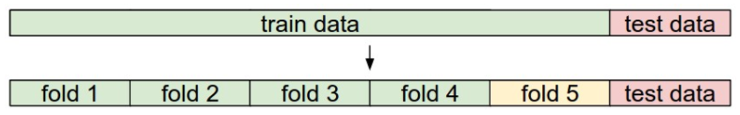
k Nearest Neighbor
Hyper-parameters
Setting k value (k = 1, 2, 3 …)
Calculating image distance (L1, L2, etc.)
Cross Validation

Slide 5
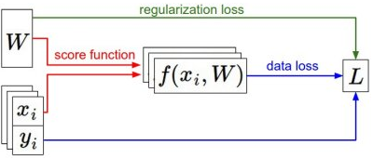
Support Vector Machine
Hyperparameter
Learning Rate
Regularization Loss

Slide 6
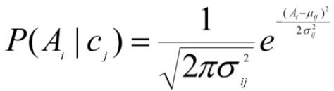
Naïve Bayesian
Bayesian Classifiers
Gaussian Formula to find probability

Slide 7
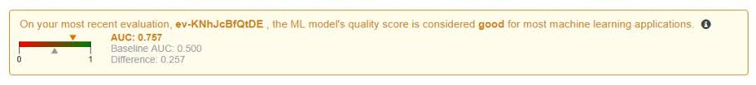
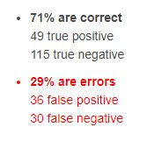
Amazon Machine Learning
AML Algorithms
Logistic Loss Function
Stochastic Gradient Descent

Slide 8
Results
Part 1 | k Nearest Neighbor | SVM
Validation Accuracy | 29.70% | 40.08%
Test Accuracy | 26.40% | 38.06%
Part 2 | Naïve Bayesian | AML
Accuracy | 74.61% | 70.99%
Recall | 69.19% | 62.03%
Precision | 64.07% | 57.65%
False Positive Rate | 22.33% | 23.84%

Slide 9
Thank you!

