Slide 1

CHARUSAT University
MADE BY:
17CE124- TALATI KEYUR
17CE129- VEDANSHU TRIVEDI

Slide 2

WE ARE GOING TO PRESENT...
THE
LOVE
CALCULATOR

Slide 3

GOALS…..
Actually this is not a official program…
But it allows us to calculate the percentage of your love..
Does it feel like you and your partner are a match made in heaven?????
It will give you output in a number which is nothing but the number which is the number of your love
It is not a official application but it is made only for FUN
So are you ready for this thriller…

Slide 4

HOW IT WORK??????
It is work on the simple concepts of c++
There are 3 ways to calculate
WITH DATE:
you can calculate the answer with the help Of your birthdate.
WITH NAME:
you can calculate the answer with your name and your partner name too.
3. WITH BIRTHPLACE:
you can also calculate the answer with your and your partners birthplace..

Slide 5
START
INPUT
Scan input
If
Input is a,b,c,d
If a
If d
If b
If c

Slide 6

CONCEPT USED IN THIS PROGRAM
If else with nested if
Looping
Goto
Class
Member function
File management
Switch case
Encapsulation
cascading

Slide 7

SOMETHING NEW….
To add new features in our program we have add some new library function that will help us to add something new in our program
The library file which are taken in our programs are
windows.h
dos.h

Slide 8
WINDOWS.H
windows.h is a Windows-specific header file for the C and C++ programming languages which contains declarations for all of the functions in the Windows API, all the common macros used by Windows programmers, and all the data types used by the various functions and subsystems. It defines a very large number of Windows specific functions that can be used in C. The Win32 API can be added to a C programming project by including the <windows.h> header file and linking to the appropriate libraries.
It help us to add or change the background of console screen and also helpful for changing the colour of font

Slide 9
WINDOWS.H
Use of <windows.h> - > windows.h is not a "code library". It's a header file, and doesn't contain any executable code as such (save for macro definitions, but those still aren't compiled - their expansions are, if and when you use them).
As has been noted, #including windows.h slows down compile time. You can use precompiled headers or do a good job of isolating the windows calls only to modules that need them to help with that.
The namespace conflicts are a legitimate gripe, but technically have nothing to do with efficiency, unless you count efficiency of your personal use of time. Considering how many thousands of definitions will be thrown into your namespace, conflicts are bound to occur at some point, and that can be severely irritating. Just use the practice of isolating your Windows calls into modules, and you will be fine. For this, put #include windows.h in the .cpp file, and not the .h file.

Slide 10
DOS.H
There are many header files present in a C++ Programming language.
Dos.h is one among the header files . It contains functions for handling interrupts, producing sound, date and time functions etc. It is a Borland specific and works in turbo c compiler as well as code blocks too
We have use this type of header file for the delay in time for some graphics

Slide 11
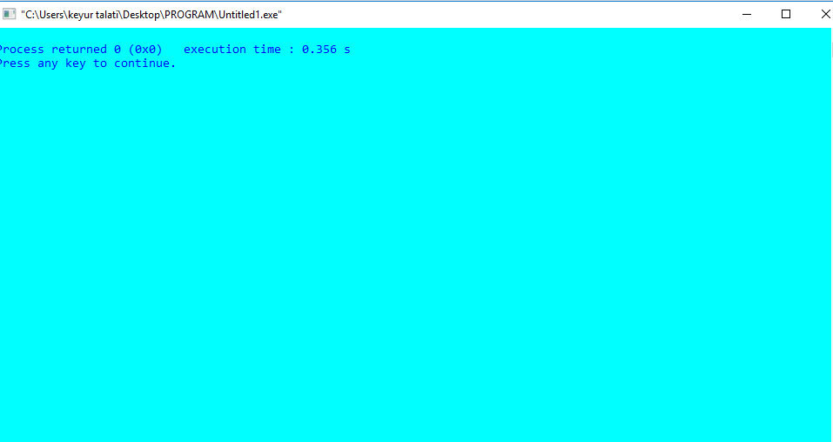
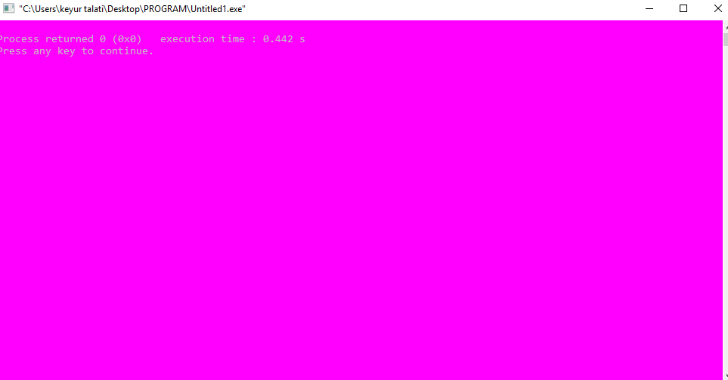
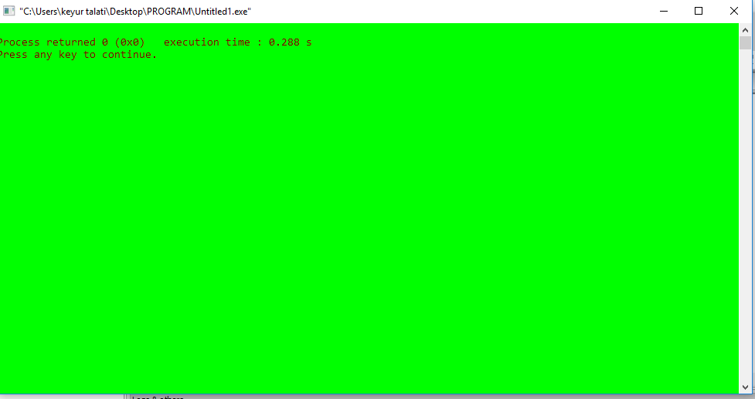
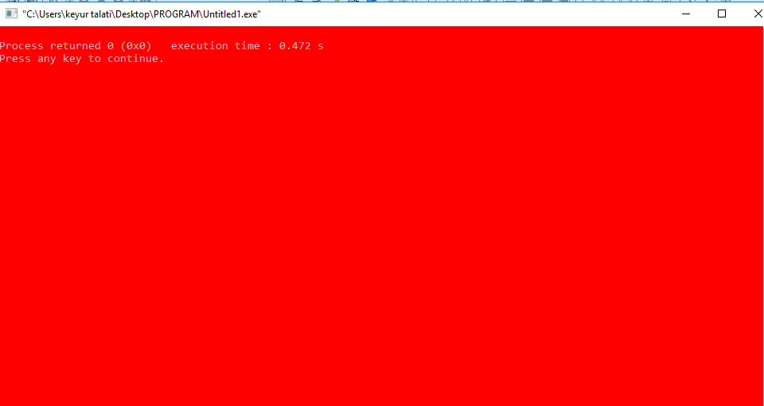
WHAT IS NEW IN OUR PROGRAM??
At the starting of our program you will see some graphics input actually not a pure graphics but it is a cycle of different colours of console screen

Slide 12
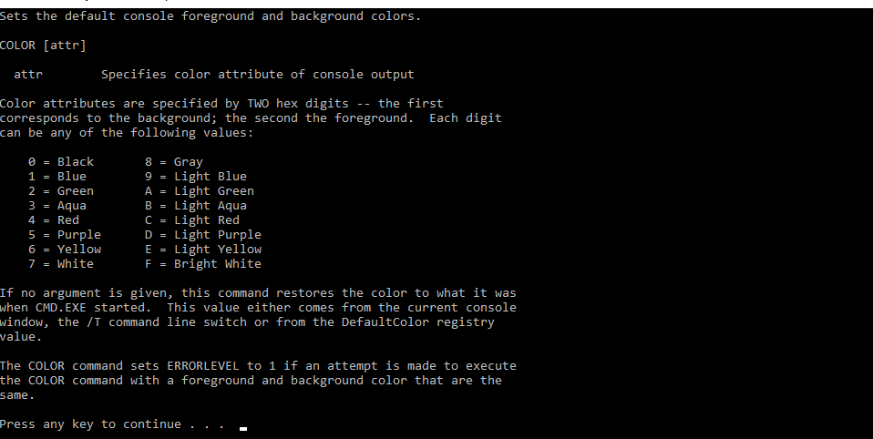
WHAT IS NEW IN OUR PROGRAM??

Slide 13
WHAT IS NEW IN OUR PROGRAM??
For delay in time we have use the sleep function…
Sleep function help us to delay in time
Sleep(23445);
Hear 23445 is look like a big number or we can say that the output will have a long break in that particular line but hear the value of time “23445” is not in a second but the value is in microsecond so there will be not a long output time will be taken by the compiler.
This definition is saved in windows.h

Slide 14


Slide 15


