Slide 1

Compiler Design Assignment 3
Iran University of Science & Technology
School of Computer Engineering
Spring 2021
Compiler Design
<number>

Slide 2
Assignment Specifications
Subject: introduction to antlr4 listener and visitor
Deadline: Saturday, , 23:59 (Would not be extended!!)
Where to upload: LMS
Your report should be provided continuing these slides
Full Name: keyvan dadashzade
Student ID: 97522148
Compiler Design
<number>

Slide 3
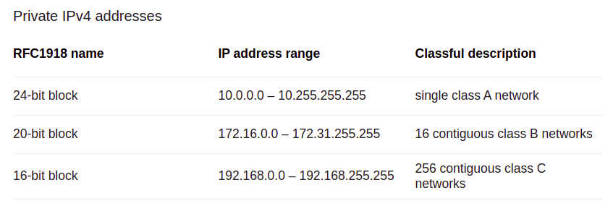
Assignment Details
1- Write a regular expression for a simple network Router: router's in computer network must validate ipv4 and drop all packet with private ipv4 address. Write a anrlr4 grammar to validate IP addresses for a router.
Requirment:
A) An ip address consists of 3 numbers, separated with two dots. The value of each number is 0-255 For example: 255.189.10.37 Correct and 256.189.89.9 is error.
B) private ip address range:
Compiler Design
<number>

Slide 4
Assignment Details
2- Write a Python program, using ANTLR regular expression, over the alphabet {a, b, c}:
a) length of input is at least 2 and at most 4
b) number of 'a's is a multiple of 3
c) contains at least three consecutive 'b's
3- Depict a DFA to accept all the binary strings, that do not include the substring “1101”. write a lexer function pseudocode to determine these strings. (code implementation in any language is optional and have extra credit)
Compiler Design
<number>

Slide 5
Assignment Details
4- Write a function with lexical analyzer of anrlr4 that undo comments from a Java program. assume that: a- we previously comment some piece of program and we know that piece of commented code has no error. b- we know in this program all comments are piece of correct Java code. and have not any discretional comment. Use antlr4 lexical analyzer and Java grammar in previous assignment. There is an example in next slide.
Compiler Design
<number>

Slide 6
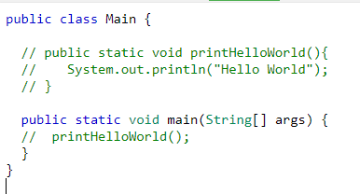
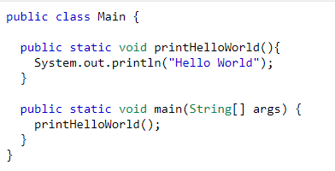
Assignment Details
Input:
Output:
Note that real compiler remove all comment in lexical analyzer step. So that in syntax analyzer step you don't have access to comments. So you must work in lexical analyzer step.
Compiler Design
<number>

Slide 7
Assignment Details
Write and explain all question completely in your report (use screenshot)
And attach your code please.
Your report must be in end of this slide.
Good Luck!
Compiler Design
<number>

Slide 8
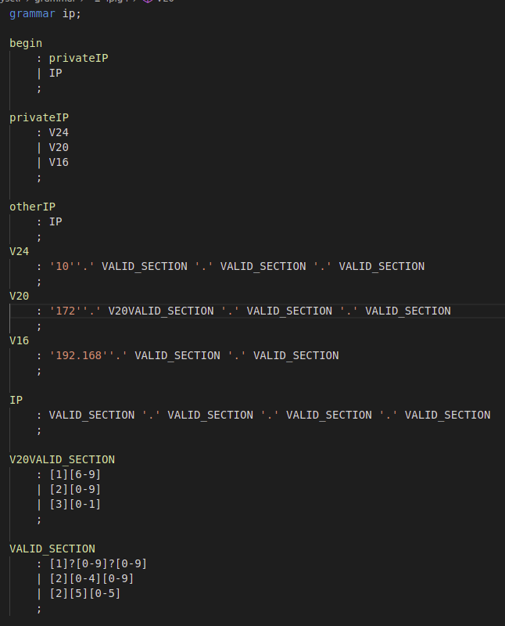
Question 1
In this question we should write 4 regex one for public ip’s and other for private ip’s in order to do this fist we write valid section which is validate each section of ip(between two ‘.’) in regex due to consantrait we first check from 0 to 199([1]?[0-9]?[0-9]) then check for 200 to 249([2][0-4][0-9]) and at last 250 to 255([2][5][0-5]) then for each version of private ip we put prefix for example for version 24 we put ‘10’’.’ and 3 times valid section and so on for other ip version but in version 20 we should write another valid section which is accept section from 16 to 31([1][6-9] | [2][0-9] | [3][0-1]) and gather all togheter:
Compiler Design
<number>

Slide 9
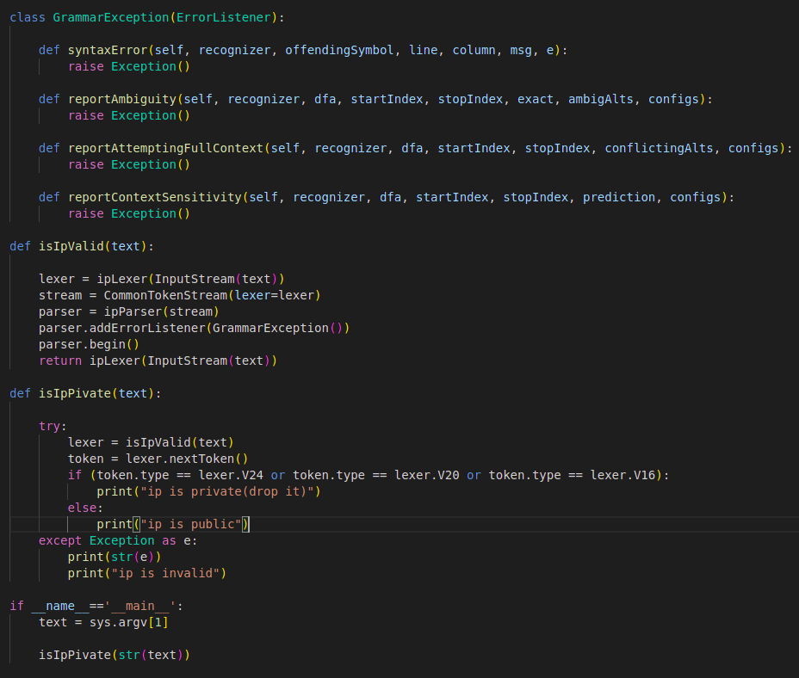
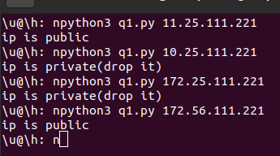
Question 1(code)
First we compile grammar(use command at slide 14)after that in the code simply we first parse for see if ip is valid after that we check if first token that we extract is v24, v20, v16(which is version of private ip’s) then we print to output and if it’s private or public ip:
The command below show
How to run:
Compiler Design
<number>

Slide 10
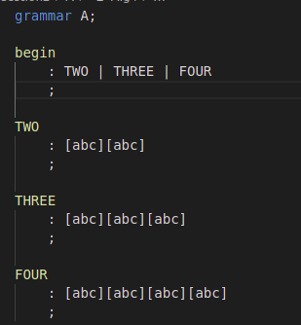
Question 2 (section a)
In section a we just need to validate 2 and 3 and 4 sequence of char’s therefore We can easily write [abc][abc] for 2 sequence of char’s [abc][abc][abc] for 3 char’s and [abc][abc][abc][abc] for 4 char’s and so on. So the answer is or of this three :
Compiler Design
<number>

Slide 11
Question 2(section b)
In section b we just care about ‘a’ so for answer this section if we see ‘a’ then we should wait and watch for 2 another ‘a’ and we beware we just care about ‘a’ not ‘b’ and ‘c’ therefore we easily ignore number of b and c watching for ‘a’ if we see again ‘a’ we repeat this procedure again for example we could use this for ignore ‘b’ and ‘c’ and watch for ‘a’: [bc]* [a] [bc]* repeating this 3 times result in checking string if number of ‘a’ dividable by 3. But beware there is some number of special case’s first case is if we don’t have any input and this case is accepted because we have 0 ‘a’ and 0 is dividable by 3 and there is another case that we only have ‘b’ and ‘c’ which is result in 0 ‘a’ which is also dividable by 3. in next slide we show grammar for section b.
Compiler Design
<number>

Slide 12
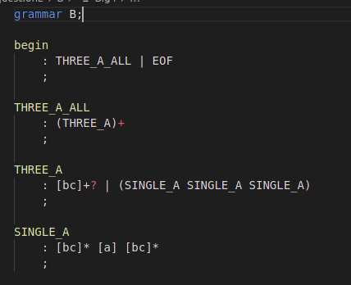
Question 2(section b)
Section b grammar:
The EOF is for zero input case
In front of [bc]+ we put ? Because
We want turn off greedy match.
Compiler Design
<number>

Slide 13
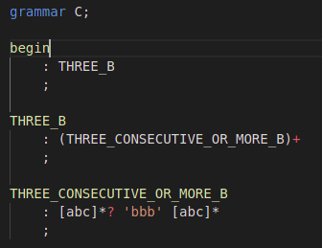
Question 2(section c)
In section c we just want to see 3 ‘b’ consecutive so for achieve that result we should match every ‘a’ ‘b’ ‘c’ and we must turn off greedy match. After we turn off greedy match (with ? In front of [abc]*) then we put simply ‘bbb’ and watch for matching but beware we could have more ‘b’ after this but we don’t care because we already saw ‘bbb’ and it’s fulfill our goal. Image of grammar:
Compiler Design
<number>

Slide 14
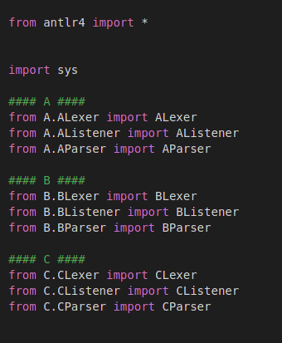
Question 2(code)
First we should compile our grammar’s with following command’s:
antlr4 -Dlanguage=Python3 -visitor ./A/*.g4
antlr4 -Dlanguage=Python3 -visitor ./B/*.g4
antlr4 -Dlanguage=Python3 -visitor ./C/*.g4
The we import requirement module’s to our code:
Compiler Design
<number>

Slide 15
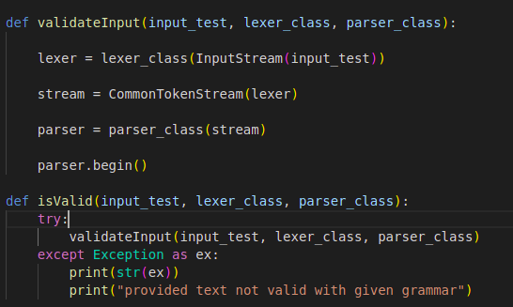
Question 2(code)
After previous section it’s time to write function that give text parser and lexer class and begin to validate given text it easily can done with the code below(we could add error listener to parser but we demonstrate this approach in question4):
Compiler Design
<number>

Slide 16
Question 2(main function)
So it’s not we write our main function we should consider easy command line that we could easily test and run our grammar’s we dont this with fist input as input grammar(A, B, C) and second input as desire text for testing then we watch if didn’t see anything at console after run script then it mean our input is valid if we see any output in console it mean our input text it’s not valid(beware that if for checking number of inputs and then decide that variable text should empty when we pass 2 input. It’s for grammar b because if you recall we could have empty string as input and it’s acceptable in context grammar b so pass empty string if you want test grammar b) images in next slide show main and output of program.
Compiler Design
<number>

Slide 17
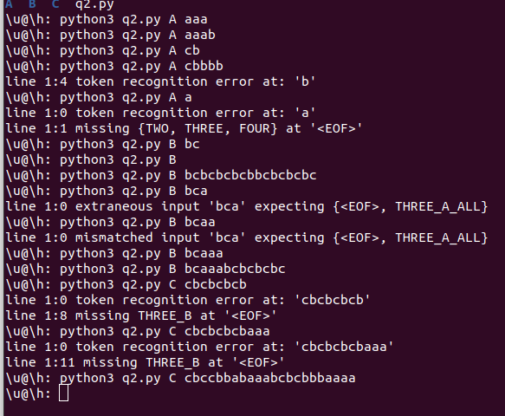
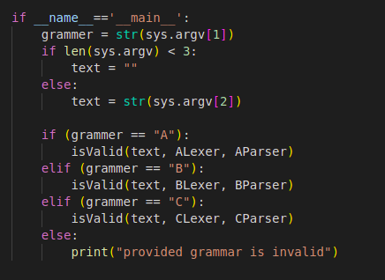
Question 2(main function and test)
Compiler Design
<number>

Slide 18
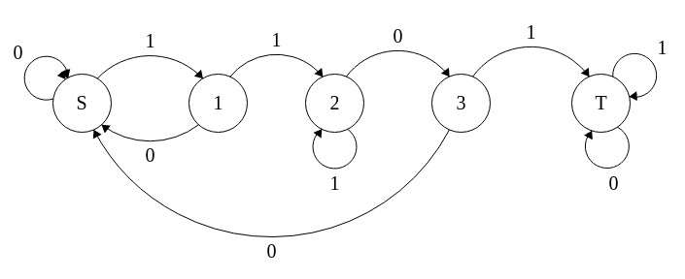
Question 3(DFA)
For answering this question we simply draw dfa. In order to draw dfa we first should draw every state that has transition with all known alphabet then we see sequence ‘1101’ we going to trap state which is state that no transition exists for exit from this state in this question all state except state trap is final state because if we are not in trap state the it mean we has valid text that does not contain ‘1101’ in this procedure every time we see anything except ‘1101’ we going back to previous state’s and repeat procedure for remain text. Dfa:
Compiler Design
<number>

Slide 19
Question 3(code)
We implement previous slide dfa with python language. We simply write class that take text and start validating give text so in order to create class in constructor we take alphabet and start state(which is ‘S’ but for simplification in code we assume ‘S’ is sate 0) and take list of end state’s(1, 2, 3 state’s) and dict of dict which is transition’s so in order validate we write for which is loop over all char’s in given text first it’s checking existence of char’s in given alphabet after that we get transition from transition dict based on start state and then checking if char is in extracted transition and updated start transition to transition that char will lead. In next slide we show class source code and input to constructor of class. (beware: 0= start state, 1,2,3 = other state, 4= trap state).
Compiler Design
<number>

Slide 20
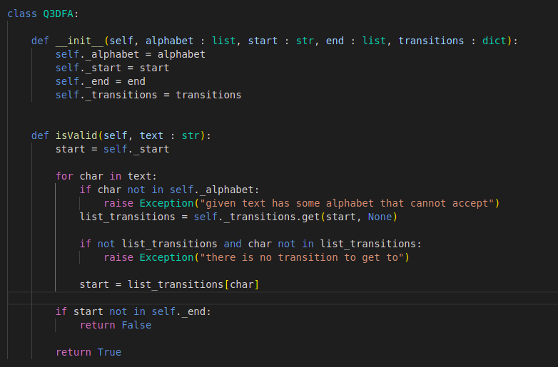
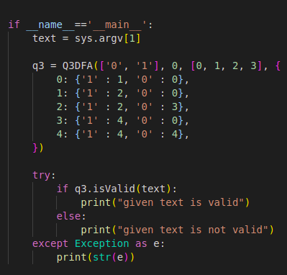
Question 3(code)
Compiler Design
<number>

Slide 21
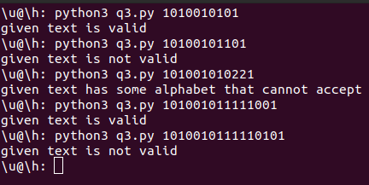
Question 3(run and test)
For running code we simply run python3 q3.py <text> :
Compiler Design
<number>

Slide 22

Question 4(explain)
In order to solve this problem we should first provide java grammar which is exists from last assignment so we compile for python language with the command below:
antlr4 -Dlanguage=Python3 -visitor ./grammar/*.g4
After that we have java lexer if we examine java grammar we see interesting section:
So it seems after we parse given java file if we compare token type with COMMENT and LINE_COMMENT and then if they are equal we easily can change token text and eliminate comment. In next slide we show uncomment class.
Compiler Design
<number>

Slide 23
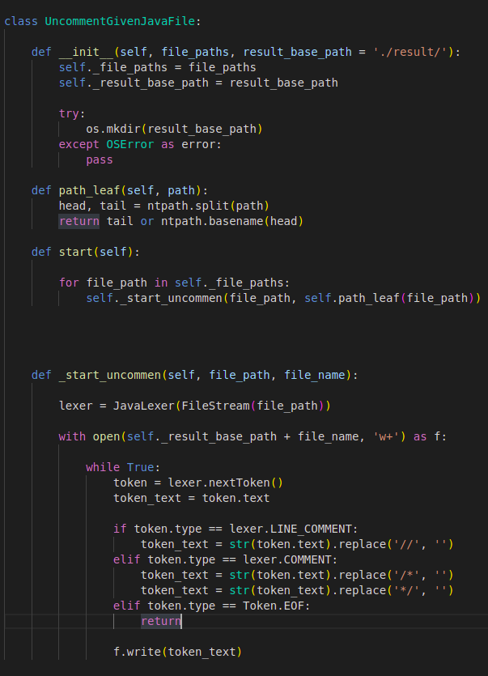
Question 4(class code)
As you see we take file paths which is list of desire
java file for uncomment commented code. Then we
Take optional parameter to which directory We should
store output file path_leaf function will give us file
Name For example if we have ./inputs/test1.java it will give us test1.java start function will Start to
process input files list in star_uncomment function
we first create output file then run lexer for input file
Then for every token we check if it’s comment token
Type(which we describe in previous slide)we
Eliminate comment(such as // and /* and */)
Then write result to file.
Compiler Design
<number>

Slide 24
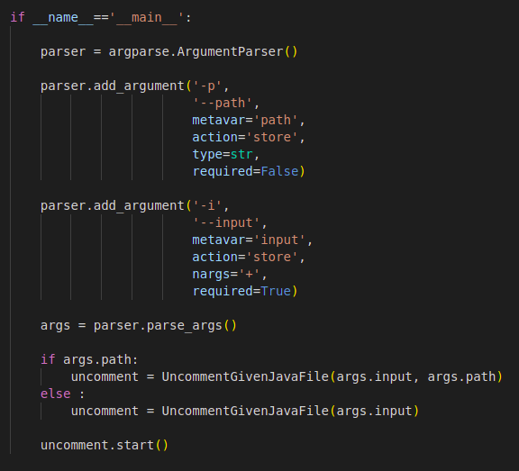
Question 4(main)
In order we take arbitrary number of input files
We use args parse library then we define -p
which is path for store result output(and it’s
Optional parameter) and -i(required) and path
To every input file then it will start uncomment
Commented input files. In next slide we show
Example.
Compiler Design
<number>

Slide 25
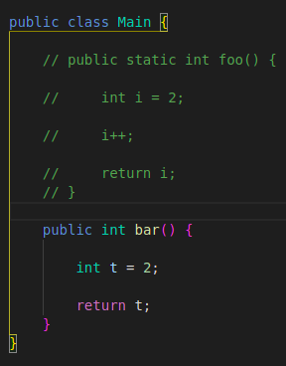
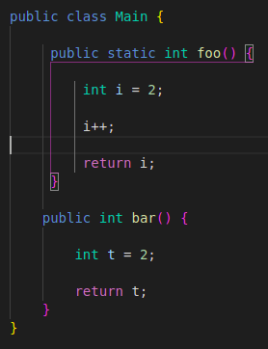
Question 4(example)
We have three test file test1.java test2.java test3.java and then run the blow command to run uncomment:
python3 q4.py -p ./output/ -i ./inputs/test1.java ./inputs/test2.java ./inputs/test3.java
Then we should see uncommented file in output directory:
===========>
Compiler Design
<number>

