Slide 1


Music Genre Classification Using
Song Lyrics!
Search
Home
Library
Presenters: Parsa & Sandra

Slide 2
Table of contents
01
02
03
04
Background
Data & Methods
What is it & Why it matters?
What data & methods we’re using?
1:15min
1:15min
Results
Future Work
Preliminary results of our project
What we’re going to do next?
1:15min
1:15min

Slide 3
01
Background
Our Music Playlists
Search
Home
Library
What is Music Genre Classification & Why it matters?

Slide 4
Music Genre Classification
Process of categorizing music based on musical features such as melody, rhythm, and harmony.
Common genres include pop, rock, hip-hop, country, jazz, etc.
Important for music recommendation systems, radio stations, and music streaming services.

Slide 5
02
Data & Methods
Our Music Playlists
Search
Home
Library
What data & methods are we using?

Slide 6
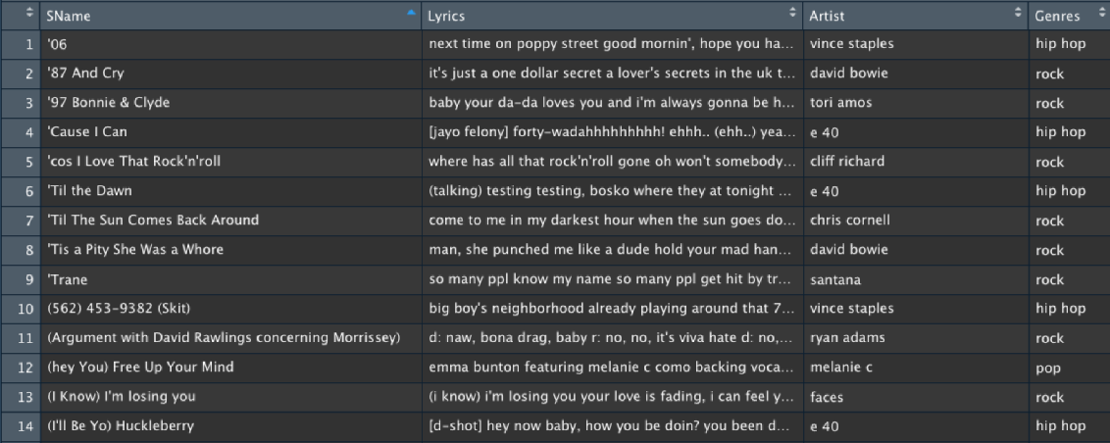
Data
From Kaggle - contains 160,000 songs in multiple languages from 79 genres and includes its lyrics and its corresponding genre.
Preprocessing
Removed duplicate lyrics
Dropped non-english songs
Removed special characters from Artist names
Changed Genres and Artist names to lowercase
3 genres (Hip-hop,Rock,Pop) selected
Total of 8000 observations were left.

Slide 7
Methods
Train GloVe embeddings of the song lyrics
As a baseline, use GloVe embeddings in two logistic regression models to classify them into genres.
Use our GloVe embeddings to train an LSTM model and bidirectional LSTM model.
Compare the performance of each model with the study.

Slide 8
03
Results
Our Music Playlists
Search
Home
Library
Preliminary results for our project

Slide 9
Baseline Model Performance
Logistic Regression
Order by
# | F1 Score |  | Accuracy | Precision | Recall
 |  | 0.6058 | 0.6459 | 0.6091 | 0.6459
Our model Performance closely resembles the performance of the study.

Slide 10
04
Future Work
Our Music Playlists
Search
Home
Library
What we’re going to do next?

Slide 11
Data Collection
Data Pre-processing
Text Tokenization
Text Embedding (GloVe)
Baseline Model Training
Baseline Model Evaluation
LSTM Model Development
Bidirectional LSTM Model Development
Model Refinement
Model Testing
Report Writing

Slide 12

Thanks!
Any Questions?

