Slide 1


Human Pose Estimation from Depth Images via Inference Embedded Multi-task Learning
Keze Wang
kezewang@gmail.com
Sun Yat-sen University
2016-10-19
Notes:
尊敬的各位评委老师，大家下午好！我是中山大学林倞。我汇报的题目是视觉计算与模式分析。

Slide 2
Outline
Background
Motivation
Framework
Results
Conclusion
Notes:
首先简要介绍下个人基本情况。

Slide 3
Outline
Background
Motivation
Framework
Results
Conclusion
Notes:
首先简要介绍下个人基本情况。

Slide 4
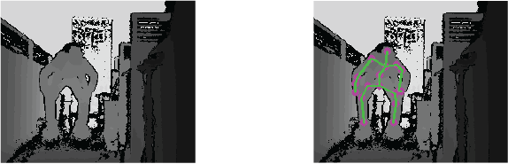
Background
Objective: Estimate human pose from a still depth image.

Slide 5
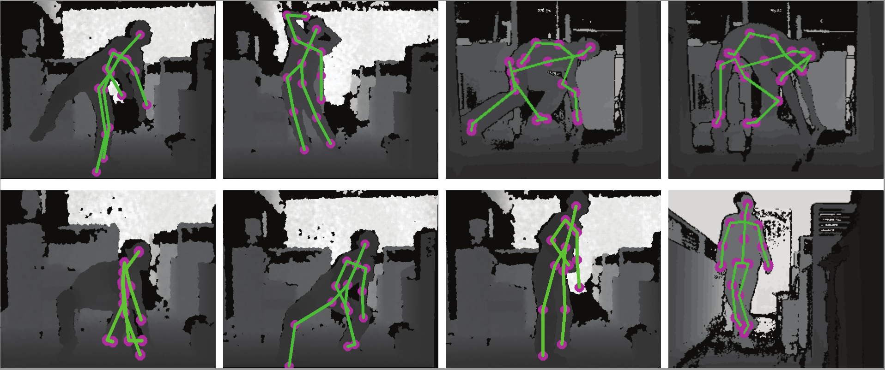
Challenging Issues
Unusual poses/views:
Current solvers often fail in handling exceptional and unusual cases. This is due to the bias of training data and errors introduced by sensor noise.
Notes:
The user may appear in diverse views or poses in real applications

Slide 6
Challenging Issues
Self-occlusions:
The depth data captured from one single sensor inevitably contains body part occlusions, especially in playing complex gestures.

Slide 7
Outline
Background
Motivation
Framework
Results
Conclusion
Notes:
首先简要介绍下个人基本情况。

Slide 8
Motivation
To handle unusual pose/views and self-occlusions,
Explicitly represent the human pose in a coarse-to-fine manner
Constrain the human pose under 3D kinematic tree structure.
To achieve towards real-time performance
Incorporates the dynamic programming inference into the deep neural network architecture.

Slide 9
Outline
Background
Motivation
Framework
Results
Conclusion
Notes:
首先简要介绍下个人基本情况。

Slide 10
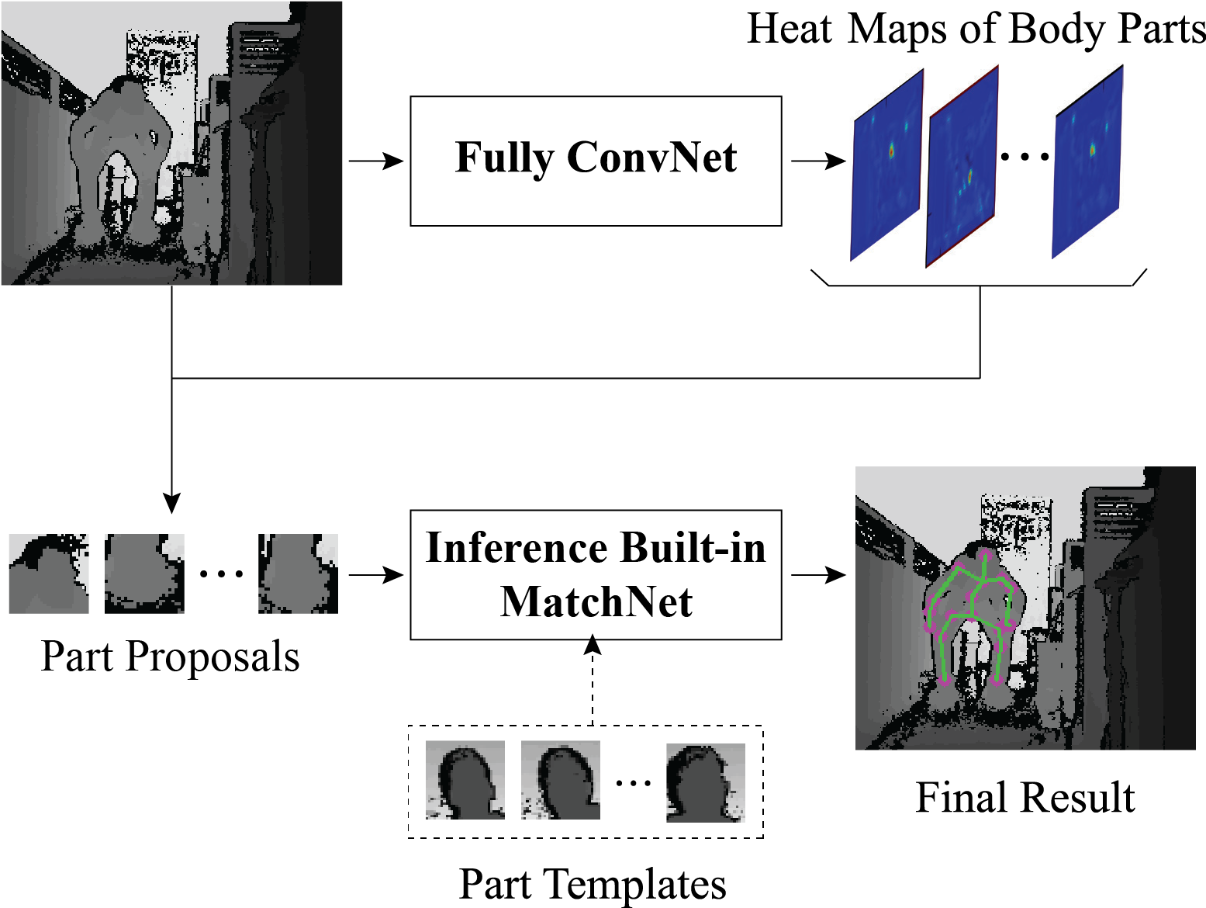
Framework: two cascaded tasks
First Task: generating human part proposals
Second Task: optimal configuration inference

Slide 11
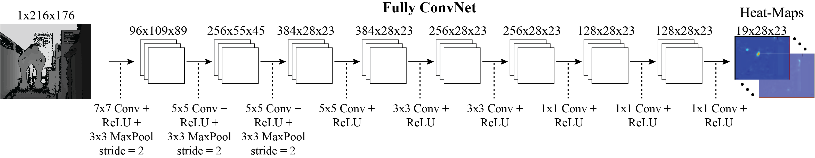
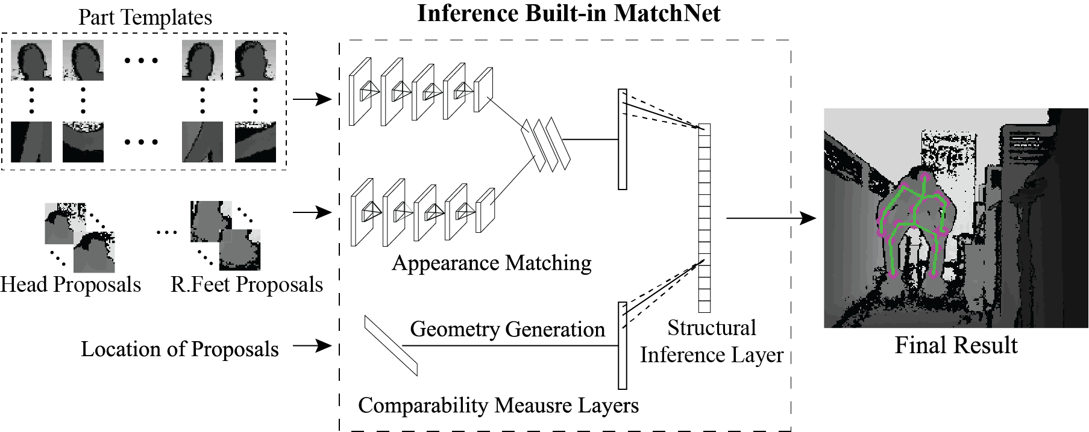
Body Part Proposal Generation
Our model generates body part proposals by design a fully convolutional network (FCN), which produces a dense heat map output for each body part.
Generate body part proposal

Slide 12
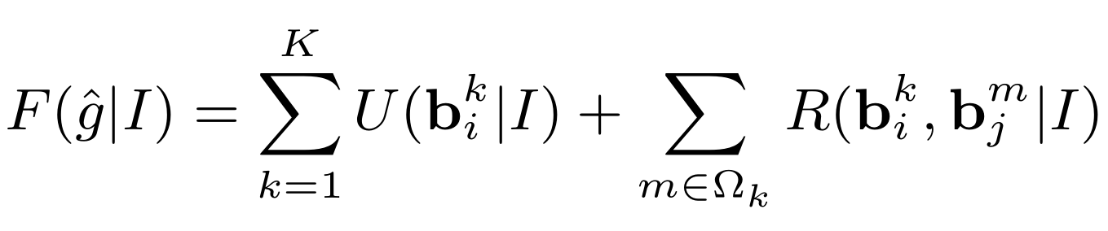
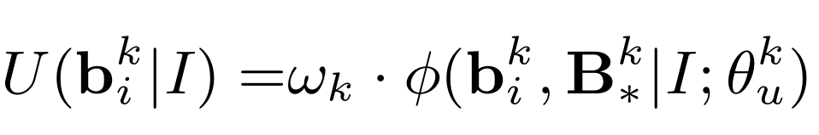
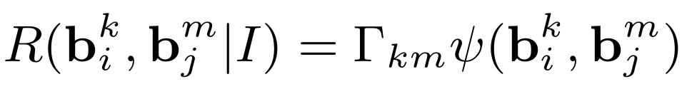
Optimal Configuration Inference
We propose to model the human pose by the sum of unary and pairwise terms according to the 3D kinematic tree structure:
Appearance Compatibility
Contextual Geometry Relationship

Slide 13
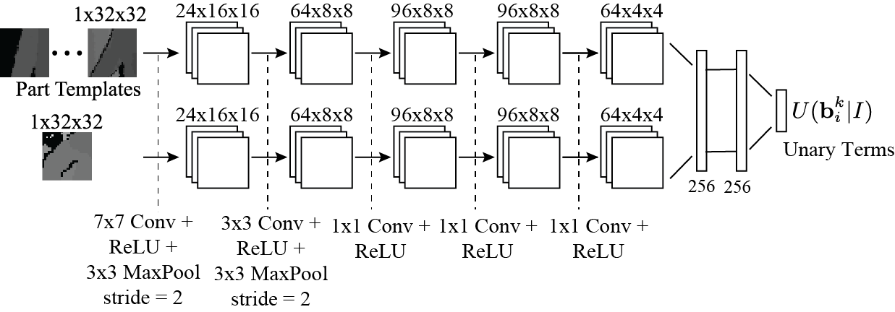
Tailored MatchNet
Part Templates: Offline Clustered via the ground truth
Notes:
Figure 4: The illustration of the inference built-in MatchNet for a fast part configuration inference.

Slide 14

Inference Built-in MatchNet
Fast Inference via dynamic programming
Head
Neck
L-Shoulder
R-Shoulder
…
Notes:
Figure 4: The illustration of the inference built-in MatchNet for a fast part configuration inference.

Slide 15
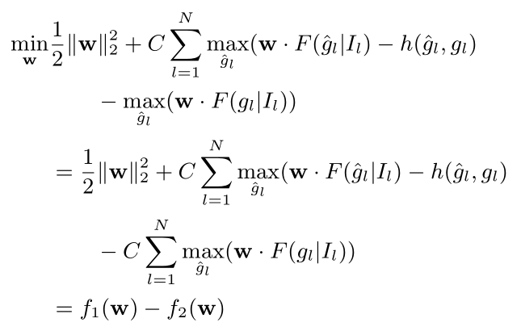
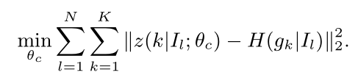
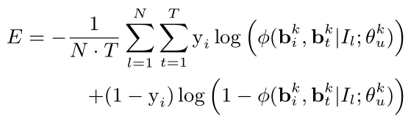
Multi-task Learning
We employ the widely used batch Stochastic Gradient Descent (SGD) algorithm to train FCN and tailored MatchNet, respectively.
We employ a latent learning algorithm extended from the CCCP framework.

Slide 16
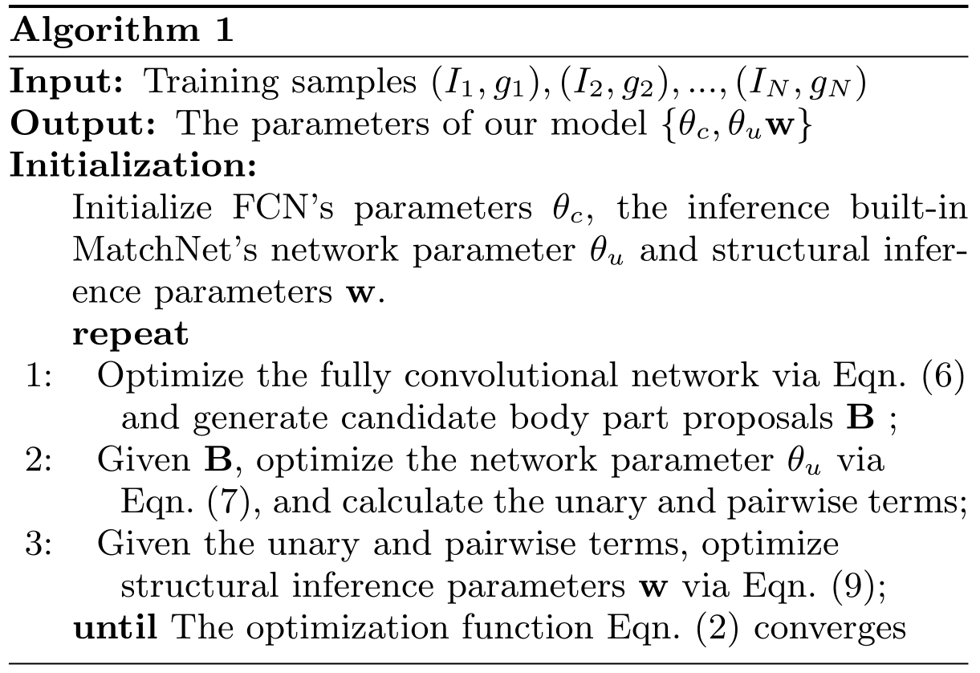
Multi-task Learning

Slide 17
Outline
Background
Motivation
Framework
Results
Conclusion
Notes:
首先简要介绍下个人基本情况。

Slide 18
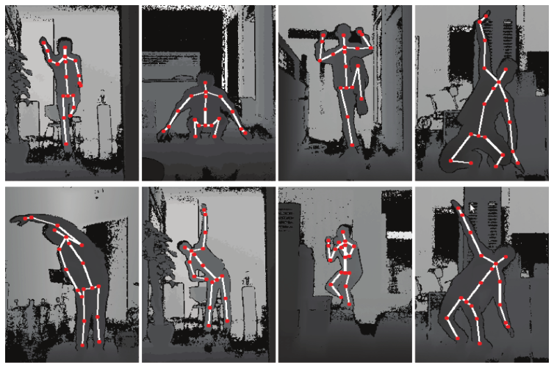
Dataset Description
Kinect2 Human Gesture Dataset (K2HGD): 100K depth images with various human poses under challenging scenarios.
19 body joints
30 subjects
10 challenging scenes.
Evaluation Metric: Percent of Detected Joints (PDJ)

Slide 19
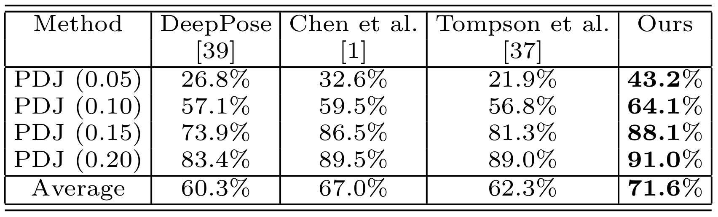
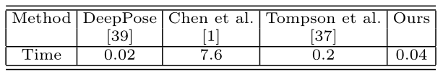
Experimental Comparisons
Quantitative Comparison with state-of-the-art approaches
Efficiency Comparison on intel 3.4GHz CPU + NVIDIA TITAN X GPU

Slide 20
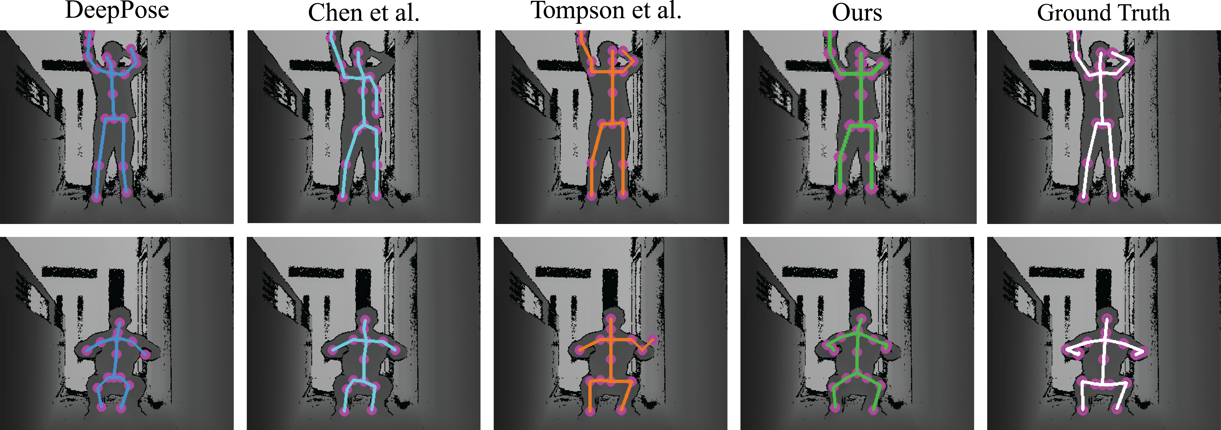
Experimental Comparisons
Qualitative Comparison with state-of-the-art approaches

Slide 21
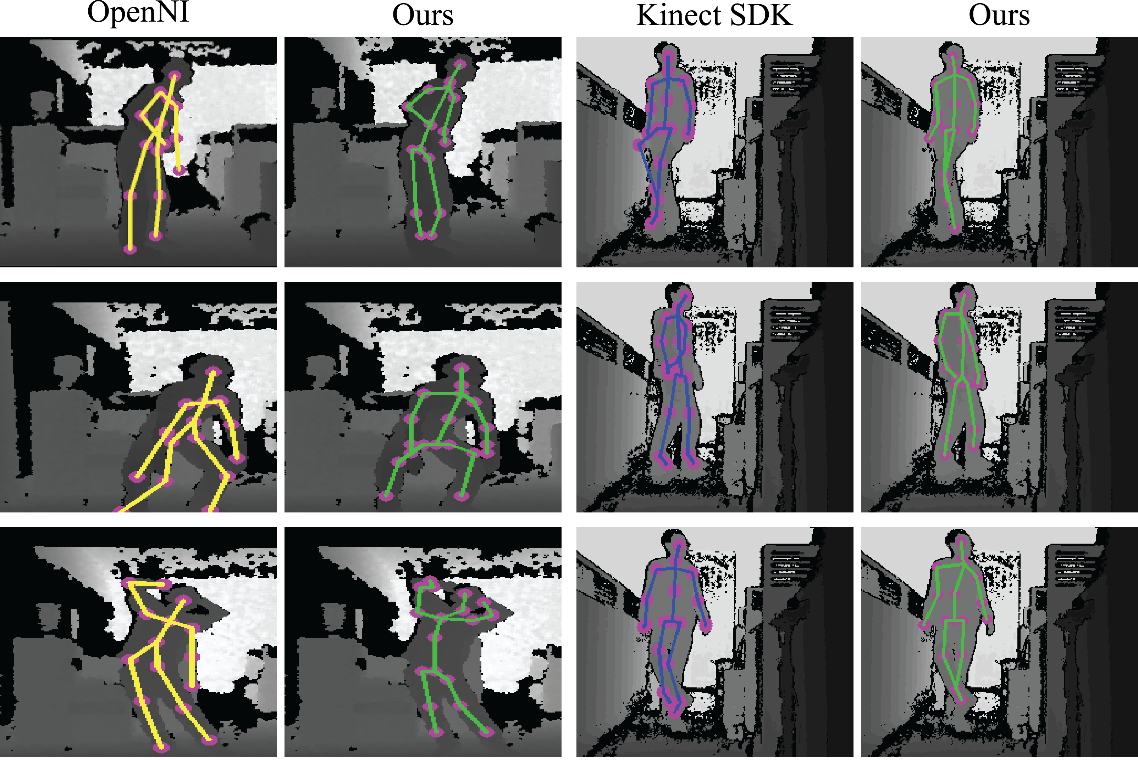
Visual Comparison with commercial products

Slide 22
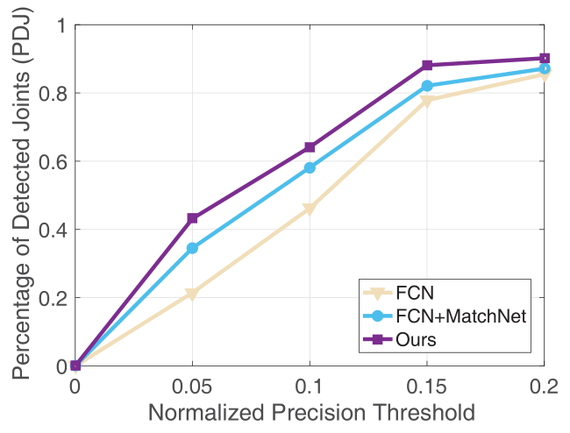
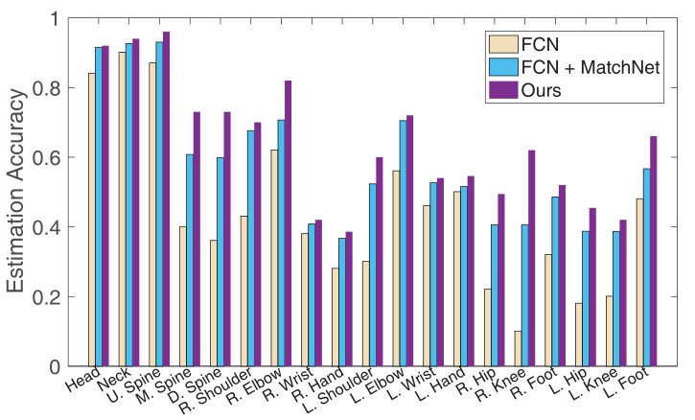
Experimental Comparisons
Component Analysis

Slide 23
Outline
Background
Motivation
Framework
Results
Conclusion
Notes:
首先简要介绍下个人基本情况。

Slide 24
Conclusions
We proposed a novel deep inference-embedded multi-task learning framework for predicting human pose from depth data.
Detecting a batch of body part proposals via a fully convolutional network (FCN);
Searching for the optimal configuration of body parts based on the body part proposals via a fast inference step (i.e., dynamic programming)
We developed a inference built-in MatchNet to incorporate the single term of appearance cost and the pairwise 3D kinematic constraint.

Slide 25
Any Questions?

Slide 26
Thank You!

