Slide 2
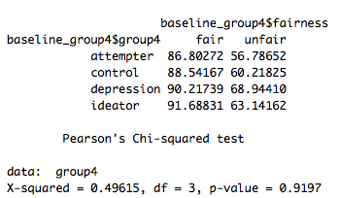
Baseline condition

Slide 3
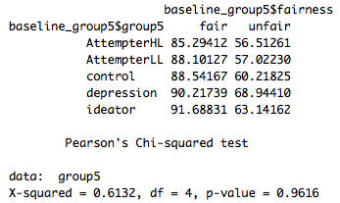
Baseline condition

Slide 4
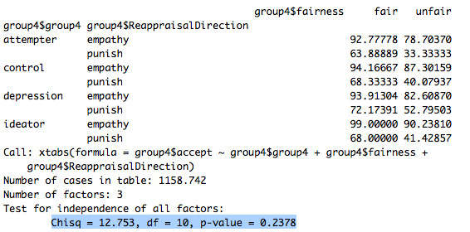
Social framing condition (4 groups)

Slide 5
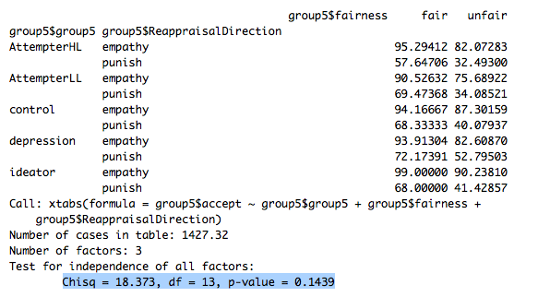
Social framing condition (5 groups)

Slide 6
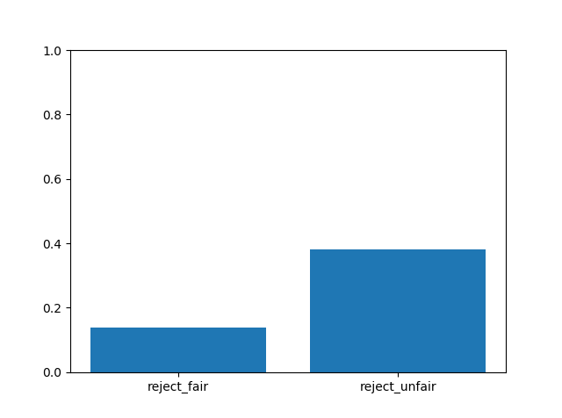
% of rejecting offers in all participants
fairness | reject | accept
fair | 212 | 1333
unfair | 2481 | 4008
proportion of accepting faired/unfair offers is significantly different from the proportion of rejecting faired/unfair offers, p=0.
Proportion of rejecting faired offers is significantly different from rejecting unfair offers, p=0.
Binomial test

Slide 7
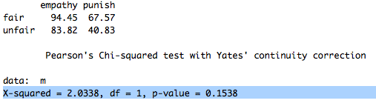
Social framing x fairness

Slide 8
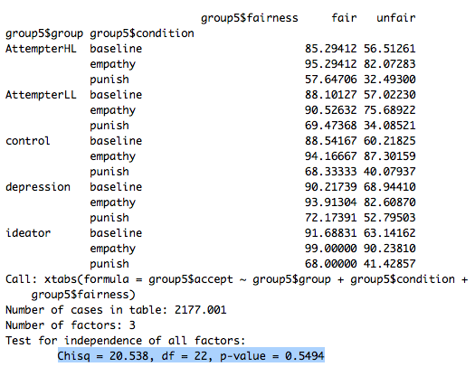
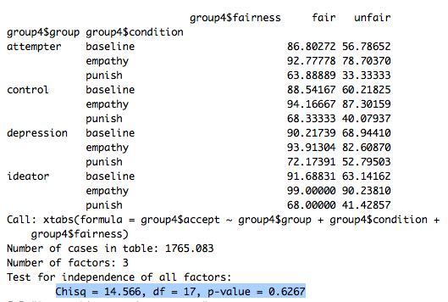
Baseline vs. punish vs. empathy
3 way chi-square:
Groups x fairness x social framing(2 levels)

Slide 9
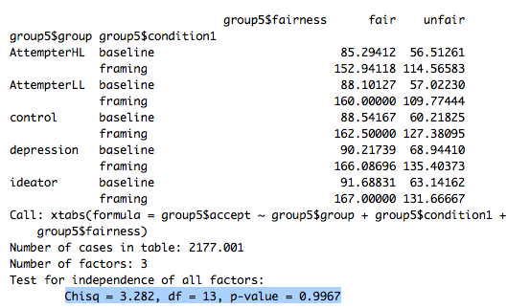
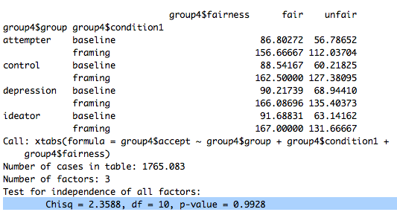
Baseline vs. social framing
3 way chi-square:
Groups x fairness x social framing(3 levels)

Slide 10
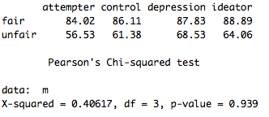
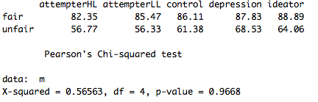
Baseline vs. social framing
2 way chi-square
Fairness x 4 groups
2 way chi-square
Fairness x 5 groups

Slide 11
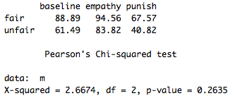
Baseline vs. social framing
2 way chi-square
Social framing x fairness

Slide 12
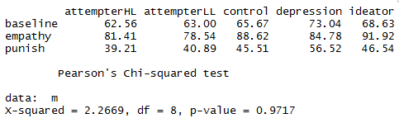
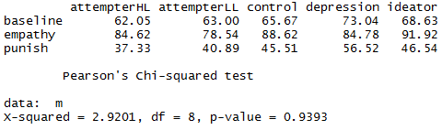
Baseline vs. social framing
2 way chi-square
Social framing x 5 groups

Slide 13
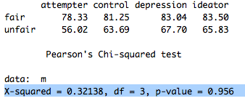
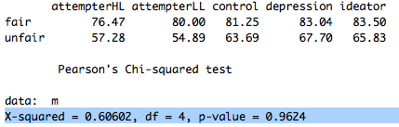
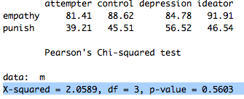
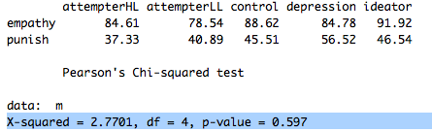
Social framing condition
Fairness x 4 groups
Framing x 4 groups
Fairness x 5 groups
Framing x 5 groups

Slide 14
New graphs

Slide 15
Groups, conditions, and fairness
Notes:
Is accepting fair/unfair offers significantly larger/smaller than unfair offers within a group?
Yes. Binomial test(accept, reject)
Is accepting fair/unfair offers significantly different across groups?
Yes, chi-square goodness of fit.

Slide 16
Groups, conditions, and fairness

Slide 17
Player proposed amount

Slide 18
Fairness score

Slide 19
Opponent proposed amount

Slide 20
HC and stake size/fairness

Slide 21
Fairness ration and stake size correlation
Fairness ratio | baseline | empathy | punish | Grand Total
1 | 206 | 206 | 206 | 618
2 | 309 | 309 | 309 | 927
3 | 721 | 721 | 721 | 2163
4 | 721 | 721 | 721 | 2163
5 | 721 | 721 | 721 | 2163
Grand Total | 2678 | 2678 | 2678 | 8034

