Slide 2
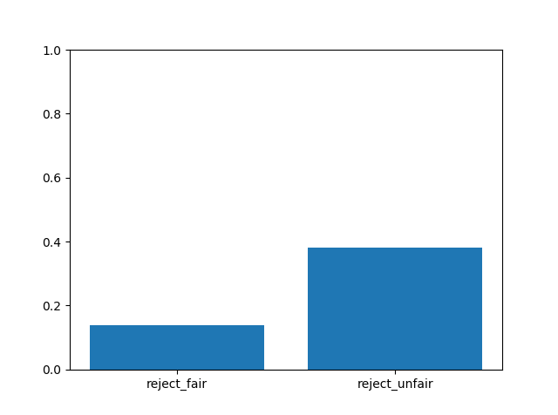
% of rejecting offers in all participants
fairness | reject | accept
fair | 212 | 1333
unfair | 2481 | 4008
proportion of accepting faired/unfair offers is significantly different from the proportion of rejecting faired/unfair offers, p=0.
Proportion of rejecting faired offers is significantly different from rejecting unfair offers, p=0.
Binomial test

Slide 3
Groups, conditions, and fairness
Notes:
Is accepting fair/unfair offers significantly larger/smaller than unfair offers within a group?
Yes. Binomial test(accept, reject)
Is accepting fair/unfair offers significantly different across groups?
Yes, chi-square goodness of fit.

Slide 4
Groups, conditions, and fairness

Slide 5
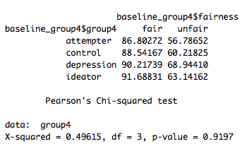
Baseline condition

Slide 6
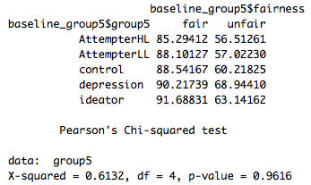
Baseline condition

Slide 7
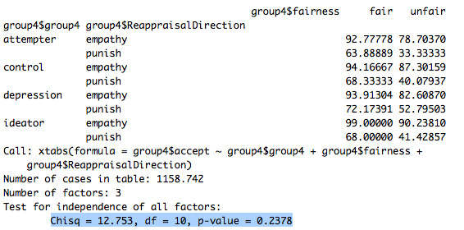
Social framing condition (4 groups)

Slide 8
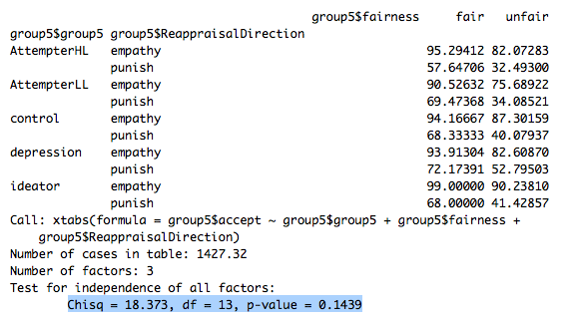
Social framing condition (5 groups)

Slide 9
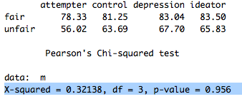
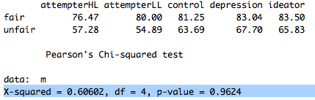
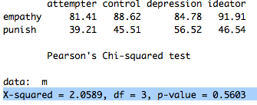
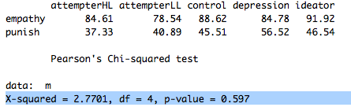
Social framing condition
Fairness x 4 groups
Framing x 4 groups
Fairness x 5 groups
Framing x 5 groups

Slide 10
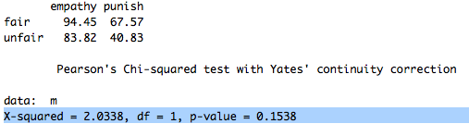
Social framing x fairness

Slide 11
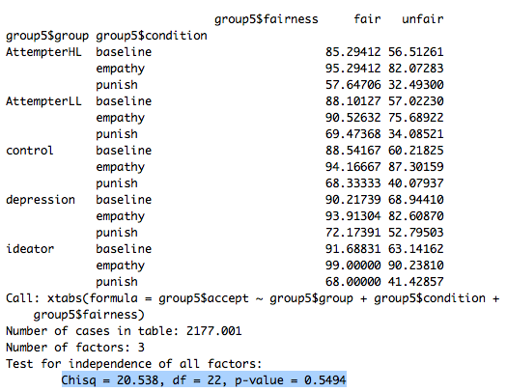
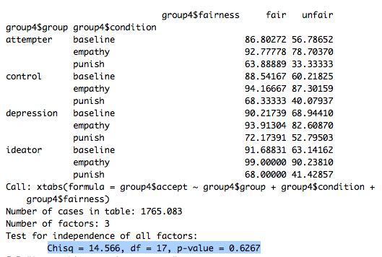
Baseline vs. punish vs. empathy
3 way chi-square:
Groups x fairness x social framing(2 levels)

Slide 12
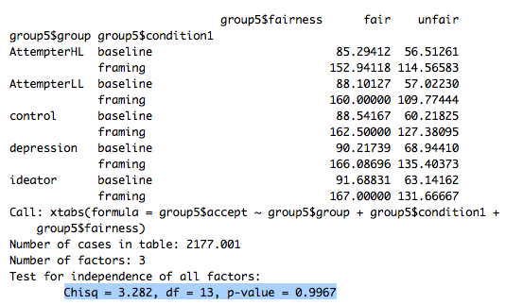
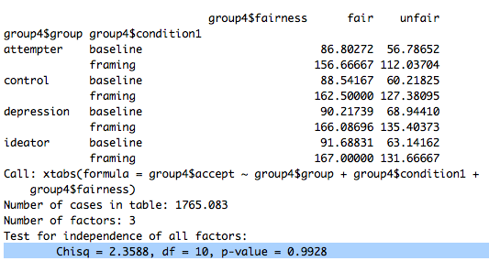
Baseline vs. social framing
3 way chi-square:
Groups x fairness x social framing(3 levels)

Slide 13
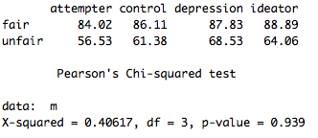
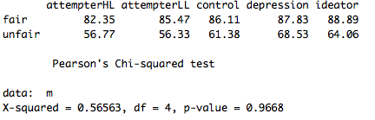
Baseline vs. social framing
2 way chi-square
Fairness x 4 groups
2 way chi-square
Fairness x 5 groups

Slide 14
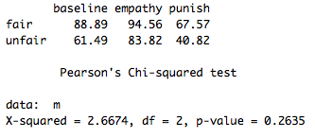
Baseline vs. social framing
2 way chi-square
Social framing x fairness

Slide 15
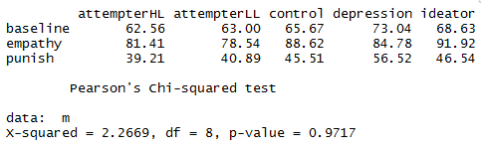
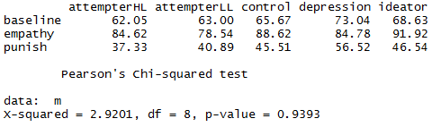
Baseline vs. social framing
2 way chi-square
Social framing x 5 groups

Slide 16
Baseline and stake size

Slide 17
Baseline and player proposed amount

Slide 18
Baseline and fairness score

Slide 19
Empathy and stake size

Slide 20
Empathy and player proposed amount

Slide 21
Empathy and fairness score

Slide 22
Punish and stake size

Slide 23
Punish and player proposed amount

Slide 24
Punish and fairness score

Slide 25
HC and stake size

Slide 26
HC, social framing, and fairness

Slide 27
HC, social framing, and player proposed stake

