Slide 2
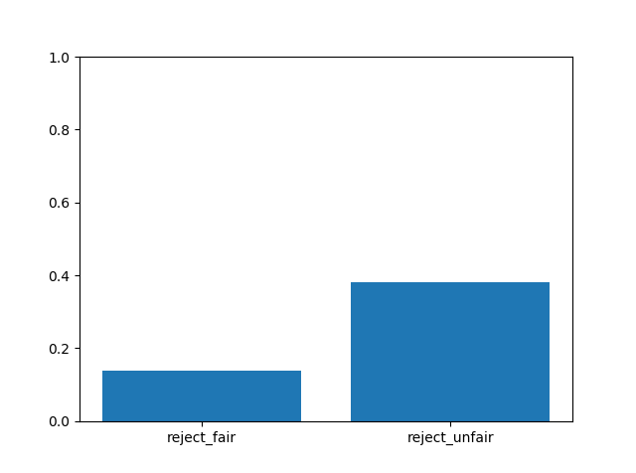
% of rejecting offers in all participants
fairness | reject | accept
fair | 212 | 1333
unfair | 2481 | 4008
proportion of accepting faired/unfaired offers is significantly different from the proportion of rejecting faired/unfaired offers, p=0.
Proportion of rejecting faired offers is significantly different from rejecting unfaired offers, p=0.

Slide 3
Demographics
Are groups significantly different in demographics info?

