Slide 2
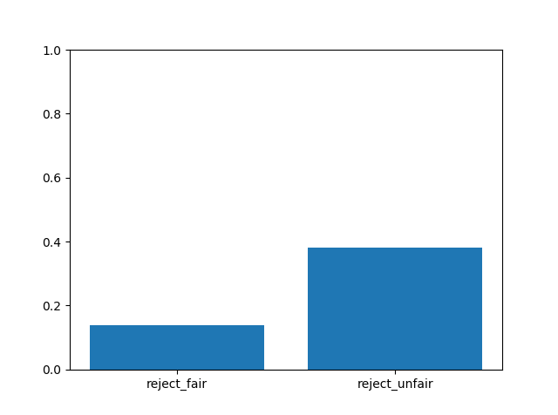
% of rejecting offers in all participants
fairness | reject | accept
fair | 212 | 1333
unfair | 2481 | 4008
proportion of accepting faired/unfair offers is significantly different from the proportion of rejecting faired/unfair offers, p=0.
Proportion of rejecting faired offers is significantly different from rejecting unfair offers, p=0.
Binomial test

Slide 3
Groups, conditions, and fairness
Notes:
Is accepting fair/unfair offers significantly larger/smaller than unfair offers within a group?
Yes. Binomial test(accept, reject)
Is accepting fair/unfair offers significantly different across groups?
Yes, chi-square goodness of fit.

Slide 4
Groups, conditions, and fairness

Slide 5

Baseline condition

Slide 6


