Slide 2
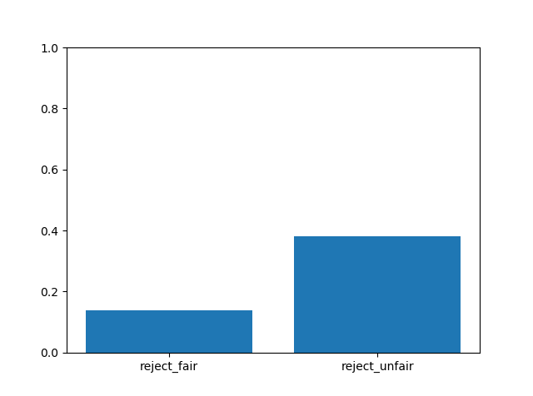
% of rejecting offers in all participants
fairness | reject | accept
fair | 212 | 1333
unfair | 2481 | 4008
proportion of accepting faired/unfair offers is significantly different from the proportion of rejecting faired/unfair offers, p=0.
Proportion of rejecting faired offers is significantly different from rejecting unfair offers, p=0.
Binomial test

Slide 3
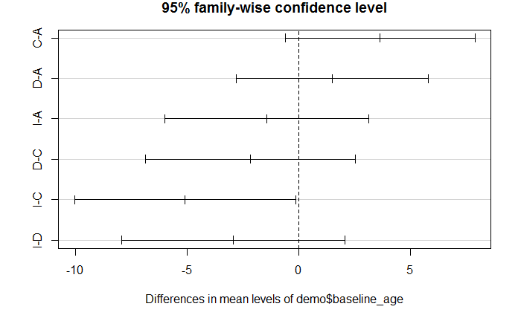
Demographics
Are groups significantly different in demographics info?
The baseline ages are significantly different across the 4 groups, F(3) = 2.826, p=0.426. Ideators and controls are significantly different (Tukey HSD), p=0.042.
The baseline ages are not significantly across the 5 groups (attempter HL & LL), F(4) = 2.364, p=0.058.
5-levels

Slide 4
Groups and offers
Is accepting fair/unfair offers significantly larger/smaller than unfair offers within a group?
Yes. Binomial test(accept, reject)
Is accepting fair/unfair offers significantly different across groups?
Yes, chi-square goodness of fit.

Slide 5
5 Groups, conditions, and fairness

Slide 6
4 Groups, conditions, and fairness
There is no significant three-way interaction between groups, conditions, and fairness, F(6, 8010) = .749, p = 0.61.
Group type is significantly interacting with reappraisal condition

