Slide 2
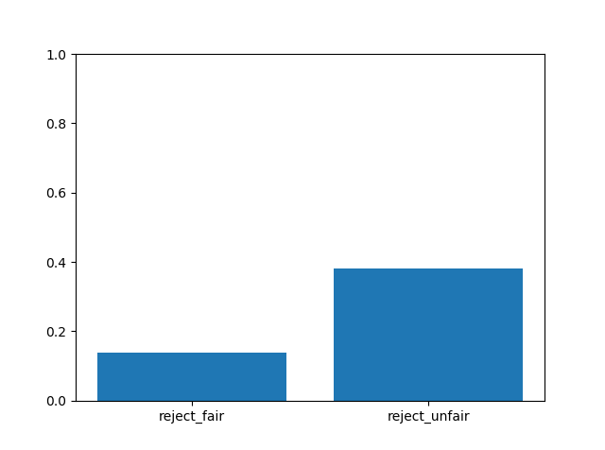
% of rejecting offers in all participants
fairness | reject | accept
fair | 212 | 1333
unfair | 2481 | 4008
proportion of accepting faired/unfair offers is significantly different from the proportion of rejecting faired/unfair offers, p=0.
Proportion of rejecting faired offers is significantly different from rejecting unfair offers, p=0.
Binomial test

Slide 3
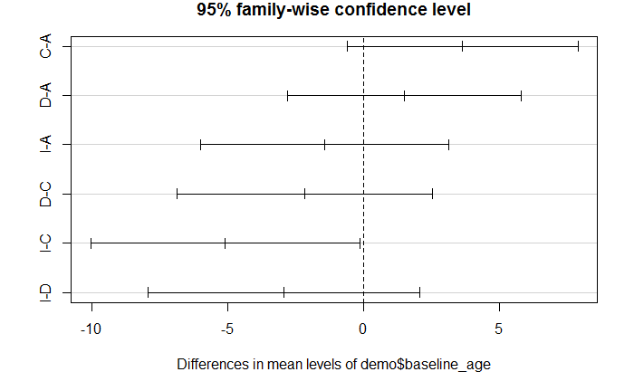
Demographics
Are groups significantly different in demographics info?
The baseline ages are significantly different across the 4 groups, F(3) = 2.826, p=0.426. Ideators and controls are significantly different (Tukey HSD), p=0.042.
The baseline ages are not significantly across the 5 groups (attempter HL & LL), F(4) = 2.364, p=0.058.
5-levels

Slide 4
Groups and offers
Is the tendency of accepting/rejecting offers independent from groups? One-sample chi-square for accept and reject.
Are groups more likely to accept offers in fair & unfair condition?
Is accepting fair offers significantly larger than unfair offers within a group?
Is accepting fair offers independent from groups?

