Slide 1
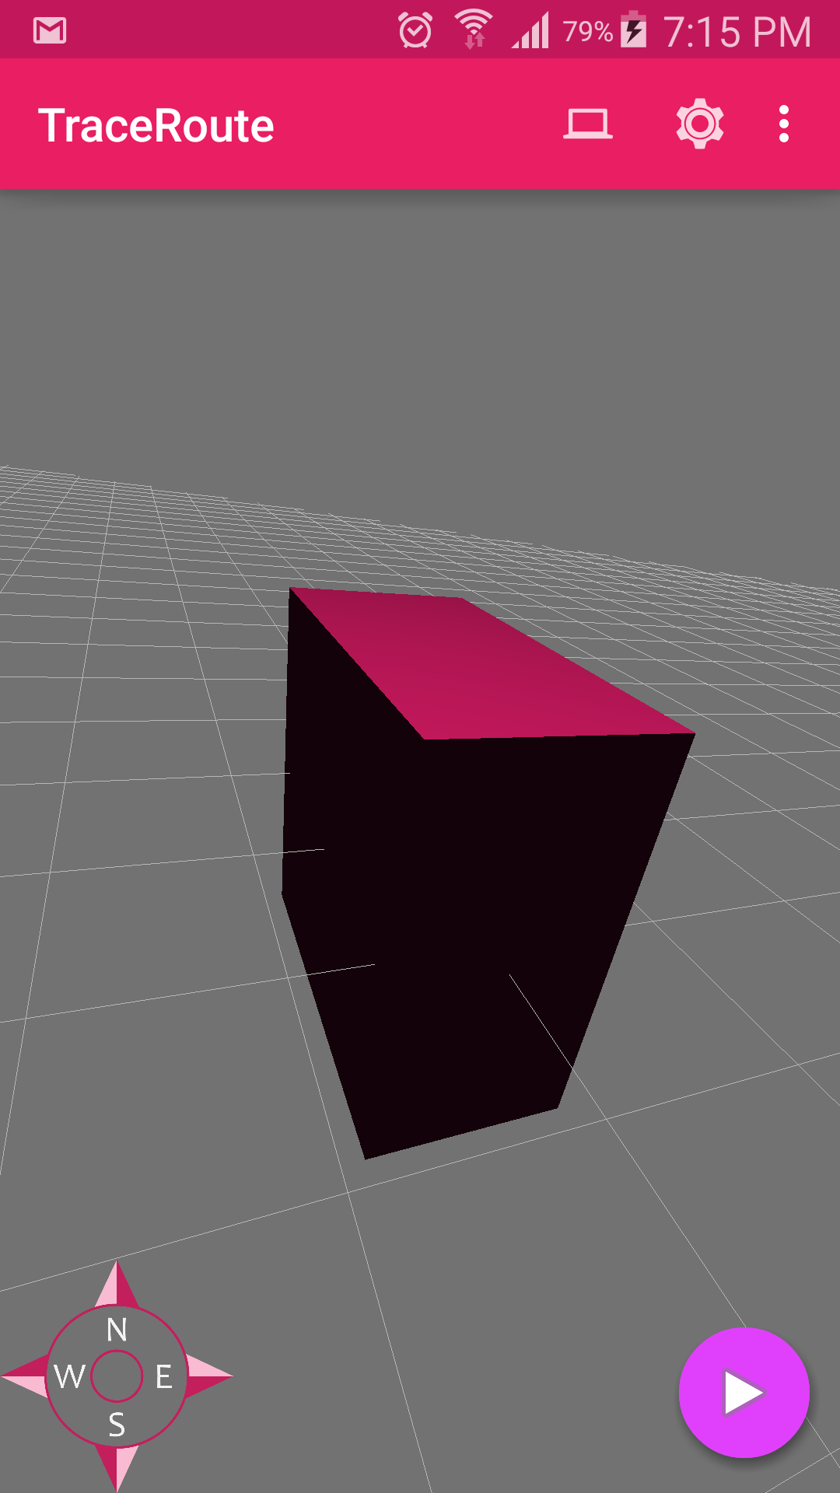
TraceRoute
Sean Aryana, Andrew Gammon, Keith yang
cse481L – Spring 2015

Slide 2
Motivation
Interior navigation. Orient yourself without using GPS! (Pedestrian dead reckoning)
Saves power, and can give you movement data in 3D space.
Phones have lots of cool sensors to play with.
It’s a field of active research and experimentation!

Slide 3
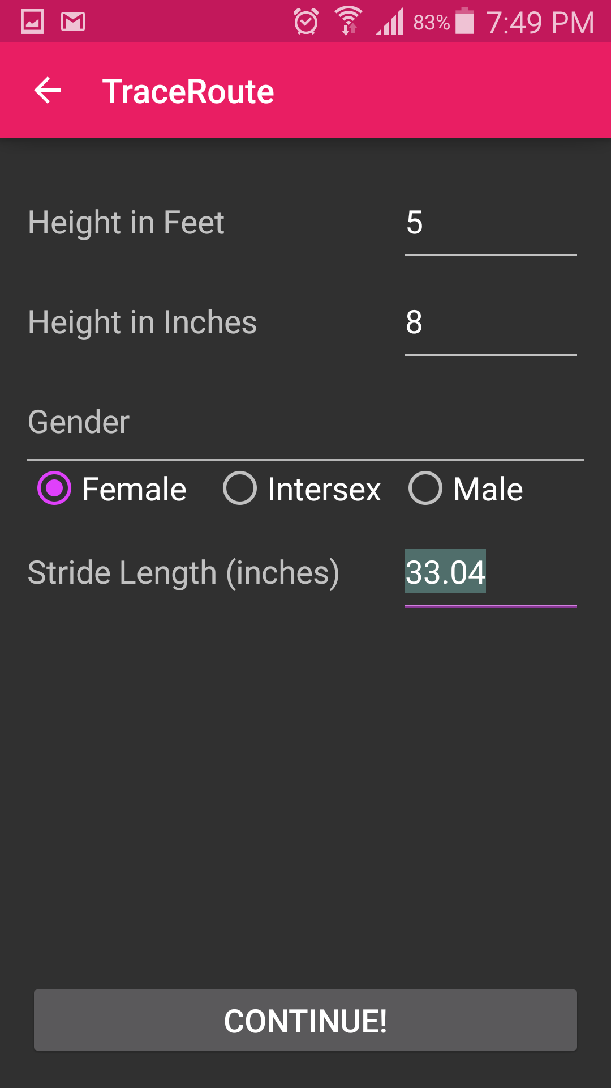
What we Built
Main Screen
User Settings
Path Creation/Viewer
Path Manager

Slide 4
What we Learned - Sensors

Slide 5
What we Learned - Navigation

Slide 6
What we Learned - OpenGL
Lots of math!
Clumsy API – OpenGL ES
Things that are intuitive from a user perspective (camera control, lighting) are fairly involved processes.

