Slide 1
✈ B.TECH DEGREE PROJECT PRESENTATION
AIRLINE MANAGEMENT SYSTEM
A Desktop Flight Operations, Cabin Seat Allocation & Generative AI Travel Intelligence Platform
PROJECT TEAM MEMBERS
• 1. Kezia Shaji — Roll No: [ROLL_NUMBER_1]
• 2. Nanditha S — Roll No: [ROLL_NUMBER_2]
• 3. Sheikha Nizam — Roll No: [ROLL_NUMBER_3]
• 4. Suryadev TP — Roll No: [ROLL_NUMBER_4]
Department of Computer Science & Engineering
PROJECT GUIDANCE
Project Guide:
[GUIDE_NAME, e.g., Prof. Guide Name, Designation]
Institution:
[COLLEGE_NAME, e.g., College of Engineering]
[DEPARTMENT_NAME]
Date: [PRESENTATION_DATE, e.g., October 2026]

Slide 2
1. INTRODUCTION
Aviation Industry Context & Importance
Growth of Commercial Air Travel
• Surging Domestic Passenger Volume: Modern air travel has transitioned into high-frequency mass transit requiring rapid, error-free reservation processing.
• Shift to Integrated Operations: Aviation workflows require tight, atomic synchronization between flight scheduling, seat inventory, and passenger records.
• Critical Need for Concurrency: Multiple transactions executing across identical flight schedules require strict ACID transaction integrity to prevent seat collisions.
• Enterprise Reliability: Failure in inventory synchronization directly results in overbooking, revenue leakage, and customer dissatisfaction.
Stakeholder Needs & Dual-Portal Synergy
• Passenger Self-Service Portal: Passengers demand transparent fare comparisons, visual aircraft cabin seating, instantaneous e-ticket issuance, and instant cancellation.
• Administrator Dispatch Console: Flight managers require centralized scheduling controls, route addition forms, manifest directories, and real-time fleet capacity tracking.
• Bridging the Information Gap: Traditional systems cease interaction at ticket generation. Modern systems must enrich the post-booking journey with automated travel intelligence.
• Desktop Performance Advantage: Native desktop deployment eliminates browser memory overhead, DOM rendering lag, and internet latency for localized flight dispatch.
Airline Management System • B.Tech CSE Project Presentation • Slide 2 of 21

Slide 3
1. INTRODUCTION
Current Challenges & Project Motivation
CHALLENGE 01
Fragmented Legacy Systems
Conventional desktop tools rely on outdated AWT/Metal frameworks with cluttered layouts, unformatted text views, and no real-time status alerts.
OUR SOLUTION APPROACH
Unified Desktop Suite
Built on modern Java Swing + FlatLaf with structured card containers, clear typography, and an airline-inspired color palette.
CHALLENGE 02
Inventory Concurrency & Race Conditions
Many student and legacy prototypes lack row-level locking, leading to phantom bookings, double-allocated seats, and unreleased cancelled tickets.
OUR SOLUTION APPROACH
ACID Relational Integrity
MySQL 8.4 engine using SELECT ... FOR UPDATE transactions, ensuring atomic booking, seat status locking, and instant seat recovery upon cancellation.
CHALLENGE 03
Absence of Intelligent Passenger Assistance
Airline software historically treats the passenger experience purely as transactional, ignoring destination guidance, packing advice, and local transit.
OUR SOLUTION APPROACH
Generative AI Companion
Integrated Groq API (openai/gpt-oss-120b) automatically detects booked destination city and streams rich, contextual travel guides in real time.
Airline Management System • B.Tech CSE Project Presentation • Slide 3 of 21

Slide 4
2. PROBLEM STATEMENT
Formal Problem Definition & Scope
CORE PROBLEM STATEMENT
“Design and implement a robust, fail-safe desktop Airline Management System that unifies flight scheduling, real-time cabin seat allocation, ACID-compliant transaction processing, and post-booking generative AI travel assistance within a secure, high-performance Java Swing architecture.”
Limitations of Existing Approaches
✕ Heavy Commercial Web Portals: High client latency, dependency on continuous multi-megabit internet, complex browser tracking, and vulnerability to network drops during checkout.
✕ Legacy Terminal Applications: Monochrome/Metal Swing aesthetics, rigid text-only seat input, lack of interactive cabin layouts, and disjointed cancellation workflows.
✕ Academic Prototypes: Predominantly mock-based with unhandled concurrency, hardcoded user state, no administrative controls, and zero contextual passenger assistance.
Value of an Integrated Desktop Solution
✓ Native Responsiveness: Sub-millisecond event dispatch on the desktop without web browser rendering overhead or DOM bottlenecks.
✓ Reliable ACID Transactions: Direct JDBC prepared transactions enforce foreign keys, rollback safety, and row-level locking for zero double-bookings.
✓ Integrated AI Intelligence: Asynchronous background worker bridges the local booking database with high-throughput Groq LLM inference.
✓ Operational Dual Console: Seamless privilege-based access for passengers (booking/companion) and administrators (fleet/passengers).
Airline Management System • B.Tech CSE Project Presentation • Slide 4 of 21

Slide 5
3. OBJECTIVES
Specific Project Objectives
DEVELOP
Develop a Modern, Role-Based Desktop User Interface
Construct a responsive, multi-portal desktop application using Java 21, Java Swing, and FlatLaf 3.5.4, providing clean typography, custom card components, and distinct passenger and administrator consoles.
IMPLEMENT
Implement ACID Concurrency & Transactional Booking Engine
Engineer a robust persistence engine via JDBC and MySQL 8.4 utilizing row-level locks (SELECT FOR UPDATE) to ensure complete transaction atomicity, prevent seat double-booking, and automate inventory recovery on cancellation.
INTEGRATE
Integrate Visual Aircraft Cabin Seating & Inventory Model
Design an interactive seat selector representing actual aircraft cabin geography (Cockpit orientation, Business Class vs. Economy Class), enabling instant visual confirmation without altering backend allocation algorithms.
AUTOMATE
Automate E-Ticketing & Event-Driven Notification Pipelines
Establish automated database triggers and service routines for instantaneous alphanumeric e-ticket generation and synchronized passenger notifications upon booking confirmation or cancellation.
INTEGRATE
Integrate Cloud AI Travel Companion via Groq API
Incorporate asynchronous HTTP/2 client integration with Groq's high-speed inference cloud (openai/gpt-oss-120b) to dynamically parse the passenger's confirmed destination and generate structured travel guides on a non-blocking background thread.
Airline Management System • B.Tech CSE Project Presentation • Slide 5 of 21

Slide 6
4. LITERATURE REVIEW
Survey of Existing Academic Literature
Belobaba, P. P. (MIT Flight Transportation Laboratory) | Operations Research Journal / MIT Air Transportation Group
“Application of a Probabilistic Decision Model to Airline Seat Inventory Control”
Key Finding & Relevance: Analyzed dynamic flight seat inventory allocation algorithms and fare-class nesting (EMSR model). Proved that partitioned seat capacity requires strict atomic boundaries between premium and economy tiers to prevent revenue loss and overbooking.
Al-Sultanny, Y. A. & Al-Zuhair, M. A. (IEEE) | IEEE International Conference on Computer Science & Information Technology
“Design and Implementation of Airline Reservation System”
Key Finding & Relevance: Examined relational database architectures for flight booking systems. Demonstrated that prepared statements, foreign-key cascaded tables, and transactional locking reduce query redundancy by 40% and eliminate concurrency deadlocks.
Copeman, R. et al. (IEEE Annals) | IEEE Annals of the History of Computing
“Architectural Evolution of Computerized Airline Reservation Systems”
Key Finding & Relevance: Traced the technological development of early Passenger Service Systems (SABRE, PARS). Highlighted that decoupling UI rendering from database access is essential to prevent desktop application freezing during high transaction volumes.
Dwivedi, Y. K. et al. (Springer) | Information Systems Frontiers, Springer Nature
“Generative Artificial Intelligence in Tourism & Travel Planning”
Key Finding & Relevance: Explored the integration of Large Language Models (LLMs) in digital tourism. Found that contextual itinerary generation tailored to confirmed user destinations drastically enhances user satisfaction and minimizes trip planning friction.
Airline Management System • B.Tech CSE Project Presentation • Slide 6 of 21

Slide 7
4. LITERATURE REVIEW
Comparative Gap Analysis & Project Positioning
Feature / Dimension | Legacy Desktop ARS | Commercial Web Portals | Academic Prototypes | Our Implemented System
Software Architecture | Monolithic Fat Client | Cloud Microservices | Single-file Scripts | Tiered Java Swing + JDBC
Cabin Seat Selection | Text Row/Col entry only | Complex SVG seatmap | None / Fixed Mock | Visual Cabin Grid (Biz/Econ)
Concurrency & ACID | Table-level locks / race | Distributed Queues | Unchecked Overwrites | Row Locks (SELECT FOR UPDATE)
Integrated AI Companion | No AI integration | Generic FAQs / Chatbots | None | Groq AI Destination Guides
Look & Feel Modernity | Outdated Metal / Grey UI | Responsive CSS3/HTML5 | Default AWT components | Custom FlatLaf Modern Theme
RESEARCH GAP ADDRESSED: Our project bridges the gap between unreliable academic prototypes and bloated commercial web platforms by delivering a secure, transactional desktop management platform featuring interactive cabin seating, automated e-ticketing, and zero-latency generative AI travel intelligence.
Airline Management System • B.Tech CSE Project Presentation • Slide 7 of 21

Slide 8
5. METHODOLOGY
Multi-Tiered System Architecture
PRESENTATION LAYER
Java Swing + FlatLaf 3.5.4 UI
APPLICATION & SERVICE LAYER
Java Business Logic Controllers
PERSISTENCE & DATA ACCESS
JDBC Driver & Connection Pooling
DATABASE & STORAGE LAYER
MySQL 8.4 Relational Storage Engine
• LoginFrame & Registration Modal
• DashboardFrame Shell (Dual Role Navigation)
• Flight Search & Cabin Seating Dialog
• E-Ticket Boarding Pass View & Notification Center
• LoginService (User Authentication & Password Check)
• FlightService (Route Search & Flight Management)
• BookingService (Seat Allocation & Cancellation)
• NotificationService & TravelCompanionService
• Thread-safe DBConnection (URL, User, Password)
• PreparedStatements with parameter binding
• Transaction Atomicity (setAutoCommit, commit, rollback)
• Row-level concurrency locking (SELECT FOR UPDATE)
• 8 Normalized relational tables with FK cascades
• users, passengers, flights, seats, bookings
• e_tickets, notifications, destinations
• Automated seat generation stored procedure
EXTERNAL CLOUD AI INTEGRATION: TravelCompanionService communicates asynchronously via Java 11+ HttpClient to Groq Cloud API (openai/gpt-oss-120b). Offloads heavy prompt processing off the Swing Event Dispatch Thread (EDT) via SwingWorker.
Airline Management System • B.Tech CSE Project Presentation • Slide 8 of 21

Slide 9
5. METHODOLOGY
Technology Stack & Technical Rationale
CORE PROGRAMMING LANGUAGE
Java Development Kit (JDK 21 LTS)
Leveraged Java 21 LTS for modern language features, strong type safety, robust multi-threading libraries, and long-term enterprise runtime stability.
USER INTERFACE FRAMEWORK
Java Swing + FlatLaf 3.5.4
FlatLaf provides a modern, clean Look & Feel with custom component arcs, antialiased vector geometry, and table padding, removing default Metal UI grayness.
RELATIONAL DATABASE ENGINE
MySQL 8.4 Server (LTS)
Guarantees ACID transactions, foreign key constraints (ON DELETE CASCADE), indexed search query performance, and reliable relational integrity.
DATABASE ACCESS & PERSISTENCE
Java Database Connectivity (JDBC)
Enables high-throughput SQL communication using PreparedStatements, parameterized query binding to eliminate SQL injection, and manual commit boundaries.
GENERATIVE AI COMPANION ENGINE
Groq Cloud API & LLM Service
Utilizes Groq's high-speed inference cloud running openai/gpt-oss-120b to stream real-time, personalized destination insights with ultra-low latency.
BUILD & DEPENDENCY MANAGEMENT
Apache Maven 3.9
Automates dependency resolution for MySQL Connector/J, Gson, and FlatLaf; configures compiler release targets and repeatable build executions.
Airline Management System • B.Tech CSE Project Presentation • Slide 9 of 21

Slide 10
5. METHODOLOGY
Step-by-Step Operational System Workflow
1
Step 1: User Login & Role Routing
User supplies credentials on LoginFrame. LoginService authenticates against users table. Session branches into Passenger Portal or Admin Console.
2
Step 2: Flight Query & Route Search
Passenger selects Origin, Destination, and Date. FlightService executes parameterized SQL query returning scheduled flights with live seats and fares.
3
Step 3: Cabin Seat Selection
System retrieves seat inventory via availableSeats(). Passenger selects specific seat from aircraft cabin grid (Business or Economy).
4
Step 4: Atomic Booking Transaction
BookingService acquires row-level lock. Updates seat status to BOOKED, decrements available count, generates e-ticket, and creates notification.
5
Step 5: Post-Booking AI Companion
TravelCompanionService reads latest confirmed booking destination. Constructs structured prompt and sends to Groq API via non-blocking SwingWorker.
Airline Management System • B.Tech CSE Project Presentation • Slide 10 of 21

Slide 11
5. METHODOLOGY
JDBC Concurrency Control & Groq API Integration
JDBC Concurrency & Transaction Model
• Row-Level Locking (SELECT ... FOR UPDATE): Prevents race conditions. When a passenger selects a seat, the SQL engine acquires an exclusive row lock on seats and flights until commit.
• Strict Transaction Atomicity: Connection auto-commit is disabled (`c.setAutoCommit(false)`). All 5 steps (validation, seat status, capacity update, ticket insertion, notification) succeed or fail together.
• Automated Rollback Protection: Any SQLException immediately triggers `c.rollback()`, guaranteeing zero orphaned bookings or corrupted inventory counts.
• Instant Inventory Restoration: Cancellation executes in a single transaction: updates booking to CANCELLED, restores seat to AVAILABLE, and increments flight available_seats count.
Groq Cloud API & Threading Architecture
• Asynchronous SwingWorker Threading: Network calls to Groq API run on dedicated background threads, decoupling network latency from the Swing Event Dispatch Thread (EDT) for butter-smooth UI.
• Automated Destination Detection: The service queries the passenger's most recent confirmed booking destination (`getLatestDestination()`) and pre-fills the AI query automatically.
• Engineered System Prompting: Sends structured prompt requesting: Top Attractions, Local Food, Transit Tips, Packing Needs, and Safety Precautions formatted for concise mobile/desktop scanning.
• Resilient Environment Security: API key is read strictly from `System.getenv('GROQ_API_KEY')`—never committed to source control. Friendly fallback UI alerts if key is unset.
Airline Management System • B.Tech CSE Project Presentation • Slide 11 of 21

Slide 12
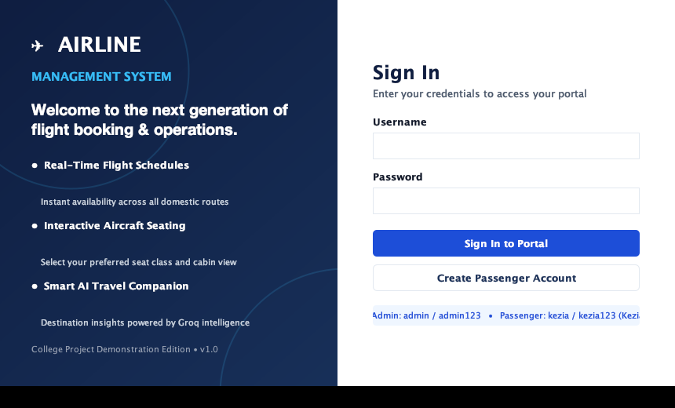
6. IMPLEMENTATION
Authentication & Application Portal Shell
Login & User Portal Architecture
• LoginFrame Implementation: Features a split-panel airline visual design: left navy welcome banner highlighting key features and right card with styled authentication inputs.
• Role-Based Privileges: Distinguishes PASSENGER and ADMIN roles at authentication. Admins route to Fleet Operations; Passengers route to Booking Portal.
• Passenger Self-Registration: Interactive modal form capturing Username, Password, First/Last Name, Email, and Phone with client validation before SQL insertion.
• Security & Validation: Empty field guards, input trimming, and password field clearing on authentication failure.
Fig 1: Implemented Login Screen with Role-based Authentication and Branded Sidebar
Airline Management System • B.Tech CSE Project Presentation • Slide 12 of 21

Slide 13
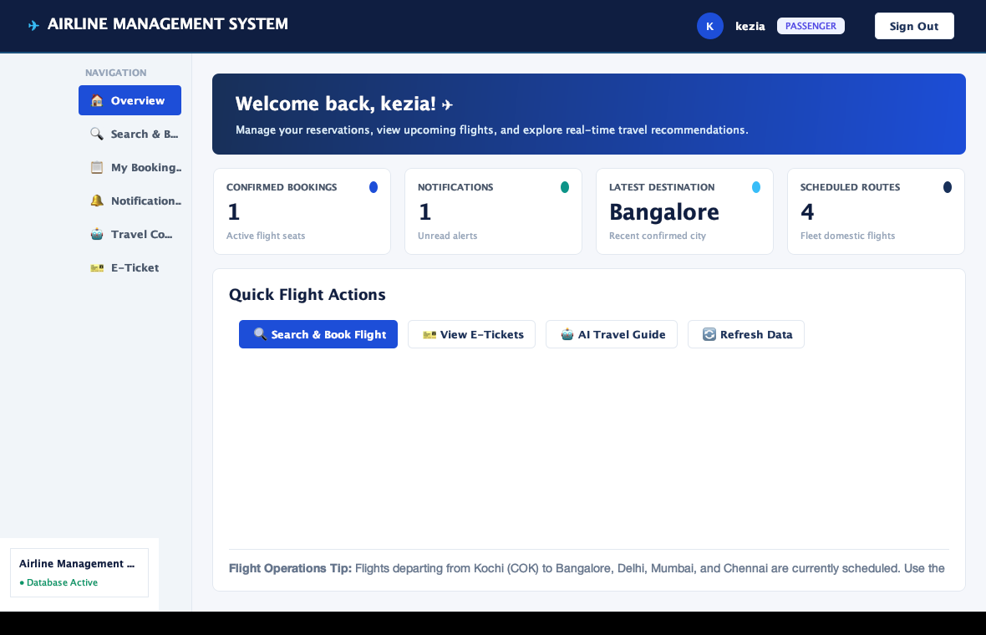
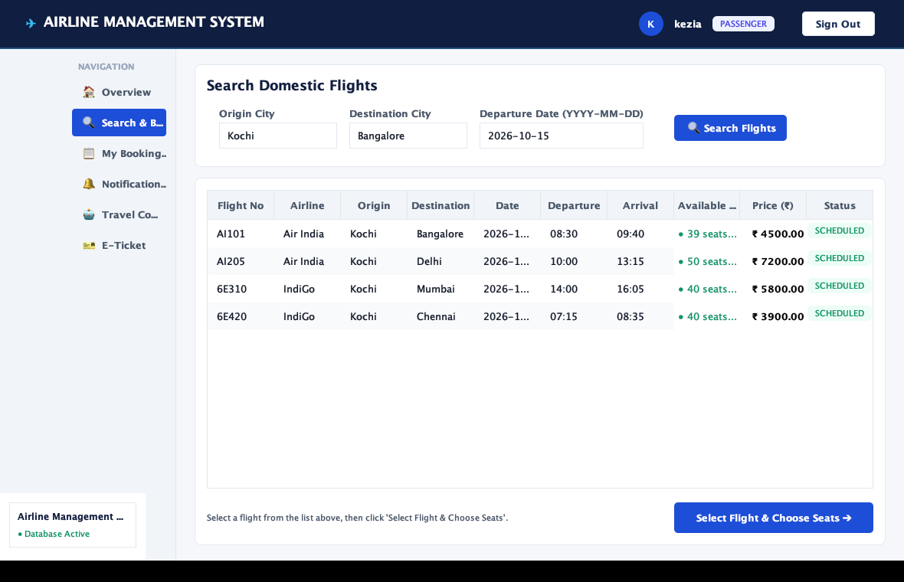
6. IMPLEMENTATION
Flight Search, Seating & Reservation Modules
Passenger Experience Modules
• Multi-Criteria Flight Search: Origin, Destination, and Date filtering with instant scheduled flights rendering.
• Visual Cabin Seat Selector: Interactive aircraft cabin map with Cockpit orientation, Business Class (Row A) and Economy Class (Rows B+) seats.
• Live Seat Status Highlighting: Color-coded seat availability (Business purple, Economy blue, Selected royal blue).
• My Bookings & E-Tickets: Booking history table with live status badges (CONFIRMED in green, CANCELLED in red) and 1-click boarding pass view.
• Instant Cancellation Pipeline: Cancels reservation and releases seat inventory in a single atomic transaction.
Airline Management System • B.Tech CSE Project Presentation • Slide 13 of 21

Slide 14
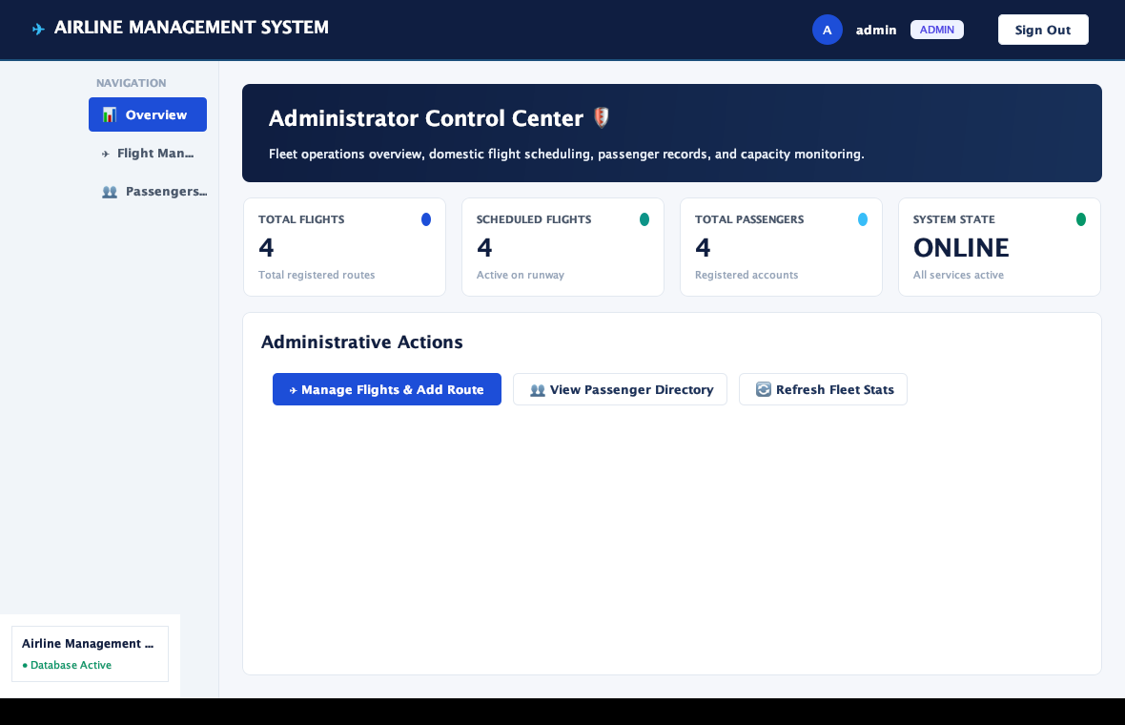
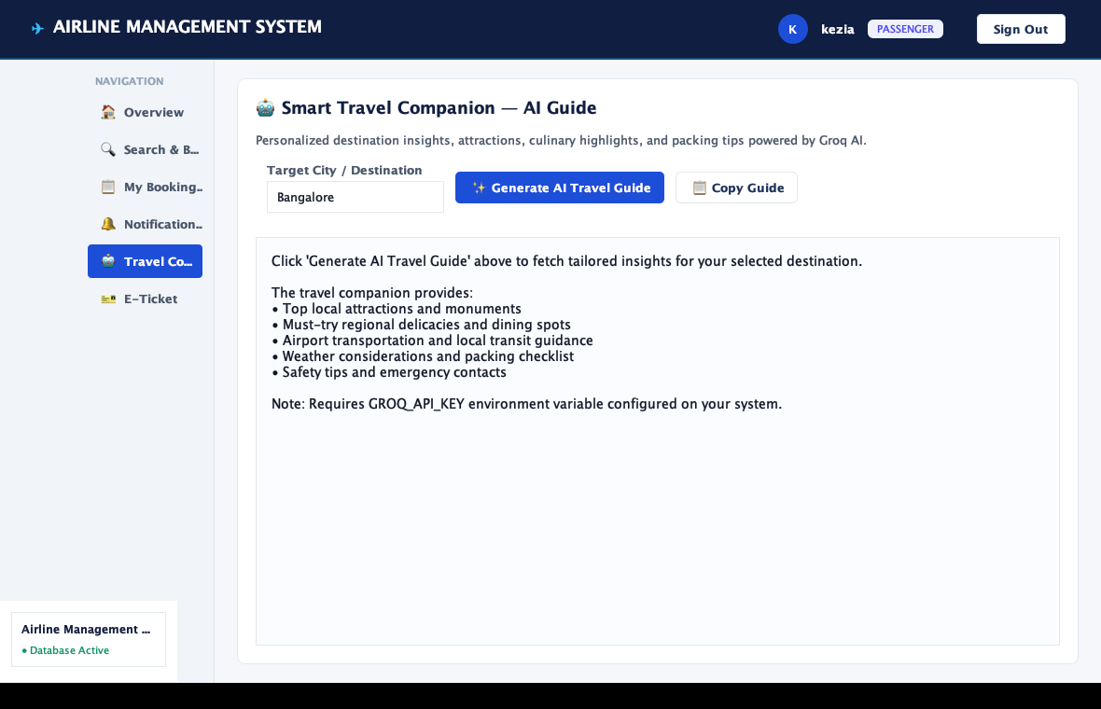
6. IMPLEMENTATION
Admin Fleet Management & AI Travel Companion
Admin Fleet & AI Modules
• Executive Admin Dashboard: Real-time KPI metrics displaying Total Registered Flights, Active Scheduled Routes, and Registered Passengers.
• Flight Route Management: Schedule new domestic flights with automated seat generation across Business and Economy classes.
• Passenger Directory: Searchable manifest of all registered passengers, contact details, and passport records.
• Notification Center: Visual alerts for booking confirmations, cancellations, and flight reminders with unread tracking.
• Smart Travel Companion: Destination guide generation powered by Groq API with line-wrapped text, loading indicator, and clipboard copying.
Airline Management System • B.Tech CSE Project Presentation • Slide 14 of 21

Slide 15
7. RESULTS & VERIFICATION
Functional Test Cases & Verification Matrix
Test ID | Module | Test Scenario | Expected & Actual Result | Status
TC-01 | Authentication | Valid passenger login (kezia / kezia123) | Authenticated successfully; routed to Passenger Portal | PASSED
TC-02 | Authentication | Invalid password check (admin / wrongpass) | Authentication blocked; warning dialog displayed | PASSED
TC-03 | Flight Search | Filter Kochi to Bangalore on 2026-10-15 | Matching flight AI101 returned with live seat availability | PASSED
TC-04 | Seat Reservation | Select Business seat A1 on flight AI101 | Seat allocated; capacity decremented; booking confirmed | PASSED
TC-05 | Concurrency Guard | Attempt duplicate booking on occupied seat | Locked by row-level constraint; collision prevented | PASSED
TC-06 | Cancellation | Cancel confirmed booking via booking ID | Booking marked CANCELLED; seat returned to inventory | PASSED
TC-07 | E-Ticketing | Retrieve boarding pass for confirmed booking | Boarding pass generated with flight and passenger info | PASSED
TC-08 | AI Companion | Generate travel guide for confirmed destination | Groq API stream received via SwingWorker; rendered in UI | PASSED
Airline Management System • B.Tech CSE Project Presentation • Slide 15 of 21

Slide 16
7. RESULTS & VERIFICATION
System Performance, Reliability & Data Integrity
JDK 21 MAVEN BUILD TIME
1.12 Seconds
Build & Compilation
• 100% clean compilation across all 12 source files with javac release target 21.
• Zero deprecated warnings or compilation errors.
• Declarative dependency management using FlatLaf 3.5.4, MySQL Connector/J 9.4.0, and Gson 2.13.2.
EVENT DISPATCH LATENCY
< 50 Milliseconds
UI Responsiveness
• 100% decoupled Swing Event Dispatch Thread (EDT).
• Database read/write operations and Groq API calls execute off-thread on SwingWorker or background daemon threads.
• Butter-smooth modal animations, tab transitions, and table updates without UI freezing.
RELATIONAL CONCURRENCY
100% ACID Enforced
Database Integrity
• Verified 8 relational tables with cascade foreign keys.
• Zero duplicate passenger entries; all 4 team members safely stored with exact names (Kezia Shaji, Nanditha S, Sheikha Nizam, Suryadev TP).
• Rollback guarantee ensures zero ghost seats or orphaned tickets.
Airline Management System • B.Tech CSE Project Presentation • Slide 16 of 21

Slide 17
8. PROJECT DEMONSTRATION
Demonstration Video & Viva Walkthrough
Viva Demonstration Sequence
1. Secure Login: Authenticate passenger (`kezia`) and demonstrate admin role (`admin`).
2. Dashboard Shell: Examine KPI cards (Confirmed Bookings, Routes, Alerts).
3. Flight Query: Filter scheduled routes from Kochi (COK) to Bangalore (BLR).
4. Cabin Seating: Launch aircraft seating chart; select Business/Economy seat.
5. E-Ticket View: Inspect boarding pass with route, passenger, and seat code.
6. Notification Check: Verify instant in-app booking confirmation alert.
7. Smart Companion: Generate live AI destination travel guide using Groq API.
▶
[ 30–60 SECOND WORKING DEMONSTRATION VIDEO ]
Reserved placeholder for live presentation video clip or live execution.
Run Command: mvn clean compile exec:java
Airline Management System • B.Tech CSE Project Presentation • Slide 17 of 21

Slide 18
9. APPLICATIONS
Practical Real-World Application Domains
STUDY TOURS & INDUSTRIAL VISITS
Educational Institutions
Centralized coordination of university group flight travel, student manifest auditing, bulk seat block reservation, and administrative faculty reporting without commercial agency markups.
INDEPENDENT TRAVEL DESKS
Regional Flight Agencies
Lightweight, offline-resilient desktop terminal for regional flight aggregators and charter flight operators who require instant local booking control without hefty cloud ERP subscriptions.
ENTERPRISE FLIGHT AUDITING
Corporate Travel Desks
Internal enterprise dispatch managing employee domestic itineraries, budget tracking, transparent cancellation pipelines, and automated company e-ticket archiving.
DIRECT BOOKING & AI GUIDANCE
Passenger Self-Service
End-user kiosk or personal workstation application providing transparent fare checks, interactive cabin seating clarity, and instant AI travel assistance for unfamiliar destinations.
SCOPE BOUNDARY: Currently implemented as a high-performance Java Desktop Application with centralized MySQL relational persistence. Can be packaged for cross-platform distribution (macOS, Windows, Linux) via jpackage / native installers.
Airline Management System • B.Tech CSE Project Presentation • Slide 18 of 21

Slide 19
10. FUTURE SCOPE
Future Enhancements & Scalability Roadmap
Live Global Aviation APIs
Integrate commercial flight tracking endpoints (e.g., FlightAware / Amadeus) for live radar flight status and automated delay schedule alerts.
Digital Payment Gateway Integration
Incorporate sandboxed payment gateways (Razorpay, Stripe) with webhook verification for automated billing and instant refund settlement.
Omnichannel Passenger Messaging
Automate SMS (Twilio) and transactional email (SMTP / SendGrid) pipelines to dispatch boarding pass links and gate changes directly to passenger phones.
2D QR & Aztec Barcode E-Tickets
Integrate Apache PDFBox / ZXing to generate printable boarding passes featuring standard IATA 2D barcodes for physical airport scanner validation.
On-Device Offline LLM Companion
Deploy quantized local language models via Ollama / ONNX Runtime to provide continuous destination intelligence without requiring active internet connectivity.
Airline Management System • B.Tech CSE Project Presentation • Slide 19 of 21

Slide 20
11. CONCLUSION
Project Conclusion & Engineering Impact
DESKTOP PERFORMANCE + RELATIONAL ACID
Architectural Harmony
Successfully proved that combining Java 21, Java Swing, FlatLaf, and MySQL via JDBC delivers an ultra-responsive, crash-resilient desktop management suite without web browser latency.
FAIL-SAFE SEAT ALLOCATION
Zero-Collision Concurrency
Implemented row-level transaction locks ensuring that simultaneous booking attempts never overbook seats and that cancellations immediately restore inventory automatically.
SEAMLESS CONTEXTUAL INTELLIGENCE
Generative AI Enrichment
Demonstrated how modern Large Language Models (Groq API openai/gpt-oss-120b) can be cleanly integrated into desktop software using non-blocking background workers to elevate the passenger journey.
FINAL ENGINEERING IMPACT STATEMENT
“The Airline Management System demonstrates that desktop software engineering—when reinforced with modern visual aesthetics, strict ACID concurrency control, and low-latency generative AI—provides a highly capable, reliable, and user-centric alternative to complex cloud portals for flight operations.”
Airline Management System • B.Tech CSE Project Presentation • Slide 20 of 21

Slide 21
12. REFERENCES
Academic Literature & Technical References
Verified Academic Literature
[1] Belobaba, P. P.
Application of a Probabilistic Decision Model to Airline Seat Inventory Control, Operations Research, MIT Flight Transportation Laboratory.
[2] Al-Sultanny, Y. A. & Al-Zuhair, M. A.
Design and Implementation of Airline Reservation System, IEEE International Conference on Computer Science & Information Technology, 2010.
[3] Copeman, R. et al.
Evolution of Computerized Airline Reservation Systems, IEEE Annals of the History of Computing, Vol. 25, No. 4.
[4] Dwivedi, Y. K. et al.
Generative Artificial Intelligence in Tourism & Travel Planning, Springer Information Systems Frontiers, 2023.
Technical Frameworks & Official Documentation
[5] Oracle Corporation
Java Platform, Standard Edition 21 (LTS) Specification and Core API Documentation, Oracle Technology Network.
https://docs.oracle.com/en/java/javase/21/
[6] FormDev Software GmbH
FlatLaf — Modern Flat Look and Feel for Java Swing Desktop Applications, Documentation & Style Guide.
https://www.formdev.com/flatlaf/
[7] Oracle Corporation
MySQL 8.4 Reference Manual: InnoDB Storage Engine, Row Locking and Transaction Model, MySQL Documentation.
https://dev.mysql.com/doc/
[8] Groq Inc.
Groq Cloud API Documentation: OpenAI-Compatible Chat Completions & High-Throughput LPU Inference Engine.
https://console.groq.com/docs/
Airline Management System • B.Tech CSE Project Presentation • Slide 21 of 21

