Slide 1
LOK SABHA ELECTIONS

Slide 2
GROUP MEMBERS
NAME | UID | Roll No.
Keziah Joseph | 219005 | 4
Yovel Prince | 219011 | 8
Bhushan Wagle | 219015 | 12
Ameya Chitnis | 219016 | 13
Surendra Kumavat | 219023 | 18
Priyanshi Malik | 219042 | 34

Slide 3
INTRODUCTION
1.We live in a democratic country which follows parliamentary democracy.So president is mainly the head of the country and the entire power is vested in parliament leaded by the Prime Minister.
2.The central power is divided into two houses,Upper house called as Rajya Sabha and the lower house called as Lok Sabha.
3.The people who are elected as MP from a particular constituency represent in Lok Sabha.
4.The Lok Sabha elections are held every 5 years.
5.Here we have analyzed different patterns associated with Voting .

Slide 4
Democracy is a government of the people, by the people and for the people.
-Abraham Lincoln

Slide 5
OBJECTIVES
To identify traits which promote and deter winning using data visualization
To build a prediction model
To conduct sentiment analysis

Slide 6
1.
DATA VISUALIZATION

Slide 7
Introduction
1. Data visualization is the process of translating large data sets and metrics into charts, graphs and other visuals. This representation makes it easier to identify outliers, real-time trends and insights about the information represented in the data.
2. The dataset used has three year( i.e 2009,2014 & 2019) information of Lok sabha elections.
3. For visualizations, year-wise data is considered to observe the trends in the characteristics of the dataset.

Slide 8
Visualization
The dataset has data of years 2009,2014 and 2019
For visualization, we have considered some parameters which may play a role in winning of elections.
All the parameters were tested for year-wise data to draw meaningful interpretations.

Slide 9
Objectives:
State-wise distribution of constituencies
Party-wise distribution of winning seats.
Educational qualifications of leaders.
Assets and liabilities of our leaders.
Caste of winning candidates
Gender-wise distribution among leaders
Age Factor of winning candidates

Slide 10
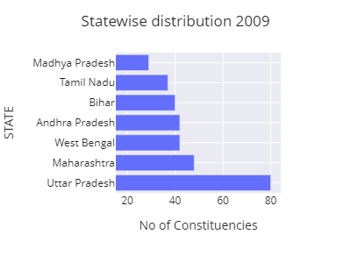
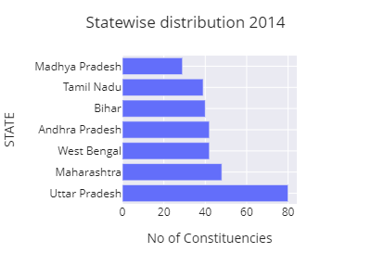
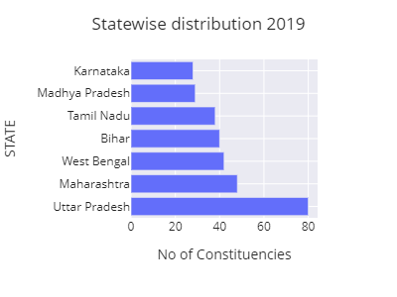
State-wise distribution of constituencies

Slide 11
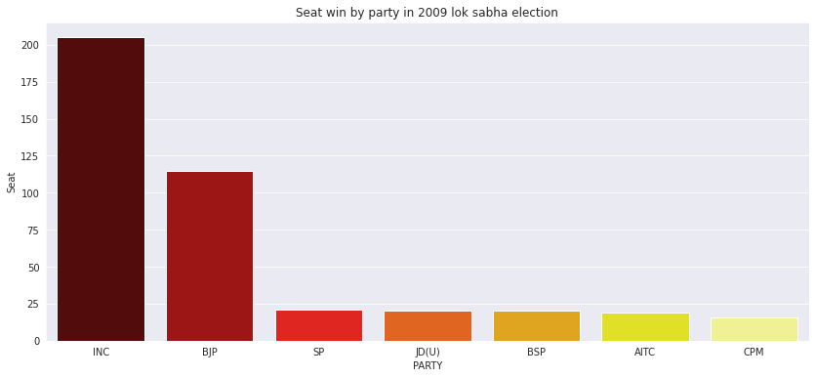
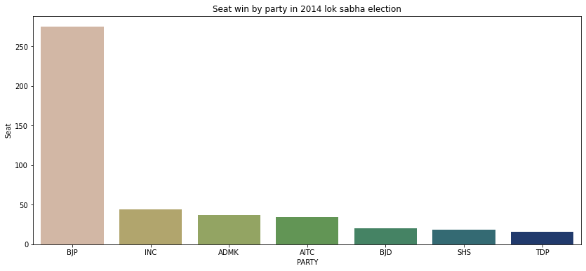
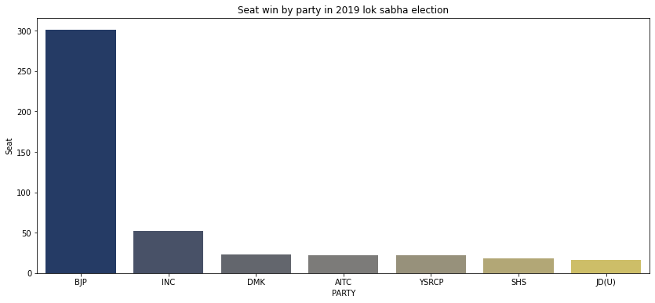
Party-wise distribution of winning seats.

Slide 12
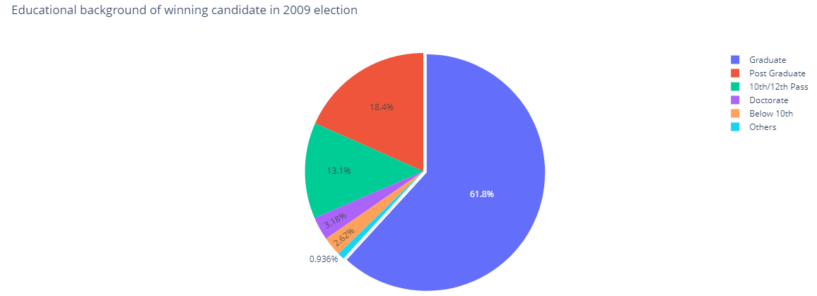
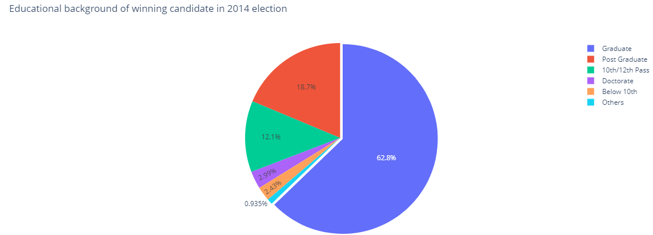
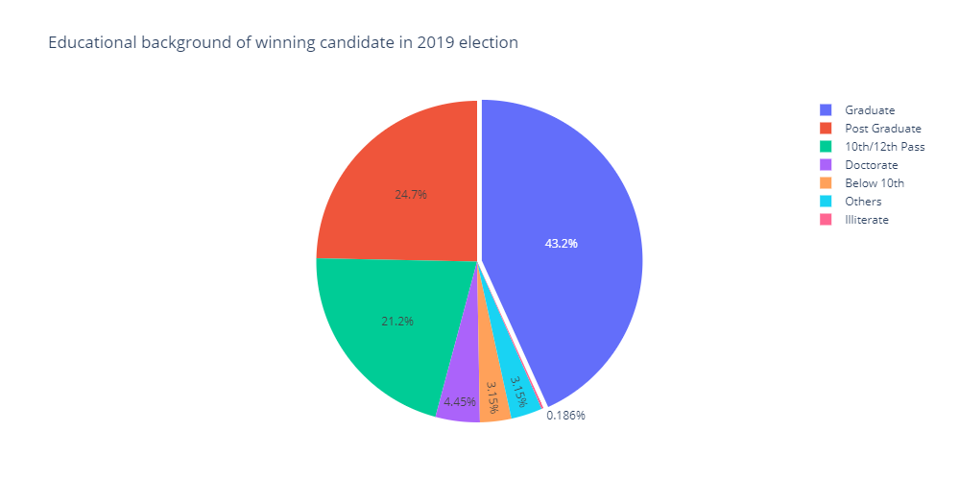
Educational background of elected candidates

Slide 13
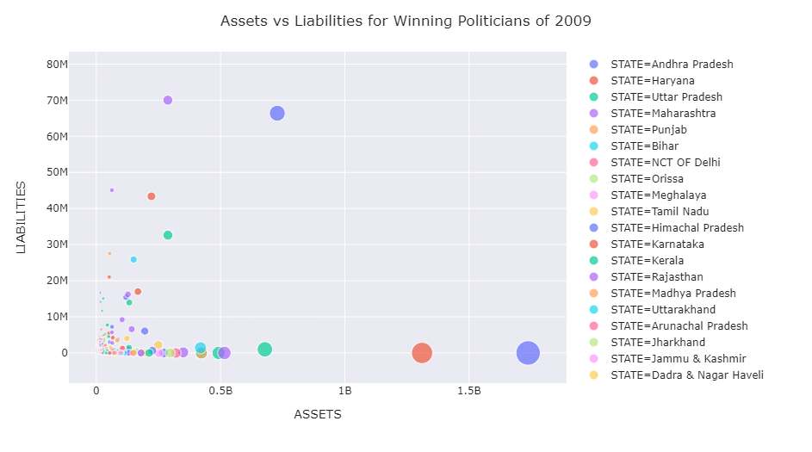
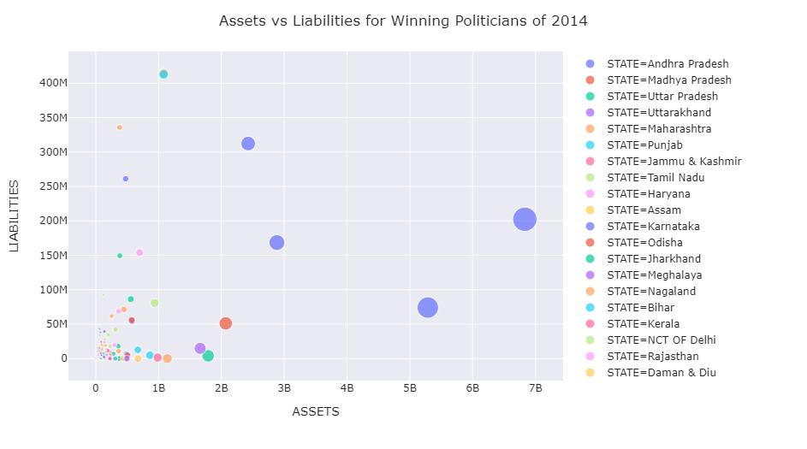
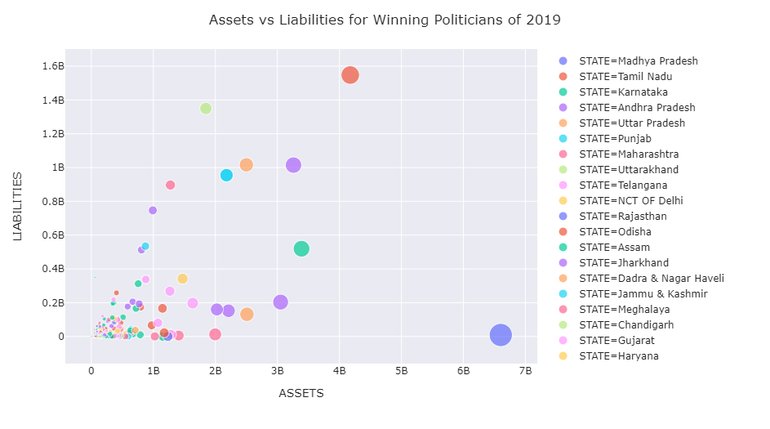
Assets and liabilities of our leaders.

Slide 14
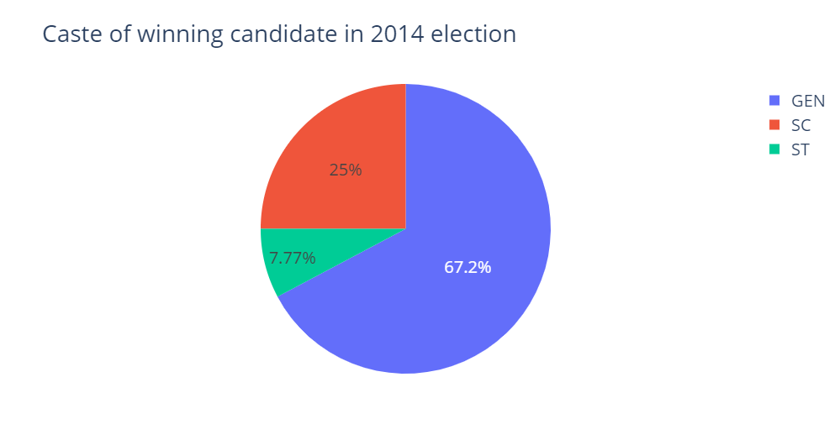
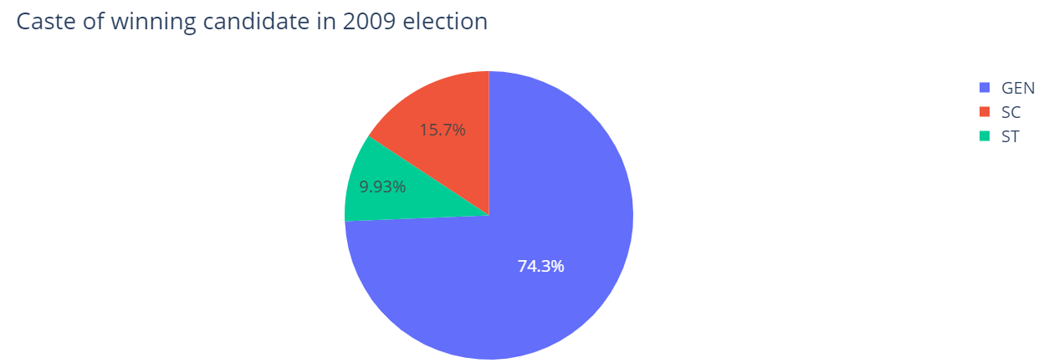
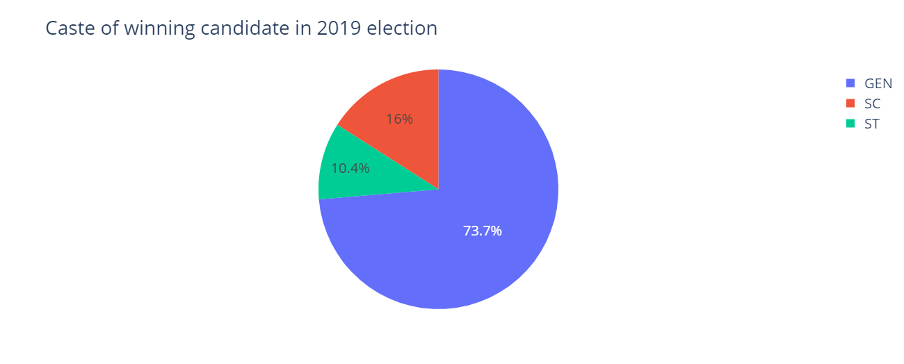
Caste of winning candidates

Slide 15
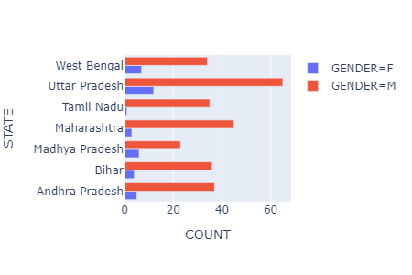
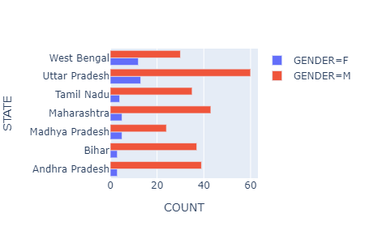
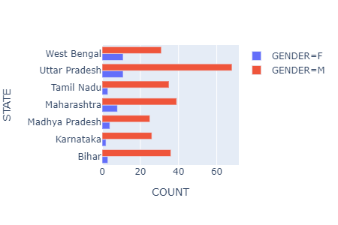
Gender-wise distribution among leaders

Slide 16
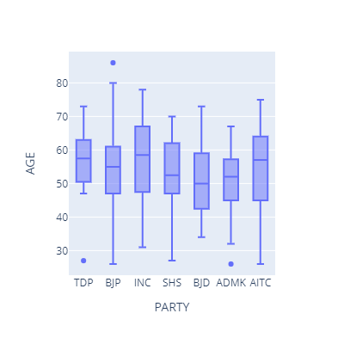
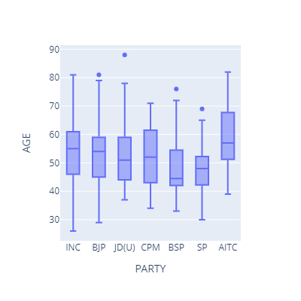
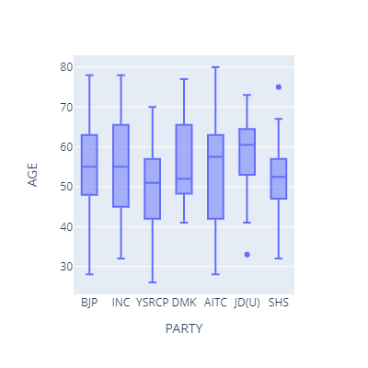
Age Factor of winning candidates

Slide 17
Conclusion:
Uttar Pradesh has the maximum number of constituencies. This has remained same throughout the years. West Bengal and Maharashtra also has high number of constituencies.
BJP tremendously won the elections in 2014 and 2019 with a big lead in number of setas. They managed to increase their seats from 2014 to 2019.
Around 60% of our leaders were Graduates in the years 2009 and 2014, however this has fallen in the year 2019 by 20%.
The assets and liabilities of our leaders has risen in this 10 year span.

Slide 18
5. Almost every election, the caste distribution among leaders has almost remained the same. There was an increase in SC share in 2014 which rose their share of seats to 25%
6. Every year Uttar Pradesh had the lead in both, male and female winners, followed by West Bengal and Maharashtra.
7. In all the parties the average age is 45 to 65 and there is little bit deviation in every election.

Slide 19
2.
PREDICTION MODEL
Using the Candidate data of last 3 Lok Sabha Elections

Slide 20
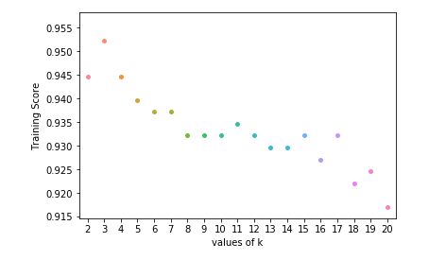
PREDICTION MODEL: I
K-NEAREST NEIGHBORS (KNN) model
K-Nearest Neighbors (KNN) is one of the simplest algorithms used in Machine Learning for regression and classification problem. KNN algorithms use data and classify new data points based on similarity measures (e.g. distance function). ... The data is assigned to the class which has the nearest neighbors.

Slide 21
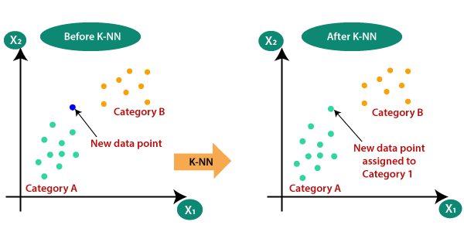
Suppose there are two categories, i.e., Category A and Category B, and we have a new data point x1, so this data point will lie in which of these categories. To solve this type of problem, we need a K-NN algorithm. With the help of K-NN, we can easily identify the category or class of a particular dataset. Consider the below diagram:

Slide 22
DRIVER CODE FOR THE MODEL
# train and test knn model
knn = KNeighborsClassifier()
knn.fit(X_train, y_train)
pred = knn.predict(X_test)
print("Testing Accuracy is: ", knn.score(X_test, y_test)*100, "%")
Testing Accuracy is: 91.19638826185101 %

Slide 23
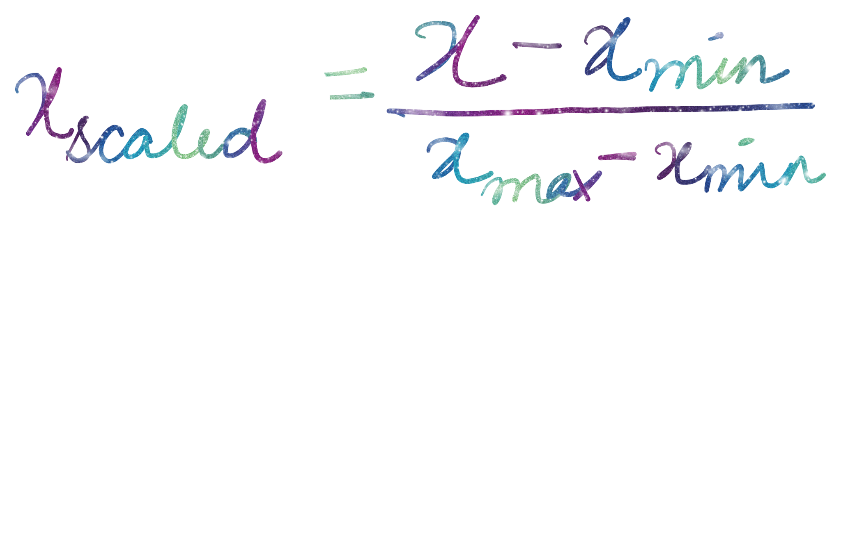
PREDICTION MODEL: II
USING MinMaxScaler
.
MinMaxScaler for each value in a feature, subtracts the minimum value in the feature and then divides by the range. The range is the difference between the original maximum and original minimum. MinMaxScaler preserves the shape of the original distribution.This method removes the median and scales the data in the range between 1st quartile and 3rd quartile

Slide 24
DRIVER CODE FOR THE GIVEN MODEL
# scaling values into 0-1 range
scaler = MinMaxScaler(feature_range=(0, 1))
features = [ 'STATE', 'CONSTITUENCY', 'NAME', 'PARTY', 'GENDER', 'CRIMINAL_CASES', 'AGE', 'CATEGORY', 'EDUCATION', 'ASSETS', 'LIABILITIES','TOTAL_VOTES','TOTAL_ELECTORS']
dataset2[features] = scaler.fit_transform(dataset[features])
# train and test knn model
knn = KNeighborsClassifier()
knn.fit(X_train, y_train)
knn.predict(X_test)
print("Testing Accuracy is: ", knn.score(X_test, y_test)*100, "%")
Testing Accuracy is: 93.62302483069978 %

Slide 25
PREDICTION MODEL: III
Modifying existing features
We encode “EDUCATION” column values in numerical form for prediction .
In order to reduce the errors we then replace the the name of given PARTY to as “others”.In this way we remove the unusual variables.
We then apply the previous model to our new formed dataset and check the accuracy of the model.

Slide 26
BASIC CODE APPLICATION FOR MODEL 3
#appending values less than average to others
temp = dataset1.value_counts('PARTY')
avg = temp.mean()
print(avg)
less_freq=[]
for k in temp.index:
if temp[k] < avg :
less_freq.append(k)
dataset1.loc[dataset1["PARTY"].isin(less_freq), "PARTY"] = "Other"
dataset1['PARTY'].value_counts()
We apply the KNN model:
Testing Accuracy is: 93.98984198645599 %

Slide 27
PREDICTION MODEL: IV
Adding new features
Every voter has a unique way of choosing a candidate but, most often their criteria depends on political party of candidate and region where they stand.
People from similar geographical regions could have like minded views and hence we create features of no. of constituents in a state and no. of voters per state.
The background of a political party plays a pivotal role when it comes to elections, so we have: no. of seats won by the party, no. of criminal cases of party, education of party, total candidates of party per constituency

Slide 28
We also consider the features related to a party in a particular constituency as no. of seats won by the party per constituency, no. of criminal cases of party per constituency and education of party per constituency.
Now, we add these new features to the data and apply the KNN model again and calculate the accuracy of the model.
Testing Accuracy is: 97.17832957110609 %

Slide 29
PREDICTION MODEL: V
Importance of features
In any model, there are some features which have a stronger influence on the prediction of the target variable.
We use SelectKBest to find the quantify the influence of these features.
Score function is a calculated using chi square test, which is used for classification model.
Code:
# apply SelectKBest class to extract top most features
bestfeatures = SelectKBest(score_func=chi2, k="all")
fit = bestfeatures.fit(X, y)
dfscores = pd.DataFrame(fit.scores_)
dfcolumns = pd.DataFrame(X.columns)
# concat two dataframes for better visualization
featureScores = pd.concat([dfcolumns, dfscores], axis=1)
featureScores.columns = ['Specs', 'Score']
print(featureScores.sort_values('Score',ascending=False))

Slide 30
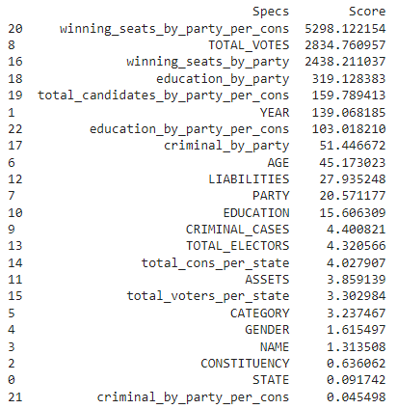
OUTPUT:

Slide 31
We drop the columns having score below 5, which leaves us with 12 most relevant features which influence the winning chances of a candidate.
CODE:
X.drop(labels=["CRIMINAL_CASES", "TOTAL_ELECTORS", "total_cons_per_state", "ASSETS","total_voters_per_state", "CATEGORY", "GENDER","NAME","CONSTITUENCY" ,"criminal_by_party_per_cons"], axis=1, inplace=True)
Now, we apply the KNN model to the modified data and check the accuracy of the model.
Output:
Testing Accuracy is: 98.9841986455982 %

Slide 32
CONCLUSION
We apply the KNN model to our data to predict whether a candidate wins the election, which is displayed by the target variable- WINNER.
We make a some modifications at every stage of the model building, which improves the accuracy of the model.
Table below summarises the accuracy of the model at each stage.
Model version | Model- I | Model- II | Model- III | Model- IV | Model- V
Accuracy | 91.2% | 93.62% | 93.99% | 97.18% | 98.98%

Slide 33
3.
SENTIMENTAL ANALYSIS

Slide 34
Introduction
1.Sentimental analysis is an approach to ML that identifies the emotional tone behind a body of text.
2.This particular analysis help organizations gather insights from unorganized and unstructured text that comes from online sources.
3.Almost 400 million tweets were made during the Lok Sabha Elections held in 2019. Tweets were made in English, Hindi as well as other languages.
4. Our project aims to analyse all the 23rd hours tweets made between March and May and draw conclusions based on social media activity.
5.We have gauged people’s thoughts and emotions on social media to predict the shift in support towards a party and compare the accuracy with actual poll results.

Slide 35
Data Preprocessing:
▸ This is the first step in building a machine learning model. Data pre-processing refers to the transformation of data before feeding it into the model.
▸ It deals with the techniques that are used to convert unusable raw data into clean reliable data.
▸ Since data collection is often not performed in a controlled manner, raw data often contains outliers (for example, age = 120), nonsensical data combinations (for example, model: bicycle, type: 4- wheeler), missing values, scale problems, and so on.
▸ Because of this, raw data cannot be fed into a machine learning model because it might compromise the quality of the results. As such, this is the most important step in the process of data science.

Slide 36
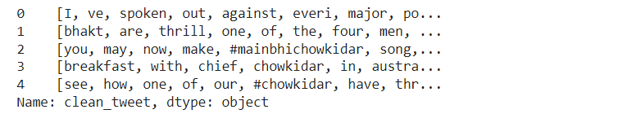
Tokenizing the tweet for creating lenient data:
1.The process of tokenizing basically involves breaking large statements into array of words.
2.As the large statement contains a sequence of words and in order to analyze the sentiments of these words we need to separate these tweets into an array.
Output:
Output:

Slide 37
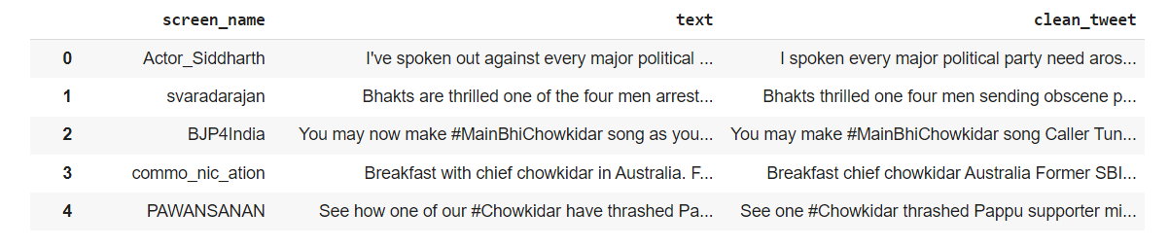
Creating new dataframe from existing one with essential data:
Here we are creating a new dataframe with screen_name that is user_id,the tweet particular individual has made and the respective clean tweet.
Output:

Slide 38
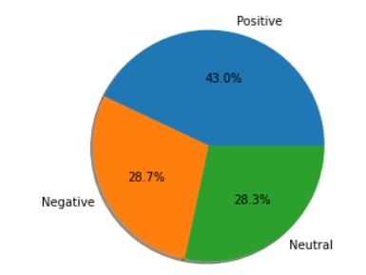
Analyzing sentiments based on tweets:
1.Textblob is a package which provides us functionality to analyze sentiments from words.
2.It classifies statements as (+1) for positive,(0) for neutral and (-1) for negative.
3.By using matplotlib package we have plotted this sentiments using a pie chart.
4.We draw the conclusion as follows:
Sentiments | Percentages
Positive | 43.0%
Negative | 28.7%
Neutral | 28.3%

Slide 39
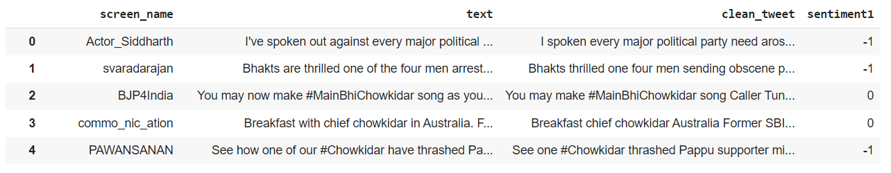
Performing sentiment analysis on basis of polarity of available tweets using Normalized Values.
Formula: (Value - Mean of Values)/Standard Deviation
Output :

Slide 40
Model Training
For accurately predicting data we have used three machine learning algorithms.
They are as follows:
1.Random Forest Classifier
2.Decision Tree Classifier
3.Gaussian Naive Bayes

Slide 41

Random Forest Classifier:
1.A random forest is a meta estimator that fits a number of decision tree classifiers on various sub-samples of the dataset and uses averaging to improve the predictive accuracy and control over-fitting.
2.The fundamental concept behind random forest
is a simple but powerful one — the wisdom of crowds.
In data science speak, the reason that the
random forest model works so well is:
”A large number of relatively uncorrelated models
(trees) operating as a committee will outperform
any of the individual constituent models.”

Slide 42
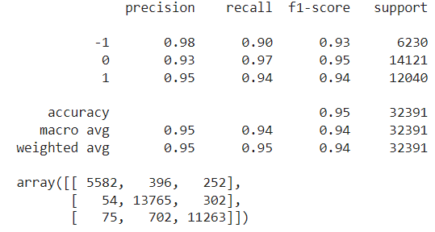
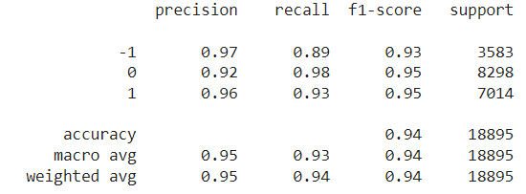
Output(Training model):
Output(Predicting values):

Slide 43
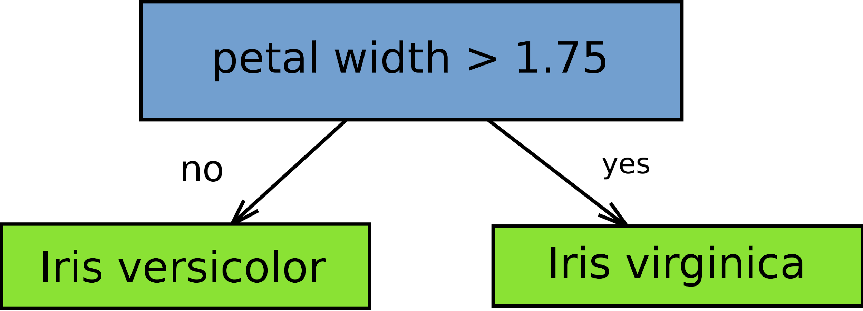
Decision Tree Classifier:
1.Decision Trees (DTs) are a non-parametric supervised learning method used for classification and regression.
2.The goal is to create a model that predicts the value of a
target variable by learning simple decision
rules inferred from the data features.
3.Easy to compute and explain why a particular variable is having higher importance.
4.The tree can be visualized and hence, for non-technical users, it is easier to explain model implementation.

Slide 44
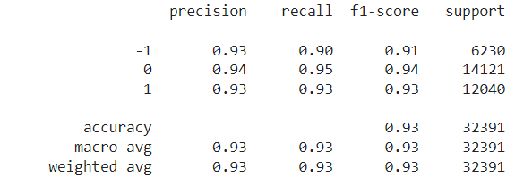
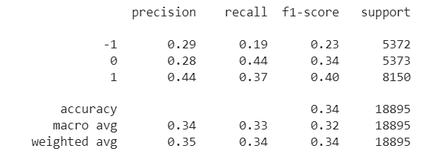
Output:(Training model)
Output:(Predicting values)

Slide 45
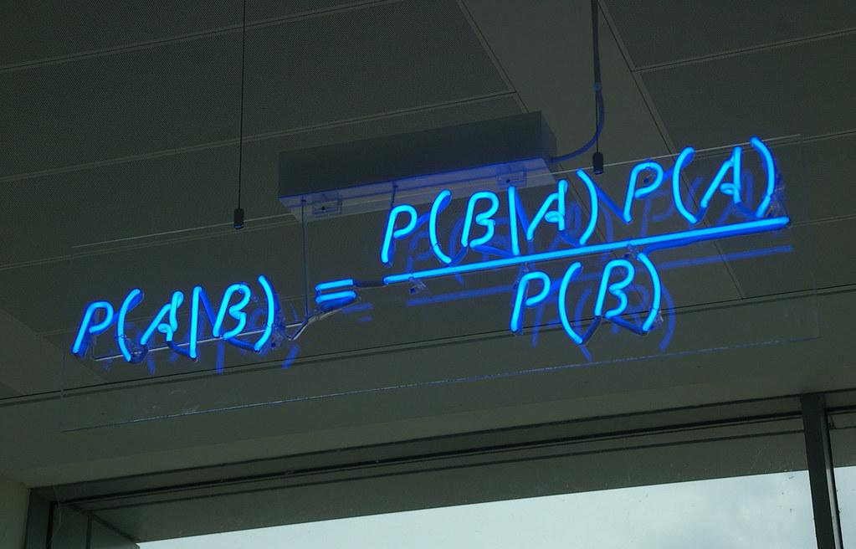
Gaussian Naive Bayes:
1.Gaussian Naive Bayes is a variant of Naive Bayes that follows Gaussian normal distribution and supports continuous data.
2.Naive Bayes are a group of supervised machine learning classification algorithms based on the Bayes theorem.
3.It is a simple classification technique
, but has high functionality.
4.Naïve Bayes classifiers are highly scalable,
requiring a number of parameters linear
in the number of variables (features/predictors)
in a learning problem.

Slide 46
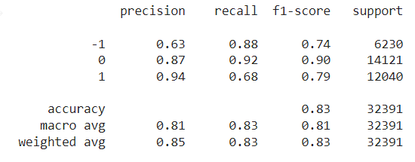
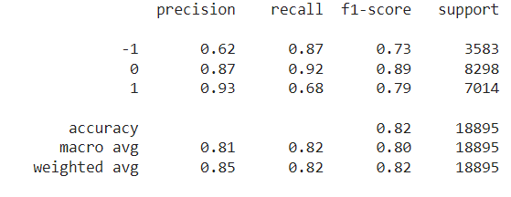
Output(Training model):
Output(Predicting values):

Slide 47
Model Deployment:
▸ The whole process of machine learning does not just stop with model building and prediction.
▸ It also involves making use of the model to build an application with the new data.
▸ Depending on the business requirements, the deployment may be a report, or it may be some repetitive data science steps that are to be executed. ▸ After deployment, a model needs proper management and maintenance at regular intervals to keep it up and running.

Slide 48
Driver Code:
def out1(txt):
words = txt.split()
table = str.maketrans('', '', string.punctuation)
stripped = [w.translate(table) for w in words]
str1 = " "
tweet = (str1.join(stripped))
analysis = TextBlob(tweet)
if analysis.sentiment.polarity > 0:
print("Positive")
elif analysis.sentiment.polarity==0 :
print("Neutral")
elif analysis.sentiment.polarity<0:
print("Negative")

Slide 49
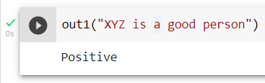
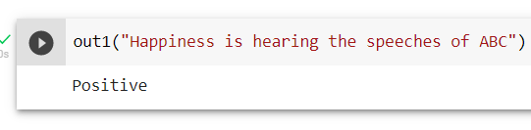
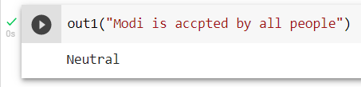
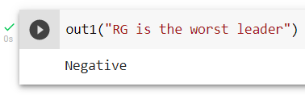
Test Cases:

Slide 50
Conclusion:
1.In our module project we have successfully analyzed the twitter data during election season of Lok Sabha 2019.
2.We bifurcated the sentiments of the tweets into three categories that are positive,negative and
neutral.
3.We successfully trained,tested our model with three different types of ML algorithms.
4.We successfully predicted the values and analyzed our results using confusion matrix.
5.By using different models we were able to observe variations between the three used classifiers.
6.Finally, we analyzed the statements given by the user and categorized them as positive,negative or neutral using the driver code.

Slide 51
THANK YOU

