Slide 1


Frontier
Commons
Ministry Partners Gathering
October 2026

Slide 2

Today
1
Why international students
2
What we've learned
3
How we can work together
4
Next steps
2

Slide 3
01
Why Now

Slide 4
The opportunity
7M
5
4
international students worldwide
stages in every student's journey
core principles guide our work
4

Slide 5
Students by region
Source: Illustrative numbers — replace with real data
5

Slide 6





What students tell us they need
Friendship
Belonging
Guidance
Someone to share a meal with in the first month.
A community that welcomes them as they are.
Help with language, culture and daily life.
Faith conversations
Career support
Mentors for internships and work after graduation.
Honest space to ask questions about the gospel.
6

Slide 7





The student journey
1. Pre-Arrival
2. Arrival
3. Integration
4. Leadership
5. Re-Entry Home
Anticipation, fear, hope
Overwhelmed, lonely, culture shock
Curious, conflicted, settled
Empowered, confident, purposeful
Reverse culture shock, determination
7

Slide 8




Core Principles
Accessible
Collaborative
Innovative
Global
over academic
over competitive
over traditional
over Western-centric
No previous experience, training, or interest required.
Building bridges and shared spaces between ministries.
Fresh approaches through the innovation pipeline.
Grounded in the realities of 7M students worldwide.
8

Slide 9
What partners can expect
Shared research on the needs of international students
Introductions to ministries already serving your campus
Coordinated calendars so events don't compete
Training that doesn't assume previous experience
A place to test new ideas with other ministries
Regular gatherings to learn from each other
Simple tools to follow up with students
Support for students returning home
9

Slide 10
How we work
What we add
What stays yours
Shared data
Coordination
Innovation support
Your ministry's identity
Your relationships
Your programs
10

Slide 11



Next twelve months
NOV 2026
JAN 2027
MAR 2027
JUN 2027
1. Partner survey
2. Shared calendar
3. Summit
4. Re-entry toolkit
Listen before we build.
One view of campus events.
Gather in person.
Support students going home.
11

Slide 12
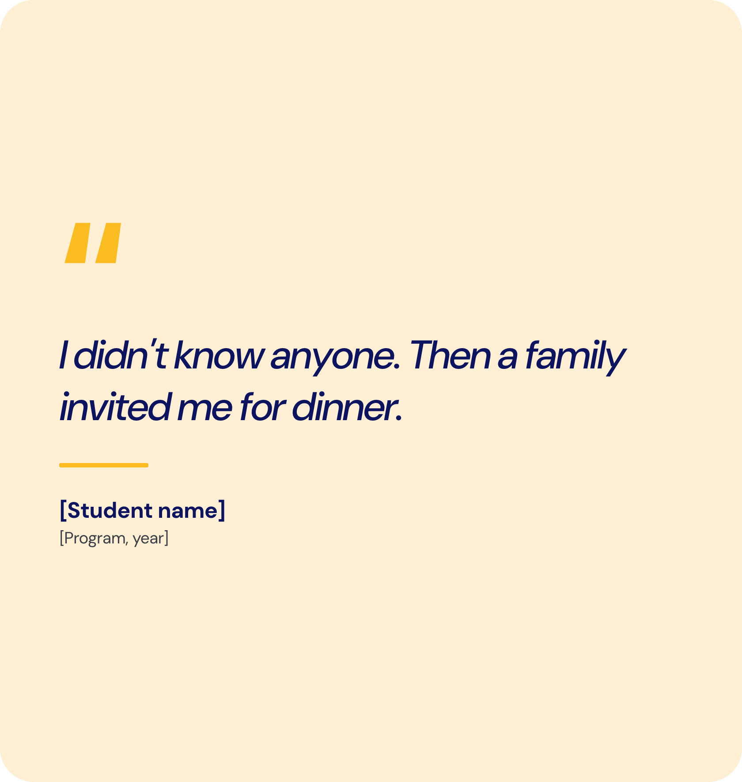
Story
Every friendship starts with a welcome
Use this space for a short story. Replace the placeholder name with a real, consented testimony.
12

Slide 13

Empowering the next generation to share the gospel confidently.
13

Slide 14
Thank you
Let's build this together.
[your.email@example.org]

